Slide 1

Phonics and Reading
September 2021
Year 1
Mrs Townley and Miss Jakeman

Slide 2
What is Phonics?
Phonics is taught in Early Years, KS1 and can continue into KS2
Phonics is taught twice a day in Year 1 at Roebuck
It helps your child to learn to read and write by learning the letters and sounds that make up the English language
It is taught through group teaching, one to one, independent and group activities, songs, rhymes and games.
Children are taught to spot spelling rules within words

Slide 3
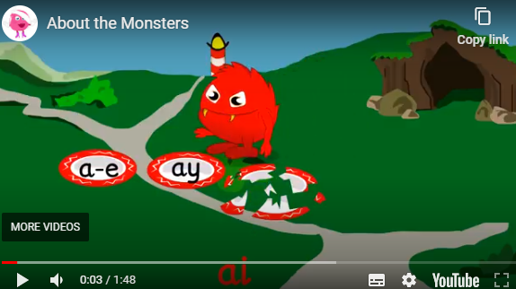
Monster Phonics
At Roebuck, we follow a scheme of work called Monster Phonics. It is a prescribed curriculum which gives daily targets and outcomes.
In Year 1, Monster phonics covers all of the sounds up to and including Phase 5.
The children meet lots of different ‘monsters’ which each represent a different sound.
This video shows an introduction to Monster Phonics
https://youtu.be/5u0N7LJIW0Q

Slide 4
Phonic Phase Timeline
Phase 1- This is the Nursery phase
Phase 2- Started towards end of Nursery year and completed in reception
Phase 3- Reception
Phase 4- started towards end of reception completed in Year 1
Phase 5- Year 1
Phase 6- Year 2
Notes:
The Government base this guide on children who attend full time nursery from 30-50 months.

Slide 5
Phonic Vocabulary
These are words your child will learn through phonics.
Phoneme – a sound or letter
Grapheme – the spelling of the sound (th, sh, ch)
Blending – blending the sounds together
Segmenting – splitting the word up into sounds
Digraph – two letters to make one sound
Trigraph – three letters to make one sound
Phoneme frame – a box to show each sound within a word (eg: three boxes for the word cat)
Sound button – a dot under each sound
Tricky words – words that are not easy to sound out
CVC (consonant, vowel, consonant words)
f | i | ll
l | o | g
Notes:
Build up vocabulary slowly. Always a good idea to ask your teacher at Parents evening, or parent meeting at the beginning of each term what vocabulary your child will be working with this term.

Slide 6
Common Mistakes
Often children learn the letter names first and then find it difficult to segment words (for example children write Bcos as they have learnt the letter name for B)
Adding a uh sound
- Sounds must be pronounced properly. https://www.youtube.com/watch?v=BqhXUW_v-1s
Moving children on too quickly
American computer/iPad games

Slide 7
Phase 1
Getting Ready for Phonics
1. Tuning into sounds
2. Listening and remembering sounds
3. Talking about sounds
Music and movement
Rhythm and rhyme/ alliteration
Sound effects
Speaking and listening skills
Example of activities
Nursery rhymes, songs, action rhymes.
Add sound effects to stories.
Music and movement: rhythm, guess the instrument.
Tap talk.
Talking about sounds: listening walks, loud/soft, high/low, silly noises.
Speaking & listening: silly sentences “Happy Harry hops”, mimics, animal sounds
Notes:
A great test for hearing. Can they hear what you hear? Can they have an accurate guess? Can they move to the beat?
Sound effects to stories, role play, conversations- mimic.
Do they respond appropriately to what you say? Can they follow a conversation?

Slide 8
Phase 2: Learning phonemes to read and write simple words
Children will learn their first 19 phonemes:
Set 1: s a t p Set 2: i n m d
Set 3: g o c k Set 4: ck (as in duck) e u r
Set 5: h b l f ff (as in puff) ll (as in hill) ss (as in hiss)
They will use these phonemes to read and spell simple “consonant-vowel-consonant” (CVC) words:
sat, tap, dig, duck, rug, puff, hill, hiss
All these words contain 3 phonemes.
We teach each sound with a corresponding action to allow for visual learners. For example a snake arm motion for S.
Notes:
Sat, pat, tap

Slide 9

Segmenting
Children need to be able to hear a whole word and say every sound that they hear
Blending
Children need to be able to hear the separate sounds in a word and then blend them together to say the whole word.
/t/ /i/ /n/ = tin
/m/ /u/ /g/ = mug
/d/ /u/ /ck/ = duck
This can be practised using the robot game.

Slide 10
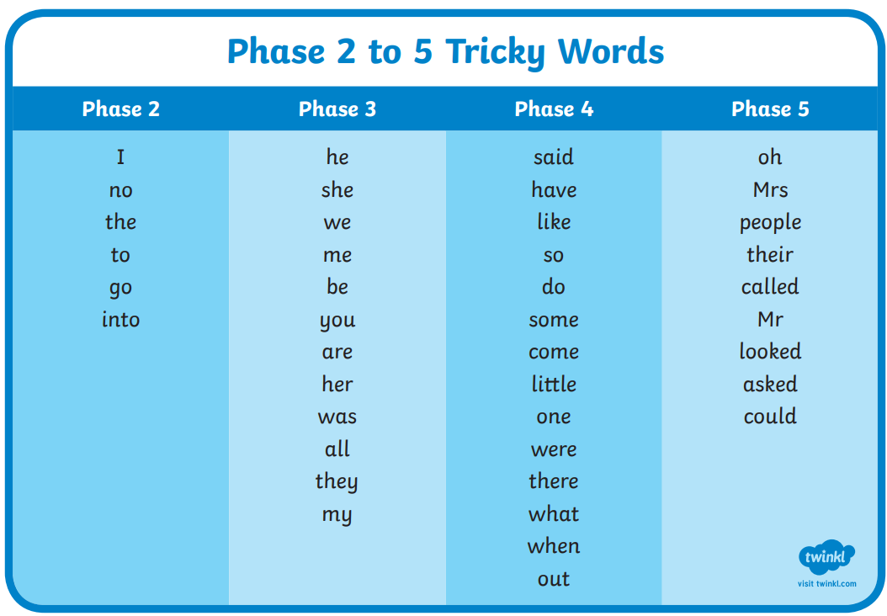
Tricky Words

Slide 11
Phase 3
The main individual letter phonemes have now been learnt, and children are reading CVC words independently. Children will enter phase 3 once they know the first 19 phonemes and can blend and segment to read and spell CVC words.
Phase 3 teaches children
To learn the graphemes (monster sounds), made up of more than one letter, eg: ‘oa’ as in boat
Read and write words in phrases and sentences

Slide 12
Phase 3
They will learn another 26 phonemes:
j, v, w, x, y, z, zz, qu
ch, sh, th, ng, ai, ee, igh, oa, oo, ar, or, ur, ow, oi, ear, air, ure, er
They will use these phonemes (and the ones from Phase 2) to read and spell words: chip, shop, thin, ring, pain, feet, night,
boat, boot, look, farm, fork, burn,
town, coin, dear, fair, sure
Tricky words
The number of tricky words is growing. These are so important for reading and spelling: he, she, we, me, be, was, my, you, her, they, all.

Slide 13
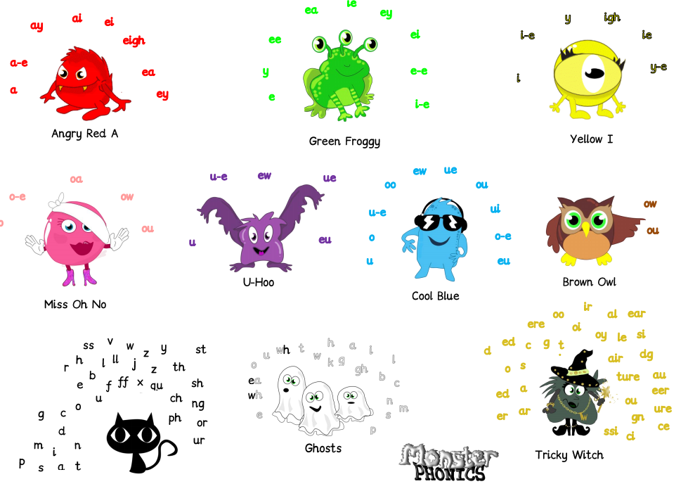
Monster phonics

Slide 14
Phoneme frames…
ring
chick
night

Slide 15
Here is how we would use the phoneme frame
r | i | ng
ch | i | ck
. . _
_ . _
n | igh | t
. _ .

Slide 16
use the phoneme frame to work out how many sounds there are in these words
pig | p | i | g
church | ch | ur | ch
boy
curl
thorn
chick
down
shirt

Slide 17
Phase 4 doesn’t introduce any new phonemes
Children move into phase 4 when they know all the phonemes from phases 2 and 3 and can use them to read and spell simple words
It focuses on reading and spelling longer words with the phonemes they already know.
These words have consonant clusters at the beginning: spot, trip, clap, green, clown …or at the end: tent, mend, damp, burnt
…or at the beginning and end! trust, spend, twist
Children continue to practise previously learned graphemes and phonemes and learn how to read and write: CVCC words: tent, damp, toast, chimp
For example, in the word ‘toast’, t = consonant, oa = vowel, s = consonant, t = consonant and CCVC words: swim, plum, sport, cream, spoon For example, in the word ‘cream’, c = consonant, r = consonant, ea = vowel, m = consonant.

Slide 18
Phase 5
Continue reading and spelling phonetically plausible 2 and 3 syllable words.
Continue teaching reading and spelling of tricky words.
New graphemes.
Alternative graphemes.
Alternative spellings for phonemes.

Slide 19
Phase 5 -Graphemes taught
a-e (as in came) | au (as in Paul) | aw (as in saw)
ay (as in day) | e-e (as in these) | ea (as in sea)
ew (as in chew) | ew (as stew) | ey (as in money)
i-e (as in like) | ie (as in pie) | ir (as in girl)
o-e (as in bone) | oe (as in toe) | ou (as in out)
oy (as in boy) | ph (as in Phil) | u-e (as in June)
u-e (as in huge) | ue (as in clue) | ue (as in due)
 | wh (as in when)

Slide 20
Phase 5
Alternative Pronunciations
hat | acorn | fast | was

Slide 21
Phase 5 –Alternative Spellings
Looking at one sound and the different ways of spelling that sound.
a_e cake | ay stay | ai rain | eigh eight | a bacon | ey prey

Slide 22
Homophones and near homophones
There/their/they’re
Here/ hear
Whose/who’s
Accept/ except
Practise/ practice
Draft/draught
Lead/led

Slide 23
Prefixes
Dis / mis / in /il / im / ir / re/ sub / inter / super / anti / auto
Using the hyphen with prefixes where two vowels would be adjacent eg co-ordinate, re-establish.
Suffixes
ation / ly / sion / ous / orous / geous / ious / eous / tion / sion / ssion / cian / ing / er / ed / s / es / er / est / ness / ful / less / ly
Using the possessive apostrophe with regular and irregular plural words.
When to double the consonant etc.

Slide 24

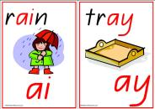

Phonics screening test
Why are the children being tested?
Every Year 1 child in the country will be taking the phonics screening check in the same week in June.
The aim of the check is to ensure that all children are able to read by the end of year two.
This ‘midpoint check’ will ensure that we have a clear understanding of what the children need to learn in year 2.
The children will complete the check one at a time in a quiet area of the school.
We practise this throughout the year so that the test format is familiar when the complete it in June.

Slide 25


Example

Slide 26
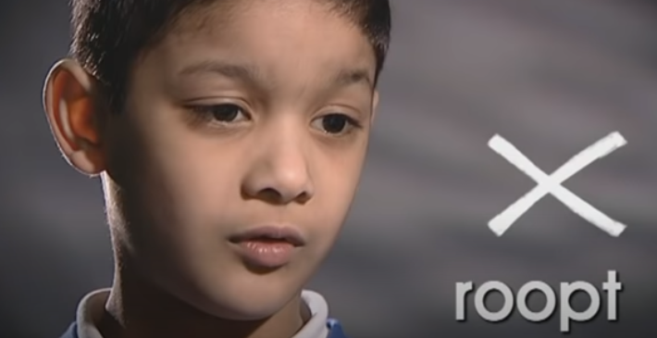
Sections of the test
Section 1
The words in section 1 will have a variety of simple word structures (for example CVC, VCC, CCVC and CVCC) using:
single letters (a, b, c, d, e, f, g, h, I, j, k, l, m, n, o, p, q(u), r, s, t, u, v, w, x, y, z)
some consonant digraphs (ch, ck, ff, ll, ng, sh, ss, th, zz)
frequent and consistent vowel digraphs (ar, ee, oi, oo,or)
Section 2
The words in section 2 will have a variety of more complex word structures (for example CCVCC, CCCVC, CCCVCC and two syllable words) with some:
additional consonant digraphs (ph, wh)
less frequent and consistent vowel digraphs, including split digraphs (a-e, ai, au, aw, ay, ea, e-e, er, ew, i-e, ie, ir, oa, o-e, ou, ow, oy, ue, u-e, ur)
trigraphs (air, igh).
Watch this video to see an example https://www.youtube.com/watch?v=IPJ_ZEBh1Bk

Slide 27
How is it marked?
The pass mark is set by the DFE and the children will receive either a pass or fail only.
Children who fail to meet the threshold in year 1 will retake the test in year 2
The pass mark for the previous years has been 32/40.
If the children blend incorrectly or not at all then the answer will be marked as incorrect even if they have segmented correctly.
Children must not add sounds or plurals to the word
Children must not pause when blending
A child’s accent, dialect or speech difficulty will be taken into account.
Children will not be told if they are correct or incorrect and we cannot ask them to try again

Slide 28
What do we do with the results?
Children who do not meet the pass mark will be supported in year two to help them further with their phonics.
The results often highlight common difficulties or problem graphemes that teachers can spend further time exploring and practising with the children.
You will receive the results with the end of year reports.

Slide 29
Is there anything I can do at home?
When spelling, encourage your child to think about what “looks right”.
Have fun trying out different options…wipe clean whiteboards are good for trying out spellings.
tray trai rain rayn
boil boyl boy boi
throat throwt snow snoa
Read stories
Use puppets and toys
Play ‘I spy’
Continue to play with magnetic letters, using some two-grapheme (letter) combinations, eg: r-ai-n = rain blending for reading rain = r-ai-n segmenting for spelling
Praise your child for trying out words
Practice tricky words
Create phonic games with a timer
Play pairs
Phonics Play
https://www.phonicsplay.co.uk/resources/phase/2/buried-treasure

Slide 30
Monster Phonics
Meet the monsters...
https://youtu.be/5u0N7LJIW0Q
Actions...
https://youtu.be/LnXdH1dA5vI
Each lesson starts with a video, song or story.
https://youtu.be/X1hNt2UBBxQ

Slide 31
Reading Fluency
Children should be reading their book with over 90% accuracy
Fluency is achieved not when children read without decoding but when they read by chunking and phrasing.

Slide 32
Look out for
Is the child struggling to decode words?
Does the child have enough high frequency words in their vocabulary?
Is the child reading with intonation and expression?
Is the child aware of and using punctuation?
Does the child read in phrases and sentences?
Does the child self correct?
How do they track the text? How are their eyes moving?

Slide 33
DSR
At Roebuck we use DSR (daily supported reading) to promote progression in reading.
The children are grouped by ability and work closely with an adult (up to groups of 6) to share a text each day.
The sessions last for 20 minutes and involves a mixture of being read to, reading, questioning and sentence structure activities.
The adult use assessment sheets to record any successes and targets for each child. These are shared with the class teachers and children are moved through the groups accordingly.

Slide 34
Reading at home
Please continue to read with your child each night and encourage them to:
Sound out, Re-read to check it makes sense, Use pictures for clues., Ask questions about the book, and most importantly ENJOY READING!
Children are expected to read at least 5 times a week. The number of times they have read is recorded. The class with the highest number of children that have read 5 times or more are celebrated during Friday’s assemblies and given a reading trophy!

