Slide 1

Year R to year 1 transition Meeting for parents
Mrs Renouf, Mrs HasHemi and Mrs herbaut

Slide 2

Teaching staff
Mrs Renouf (Mon-Thurs) Mrs Herbaut (Friday)– Maple class teacher
Mrs Hashemi – Elm class teacher

Slide 3
Differences between EYFS and Year 1
Structure of the timetable
National curriculum not EYFS
Back to basics- independence, responsibility and ownership (changing books, getting organised, getting dressed, looking after their belongings, etc)
Say goodbye at the gate
Playtime on KS1 playground alongside year 2 children
Slightly later lunchtime
This all links very closely to growth mindset
We will set some classroom rules as chosen by the children and we also adhere to the school rules.
Developing emotional responses and social skills

Slide 4
Curriculum changes
Children will be judged against age related expectation.
We will follow the national curriculum instead of the EYFS. The national curriculum is divided into subject areas (literacy, numeracy, science, DT, art, history, geography, music, PHSE, computing, PE)
Topic based learning
Literacy encompasses phonics, spelling and reading and is taught daily. Numeracy is also taught daily.
Friday morning science
Phonics is taught daily and is an essential part of our learning- children will all take part in the national phonic screening test in June and will receive a pass or fail result.
Handwriting is cursive and will be taught as children should be fluent for year 2 transition.
Daily supported reading / Monster phonics takes place every morning

Slide 5

Year 1 national Curriculum
Computing
French

Slide 6
Year 1 Topics
Burps, Bottoms and Body parts
Fur, Feathers and scales
Out of this world
Walk the plank
Camping Out
Computing
Heroes
French

Slide 7
Year 1 science
Animal antics
Everyday materials
Using our senses
Plant detectives
Looking at animals
Sensing seasons
Computing
French

Slide 8

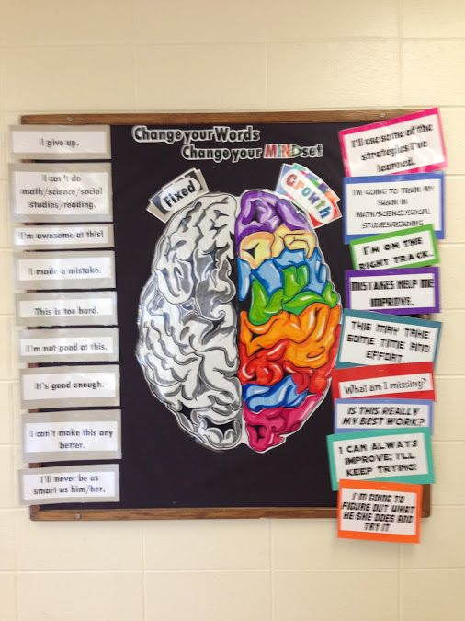

Growth Mindset

Slide 9



Be like Superman: Use your imagination. Be Curious.
Ask questions
Notice things
Look for patterns and connections
Ask, ‘What if..?’
Think of possible reasons
Conduct your own research and find out more

Slide 10
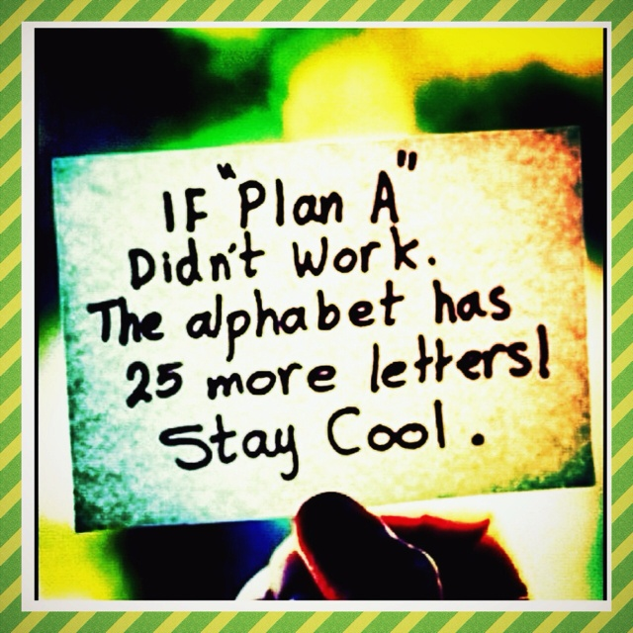

Slide 11

Talk Partners at Roebuck…
Face each other
Look at each other
Listen to one another
Challenge and support each other
Talk about the question
Take turns to speak
Share ideas
together
Prepare an answer
Notes:
11

Slide 12
Attendance & punctuality
We have high expectations of attendance and punctuality at Roebuck. We follow up on all absences as well as lateness to school.
As standard NO holidays are permitted to be taken in school time. All unauthorised absences will be accrued .
Any absence below 96%will trigger intervention with the pastoral and attendance lead, Mrs Johnson.
As a school we do follow our school policy and will issue fines when benchmarks are triggered.
Descriptor | Attendance Level | Actual Attendance | Whole Days Absence | Hours of learning lost
Excellent | 100% | 190 days | 0 | 0
 | 99% | 188 days | 2 | 10
Good | 98% | 186 days | 4 | 20
 | 97% | 184 days | 6 | 30
 | 96% | 182.5 days | 7.5 | 37.5
Satisfactory | 95% | 180.5 days | 9.5 | 47.5
Cause for Concern | 90% | 171 days | 19 | 95

Slide 13
Physical environment
The classroom is an interactive environment in the same way that the reception class is and we still encourage independence and resourcefulness.
We use our topic to inspire our classroom displays and learning areas
Our learning environment becomes more formal as the year progresses
We have an outside area which is used and we also use the other outdoor areas regularly throughout the week.
We use working walls to show our learning journey in maths and literacy giving children opportunities to show their work
Displaying high quality work and children’s personal achievements
Labelled resources for child access
Inspiring book corners linked to half termly topics

Slide 14
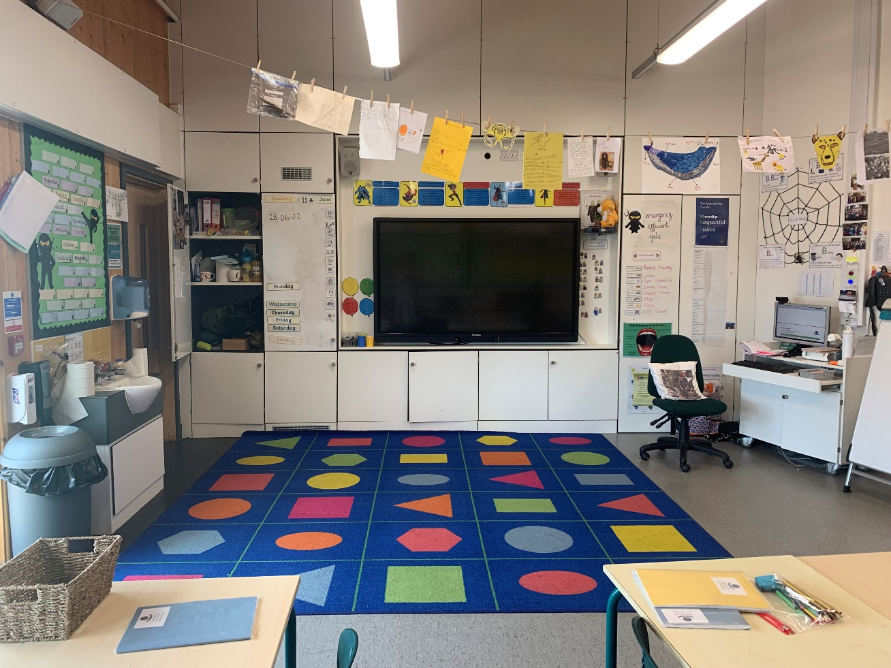
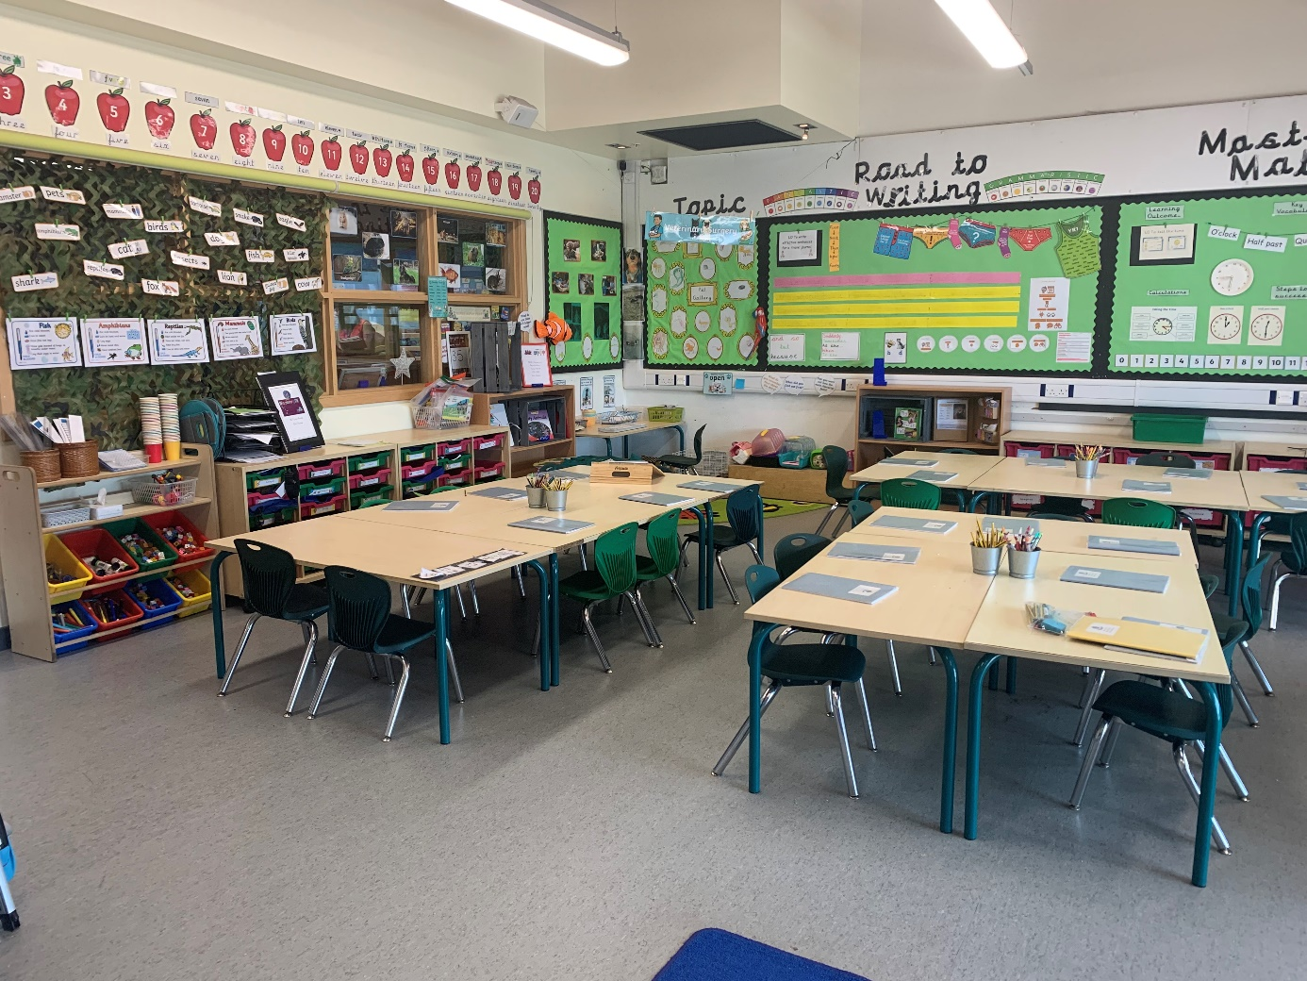

Slide 15
Emotional environment
Open door policy- please come and speak to us with any problems or questions you may have- after the school day is best as mornings are a busy time for preparations. We can also make appointments.
We do our very best to make our learning environment and lesson content very special for the children as we believe that their happiness and enthusiasm for learning is paramount.
PHSE lessons look at changes and building new relationships
Meeting with reception colleagues to discuss each child individually and their needs as well as strengths

Slide 16
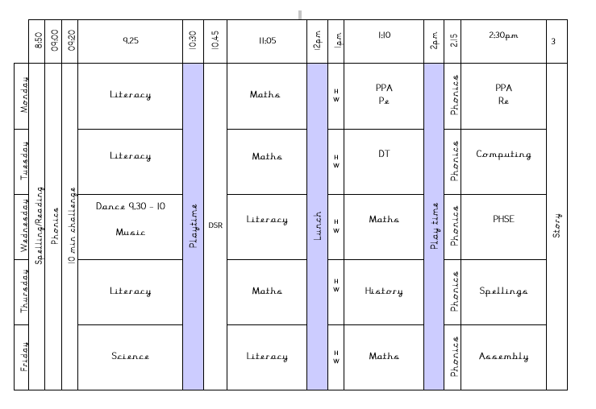
Typical timetable

Slide 17
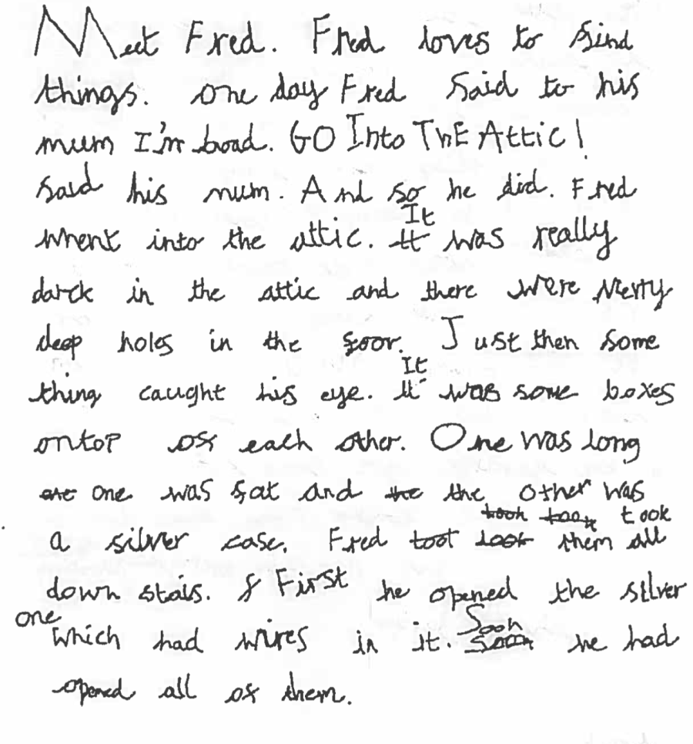
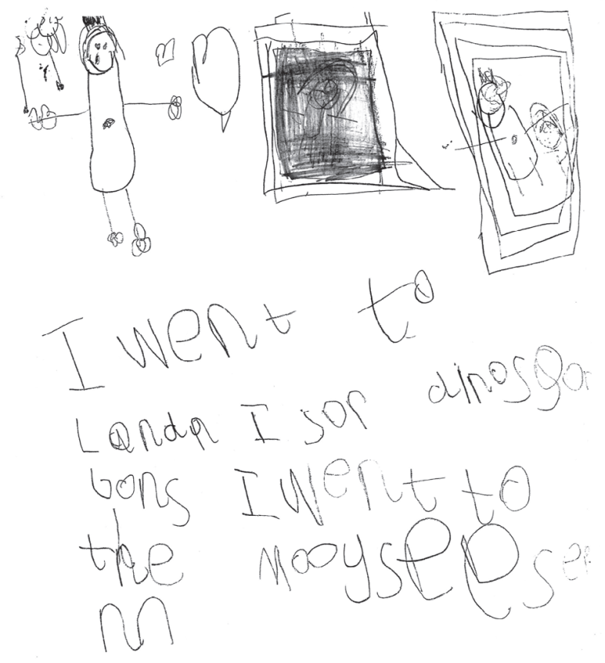
Progression in WRITING –

Slide 18

Progression in Maths

Slide 19
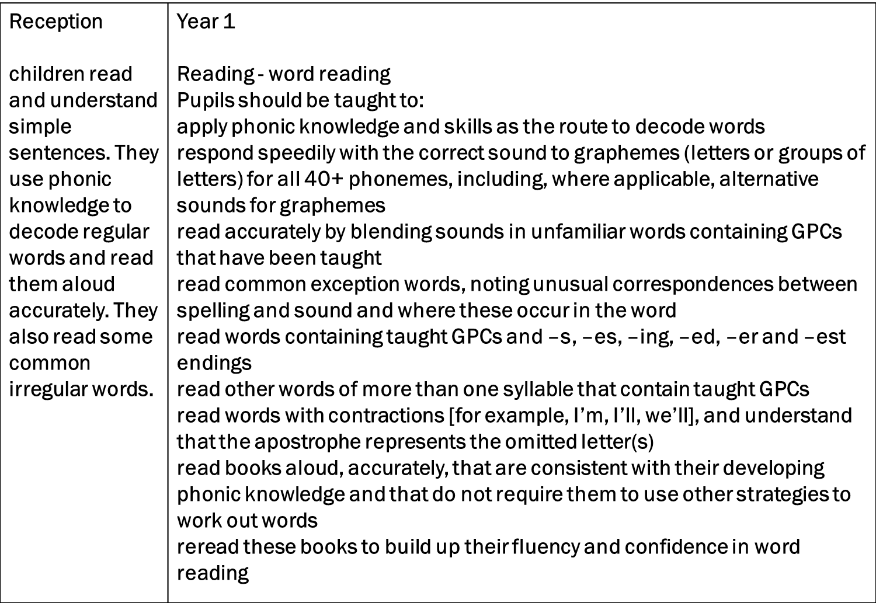
Progression in reading

Slide 20
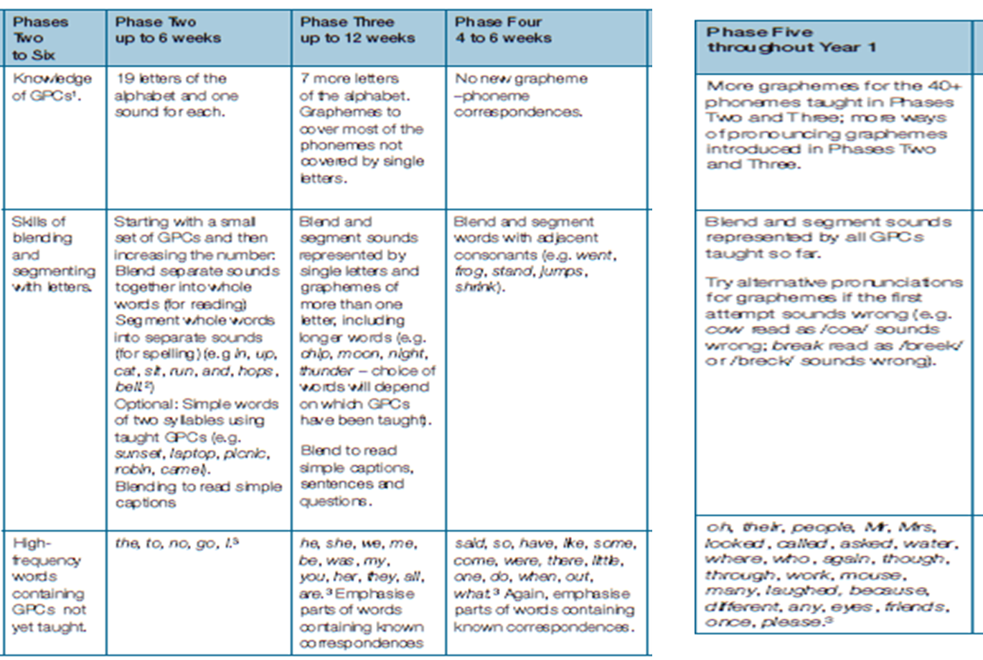

Progression in phonics

Slide 21
Phonics screening
Every Year 1 child in the country will be taking the phonics screening check in the same week in June.
The aim of the check is to ensure that all children are able to read by the end of year two.
This ‘midpoint check’ will ensure that we have a clear understanding of what the children need to learn in year 2.

Slide 22
Uniform children are expected to come to school appropriately dressed in named school uniform.
Roebuck Academy logo polo shirt, white or royal blue
(or plain white or royal blue polo shirt).
Plain grey or black school trousers/tailored shorts.
Plain grey or black skirt/pinafore dress/tailored trousers. No Leggings
Blue and white checked or striped summer dresses
Roebuck Academy logo sweatshirt or cardigans
Roebuck Academy logo fleece.
Black school shoes or plain black trainers.
Hats with a brim for summer.
Flat black school shoes or plain black trainers – no open toes.

Slide 23
Uniform Information children are expected to come to school appropriately dressed in our school uniform.
Please tie hair back at all times
No large bows – any hairbands or bows are to be either white, blue or black.
Simple studs to be worn – no other earrings permitted
Book bag needed every day
Flat shoes – no heels or AstroTurf boots / shoes

Slide 24
PE Kit
White t-shirt with Roebuck Academy logo (or plain white t-shirt).
Royal blue shorts.
Plimsolls or trainers for outside games.

Slide 25
Autumn term
What will happen to ensure effective transition:
Children will continue with CHIL through continuous provision and we will steadily increase the structure over the year
Workshops available for KS1 (maths/ spelling/ phonics/ reading)
Timetables and curriculum grids distributed
Guidance for reading, spelling, homework etc

Slide 26
Physical environment
Working walls are there to support children with key vocabulary, steps to success and a sequence to learning.
WAGOLL are used
-What a good one looks like
Year 1 is about developing independence in their own learning, so the use of the working walls will be a key focus.
Reading corners aim to inspire children to want to read. And are topic based
We also get to start using the ‘big play ground’ including the Pirate Ship!

Slide 27
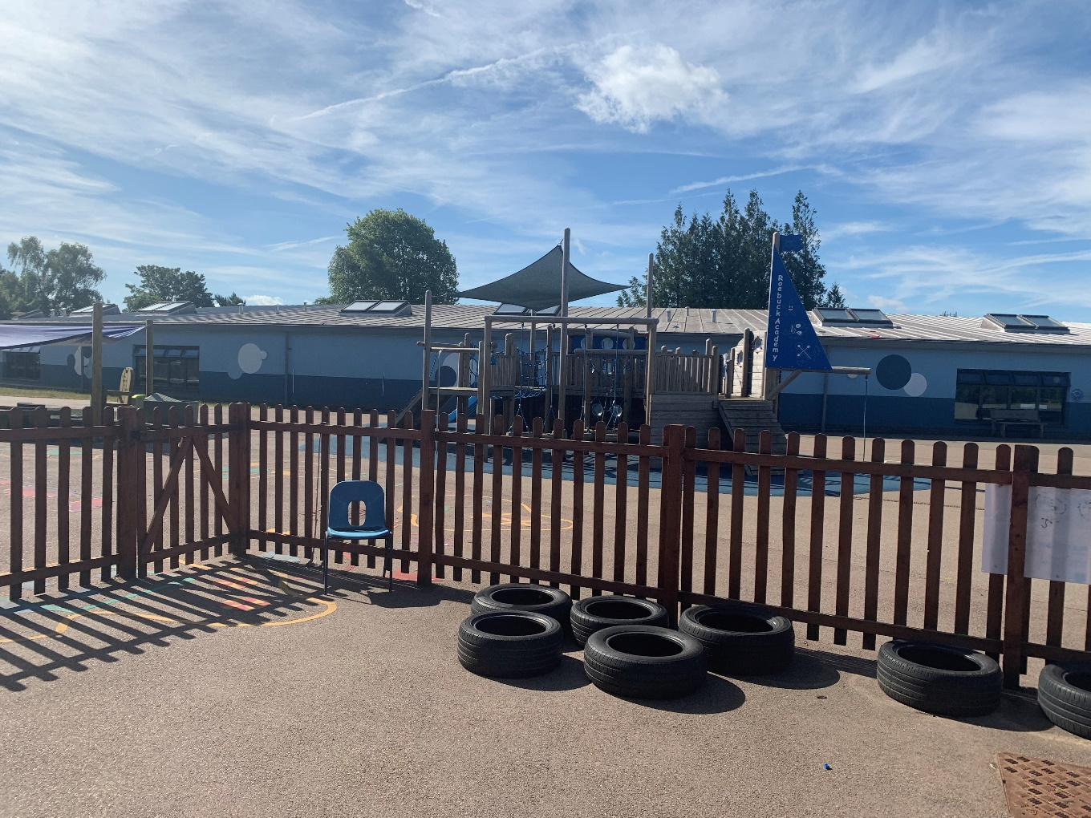
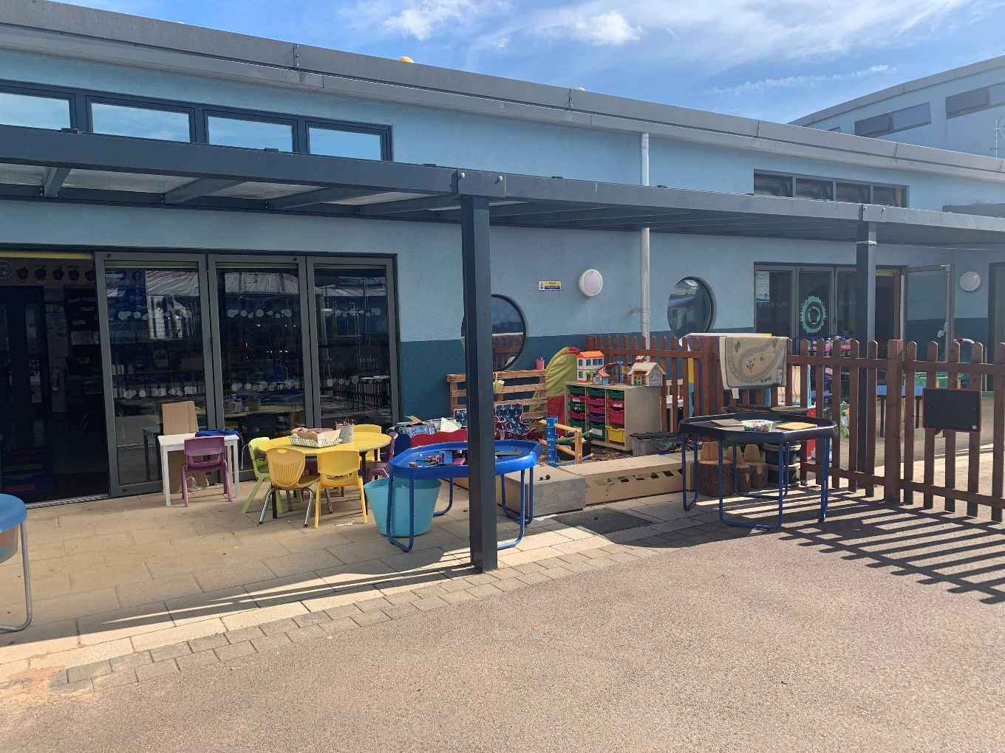

Slide 28
Emotional environment
PSHE lessons.
School assemblies e.g. growth mindset
Meeting with Year R teachers to discuss each child individually and their needs as well as strengths.
Open door policy.

Slide 29


Reading
We actively encourage reading throughout the school. This continues in year 1. Reading buddies will start each week where they are given the opportunity to read to an older peer
Please can you continue to support your child’s enjoyment of reading at home by ensuring they continue to read at least 5 times a week.
Reading record books are collected on Thursday. This enables us to monitor their reading which feeds into a whole school weekly reading competition.
Book banding for books that come home. This is assessed every month – children will move accordingly. Children benchmarked at the end of Reception.
Reading rainbow used during monster phonics reading sessions.

Slide 30
How to Help your child at home…
Read with your child as often as possible,
discussing the book and making predictions
about what will happen next. Encourage your
child to read aloud to you, as well as hearing
you read to them. Encourage children to
explain the meaning of unfamiliar words and
language. Use a dictionary or thesaurus to
look up their word meanings.

Slide 31
How to Help your child at home…
Ensure that your child practises their spellings
at home every evening. Every child will have
a spelling book that they will bring home
daily.
Encourage your child to complete their
spelling every night throughout the week.
Spelling tests are on a Thursday

Slide 32
Website…
Roebuck School Website is your first port of
call for ALL communication
Policies
Letter Section
Admissions
Uniform
Blogs
Follow us on twitter @academy_roebuck

Slide 33
Communication at roebuck…
Reminder:
Facebook
School Website
Flyers and Posters
Email
Text
Open Door Policy

Slide 34
Roebuck is using Gateway for…
Online payments
School grid for lunch orders
Communication
Booking into workshops
Booking clubs
Booking into special events

Slide 35
Collecting pupils from school
Drop off: Outside the Year 1 playground.
Doors will open at 8:45am. Parents are to say goodbye at the gate
Registration begins at 8:45am. Doors will be
closed at 9:00am. Anyone late will need to
register at the main office. Lessons begin at
9:00am sharp.
Collection: Teacher will open the gate at 3.15 and parents to collect from the Year 1 gate

Slide 36
Safeguarding
Please update the office with names of
parents/guardians who are permitted to collect your
child.
Do not use mobile phones inside school or while on
school trips.
Scooters and bikes to be walked into school and
placed in the cycle/scooter parks
We are a NUT FREE SCHOOL. Please ensure that no
items containing nuts are allowed into school.

Slide 37
medical Information
Support your child:
Keep the school and class teacher up to date with new medical information
Ensure that your child’s asthma pump/inhaler, epipen or additional medicine is in date and with a good expiration life.
Ensure that all contact information; especially phone numbers are correct
Inform us if your child’s medical information or needs change
You will always be contacted if your child sustains any form of head injury – this includes minor bumps and knocks
Children will only be permitted to miss PE if they have a letter from a parent/carer

Slide 38
REMINDER: PACKED LUNCHES
Drink – no fizzy drinks or high-sugar content
No Chocolate bars
No Sweets
No products containing nuts
School dinners are chosen before the children come in. Year 1 eat in the school hall, not in classrooms.

Slide 39
Facilities available to you…
Buccaneers Breakfast Club: 7:30 – 8:15am
Buccaneers After-School Club 3:15-6:00pm
Pastoral Support Worker – Mrs Johnson
Range of After-School Clubs

Slide 40
Pupil Questions?

Slide 41
Parent/Carer Questions?

