Slide 1

Year n to year R transition Meeting for parents
Mrs Hnatiuk Miss Wade
Notes:
Hello, this is the normal transition powerpoint we would share with you at this time of year. Hopefully as we go along any questions you have may be answered.

Slide 2

Teaching staff
Mrs Hnatiuk– Oak
Miss Wade - Willow

Slide 3
What will we do to support transition?
We will be using Tapestry as a way to familiarise you and your child with their classroom and class teacher.
We will upload videos showing you your child's classroom. Teachers will read stories for your child to listen to. We will also use Tapestry to share any other useful information.
We will visit any children new to our setting either in your home or at their current nursery.

Slide 4
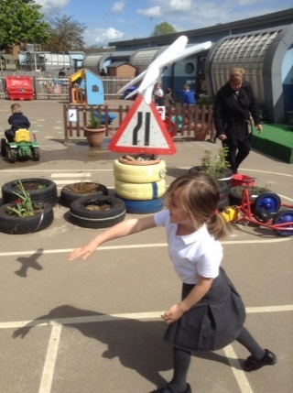
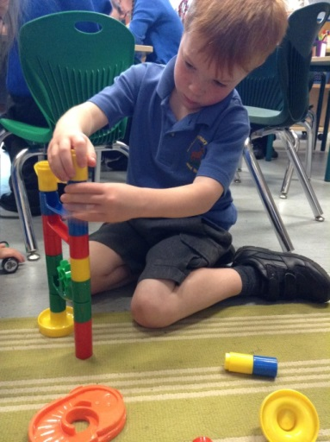
EYFS Curriculum
3 PRIME AREAS
1. Personal, Social and Emotional Development
2. Communication and Language
3. Physical Development
These are crucial for developing children's curiosity and enthusiasm for learning.
4 SPECIFIC AREAS
4. Literacy;
5. Mathematics;
6. Understanding the world;
7. Expressive arts and design
Notes:
This just gives you a general idea of the Early Years curriculum……

Slide 5
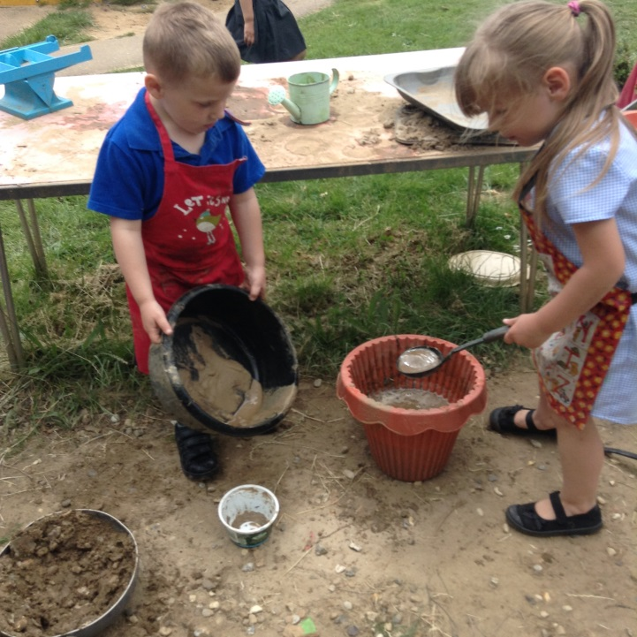
A typical day in our Foundation Class…
Busy Fingers – stay and play
Phonics
Literacy – reading and writing
Maths
Child Initiated learning
Topic based activities
PE/Dance weekly
Outside Learning
Notes:
This just outlines a typical day in reception.

Slide 6

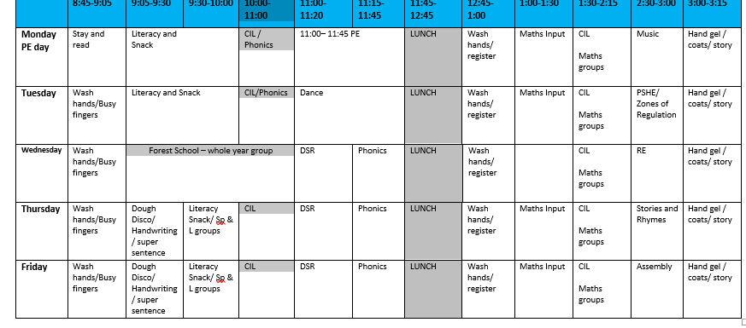
Typical timetable
Notes:
This is what our timetable usually looks like, it can be subject to change.

Slide 7
Reception Topics
Let’s Party!
Street Detectives
Fact or Fiction
French
Notes:
Each term we focus on a new topic. These are our current topics. We like to finish each topic with a ‘Fantastic Finish’ where you will be invited into school for a celebration event.

Slide 8
Online Learning journal
In EYFS, we are constantly observing and assessing the children and we take photographs and videos as evidence of the children’s experiences and achievements.
What is Tapestry?
Tapestry is an on-line system which allows us to create an individual Learning journey for every child in EYFS.
Advantage for parents
Parents have access 24/7 to their child’s Learning Journey and can comment on the observations added by school staff.
Parents can add their own observations to share progress and milestones achieved at home.
Notes:
This slide explains about Tapestry which we use for our online learning journal. We regularly add observations to show what your child has been learning in school. We encourage this to be an interactive tool, where you can comment and also add any observations of activities and learning your child has done at home.
If you encounter any problems with tapestry please just speak to your class teacher.

Slide 9



Be like Superman: I ask questions.
Ask questions
Notice things
Look for patterns and connections
Ask, ‘What if..?’
Think of possible reasons
Conduct your own research and find out more
Notes:
At Roebuck Academy, growth mindset is an important part of our culture. Each week we focus on a different superhero who has unique growth mindset qualities. For example when we go on our first learning walk around the school we need to be like superman and talk about the things we notice.

Slide 10

Talk Partners at Roebuck…
Face each other
Look at each other
Listen to one another
Challenge and support each other
Talk about the question
Take turns to speak
Share ideas
together
Prepare an answer
Notes:
As part of our learning process children are encouraged to talk with each other to share ideas and solve problems. Talk partners encourages every child to be heard and contribute.
10

Slide 11
School expectations
Reading – you are expected to listen to your child read five times a week and write a comment in their reading journal each time they read the book.
Book bags, reading books and reading records need to be in school every day
Doors open at 8.45 am . All children must be in school by 9am
Book your child’s lunch online before coming to school.
Please do not bring any toys into school
Notes:
Reading is crucial to children’s development of language and love of books. The teaching of reading is one of the school’s key priorities. You are expected to listen to your child read at home, 5 times a week. We ask that you log this in their reading record which then contributes to the schools weekly reading challenge. We both very competitive and every reading log counts.
Your child will need a book bag as we do send home work as well as any drawings they do in school. We also ask that the reading book and reading records are kept in the bag and brought into school every day.
Classroom doors are open from 8:45am and we require all children to be in school by 9am. If you are running late you will need to take your child to the school office and not the classroom door.
We will update you with the arrival and collection procedures as soon as we are given further government guidance.
Current government guidelines stipulates that visitors to the school including parents are not allowed into the building. If you feel your child will have issues separating from you at the classroom please let us know.
You should have received some information about School Grid, this is the website where you can order your child’s lunch. You have the option to do it daily or you can book them all in advance. Please make sure you register if you haven’t already done so.

Slide 12
Attendance & punctuality
We have high expectations of attendance and punctuality at Roebuck. We follow up on all absences as well as lateness to school.
As standard NO holidays are permitted to be taken in school time. All unauthorised absences will be accrued .
Any absence below 96%percent will trigger intervention with the pastoral and attendance lead, Mrs Johnson.
As a school we do follow our school policy and will issue fines when benchmarks are triggered.
Descriptor | Attendance Level | Actual Attendance | Whole Days Absence | Hours of learning lost
Excellent | 100% | 190 days | 0 | 0
 | 99% | 188 days | 2 | 10
Good | 98% | 186 days | 4 | 20
 | 97% | 184 days | 6 | 30
 | 96% | 182.5 days | 7.5 | 37.5
Satisfactory | 95% | 180.5 days | 9.5 | 47.5
Cause for Concern | 90% | 171 days | 19 | 95
Notes:
Just read slide.

Slide 13


Reading
Promoting a love of reading is the number one priority.
The best way to get better at reading is to read!
We will be running a phonics and reading workshop later in September
We actively encourage reading throughout the school.
Please can you continue to support your child’s enjoyment of reading at home by ensuring they continue to read at least 5 times a week.
Each child will have two books to take home one for reading for pleasure and one for decoding, once the children have settled in.
You will need to sign the reading record every time you read with your child.
Every class has an interacting and inviting book corner with a range of different books to read.
Stay and read days on a Monday morning (once the children have settled in)
Notes:
If the government restrictions have been removed we plan to run a phonics and reading workshop in September to show you how we teach reading and phonics at school and how you can support your child at home.

Slide 14
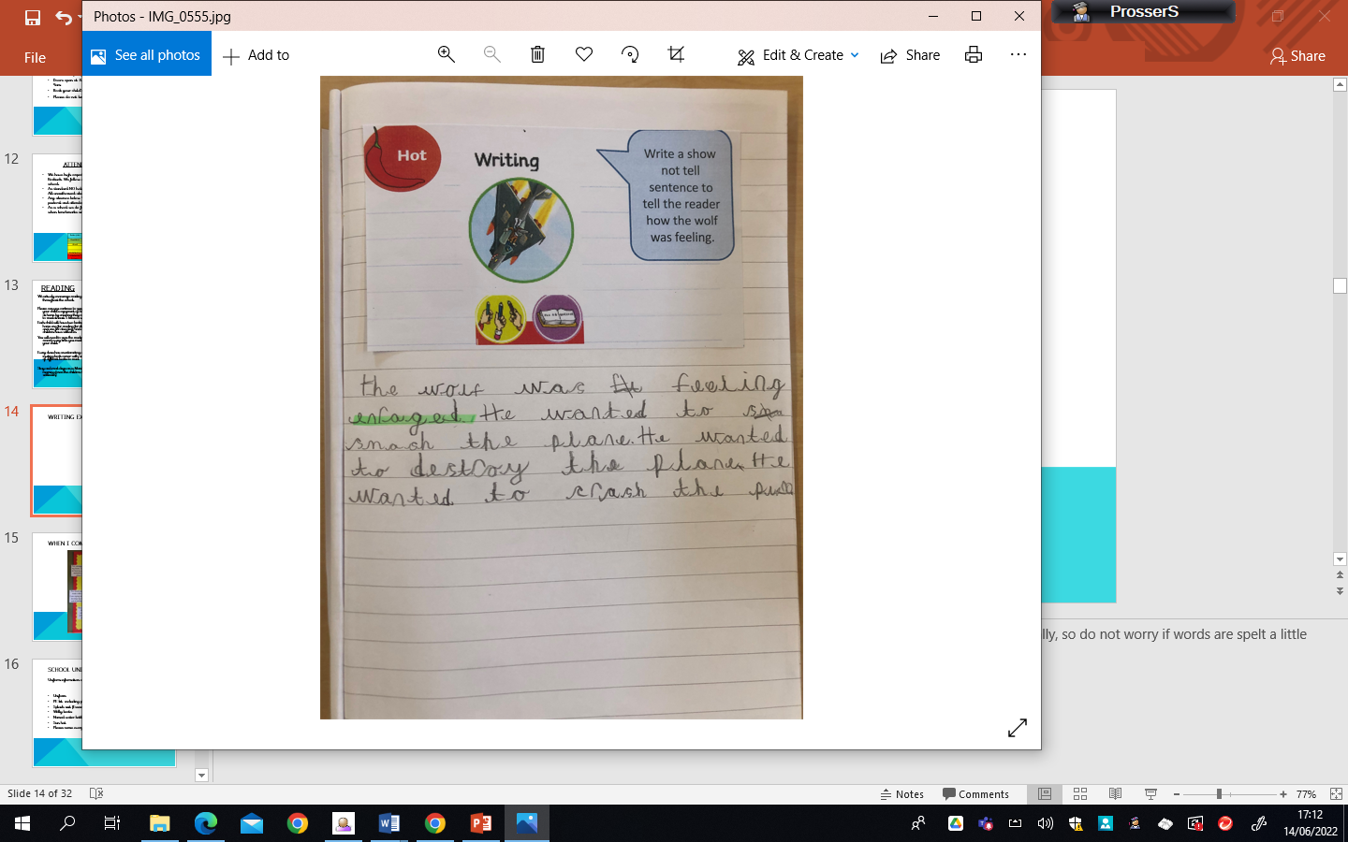
Writing expectations
Notes:
This is an example of a typical reception child’s writing by the end of the year. In reception children are taught to spell words phonetically, so do not worry if words are spelt a little different.

Slide 15
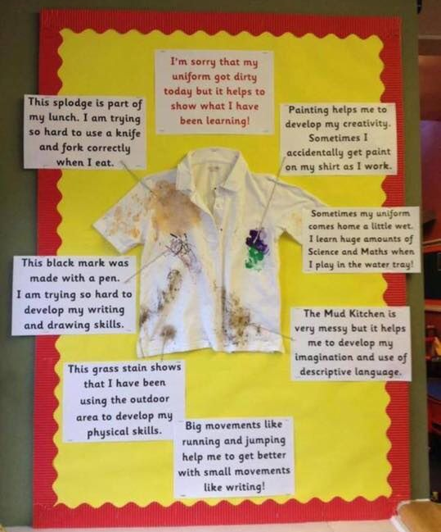
When I come home messy…
Notes:
In reception our learning is all cross curricular and means that we engage is a wide variety of activities which sometimes results in us getting messy. Of we are messy we know we have had a great day! We use child friendly paints and pens and they should all wash out easily with a bit of stain remover.

Slide 16


School Uniform
Uniform information can be found in your pack
Uniform
PE kit including plimsolls
Splash suit (Essesntial)
Welly boots
Named water bottle
Sun hat
Please name everything!

Slide 17
How to Help your child
Independence!

Slide 18

Uniform Information children are expected to come to school appropriately dressed in our school uniform.
Please tie hair back at all times
No large bows – any hairbands or bows are to be either white, blue or black
Simple studs to be worn – no other earrings permitted
Book bag needed every day
Flat shoes – no heels or astroTurf
boots
Plain Black Trainers
Notes:
Read slide.

Slide 19
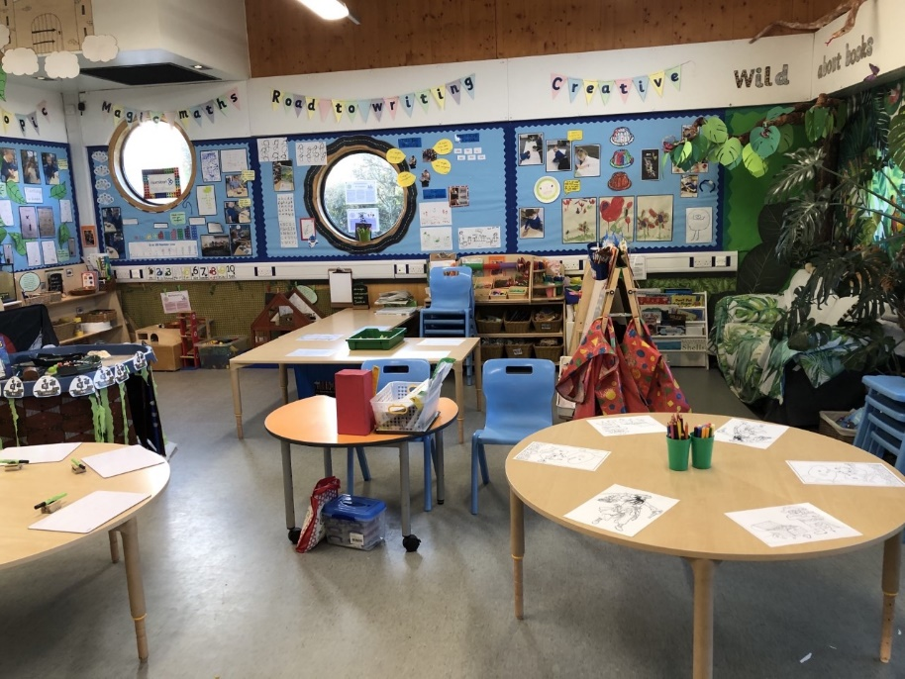
Physical environment
Working walls are there to support children with key vocabulary, steps to success and a sequence to learning.
Reception is about developing independence in their own learning, so the use of the working walls will be a key focus.
Reading corners aim to inspire children to want to read.
Celebratory display –children’s work is displayed.
Notes:
Read Slide

Slide 20
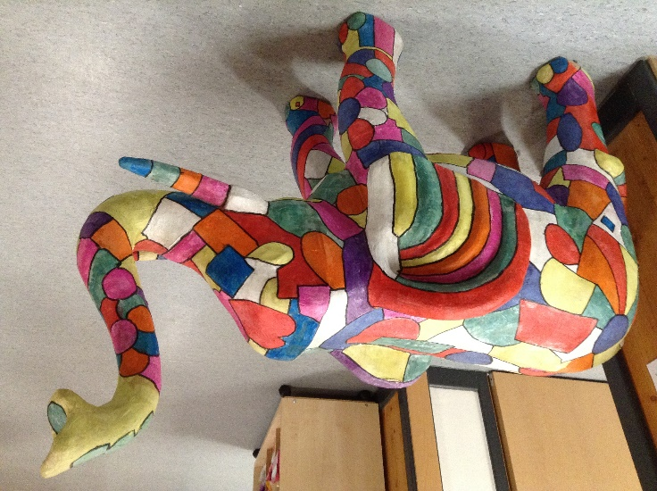
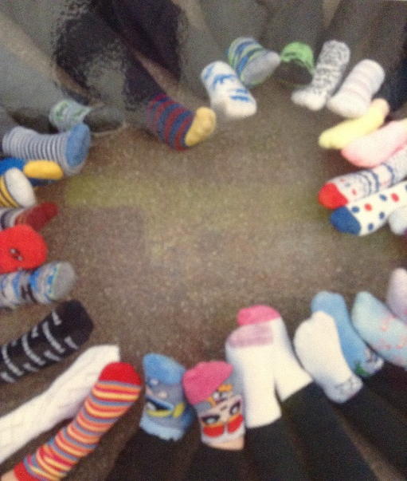
Emotional environment
PSHE lessons with strong focus on wellbeing.
Year group assembly e.g. growth mind set and celebrations.
House Teams.
Nurturing team.
Pastoral/Attendance– Mrs Johnson
Notes:
This year we realise more than ever the importance of emotional wellbeing for the children. In September our PSHE lessons will all be focussed on supporting children after this unique situation we have been through.
We also do weekly assemblies, where we celebrate birthdays, star of the week and any other good news.
On entry to Roebuck Academy your child will be placed in one of our four house teams. If they already have a sibling at the school they will be in the same team.
Mrs Johnson is our Pastoral and Attendance Officer and is here to help you with any worries or concerns you have that you feel may affect your child’s wellbeing at school.

Slide 21
Website…
Roebuck School Website is your first port of call for ALL communication
Policies
Letter Section
Admissions
Uniform
Blogs
Twitter
Notes:
Read Slide

Slide 22

Roebuck uses Gateway for…
Online payments
Communication
Booking into workshops
Booking clubs
Booking into special events
Notes:
Read the slide. The staff in the school office are the best people to answer questions about the above.

Slide 23
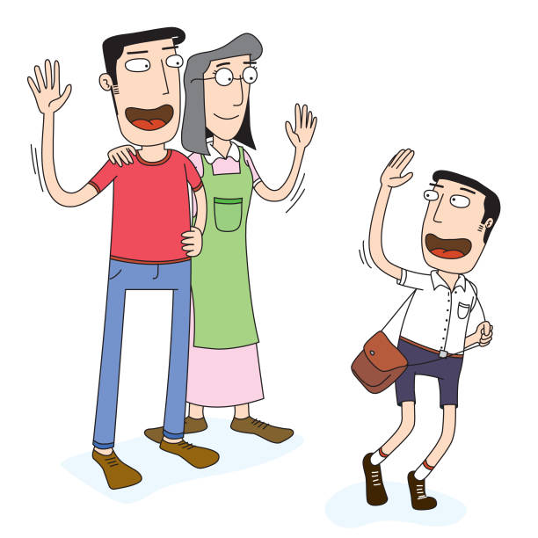
Collecting pupils from school
Drop off:
Outside the classroom entrance.
Doors will open at 8:45am. Children are not allowed into a classroom without a teacher.
Registration begins at 8:45am. Gates will be closed at 9:00am. Anyone late will need to register at the main office.
Notes:
Read slide

Slide 24

Collecting pupils from school
Collection:
Outside the classroom entrance.
Doors will open at 3:15pm.
Children will remain seated on the carpet until the adult on the door calls their name.
If someone different will be collecting your child you will need to have completed a blue permission slip. Please ask a member of staff.
If you are running late please telephone the
office to inform them and we will wait until
you arrive.
Notes:
Read Slide

Slide 25
Safeguarding
Please update the office with names of parents/guardians who are permitted to collect your child.
Do not use mobile phones inside school or while on school trips.
Children below the age of 13 should not have access to any social media networking sites / platforms
Scooters and bikes to be walked into school and placed in the cycle/scooter parks
We are a NUT FREE SCHOOL. Please ensure that no items containing nuts are allowed into school. This includes peanut butter, pesto and chocolate spread.
Notes:
At Roebuck Academy, safeguarding is our number one priority. Read slide.

Slide 26
medical Information
Support your child:
Keep the school and class teacher up to date with new medical information
Ensure that your child’s asthma pump/inhaler, epi-pen or additional medicine is in date and with a good expiration life.
Ensure that all contact information; especially phone numbers are correct
Inform us if your child’s medical information or needs change
You will always be contacted if your child sustains any form of head injury – this includes minor bumps and knocks
Any sickness, diarrhoea, must be followed by at least 48 hours absence.
Head lice! Please check regularly and treat as recommended.
Any absence requires a telephone call to the school office or via the school app by 9:15am
Any prescribed medication can only be administered by prior arrangement with the school office
Notes:
Read

Slide 27

REMINDER: PACKED LUNCHES
Drink – no fizzy drinks or high-sugar content
No Chocolate bars
No Sweets
No products containing nuts
Notes:
Read

Slide 28
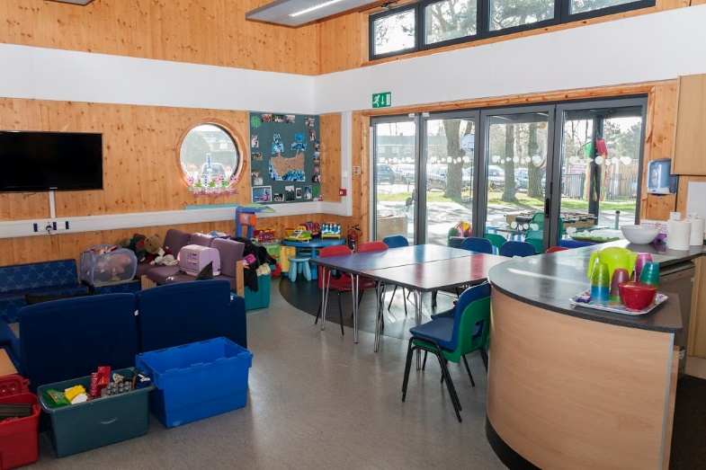
Facilities available to you…
Buccaneers Breakfast Club: 7:30 – 8:45am
Buccaneers After-School Club 3:15-6:00pm
Pastoral Support Worker – Mrs Johnson
Bright Stars Holiday Club – Jess George
Rising Stars Holiday Sporting Days
Range of After-School Clubs
Notes:
There are lots of extra facilities that the school offer to either develop your child’s interest in something through the after-school clubs or by offering wrap around care through our breakfast and afterschool club.

Slide 29
The First Few Days ...
There can be a lot to remember in the first few days, but please do not worry as your child will quickly be teaching you the routines!
All clothing named!
Book bag everyday
PE bag - left in school
Packed lunch or school dinner ordered via School Grid
Notes:
read

Slide 30


School meals and milk
Everyone to register for universal free school meals –
irrespective of income/ status.
www.hertsdirect.org/freeschoolmeals
System should be available from mid July.
Information can be found in school pack.
Notes:
Read and stress the importance of registering.

Slide 31

Holiday Task
We are sending home a book to read over the summer holidays with a short task to complete. Please bring this back at the start of September.

Slide 32
Questions
If you have any questions please do not hesitate to contact Mrs Hnatiuk and Miss Wade

