Slide 1

Year one to Year TWO transition Meeting for parents
2021-2022

Slide 2
Meet the team
Pine Mrs Townley
Birch Mrs Blythe

Slide 3
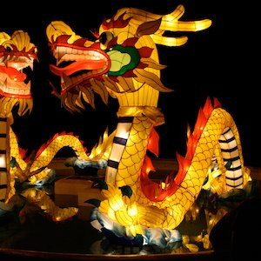
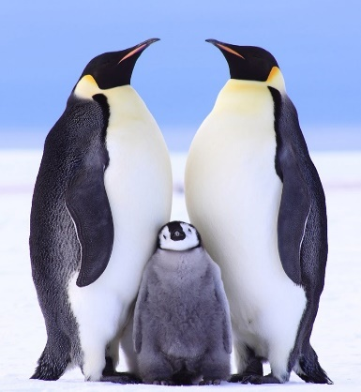
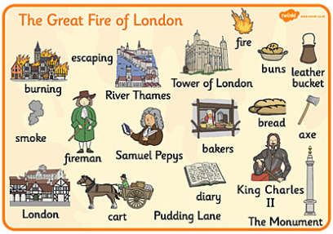
Year 2 curriculum overview
Immersive curriculum- over time the curriculum has increased the expectations and impact for our children. Topic based learning will help our children to have a broad and balanced curriculum and learn skills that are transferable throughout the curriculum.
Children will be judged against age related expectation.
At the end of year 2 children will be assessed using the ITAF (interim teacher assessment frameworks). They will be judged against expected standards. WTS (working towards standard), ARE (age related expectation) or GDS (greater depth standard). In order to achieve ARE or GDS children must have secured ALL aspects of the ITAF.
Notes:
see hand outs
Making pancakes- using purple mash see James Mayhew book- jump into a picture
Insert pictures of trips

Slide 4

national Curriculum

Slide 5
Differences between Year 1 and Year 2
No gated area so we ask parents to please stand back away from the canopy to allow children to continue to independently organise themselves and prepare themselves for the day.
Book band colours will continue but when your child is fluent, expressive and able to answer questions about a more complex text we may place them on to the accelerated reader reading scheme.
Monster Phonics reading groups every day.
Handwriting will be practised daily
Spelling will link closely to phonics and key spelling rules
Children will attend assemblies including singing
SAT’s

Slide 6
CURRICULUM CHANGES
Phonics is still taught daily with a greater focus on grammar, spelling patterns, and rules.
Children who are not meeting expected standards in phonics will be supported through targeted intervention and review work.
Core curriculum subjects, (topic based learning)
Literacy, Maths, Science as well as DT, Music, Art, History, Geography, Drama, PSHE, Computing , RE and PE
Cursive handwriting is taught explicitly
SATS happen over May

Slide 7

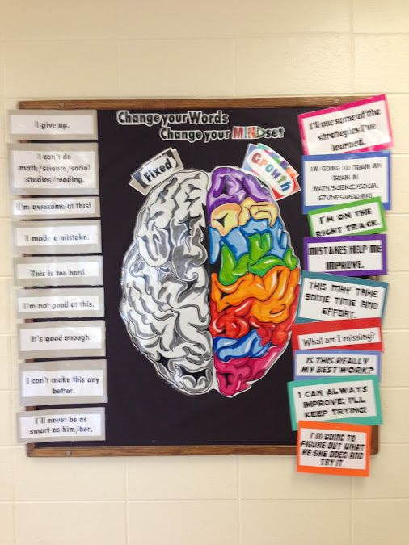

Growth Mindset

Slide 8
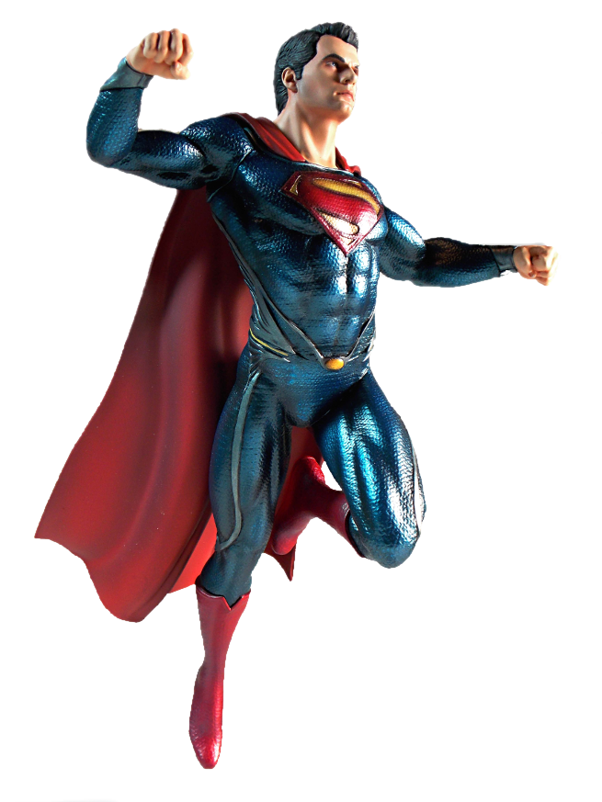


Be like Superman: Use your imagination. Be Curious.
Ask questions
Notice things
Look for patterns and connections
Ask, ‘What if..?’
Think of possible reasons
Conduct your own research and find out more

Slide 9
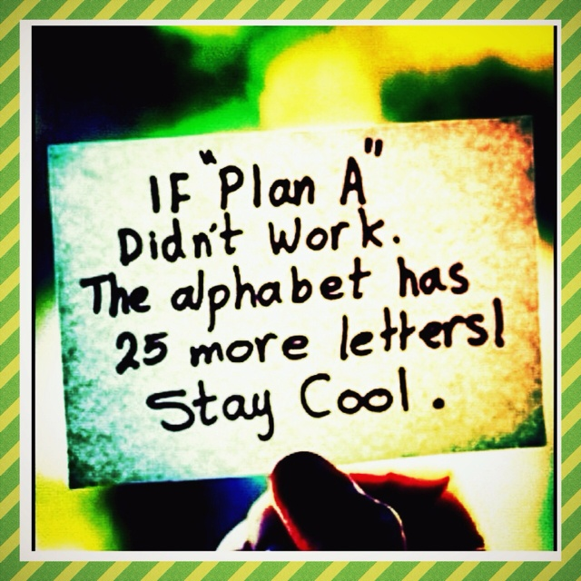

Slide 10

Talk Partners at Roebuck…
Face each other
Look at each other
Listen to one another
Challenge and support each other
Talk about the question
Take turns to speak
Share ideas
together
Prepare an answer

Slide 11
Attendance & punctuality
We have high expectations of attendance and punctuality at Roebuck. We follow up on all absences as well as lateness to school.
As standard NO holidays are permitted to be taken in school time. All unauthorised absences will be accrued .
Any absence below 96%will trigger intervention with the pastoral and attendance lead, Mrs Johnson.
As a school we do follow our school policy and will issue fines when benchmarks are triggered.
Descriptor | Attendance Level | Actual Attendance | Whole Days Absence | Hours of learning lost
Excellent | 100% | 190 days | 0 | 0
 | 99% | 188 days | 2 | 10
Good | 98% | 186 days | 4 | 20
 | 97% | 184 days | 6 | 30
 | 96% | 182.5 days | 7.5 | 37.5
Satisfactory | 95% | 180.5 days | 9.5 | 47.5
Cause for Concern | 90% | 171 days | 19 | 95

Slide 12
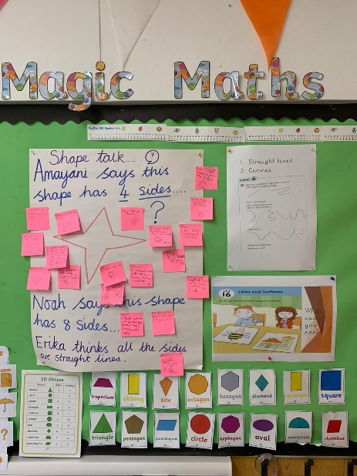
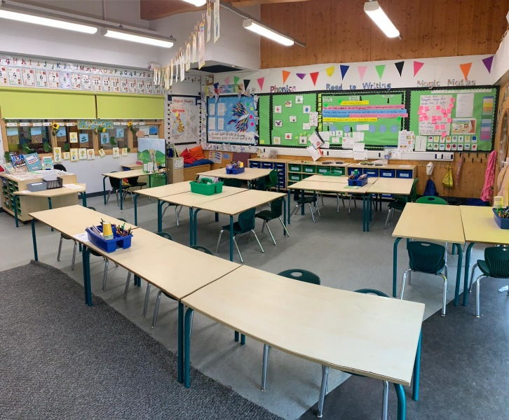
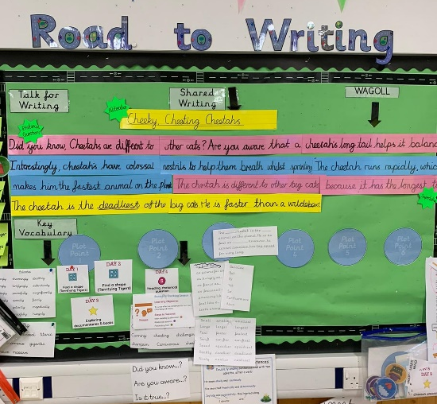
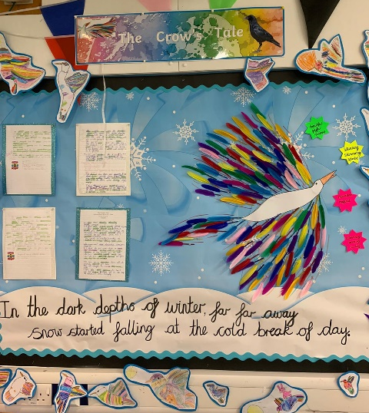
Physical environment
Working walls are there to support children with key vocabulary, steps to success and a sequence to learning. We also display sentence stacking for our literacy learning.
Wapoll and Wagoll are used
What a poor one looks like
What a good one looks like
Reading corners aim to inspire children to want to read, they create an immersive learning environment.
Celebratory display –children’s high quality work is displayed

Slide 13

Emotional environment
Circle times
PSHE lessons
Whole school assemblies re: changes
Transition mornings
Meeting with Year 1 colleagues to discuss each child individually and their needs as well as strengths
Open door policy

Slide 14
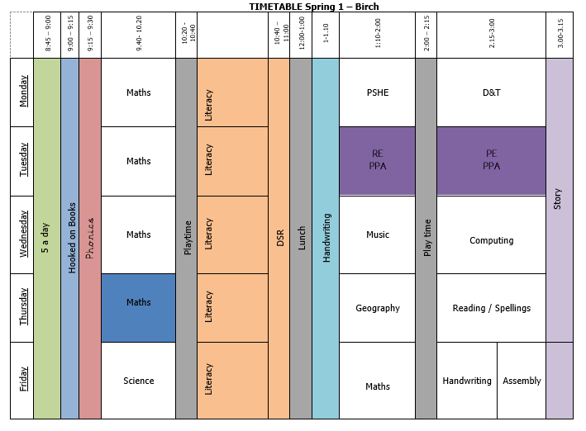

Slide 15
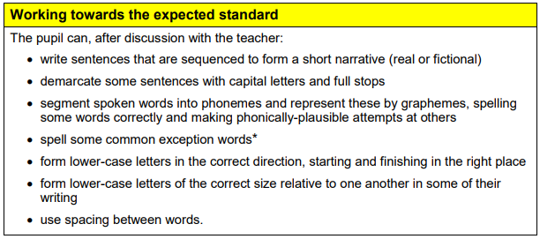
Progression in WRITING

Slide 16
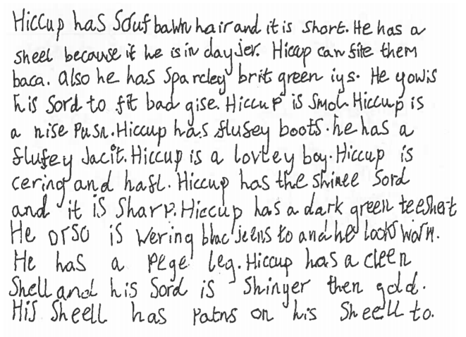

Slide 17
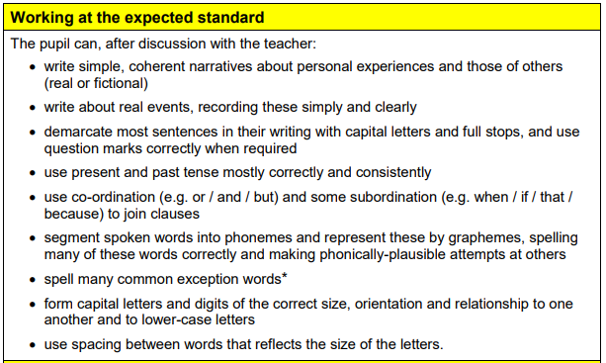

Slide 18
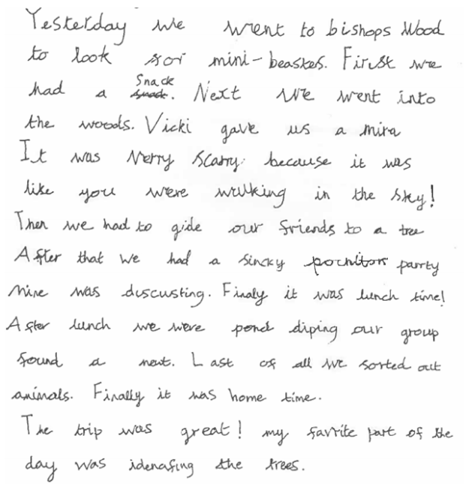

Slide 19
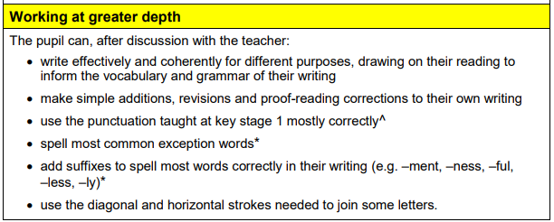

Slide 20
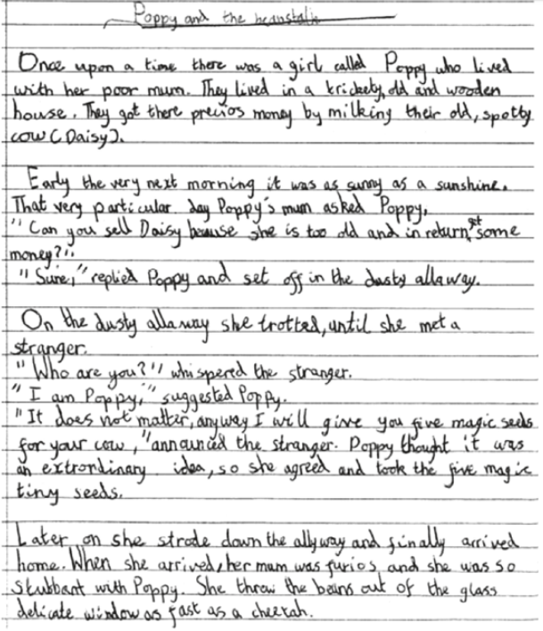

Slide 21
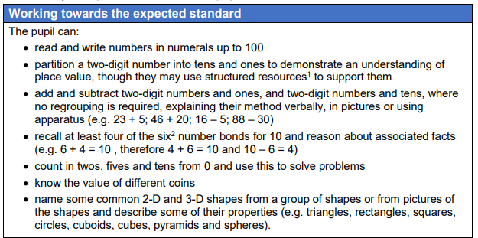
Progression in Maths

Slide 22
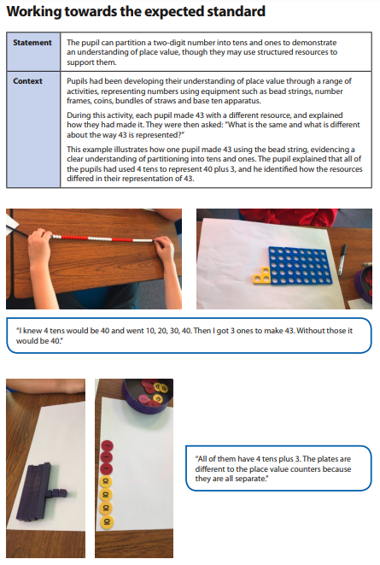

Slide 23
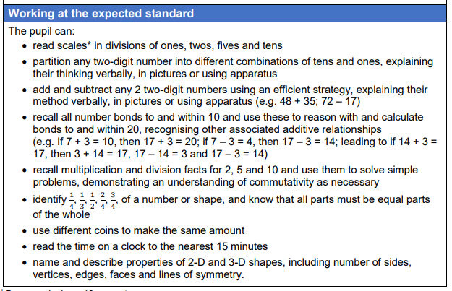

Slide 24
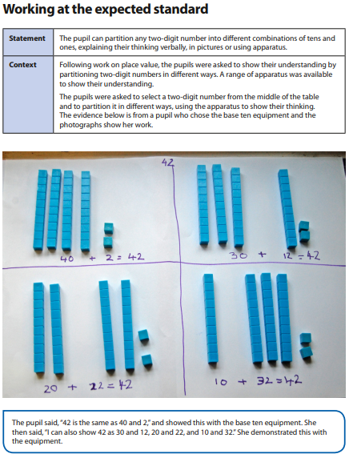

Slide 25
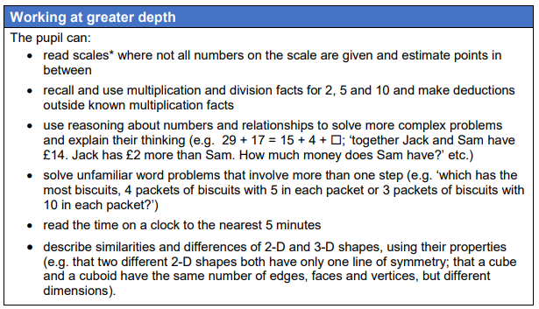

Slide 26
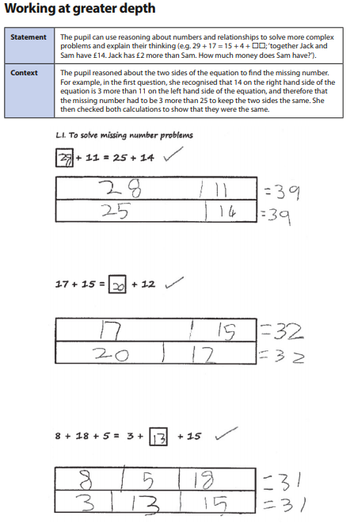

Slide 27
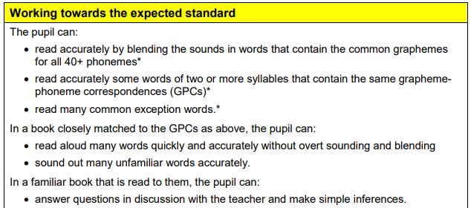
Progression in READING

Slide 28
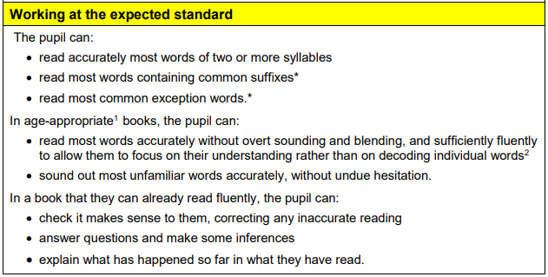

Slide 29
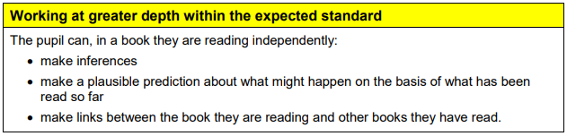

Slide 30
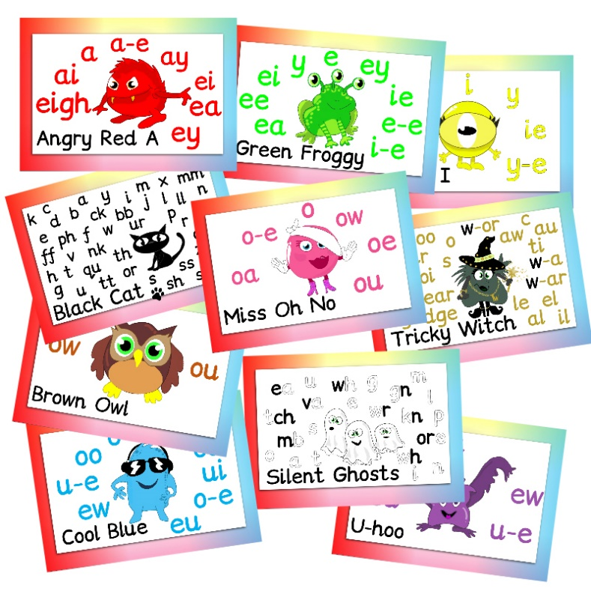

Progression in PHONICS
Phase 6
Reinforces learning in phase 5
Understand and begin to learn the conventions for adding the suffix -ed for past tense and -ing for present tense.
To add common prefixes to root words and to understand how they change meaning e.g. un and dis.

Slide 31
AUTUMN TERM IN YEAR 2
What will happen to ensure effective transition:
Meet & Greet the teacher event
Workshops will be planned for parent support

Slide 32
Uniform children are expected to come to school appropriately dressed in named school uniform.
Roebuck Academy logo polo shirt, white or royal blue
(or plain white or royal blue polo shirt).
Plain grey or black school trousers/tailored shorts.
Plain grey or black skirt/pinafore dress/tailored trousers. No Leggings
Blue and white checked or striped summer dresses
Roebuck Academy logo sweatshirt or cardigans
Roebuck Academy logo fleece.
Black school shoes or plain black trainers.
Hats with a brim for summer.
Flat black school shoes or plain black trainers – no open toes.

Slide 33
Uniform
Please tie hair back at all times
No large bows – any hairbands or bows are to be either white, blue or black.
Simple studs to be worn – no other earrings permitted
Book bag needed every day
Flat shoes – no heels or AstroTurf boots / shoes
No leggings

Slide 34
pe
White t-shirt with Roebuck Academy logo (or plain white t-shirt).
Royal blue shorts.
Plimsolls or trainers for outside games.

Slide 35


Reading
We actively encourage reading throughout the school. This continues in year 2. Reading buddies will start each week where they are given the opportunity to read to an older peer
Please can you continue to support your child’s enjoyment of reading at home by ensuring they continue to read at least 5 times a week for at least 20 minutes.
Reading record books are collected on Thursday. This enables us to monitor their reading which feeds into a whole school weekly reading competition.

Slide 36
How to Help your child at home…
Read with your child as often as possible, discussing the book and making predictions about what will happen next.
Encourage your child to read aloud to you, as well as hearing you read to them.
Encourage children to explain the meaning of unfamiliar words and language.
Use a dictionary or thesaurus to look up their word meanings.
Ensure that your child practises their spellings at home every evening. Every child will have a spelling book that they will bring home daily.
Encourage your child to complete their spelling every night throughout the week.
SATS booklets to be sent home in Autumn term.

Slide 37
Website…
Roebuck School Website is your first port of
call for ALL communication
Policies
Letter Section
Admissions
Uniform
Blogs
Follow us on twitter @academy_roebuck

Slide 38
Communication at roebuck…
Reminder:
Facebook
School Website
Flyers and Posters
Email
Text
Open Door Policy

Slide 39
Roebuck is moving to using Gateway for…
Online payments
Communication
Booking into workshops
Booking clubs
Booking into special events
School grid to order lunches

Slide 40
Safeguarding
Please update the office with names of
parents/guardians who are permitted to collect your
child.
Do not use mobile phones inside school or while on
school trips.
Scooters and bikes to be walked into school and
placed in the cycle/scooter parks
We are a NUT FREE SCHOOL. Please ensure that no
items containing nuts are allowed into school.

Slide 41
REMINDER: PACKED LUNCHES
Drink – no fizzy drinks or high-sugar content
No Chocolate bars
No Sweets
No products containing nuts
School dinners are chosen before the children come in on “school grid”

Slide 42
Parent/Carer Questions?

