Slide 1

Year 3 to year 4 transition Meeting for parents
CEDAr: Mrs JaRMAN
ROWAN:Miss McAnuff

Slide 2

Teaching staff
Cedar class (current Pear class):
Mrs Jarman (Monday to Thursday)
Mr Mari (Friday)
Rowan class (current Cherry class):
Miss McAnuff

Slide 3
What will we do to support transition?
LJ
Hand over meetings will take place from one class teacher to the next.
Transition book will introduce in class and will be brought home over the holiday to be enjoyed. This will support our learning in the first half term.

Slide 4
Essentials for Year 4…
LO
As with ALL year groups, reading remains a KEY focus of the
year. Children should aim to read for at least 20 minutes a night, preferably to an adult when possible.
Children are expected to have their reading journal signed and checked by parents / carers every evening.
Timetables – children should enter Year 4 knowing their 2, 5, 10, 3, 4 and 8. By the end of year children should know all tables up to 12 x 12.

Slide 5

Year 4 national Curriculum
LJ
Computing
French

Slide 6
Year 4 HISTORY Topics
LO
The Wind of Change
Ancient Greece
Ancient Egypt
Computing
French

Slide 7
Year 4 Geography Topics
LO
The River Nile
Peculiar Plants
Countries of the world
Computing
French

Slide 8
Year 4 SCIENCE
LJ
Animals including humans
Electricity
Living things & their habitats
States of matter
Computing
Sound
French

Slide 9

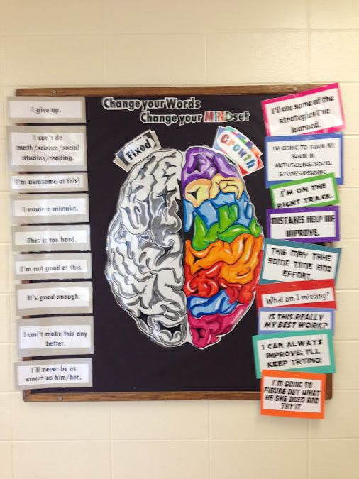

Growth Mindset
LJ

Slide 10
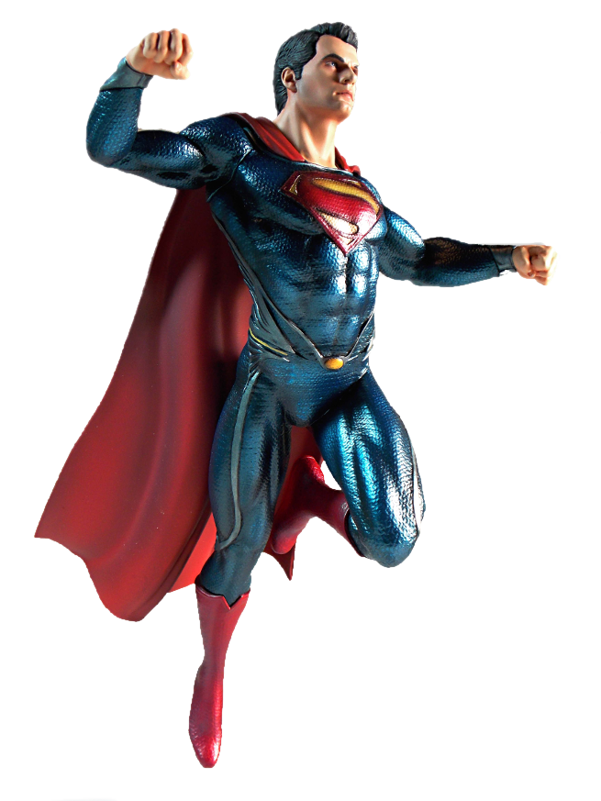


LJ
Be like Superman: Use your imagination. Be Curious.
Ask questions
Notice things
Look for patterns and connections
Ask, ‘What if..?’
Think of possible reasons
Conduct your own research and find out more

Slide 11
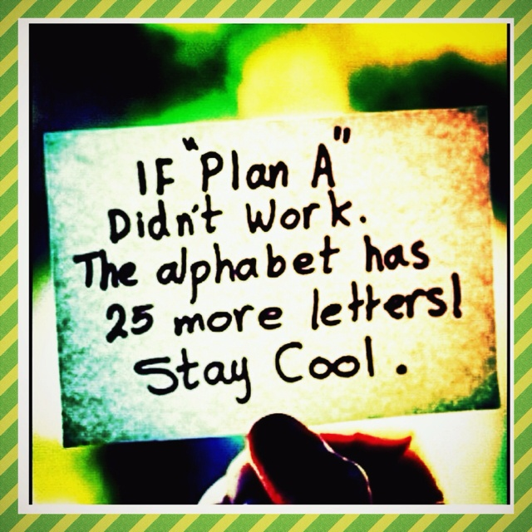
LJ

Slide 12

Normally, we use
Normally, we use
Talk Partners at Roebuck…
LJ
Face each other
Look at each other
Listen to one another
Challenge and support each other
Talk about the question
Take turns to speak
Share ideas
together
Prepare an answer
(this will be adapted to follow the current social distancing rules)
Notes:
12

Slide 13
Attendance & punctuality
LO
We have high expectations of attendance and punctuality at Roebuck. We follow up on all absences as well as lateness to school.
As standard, NO holidays are permitted to be taken in school time. All unauthorised absences will be accrued .
Any absence below 96%will trigger intervention with the pastoral and attendance lead, Mrs Johnson.
As a school we do follow our school policy and will issue fines when benchmarks are triggered.
Descriptor | Attendance Level | Actual Attendance | Whole Days Absence | Hours of learning lost
Excellent | 100% | 190 days | 0 | 0
 | 99% | 188 days | 2 | 10
Good | 98% | 186 days | 4 | 20
 | 97% | 184 days | 6 | 30
 | 96% | 182.5 days | 7.5 | 37.5
Satisfactory | 95% | 180.5 days | 9.5 | 47.5
Cause for Concern | 90% | 171 days | 19 | 95

Slide 14
Differences between year 3 and year 4
LO
Increase in independence – as with all year group changes, the children will expected to develop in their level of independence.
Statutory times table test – children will be tested on a computer generated times table tests, recalling multiplication facts up to the 12 times tables. This is a 3 week window during the month of June.
Swimming – each Year 4 class will swim during the year. (Timings will be confirmed).

Slide 15
Uniform children are expected to come to school appropriately dressed in our school uniform.
LJ
School Uniform
Roebuck Academy logo polo shirt, white or royal blue (or plain white or royal blue polo shirt).
Plain grey or black school tailored trousers/tailored shorts/skirt/pinafore (no leggings)
Roebuck Academy logo sweatshirt /cardigan or royal blue sweatshirt /cardigan
Roebuck Academy logo fleece.
Black school shoes or plain black trainers. Shoes must be flat – no open toes.
Hats with a brim for summer.
Winter coat – brighter the better
Hair bands and bows – must be royal blue, white or black
Please ensure you label all of your children’s uniform

Slide 16
Uniform Information children are expected to come to school appropriately dressed in our school uniform.
LJ
Please tie hair back at all times
No large bows – any hairbands or bows are to be either white, blue or black.
Simple studs to be worn – no other earrings permitted
Book bag needed every day
Flat shoes – no heels or AstroTurf boots / shoes

Slide 17
PE Kit
LJ
White t-shirt with Roebuck Academy logo (or plain white t-shirt).
Royal blue shorts.
Plimsolls or trainers for outside games.
Hair tied back
No earrings

Slide 18
equipment
LO
Your child will be provided with a pen, pencil and ruler
at the beginning of the year. They do not need to bring
a pencil case in from home.
Your child will be participating in various Art, Design
and Technology projects throughout the year. Please
provide your child with a named apron, alternatively a
large old shirt will do.

Slide 19
Physical environment
LJ
Working walls are there to support children with key vocabulary, steps to success and a sequence to learning.
Sentence stacking wall to showcase children’s sentences in literacy writing units.
WAPOLL (What a poor one looks like)
WAGOLL (What a good one looks like)
Reading corners aim to inspire children to want to read.
Celebratory display –children’s work is displayed.

Slide 20
Emotional environment
LO
PSHE lessons
Whole school themes & focuses
Meeting with Year 3 teacher to discuss each child individually and their needs as well as strengths
Open door policy (via email at the moment y4@roebuck.herts.sch.uk)

Slide 21
Year 4 curriculum
LJ
To achieve working towards (WTS), age related (ARE) or Greater depth (GDS) children must meet objectives from the Teacher Assessment Framework.
Notes:
see hand outs
Making pancakes- using purple mash see James Mayhew book- jump into a picture

Slide 22
Progression - Reading
LO
Year 3
Begin to notice key words and phrases used to convey passing of time to introduce paragraphs or chapters.
Year 4
Consistently noticing key words and phrases used to convey passing of time to introduce paragraphs or chapters.

Slide 23


Reading
LO
We actively encourage reading throughout the school. This continues in Year 4. Reading buddies will be set up. This is where they are given the opportunity to nurture the enjoyment of reading in the younger generations.
Please can you continue to support your child’s enjoyment of reading at home by ensuring they continue to read at least 5 times a week for at least 20 minutes.
Reading record books are collected daily. This enables us to monitor their reading which feeds into a whole school weekly reading competition.
Once your child has completed a book, they will use the iPads to complete an accelerated reading quiz. You can monitor your own child’s progress by signing up to Home Connect.
http://www.roebuck.herts.sch.uk/page/?title=Accelerated+Reader&pid=99
Although there is a heavy focus on reading comprehension,, promoting a love of reading is still the number one priority. The best way to get better at reading is to read!

Slide 24

Reading –
Book talk and comprehension
LJ

Slide 25
Progression - Writing
LO
Year 4
Use speech punctuation correctly most of the time
Year 3
Use speech punctuation when following modelled writing
Year 3
Use some conjunctions, adverbs and prepositions for cohesion and to add detail
Year 4
Use a range of conjunctions, adverbs, prepositions and pronouns for cohesion, detail and clarity
Year 3
Uses commas in a list
Year 4
Uses commas after fronted adverbials

Slide 26

Progression - Writing
LJ

Slide 27
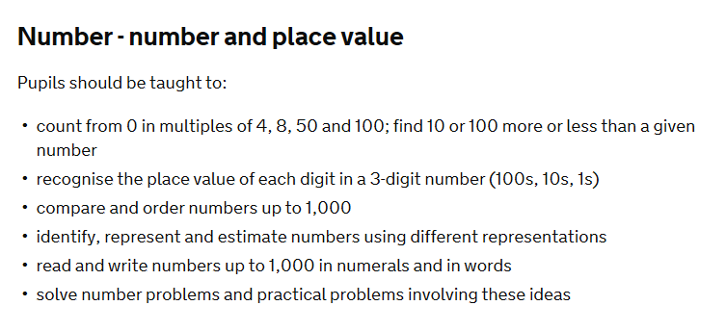
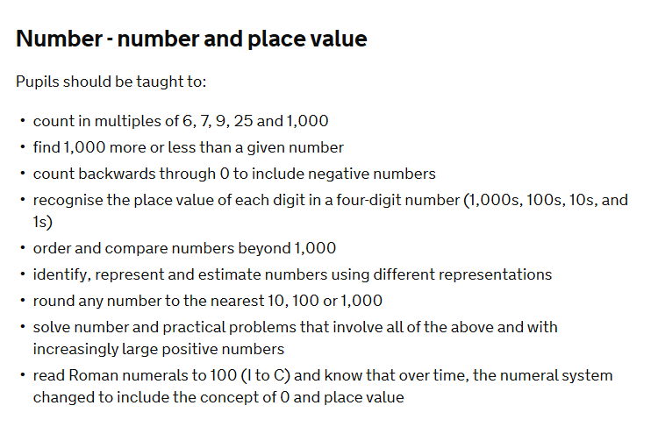
Progression - Maths
LO
Year 3
Year 4

Slide 28
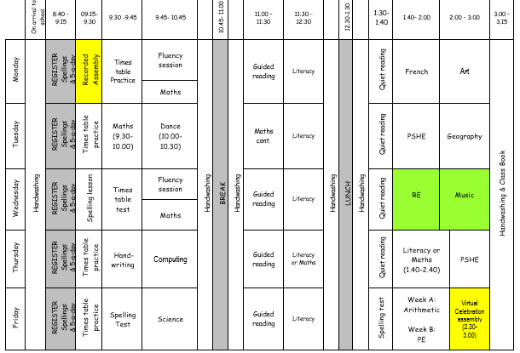
Typical timetable
LJ

Slide 29
How to Help your child at home…
LO
Read with your child as often as possible,
discussing the book and making predictions
about what will happen next. Encourage your
child to read aloud to you, as well as hearing
you read to them. Encourage children to
explain the meaning of unfamiliar words and
language. Use a dictionary or thesaurus to
look up their word meanings.

Slide 30
How to Help your child at home…
LJ
Ensure that your child practises their spellings
at home every evening. Every child will have
a spelling journal that they will bring home
every evening.
Encourage your child to complete their
spelling every night throughout the week.
When writing at home, encourage your child
to check their spelling, grammar and
punctuation. Their handwriting should also be
cursive and produced with a blue pen.

Slide 31
How to Help your child at home…
LO
Weekly homework on Google Classroom (Maths problem solving) and Mathletics
TT Rockstars
Reading at least 5 times a week
Spelling practise
Times tables
Themed Homework (holiday homework)

Slide 32
How to Help your child at home…
LJ
Please monitor your child’s home learning
tasks and encourage them to complete them.
Please ask if you need any help with
motivating your child or if you would like
suggestions of different strategies to try with
them.

Slide 33
Website…
LO
Roebuck School Website is your first port of
call for ALL communication
Policies
Letter Section
Admissions
Uniform
Blogs

Slide 34
Communication at roebuck…
LJ
Reminder:
Facebook
Twitter
School Website
Flyers and Posters
Email
Text
Open Door Policy (via email)

Slide 35
Roebuck uses Gateway for…
LO
Online payments
Communication
Booking into workshops
Booking clubs
Booking into special events
Use school grid for booking lunch
for your child

Slide 36
Collecting pupils from school
LJ
Drop off: Outside the classroom entrance.
Doors will open at 8:45am. Children are not
allowed into a classroom without a teacher.
Registration begins at 8:45am. Doors will be
closed at 9:00am. Anyone late will need to
register at the main office. Lessons begin at
9:00am sharp.
Collection: Blue slips need to be completed if somebody
different is picking up your child (only applies to those who are collected).

Slide 37
Safeguarding
LO
Please update the office with names of
parents/guardians who are permitted to collect your
child.
Do not use mobile phones inside school or while on
school trips.
Children below the age of 13 should not have access
to any social media networking sites / platforms
Scooters and bikes to be walked into school and
placed in the cycle/scooter parks
We are a NUT FREE SCHOOL. Please ensure that no
items containing nuts are brought into school.

Slide 38
medical Information
LJ
Support your child:
Keep the school and class teacher up to date with new medical information (Health care plans need to be completed if an ongoing medical need)
Ensure that your child’s asthma pump/inhaler, epipen or additional medicine is in date and with a good expiration life.
Ensure that all contact information; especially phone numbers are correct
Inform us if your child’s medical information or needs change
You will always be contacted if your child sustains any form of head injury – this includes minor bumps and knocks
Children will only be permitted to miss PE if they have a letter from a parent/carer

Slide 39
REMINDER: PACKED LUNCHES
LO
Drink – no fizzy drinks or high-sugar content
No chocolate bars
No sweets
No products containing nuts

Slide 40
Facilities available to you…
LJ
Buccaneers Breakfast Club: 7:30 – 8:45am
Buccaneers After-School Club 3:15-6:00pm
Pastoral Support Worker – Mrs Johnson

Slide 41
Parent/Carer Questions?
Email: y4@roebuck.herts.sch.uk

