Slide 1

Year 4 to year 5 transition Meeting for parents
Mrs Norman and mr downie

Slide 2

Teaching staff
Mrs Norman - Year 5 Juniper Class Teacher
(current Cedar Class)
Mr Downie – Year 5 Sycamore Class Teacher
(current Rowan Class)

Slide 3
What will we do to support transition?
Children will spend a morning with their new class teacher in their new room –
this will form part of getting to know their new teacher and
familiarising themselves with their new classroom environment.
During this time they will produce:
A piece of art work based on the book Bloom
A piece of writing based on the book Bloom
Handover meetings will take place from the current class teacher to the new class teacher

Slide 4

Year 5 national Curriculum
Computing
French

Slide 5
Year 5 Topics
Anglo-Saxons and Scots
Viking and Anglo-Saxon struggle
Water World
North America
Computing
Victorians
French
Extreme Earth

Slide 6
Year 5 SCIENCE
Living things & their habitats
Forces
Properties & changes of materials
Animals including humans
Earth & Space
Computing
French

Slide 7

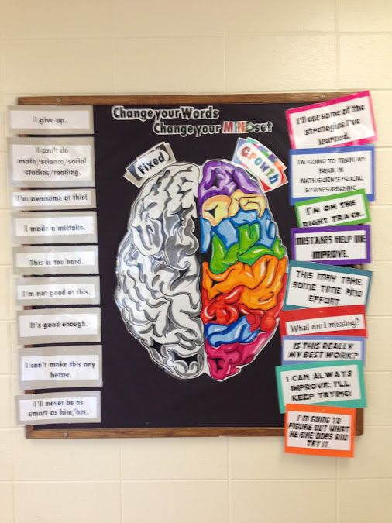

Growth Mindset

Slide 8
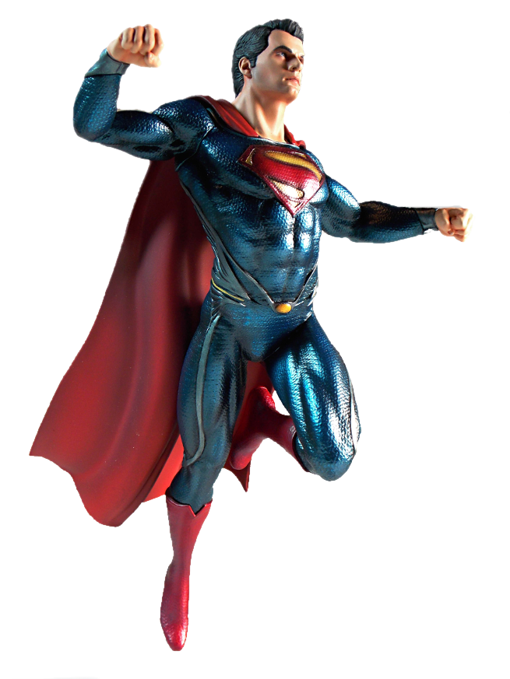


Be like Superman: Use your imagination. Be Curious.
Ask questions
Notice things
Look for patterns and connections
Ask, ‘What if..?’
Think of possible reasons
Conduct your own research and find out more

Slide 9
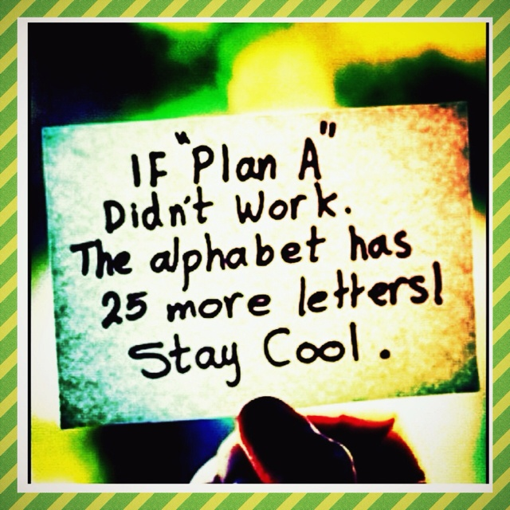

Slide 10

Talk Partners at Roebuck…
Face each other
Look at each other
Listen to one another
Challenge and support each other
Talk about the question
Take turns to speak
Share ideas
together
Prepare an answer
Notes:
10

Slide 11
Attendance & punctuality
We have high expectations of attendance and punctuality at Roebuck. We follow up on all absences as well as lateness to school.
As standard, NO holidays are permitted to be taken in school time. All unauthorised absences will be accrued .
Any absence below 96% will trigger intervention with the pastoral and attendance lead, Mrs Johnson.
As a school we do follow our school policy and will issue fines when benchmarks are triggered.
Descriptor | Attendance Level | Actual Attendance | Whole Days Absence | Hours of learning lost
Excellent | 100% | 190 days | 0 | 0
 | 99% | 188 days | 2 | 10
Good | 98% | 186 days | 4 | 20
 | 97% | 184 days | 6 | 30
 | 96% | 182.5 days | 7.5 | 37.5
Satisfactory | 95% | 180.5 days | 9.5 | 47.5
Cause for Concern | 90% | 171 days | 19 | 95

Slide 12
Differences between year 4 and year 5
More responsibility. E.g. jobs around the school.
Citizenship Award
Children are allowed to walk home on their own with written permission – a letter will be sent out this week, please complete and return to the school office ASAP so information can be collated ready for September.
Children have the opportunity to play on a wider range of school sports teams - e.g. football and netball. Also, lots of sports festivals for yr5/6 - e.g. cricket and basketball.
Phones – If brought in, will be locked away securely in teacher cupboard.

Slide 13
What will happen to ensure effective
transition:
Meet & Greet the teacher event.
Books events
Open door policy
Year group email address
y5@roebuck.herts.sch.uk

Slide 14
Uniform children are expected to come to school appropriately dressed in our school uniform.
School Uniform
Plain white or royal blue polo shirt).
Plain grey or black school tailored trousers/tailored shorts/skirt/pinafore
Roebuck Academy sweatshirt /cardigan or royal blue sweatshirt /cardigan
Roebuck Academy fleece.
Black school shoes or plain black trainers. Shoes must be flat – no open toes.
Hats with a brim for summer.
Wellington boots
Puddle suit
Winter coat – brighter the better
Hair bands and bows – must be royal blue, white or black
Please ensure you label all of your children’s uniform

Slide 15
Uniform Information children are expected to come to school appropriately dressed in our school uniform.
Please tie hair back at all times
No large bows – any hairbands or bows are to be either white, blue or black.
Simple studs to be worn – no other earrings permitted
Bag needed every day
Flat shoes – no heels or AstroTurf boots / shoes

Slide 16
PE Kit
White t-shirt with Roebuck Academy logo (or plain white t-shirt).
Royal blue shorts.
Plimsolls or trainers for outside games.

Slide 17
equipment
Your child will be provided with a pen, pencil and ruler
at the beginning of the year. You are welcome to add to
this and provide a sensible pencil case for your child to
store their equipment in their drawer.
Your child will be participating in various Art, Design
and Technology projects throughout the year. Please
provide your child with a named apron, alternatively a
large old shirt will do.

Slide 18
Physical environment
Working walls are there to support children with key vocabulary, steps to success and a sequence to learning.
WAGOLL (What A Good One Looks Like) and Plot Points are used
-Year 5 is about developing independence in their own learning, so the use of the working walls will be a key focus.
Reading corners aim to inspire children to want to read.

Slide 19
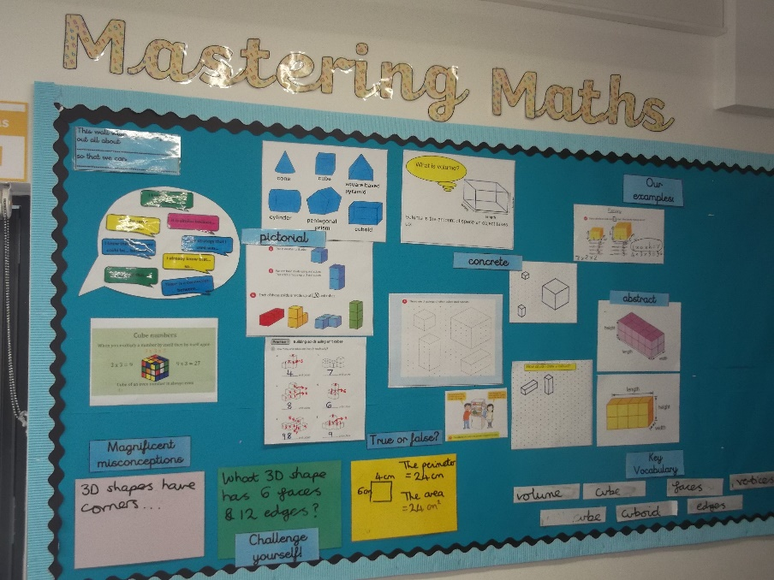
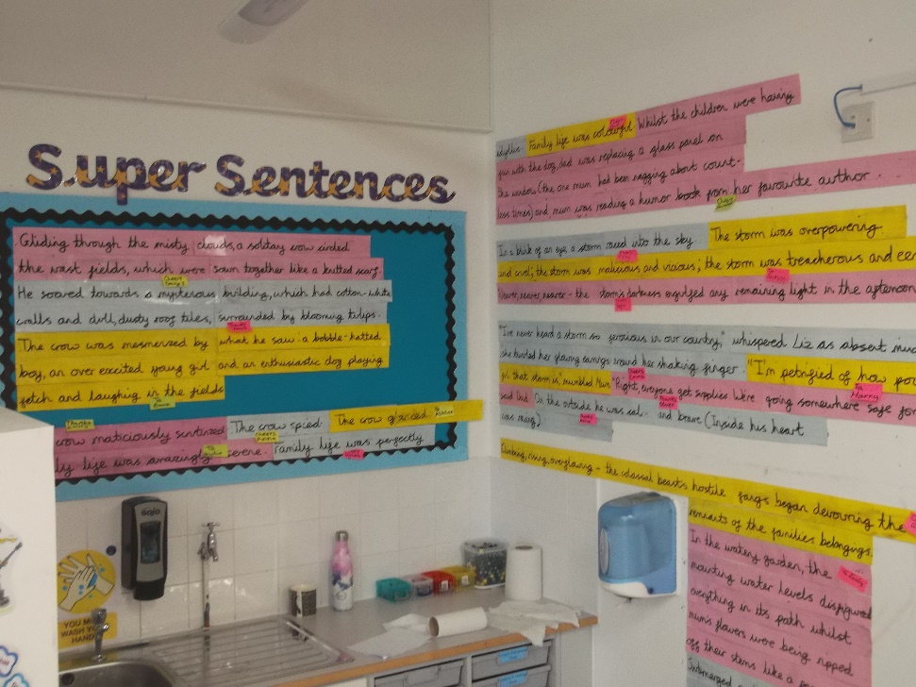
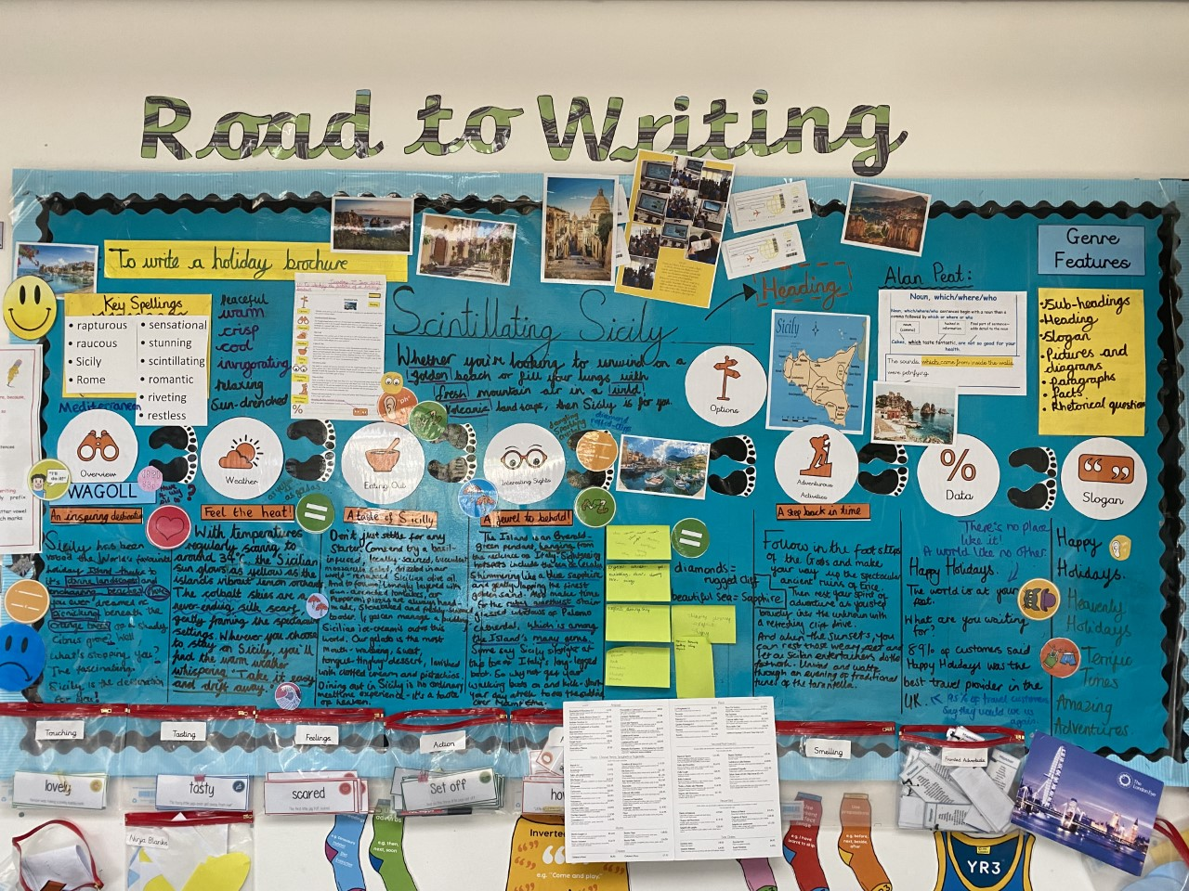

Physical environment

Slide 20
Emotional environment
PSHE lessons.
Whole school assemblies e.g. growth mindset
Transition morning
Meeting with current Year 4 teacher to discuss each child individually and their needs as well as strengths.
Zones of Regulation
Open door policy.
Email: Y5@roebuck.herts.sch.uk

Slide 21
Year 5 curriculum
To achieve working towards (WTS), age related (ARE) or Greater depth (GDS) children must meet objectives from the Teacher Assessment Framework.
Notes:
see hand outs
Making pancakes- using purple mash see James Mayhew book- jump into a picture

Slide 22


Reading
Although there is a heavy focus on reading comprehension,, promoting a love of reading is still the number one priority. The best way to get better at reading is to read!
We actively encourage reading throughout the school. This continues in Year 5. Reading buddies will continue each week where they are given the opportunity to nurture the enjoyment of reading in the younger generations.
Please can you continue to support your child’s enjoyment of reading at home by ensuring they continue to read at least 5 times a week for at least 20 minutes.
Reading record books are collected daily. This enables us to monitor their reading which feeds into a whole school weekly reading competition.
Once your child has completed a book, they will use the iPads to complete an accelerated reading quiz. You can monitor your own child’s progress by signing up to Home Connect.
http://www.roebuck.herts.sch.uk/page/?title=Accelerated+Reader&pid=99

Slide 23
Progression - Reading
Year 4
Notices key words and phrases used to convey passing of time to introduce paragraphs or chapters.
Year 5
Identifies examples of effective description that evoke time or place commenting both on word and sentence choice.

Slide 24


Slide 25
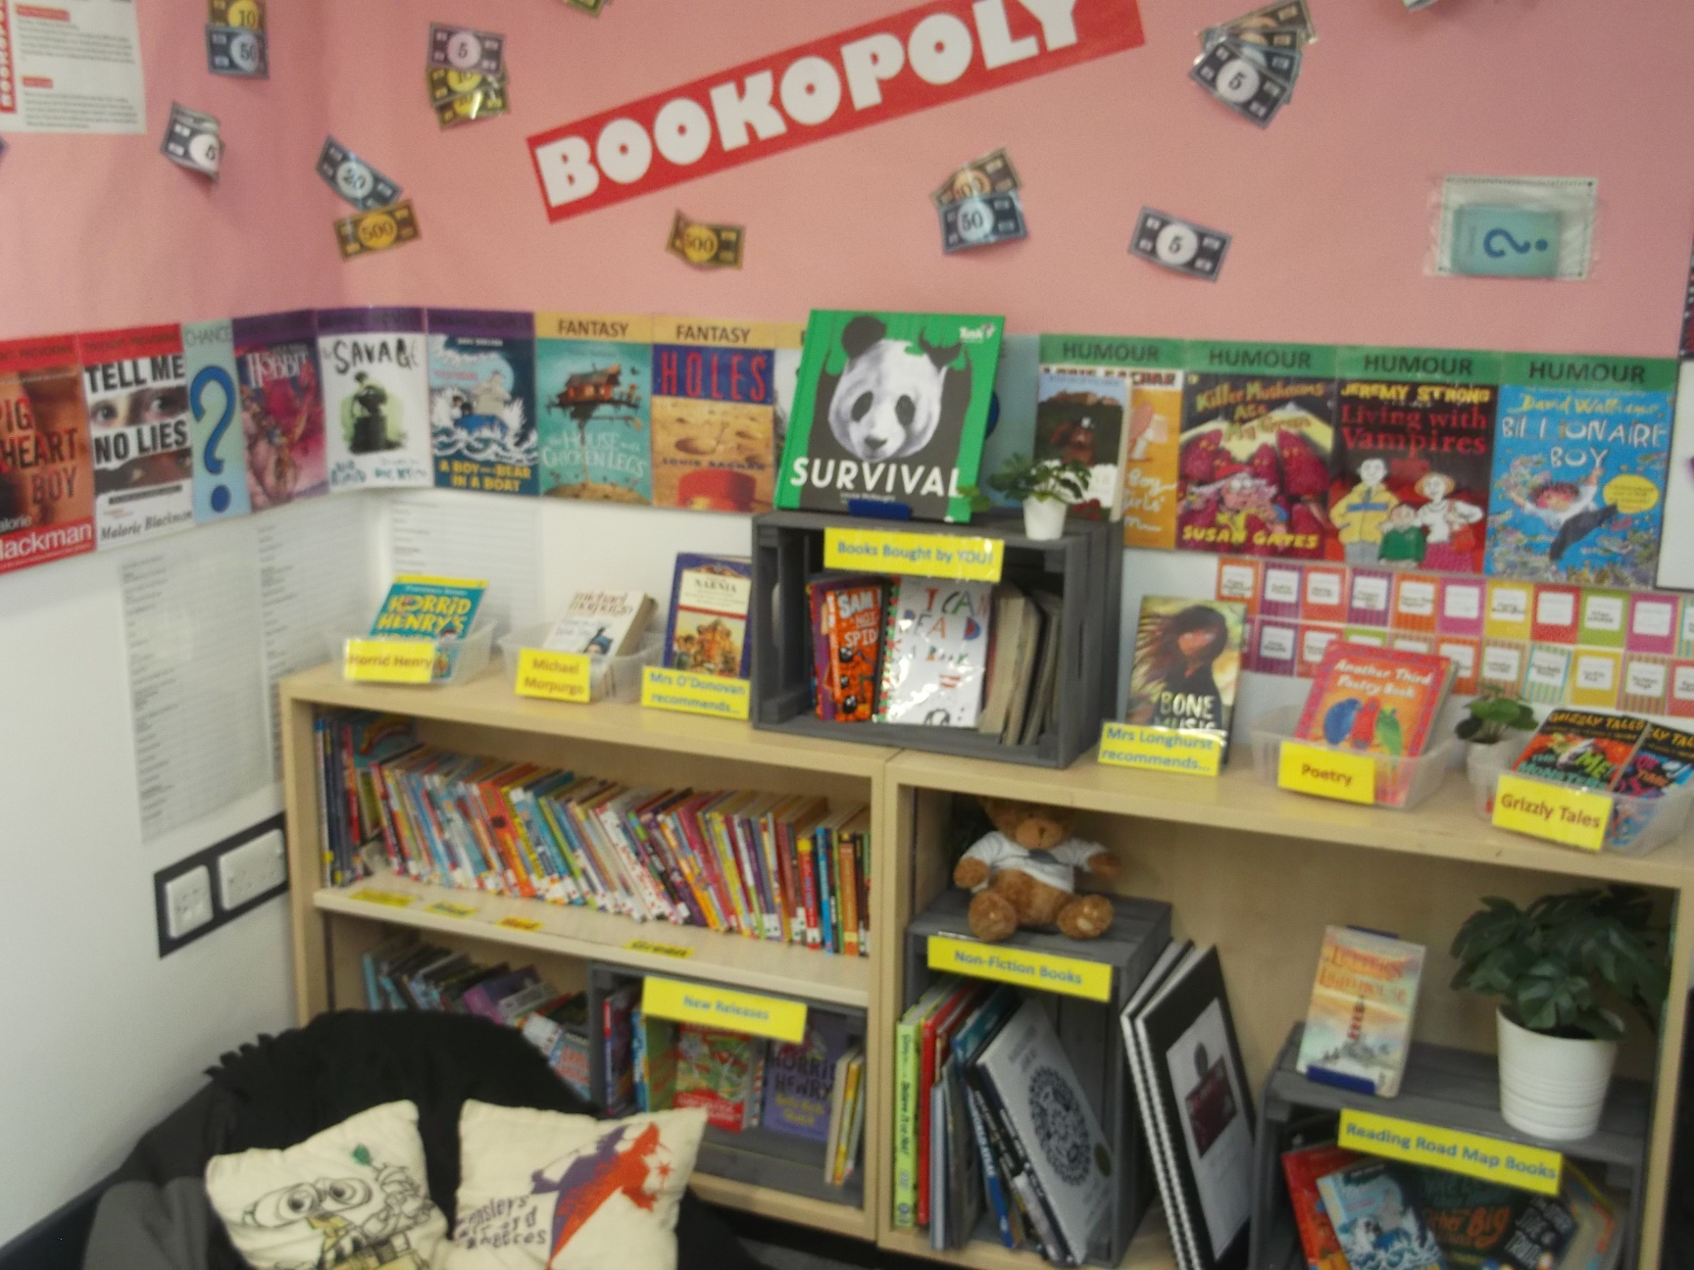
Reading Corner

Slide 26

Book Talk

Slide 27
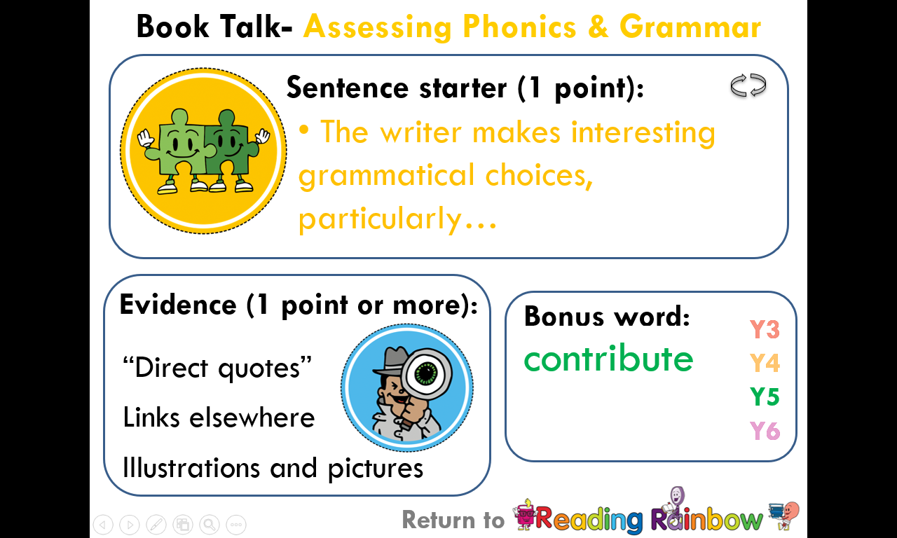
Book Talk

Slide 28
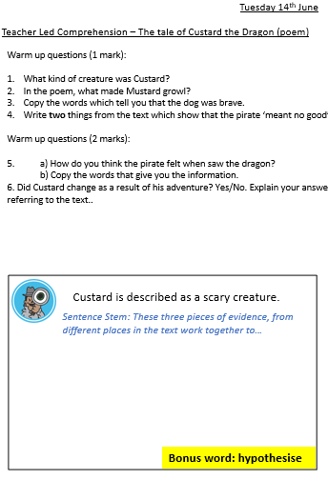

Slide 29
Essentials for Year 5…
As with ALL year groups, reading remains a KEY focus of the year. We shall encourage them to read a wider range of texts and those which will challenge reading and comprehension ability.
Children are expected to have their reading journal signed and
checked by parents / carers every evening.
We aim for a minimum of 5 reads a week – each session should be no shorter than 20 minutes with several pages read during this time.

Slide 30
How to Help your child at home…
Read with your child as often as possible,
discussing the book and making predictions
about what will happen next. Encourage your
child to read aloud to you, as well as hearing
you read to them. Encourage children to
explain the meaning of unfamiliar words and
language. Use a dictionary or thesaurus to
look up their word meanings.

Slide 31
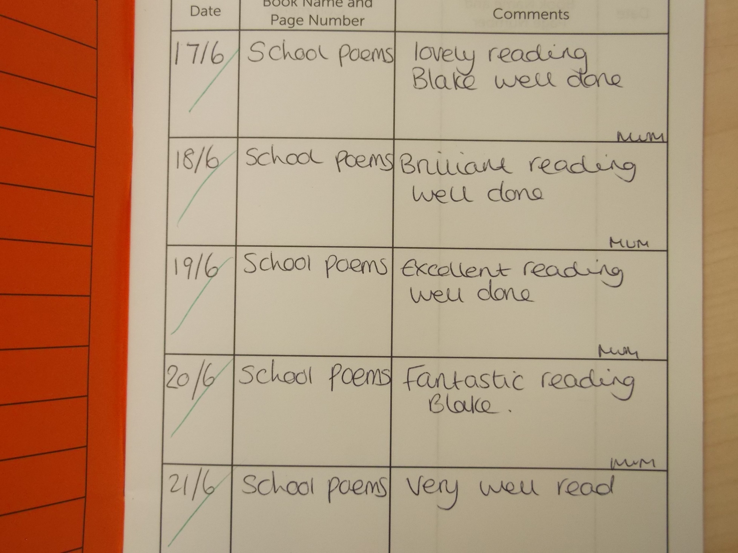
This is what a reading record entry should look like:

Slide 32
How else to Help your child at home…
Ensure that your child practises their spellings
at home every evening. Every child will have
a spelling journal that they will bring home
every evening.
Encourage your child to complete their
spelling every night throughout the week.
When writing at home encourage your child
to check their spelling, grammar and
punctuation. Their handwriting should also be
cursive and produced with a blue pen.

Slide 33
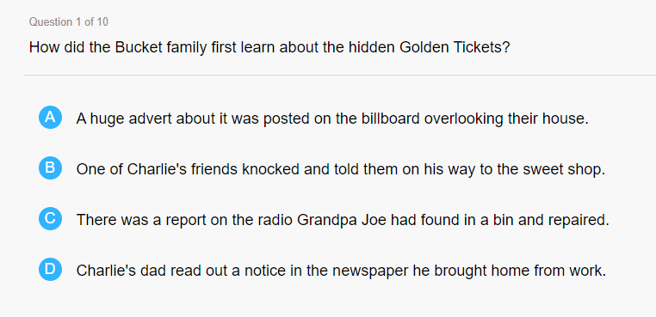
Accelerated Reader

Slide 34
Progression - Writing
Year 5
Uses devices (such as adverbials of time) to build cohesion within a paragraph
Year 4
Uses paragraphs to organise ideas
Year 4
Uses noun phrases expanded by the addition of modifying adjectives, nouns and preposition phrases
Year 5
Makes precise use of expanded noun phrases with modifiers before and after the noun
Year 4
Uses commas after fronted adverbials
Year 5
Places commas (mostly accurately) to clarify meaning and avoid ambiguity

Slide 35


Slide 36
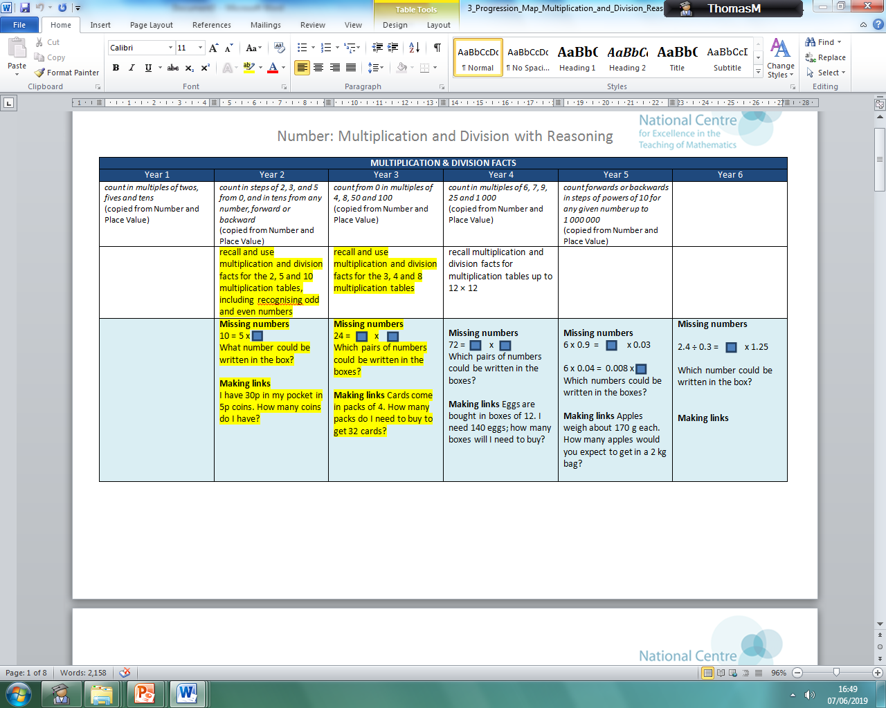
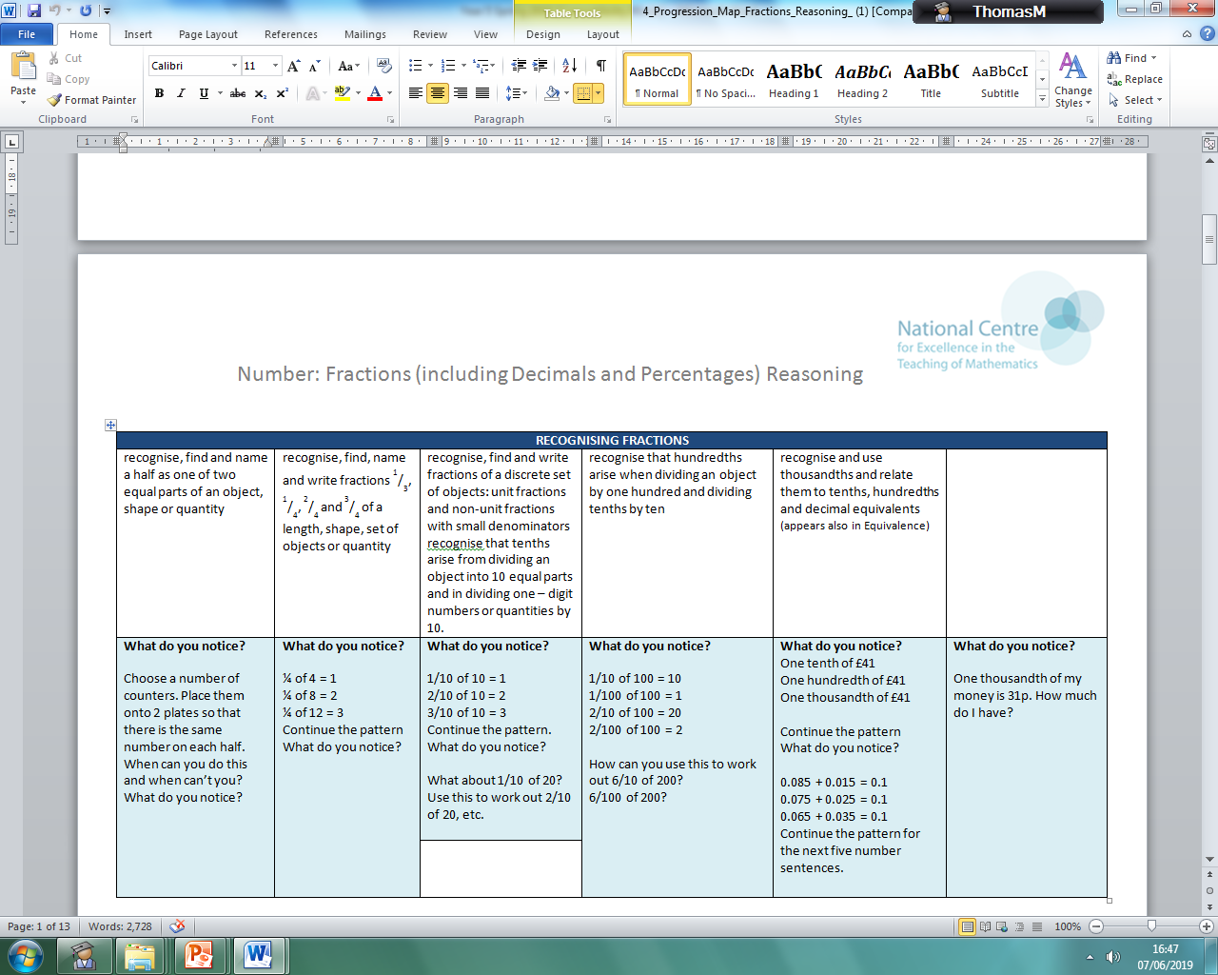
Progression - Maths
Times table knowledge is key!

Slide 37
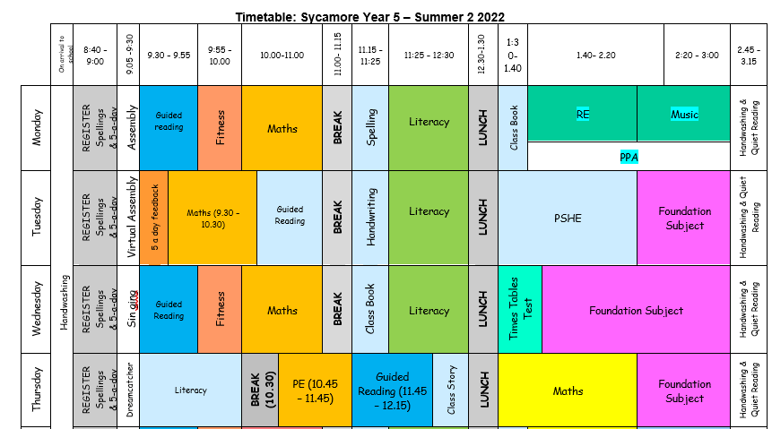
Typical timetable

Slide 38
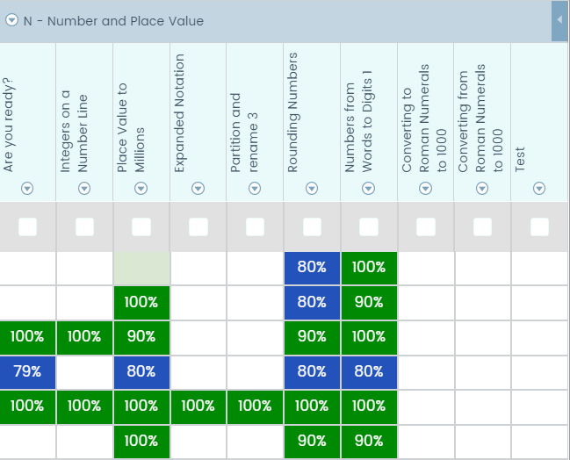
How to Help your child at home…
Mathletics and use of TT Rockstars:

Slide 39
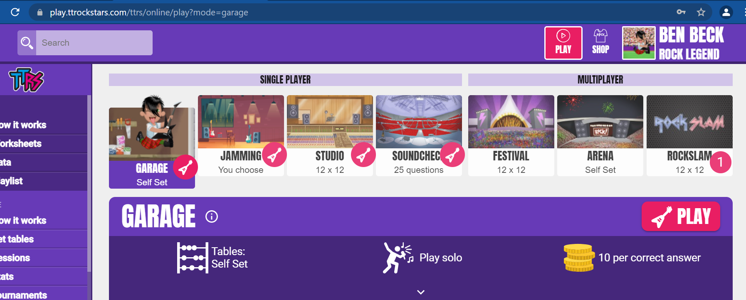
How to Help your child at home…
Mathletics and use of TT Rockstars:

Slide 40
How to Help your child at home…
Please monitor your child’s homework to
ensure that this is completed with care and
sufficient attention to detail this will continue to be set on Google Classroom.

Slide 41
How to Help your child at home…
HOMEWORK -daily
Spellings
Reading
TT Rockstars
HOMEWORK -weekly
Maths problem solving (google classroom)
Mathletics
HOMEWORK –half termly
Topic
Topic (half termly)

Slide 42
Website…
Roebuck School Website is your first port of
call for ALL communication
Policies
Letter Section
Admissions
Uniform
Blogs

Slide 43
Communication at roebuck…
Reminder:
Facebook
School Website
Flyers and Posters
Email
Text
Twitter
Open Door Policy

Slide 44
Roebuck is using Gateway for…
Online payments
Communication
Booking into workshops
Booking clubs
Booking into special events
Booking lunches (School Grid)

Slide 45
Collecting pupils from school
Drop off: Outside the classroom entrance.
Doors will open at 8:45am. Children are not
allowed into a classroom without a teacher.
Registration begins at 8:45am. Doors will be
closed at 9:00am. Anyone late will need to
register at the main office. Lessons begin at
9:00am sharp.
Collection: Blue slips need to be completed if somebody
different is picking up your child (only applies to those who are collected).

Slide 46
Safeguarding
Please update the office with names of
parents/guardians who are permitted to collect your
child.
Do not use mobile phones inside school or while on
school trips.
Children below the age of 13 should not have access
to any social media networking sites / platforms
Scooters and bikes to be walked into school and
placed in the cycle/scooter parks
We are a NUT FREE SCHOOL. Please ensure that no
items containing nuts are brought into school.

Slide 47
medical Information
Support your child:
Keep the school and class teacher up to date with new medical information
Ensure that your child’s asthma pump/inhaler, epipen or additional medicine is in date and with a good expiration life.
Ensure that all contact information; especially phone numbers are correct
Inform us if your child’s medical information or needs change
You will always be contacted if your child sustains any form of head injury – this includes minor bumps and knocks
Children will only be permitted to miss PE if they have a letter from a parent/carer

Slide 48
REMINDER: PACKED LUNCHES
Drink – no fizzy drinks or high-sugar content
No chocolate bars
No sweets
No products containing nuts

Slide 49
Facilities available to you…
Buccaneers Breakfast Club: 7:30 – 8:45am
Buccaneers After-School Club: 3:15-6:00pm
Pastoral Support Worker – Mrs Johnson
Bright Stars Holiday Club – Jess George
Rising Stars Holiday Sporting Days
Range of After-School Clubs

Slide 50
Pupil Questions?

Slide 51
Parent/Carer Questions?

