Slide 1







READING AT ROEBUCK
ACADEMY
Notes:
Year 2 and 6 provide parents with a copy of a SATs reading booklet and answer booklet to look at - have their children got this level of ability and stamina yet - other kids around the country have? what is it that is holding our kids back?

Slide 2




READING - WHY?
The Importance of Reading
Aim
Engaging with books helps children to be transported to other places and worlds.
We can become immersed in the lives of fictional characters or learn about the real world around us.
Our Aim is that all children will be able to read exceptionally well by the time that they are in Year 6.
The importance of reading for children cannot be underestimated.
Reading for pleasure can benefit a child's education, social and cognitive development, their wellbeing & mental health.
Notes:
Aim - hope that parents support this aim too! Competitive world we live in and other local schools will have exactly the same aim - our children can achieve and we want them to be capable of any career in the future - without reading this is not possible!

Slide 3
READING - THE KEY TO SUCCESS!
A child's Future / Current Academic Success, & Job Prospects are directly related to their reading proficiency.
Reading is a KEY Life Skill.
It is placed at the heart of Roebuck's Curriculum.
Texts have been planned and selected carefully to engage and interest our children.

Slide 4
READING - THE KEY TO SUCCESS!
‘Reading aloud to young children is one of the best activities to stimulate language and cognitive skills; it builds motivation, curiosity & memory.’
Reading supports self-esteem.
It supports the development of a wide range of language and vocabulary building.
Makes connections between the spoken and written words.

Slide 5
Children learn by listening to family members talk. Children who do not hear a lot of talk and who are not encouraged themselves to talk often have problems learning to read.

Slide 6
‘Research shows that the more words a parent/s uses when speaking to an 8 month old; the greater the size of the child’s vocabulary at the age of 3. This continues throughout life.’

Slide 7
READING - THE KEY TO SUCCESS!
Reading is linked to being financially stable in adulthood.
Children with higher reading ages at age 10 see the impact through their salaries 25 years later by a minimum of 25% more than someone with poorer reading skills.
The Importance of Reading...
Reading helps pupils to develop empathy for those around them.
Helps to make informed decisions about the world around them.
Reading is fundamental
in developing children
as thinkers and moving learning forward.

Slide 8




PARENTS IN PARTNERSHIP
WE NEED YOU!
It is crucial that parents and school work together to actively teach children to read. We cannot do this alone.
We need you to create a home environment where reading is encouraged and valued as part of normal life and routine.
We need you to demonstrate and model to your child that reading is a pleasurable experience.
Spending just 10-15 mins reading with your child every day is invaluable in developing their ability and desire to read and listen well.

Slide 9
‘The word gap is the attainment gap!’

Slide 10
SCHOOL ROUTINES
Your child will bring a reading book home everyday - this will be to improve decoding, fluency and confidence as a reader.
Your child will bring home a book that will be solely for the purpose of reading for pleasure and enjoyment.
Your child will be assessed regularly throughout the year - this will ensure that your child is provided with the correct levelled book to read in school and at home.
Notes:
What we do as a school…

Slide 11
SCHOOL ROUTINES
Your child will be reading everyday in school using the approach appropriate for their ability and key stage.
Your child will be exposed to a wide range of reading texts everyday - these will be in the class library, the whole school library and within their learning environment.
Notes:
Detail the approach – DSR/Hooked on books/Monster Phonics etc

Slide 12
PARENTS IN PARTNERSHIP
SUPPORTING YOUR CHILD...
Reading at home is invaluable - read at home at least five times a week.
Log your child's reading in their reading diary so that they can access school rewards.
Make reading time relaxed and pleasurable by finding a quiet, comfortable space and giving your child your undivided attention., (MUST TURN OFF THE TV!)
Ask your child simple questions as they read to check understanding.
Use positive language and praise their efforts.
Read to your child as part of their evening/bedtime routine. This builds vocabulary, feeds imagination and improves sleep patterns.

Slide 13
‘Children who grow up in homes where reading is valued do better in school and their future career/s ’

Slide 14
PARENTS IN PARTNERSHIP
SUPPORTING YOUR CHILD...
Ask your child about the examples of text around them - shop signs, maps, adverts etc
Ensure that when reading homework is set, that this is completed throughout the holidays.
Read at home yourself. Modelling reading is crucial. Your child will learn from you how important reading is.
Read a variety of texts including non-fiction. Ex:Newspaper, comics, annuals, story books etc
Show an interest in what your child is reading at school. Ask them!
Have books at home. Invest in a small library of books - charity shops are superb as well as the school and local library.

Slide 15
PHONICS
AT
ROEBUCK

Slide 16

-Daily phonic sessions continue to take place twice a day in Year 2
_ Any children that didn’t pass the phonics screening check at the end of year 1 are taking part in intervention groups and will be re-tested in June 2023

Slide 17
KS1 SATs
AT
ROEBUCK

Slide 18
‘Challenges’ are used throughout the year to identify any gaps in learning
Children’s work is Teacher assessed through the terms to ascertain an accurate level of attainment
Moderators will check all assessments and view children’s work to verify the teacher assessments

Slide 19
Reading -2 papers
Maths 2 papers -Arithmetic and reasoning
Writing task (all unaided writing looked at from across the year)

Slide 20
How can you help?
Use the SAT revision homework books
Regular attendance (one topic missed could have huge implications)
Draw pictures to help calculate (2 mark questions)
Regular reading and ask questions
Be mindful of talking about SATs!

Slide 21
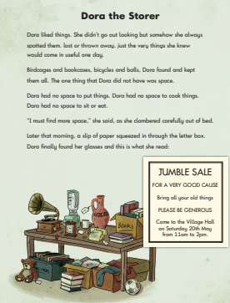
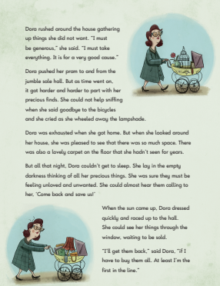
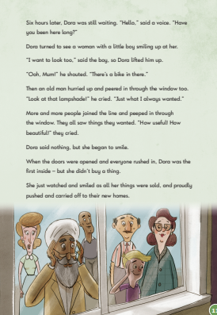
Example of Reading text

Slide 22
All previous SAT papers are online!!

Slide 23
YEAR 4
TABLES
CHECK AT
ROEBUCK

Slide 24
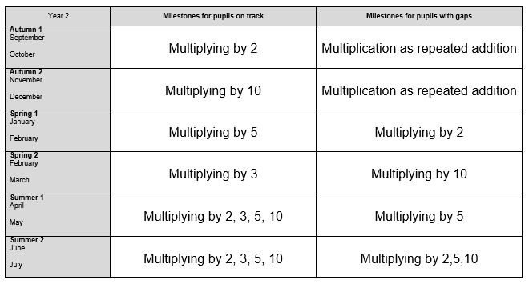
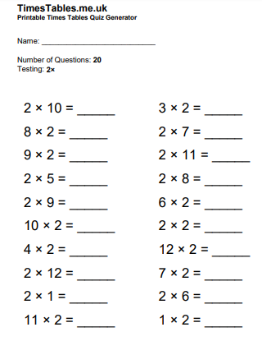
Times tables coverage
Timestable.me.uk

Slide 25
TTRockstars AT ROEBUCK
ACADEMY

Slide 26
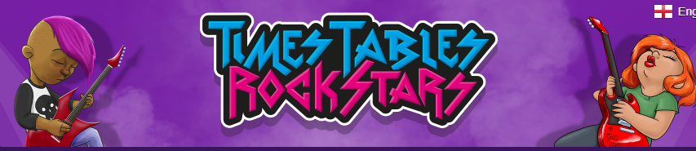
-Each child has a log-in
-Currently in Year 2 children are learning x2, x5 and x10
- Coins are accrued by the amount of games played
Weekly leaderboard, prizes and certificates for top 3 three spots
- Teachers check progress of each child weekly

Slide 27

Any
questions?

