Slide 1







YEAR 4
TABLES
CHECK AT
ROEBUCK

Slide 2





Who will take the test and when?
It will be taken by children in Year 4, in the summer term (June) for all English schools.

Slide 3
Primary –school children are expected to know ALL their times tables up to 12 x 12.
Under the current National Curriculum, children should know all their times tables by the end of Year 4.
This is now formally tested.

Slide 4
How will children be tested?
Children will be tested using an on-screen check, where they will have to answer multiplication questions against the clock. The test will last no longer than 5 minutes and their answer will be marked instantly.
Children will be given six seconds to answer each of the questions, with a three second blank gap between each question.
The questions will be randomly selected by the testing programme. The test’s software has been programmed to show children more questions from the 6, 7, 8, 9 and 12 times tables, as these are trickier times tables focused on more in Years 3 and 4.

Slide 5
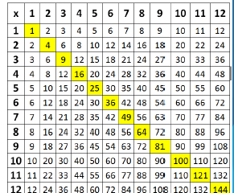
Learning times tables
This diagram shows all the multiplication facts that every child needs to commit to memory.
Children need to be able to recall any times tables answer within 2-3 seconds. This leaves no time for counting up to the answer. The answer has to ‘pop’ out of the memory fairly instantly.

Slide 6
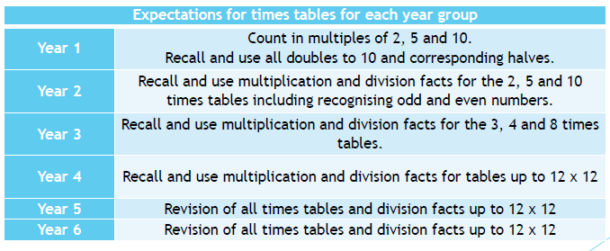
National Curriculum Expectations

Slide 7
Language and Times Tables
There are many different ways to say the tables and they’re all correct.
Children should be exposed to a range of language, for example;
Three times eight is…
Three multiplied by eight…
Three eights are…
Three lots of eight…
Three groups of eight…

Slide 8
Useful tips
Stick to one table at a time to minimise confusion
Start with chanting and writing them out slowly in order
Then move on to completing the answers quickly in order
Finally, move on to completing answers in any order
Keep reminding your child that 3 x 4 is the same as 4 x 3
Talk about numbers as you encounter them “5 x 7 = 35 that’s our house number “ – that makes more memory hooks.

Slide 9
Research shows that daily practise is the best strategy for children to learn these important facts. Short bursts of daily practise are much more effective than spending hours once a week.
Parental support is critical in this area. For children to be fully motivated and for them to get the best out of the practice, they need an adult's help. Without a parent's praise and reminders, without sitting down together or checking their work, practising times tables will not feel important.

Slide 10

​When it comes to times tables, speed AND accuracy are important – the more facts your child remembers, the easier it is for them to do harder calculations.
​
To be a Times Table Rock Star you need to answer any multiplication fact up to 12×12 in less than 3 seconds!

Slide 11
There are 2 Single Player modes:
Garage (main mode children should play)
The questions will only come from the times tables the teacher has set for the week. The Garage is best for getting quicker at a few facts.
Studio
The questions in the Studio can be anything from 1×1 up to 12×12. TT Rock Stars calculates the mean response time from their last 10 games in the Studio and translates that time into a Rock Status.
(If you don’t play in the Studio you don’t get a Rock Status.)
Soundcheck
When you play Soundcheck, you get 25 questions each with a 6-second time limit. The questions are multiplication only and evenly weighted in terms of difficulty each time you play.

Slide 12
Multiplayer
Rock Arena
The Arena allows players to compete against all other members of their Band/class (their Bandmates would need to join the same game in order to compete together).
Rock Festival
​The Rock Festival games are open to players from around the world. Like the Arena, there is no limit to the number of players who can join a game; however, unlike the Arena, questions are selected at random from 1×1 to 12×12.

Slide 13
Short bursts of daily practise are more effective than a long period once a week.
To make a success of this program and ensure your child remains motivated on their times tables your help is imperative. Without your praise and reminders, without you sitting down next to them or checking their work, practising times tables will not feel important to your child.

Slide 14
GAMES YOU CAN TRY AT HOME

Slide 15
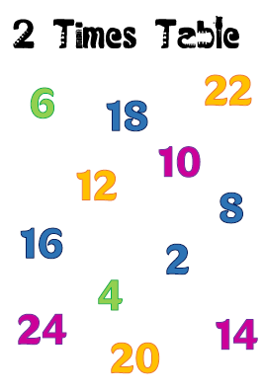
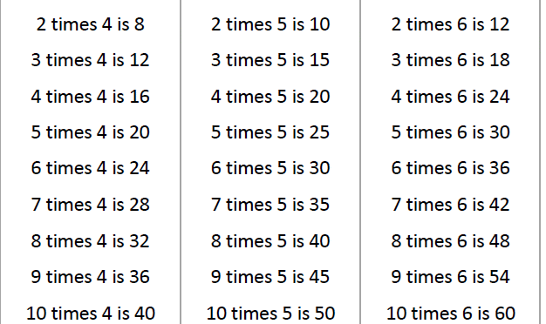
Scatter tables
Chanting & reciting

Slide 16
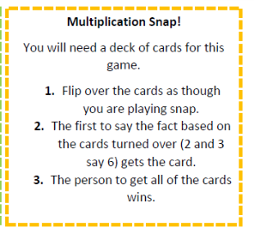
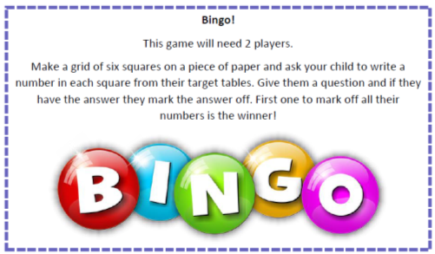

Slide 17
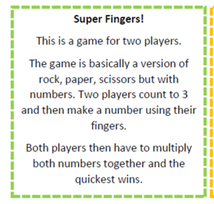
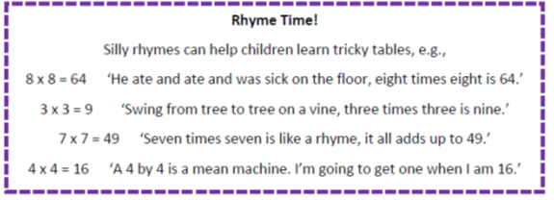

Slide 18
READING AT ROEBUCK
ACADEMY
Notes:
Year 2 and 6 provide parents with a copy of a SATs reading booklet and answer booklet to look at - have their children got this level of ability and stamina yet - other kids around the country have? what is it that is holding our kids back?

Slide 19



READING - WHY?
The Importance of Reading
Aim
Engaging with books helps children to be transported to other places and worlds.
We can become immersed in the lives of fictional characters or learn about the real world around us.
Our Aim is that all children will be able to read exceptionally well by the time that they are in Year 6.
The importance of reading for children cannot be underestimated.
Reading for pleasure can benefit a child's education, social and cognitive development, their wellbeing & mental health.
Notes:
Aim - hope that parents support this aim too! Competitive world we live in and other local schools will have exactly the same aim - our children can achieve and we want them to be capable of any career in the future - without reading this is not possible!

Slide 20
READING - THE KEY TO SUCCESS!
A child's Future / Current Academic Success, & Job Prospects are directly related to their reading proficiency.
Reading is a KEY Life Skill.
It is placed at the heart of Roebuck's Curriculum.
Texts have been planned and selected carefully to engage and interest our children.

Slide 21
READING - THE KEY TO SUCCESS!
‘Reading aloud to young children is one of the best activities to stimulate language and cognitive skills; it builds motivation, curiosity & memory.’
Reading supports self-esteem.
It supports the development of a wide range of language and vocabulary building.
Makes connections between the spoken and written words.

Slide 22
Children learn by listening to family members talk. Children who do not hear a lot of talk and who are not encouraged themselves to talk often have problems learning to read.

Slide 23
‘Research shows that the more words a parent/s uses when speaking to an 8 month old; the greater the size of the child’s vocabulary at the age of 3. This continues throughout life.’

Slide 24
READING - THE KEY TO SUCCESS!
Reading is linked to being financially stable in adulthood.
Children with higher reading ages at age 10 see the impact through their salaries 25 years later by a minimum of 25% more than someone with poorer reading skills.
The Importance of Reading...
Reading helps pupils to develop empathy for those around them.
Helps to make informed decisions about the world around them.
Reading is fundamental
in developing children
as thinkers and moving learning forward.

Slide 25
PARENTS IN PARTNERSHIP
WE NEED YOU!
It is crucial that parents and school work together to actively teach children to read. We cannot do this alone.
We need you to create a home environment where reading is encouraged and valued as part of normal life and routine.
We need you to demonstrate and model to your child that reading is a pleasurable experience.
Spending just 10-15 mins reading with your child every day is invaluable in developing their ability and desire to read and listen well.

Slide 26
‘The word gap is the attainment gap!’

Slide 27
SCHOOL ROUTINES
Your child will bring a reading book home everyday - this will be to improve decoding, fluency and confidence as a reader.
Your child will bring home a book that will be solely for the purpose of reading for pleasure and enjoyment.
Your child will be assessed regularly throughout the year - this will ensure that your child is provided with the correct levelled book to read in school and at home.
Notes:
What we do as a school…

Slide 28
SCHOOL ROUTINES
Your child will be reading everyday in school using the approach appropriate for their ability and key stage.
Your child will be exposed to a wide range of reading texts everyday - these will be in the class library, the whole school library and within their learning environment.
Notes:
Detail the approach – DSR/Hooked on books/Monster Phonics etc

Slide 29
PARENTS IN PARTNERSHIP
SUPPORTING YOUR CHILD...
Reading at home is invaluable - read at home at least five times a week.
Log your child's reading in their reading diary so that they can access school rewards.
Make reading time relaxed and pleasurable by finding a quiet, comfortable space and giving your child your undivided attention., (MUST TURN OFF THE TV!)
Ask your child simple questions as they read to check understanding.
Use positive language and praise their efforts.
Read to your child as part of their evening/bedtime routine. This builds vocabulary, feeds imagination and improves sleep patterns.

Slide 30
‘Children who grow up in homes where reading is valued do better in school and their future career/s ’

Slide 31
PARENTS IN PARTNERSHIP
SUPPORTING YOUR CHILD...
Ask your child about the examples of text around them - shop signs, maps, adverts etc
Ensure that when reading homework is set, that this is completed throughout the holidays.
Read at home yourself. Modelling reading is crucial. Your child will learn from you how important reading is.
Read a variety of texts including non-fiction. Ex:Newspaper, comics, annuals, story books etc
Show an interest in what your child is reading at school. Ask them!
Have books at home. Invest in a small library of books - charity shops are superb as well as the school and local library.

Slide 32
QUESTIONS…
If you have any questions related to anything that you have seen, please don’t hesitate to get in touch with Ms McAnuff or Mrs Jarman at Y4@roebuck.herts.sch.uk

