Slide 1

Year 3
Parent Workshop

Slide 2







READING AT ROEBUCK
ACADEMY
Notes:
Year 2 and 6 provide parents with a copy of a SATs reading booklet and answer booklet to look at - have their children got this level of ability and stamina yet - other kids around the country have? what is it that is holding our kids back?

Slide 3
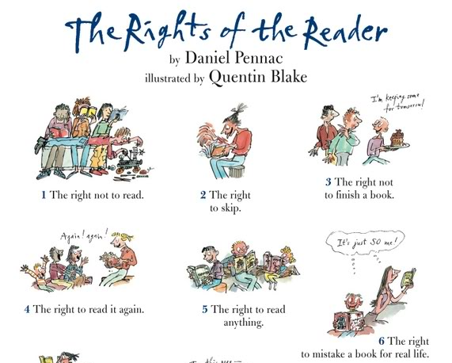

Slide 4
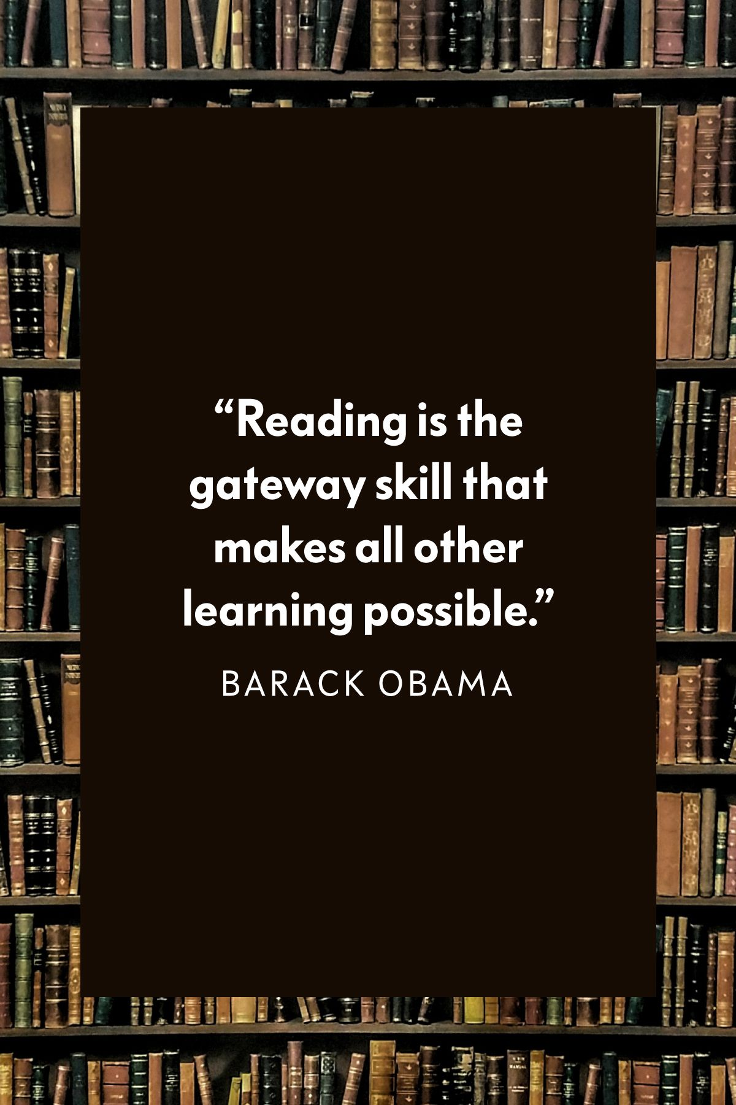
Why is reading so important?
Reading is so important because it feeds into all aspects of adult life for every individual. There isn’t a day that goes by where you don’t read!
Children with higher reading skills under the age of 10 see the impact through their salaries more than 25 years later.
A strong reader at age 10 would earn 21% more an hour at age 38 on average than someone from a similar background with poor reading skills.

Slide 5

School expectations of reading at home
Read 5 times or more a week (on different days). This should include some reading with an adult.
Reading record books signed and brought to school every day. Thursday is when we check the number of times they have read that week.
Many Key Stage Two classes like to compete! It is a huge celebration when a class reaches 100%!
Year 3 rewarded with extra time on the pirate ship on a Friday if they have read 5 times.
If your child is not enjoying their reading book, they do not need to finish the book- encourage them to change it.

Slide 6
‘The word gap is the attainment gap!’

Slide 7
Expectations of reading at school
Gradual Introduction Accelerated Reader
From KS2, all children will have access to Accelerated Reader.
They begin with a STAR test which assesses their reading understanding which then generates a number range. The children then can read any book within this range.
STAR tests are done every half term so we can monitor progress and adjust their number range.
Once children have finished their reading book, they can complete a book quiz on the iPad. We expect the children to get 80% or more for their quizzes. This shows a great understanding of what they have read.

Slide 8
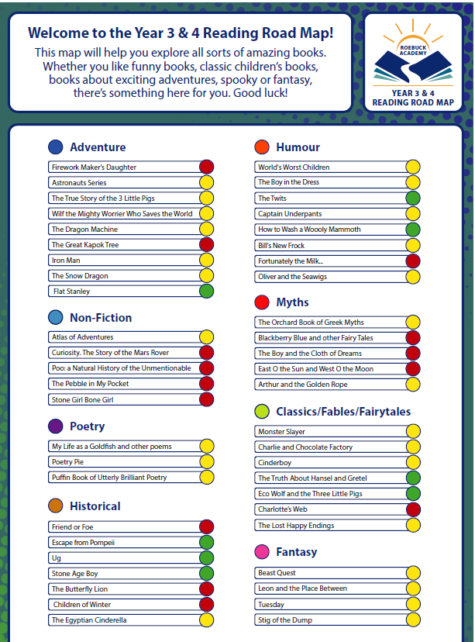
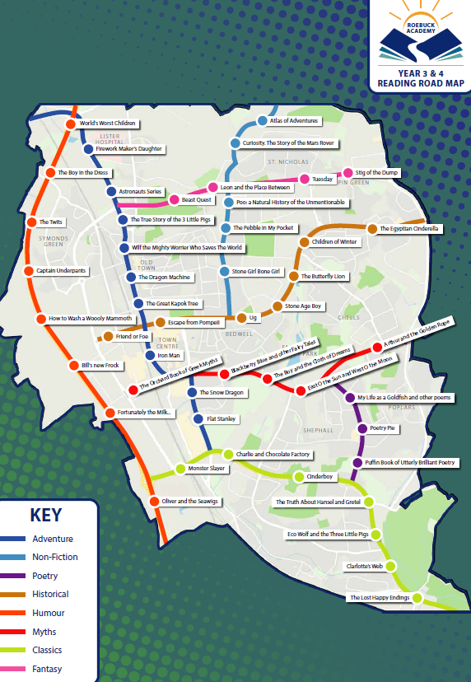
Reading Road Map
We also have a reading road map. This is a selection of different types of books that will benefit your children and will be celebrated if you finish the Road Map by the end of Year 4!

Slide 9

Reading for pleasure and enjoyment
As well as reading being a key life skill, it is equally important for children to develop a love for reading.
Some children may need support and modelling to help them recognise how much fun reading can be.
Ways to instil a love for reading:
Show your child that you love to read and enjoy books.
They do not have to read books. This can be in the form of comics, newspapers, recipes, magazines etc!
If your children prefers non-fiction, this is great too!

Slide 10
What does reading look like at home?
Taking it in turns to read.
Showing children how you can use expression to bring the text to life.
A quiet (ish) area so they can concentrate
To make sure you have each other’s attention
Allocate at least 10 minutes of dedicated time for reading together. This can become your special time!
Have fun with different voices!
MOST IMPORTANTLY- HAVE FUN!

Slide 11
Strategies to help at home
Sharing a book
Fastest fingers- Racing to find a key word the quickest.
‘Tell me’ Questions (next slide)
Re-read the sentence together.
Asking children what they have just read.
Reading the whole sentence to help with unknown words

Slide 12
Strategies
If your child is struggling with a word, encourage them to use their phonics knowledge to sound out the word.
For example
cheek

Slide 13
Tell me Questions
These are some questions that you could ask your children and discuss at home when reading together.
The whole book
Was there anything you liked about this book?
What especially caught your attention?
What would you have liked more of?
Was there anything you disliked about this book?

Slide 14
Tell me Questions (Please see website for more of these questions)
When you first saw this book, even before you read it, what kind of book did you think it was going to be?
What made you think this?
Now you’ve read it, is it as you expected?
Have you read other books like it?
How is this one the same?
How is it different ?
Have you read this book before? [If so:] Was it different this time?
What kind of person is _____________. Would you have reacted in the same way?

Slide 15
‘Children who grow up in homes where reading is valued do better in school and their future career/s ’

Slide 16
TIMES TABLES AT ROEBUCK ACADEMY
Notes:
Year 2 and 6 provide parents with a copy of a SATs reading booklet and answer booklet to look at - have their children got this level of ability and stamina yet - other kids around the country have? what is it that is holding our kids back?

Slide 17


Primary –school children are expected to know ALL their times tables up to 12 x 12.
Under the current National Curriculum, children should know all their times tables by the end of Year 4.
This will now be formally tested.

Slide 18
Research shows that daily practise is the best strategy for children to learn these important facts. Short bursts of daily practise are much more effective than spending hours once a week.
Parental support is critical in this area. For children to be fully motivated and for them to get the best out of the practice, they need an adult's help. Without a parent's praise and reminders, without sitting down together or checking their work, practising times tables will not feel important.

Slide 19


​When it comes to times tables, speed AND accuracy are important – the more facts your child remembers, the easier it is for them to do harder calculations.
​
To be a Times Table Rock Star you need to answer any multiplication fact up to 12×12 in less than 3 seconds!
Notes:
Times Table Rock Stars is a fun and challenging programme designed to help students master the times tables!

Slide 20
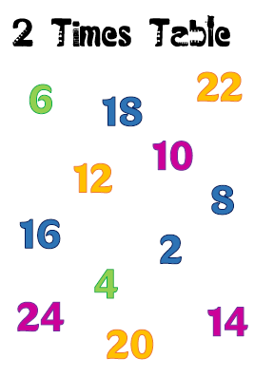
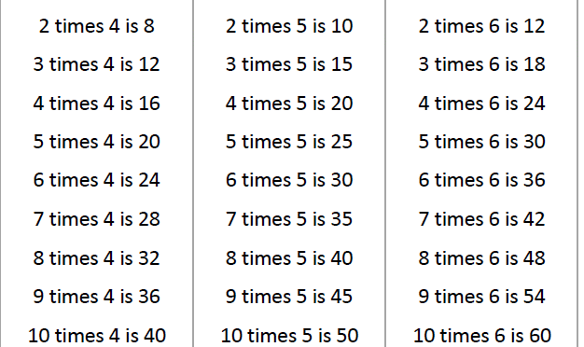
Scatter tables
Chanting & reciting
Notes:
Adult reads out a question and child points to an answer.
To use them, you call out a question from the times table you are focusing on and your child should point to the answer on the page. For example, if you are concentrating on the 5 times table, then find the Scatter Table for the 5s and call out questions like, “9 times 5” (your child points to 45), “6 times 5” (your child points to 30) or “5 times 12” (your child points to 60). Your child should be trying to get them correct each time and not worrying about the speed.

Slide 21

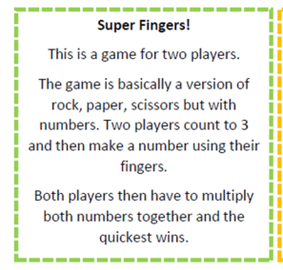
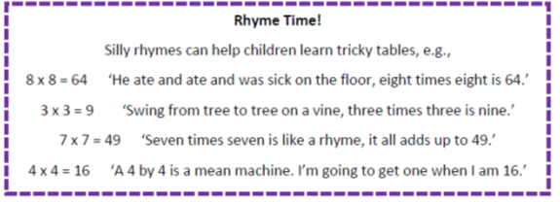
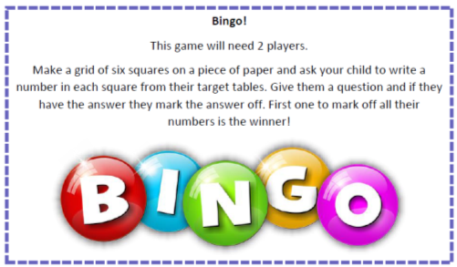
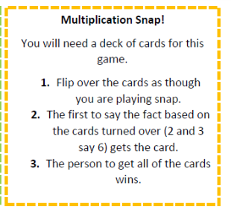
Games to try at home

Slide 22

Y3@roebuck.herts.sch.uk
@academy_roebuck

