Slide 1







Phonics and Reading
September 2022
Year 1
Mrs Renouf, Mrs Herbaut
and Mrs Hashemi

Slide 2
READING - WHY?
The Importance of Reading
Aim
Engaging with books helps children to be transported to other places and worlds.
We can become immersed in the lives of fictional characters or learn about the real world around us.
Our Aim is that all children will be able to read exceptionally well by the time that they are in Year 6.
The importance of reading for children cannot be underestimated.
Reading for pleasure can benefit a child's education, social and cognitive development, their wellbeing & mental health.
Notes:
Aim - hope that parents support this aim too! Competitive world we live in and other local schools will have exactly the same aim - our children can achieve and we want them to be capable of any career in the future - without reading this is not possible!

Slide 3
READING - THE KEY TO SUCCESS!
‘Reading aloud to young children is one of the best activities to stimulate language and cognitive skills; it builds motivation, curiosity & memory.’
Reading supports self-esteem.
It supports the development of a wide range of language and vocabulary building.
Makes connections between the spoken and written words.

Slide 4





Children learn by listening to family members talk. Children who do not hear a lot of talk and who are not encouraged themselves to talk often have problems learning to read.

Slide 5
‘Research shows that the more words a parent/s uses when speaking to an 8 month old; the greater the size of the child’s vocabulary at the age of 3. This continues throughout life.’

Slide 6
READING - THE KEY TO SUCCESS!
Reading is linked to being financially stable in adulthood.
Children with higher reading ages at age 10 see the impact through their salaries 25 years later by a minimum of 25% more than someone with poorer reading skills.
The Importance of Reading...
Reading helps pupils to develop empathy for those around them.
Helps to make informed decisions about the world around them.
Reading is fundamental
in developing children
as thinkers and moving learning forward.

Slide 7




PARENTS IN PARTNERSHIP
WE NEED YOU!
It is crucial that parents and school work together to actively teach children to read. We cannot do this alone.
We need you to create a home environment where reading is encouraged and valued as part of normal life and routine.
We need you to demonstrate and model to your child that reading is a pleasurable experience.
Spending just 10-15 mins reading with your child every day is invaluable in developing their ability and desire to read and listen well.

Slide 8
‘The word gap is the attainment gap!’

Slide 9
SCHOOL ROUTINES
Your child will bring a reading book home everyday - this will be to improve decoding, fluency and confidence as a reader.
Your child will bring home a book that will be solely for the purpose of reading for pleasure and enjoyment.
Your child will be assessed regularly throughout the year - this will ensure that your child is provided with the correct levelled book to read in school and at home.
Notes:
What we do as a school…

Slide 10
SCHOOL ROUTINES
Your child will be reading everyday in school using the approach appropriate for their ability and key stage.
Your child will be exposed to a wide range of reading texts everyday - these will be in the class library, the whole school library and within their learning environment.
Notes:
Detail the approach – DSR/Hooked on books/Monster Phonics etc

Slide 11
Daily Supported Reading
At Roebuck we use DSR (daily supported reading) to promote progression in reading.
The children are grouped by ability and work closely with an adult (up to groups of 6) to share a text each day.
The sessions last for 20 minutes and involves a mixture of being read to, reading, questioning and sentence structure activities.
The adult use assessment sheets to record any successes and targets for each child. These are shared with the class teachers and children are moved through the groups accordingly.

Slide 12
PARENTS IN PARTNERSHIP
SUPPORTING YOUR CHILD...
Reading at home is invaluable - read at home at least five times a week.
Log your child's reading in their reading diary so that they can access school rewards.
Make reading time relaxed and pleasurable by finding a quiet, comfortable space and giving your child your undivided attention., (MUST TURN OFF THE TV!)
Ask your child simple questions as they read to check understanding.
Use positive language and praise their efforts.
Read to your child as part of their evening/bedtime routine. This builds vocabulary, feeds imagination and improves sleep patterns.

Slide 13
‘Children who grow up in homes where reading is valued do better in school and their future career/s ’

Slide 14
PARENTS IN PARTNERSHIP
SUPPORTING YOUR CHILD...
Ask your child about the examples of text around them - shop signs, maps, adverts etc
Ensure that when reading homework is set, that this is completed throughout the holidays.
Read at home yourself. Modelling reading is crucial. Your child will learn from you how important reading is.
Read a variety of texts including non-fiction. Ex:Newspaper, comics, annuals, story books etc
Show an interest in what your child is reading at school. Ask them!
Have books at home. Invest in a small library of books - charity shops are superb as well as the school and local library.

Slide 15
PHONICS
AT
ROEBUCK

Slide 16
What is Phonics?
Phonics is taught in Early Years, KS1 and can continue into KS2
Phonics is taught twice a day in Year 1 at Roebuck
It helps your child to learn to read and write by learning the letters and sounds that make up the English language
It is taught through group teaching, one to one, independent and group activities, songs, rhymes and games.
Children are taught to spot spelling rules within words

Slide 17

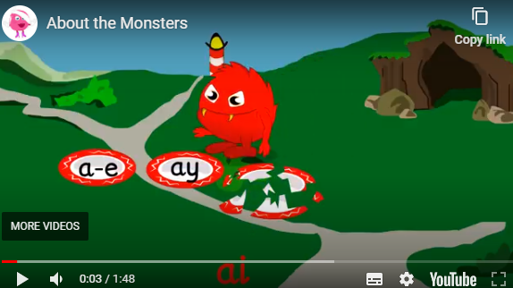
Monster Phonics
At Roebuck, we follow a scheme of work called Monster Phonics. It is a prescribed curriculum which gives daily targets and outcomes.
In Year 1, Monster phonics covers all of the sounds up to and including Phase 5.
The children meet lots of different ‘monsters’ which each represent a different sound.
This video shows an introduction to Monster Phonics
https://youtu.be/5u0N7LJIW0Q

Slide 18
Common Mistakes
Often children learn the letter names first and then find it difficult to segment words (for example children write Bcos as they have learnt the letter name for B)
Adding a uh sound
- Sounds must be pronounced properly. https://www.youtube.com/watch?v=BqhXUW_v-1s
Moving children on too quickly
American computer/iPad games

Slide 19
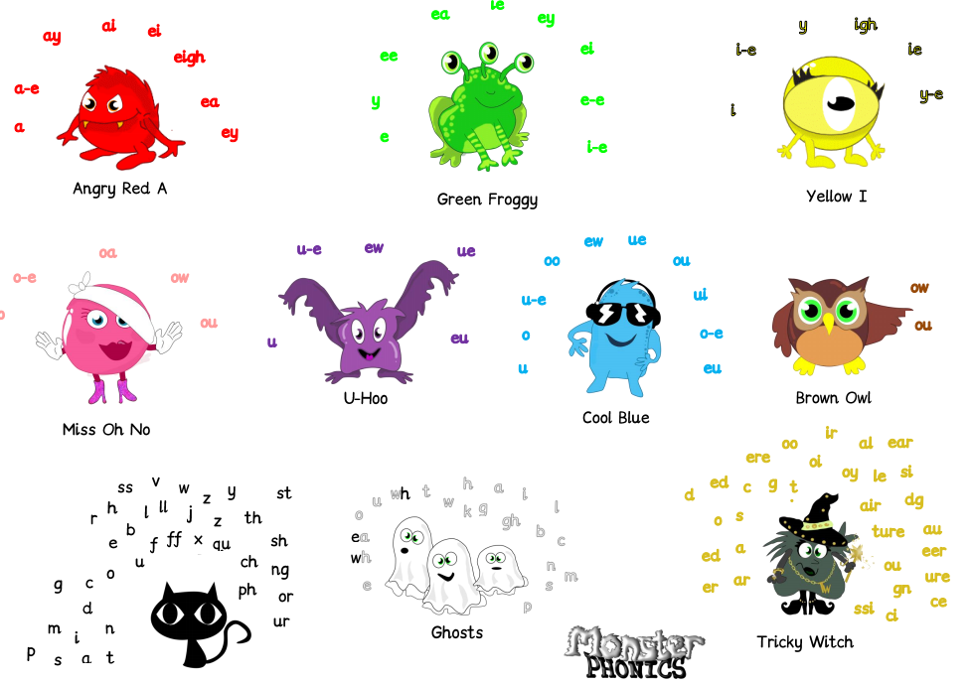
Monster phonics

Slide 20

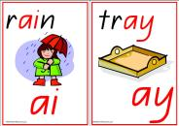

Phonics screening test
Why are the children being tested?
Every Year 1 child in the country will be taking the phonics screening check in the same week in June.
The aim of the check is to ensure that all children are able to read by the end of year two.
This ‘midpoint check’ will ensure that we have a clear understanding of what the children need to learn in year 2.
The children will complete the check one at a time in a quiet area of the school.
We practise this throughout the year so that the test format is familiar when the complete it in June.

Slide 21


Example

Slide 22
How is it marked?
The pass mark is set by the DFE and the children will receive either a pass or fail only.
Children who fail to meet the threshold in year 1 will retake the test in year 2
The pass mark for the previous years has been 32/40.
If the children blend incorrectly or not at all then the answer will be marked as incorrect even if they have segmented correctly.
Children must not add sounds or plurals to the word
Children must not pause when blending
A child’s accent, dialect or speech difficulty will be taken into account.
Children will not be told if they are correct or incorrect and we cannot ask them to try again

Slide 23
What do we do with the results?
Children who do not meet the pass mark will be supported in year two to help them further with their phonics.
The results often highlight common difficulties or problem graphemes that teachers can spend further time exploring and practising with the children.
You will receive the results with the end of year reports.

Slide 24
Is there anything I can do at home?
When spelling, encourage your child to think about what “looks right”.
Have fun trying out different options…wipe clean whiteboards are good for trying out spellings.
tray trai rain rayn
boil boyl boy boi
throat throwt snow snoa
Read stories
Use puppets and toys
Play ‘I spy’
Continue to play with magnetic letters, using some two-grapheme (letter) combinations, eg: r-ai-n = rain blending for reading rain = r-ai-n segmenting for spelling
Praise your child for trying out words
Practice tricky words
Create phonic games with a timer
Play pairs
Phonics Play
https://www.phonicsplay.co.uk/resources/phase/2/buried-treasure

Slide 25
Remember the most important thing is to have fun. If children see you enjoying reading, they will to.

