Slide 1







PHONICS AT
ROEBUCK

Slide 2

PHUN with Phonics!

Slide 3

What is a phoneme?
It’s a unit of sound.
How many sounds in cat?
c a t

Slide 4
How often do we teach it?
We teach phonics EVERY DAY!
We enjoy phase 1 activities throughout the year – rhyming, I spy, listening games
Phase 2 – 19 phonemes
Phase 3 – 26 phonemes
Phase 4 – ccvc and cvcc words
Phase 5a – 16 phonemes

Slide 5

How do we teach it?
Learning through actions, pictures, stories and sounds.

Slide 6
The first sounds…
We teach the sounds not the letter names.
The first set of sounds we teach are:
s a t p i n

Slide 7
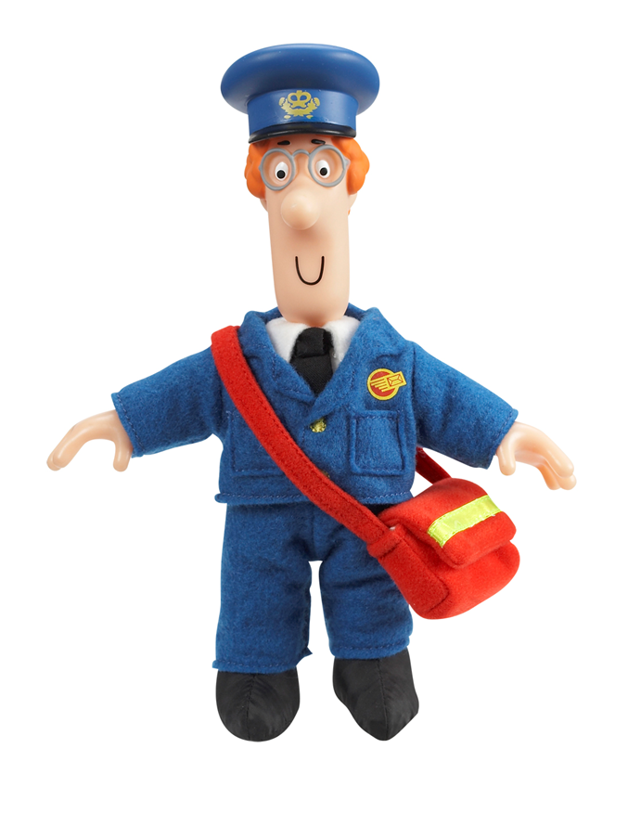

Making words
Once children know these sounds we can start making words.
sat
pin
nip
sit
pit
pat

Slide 8
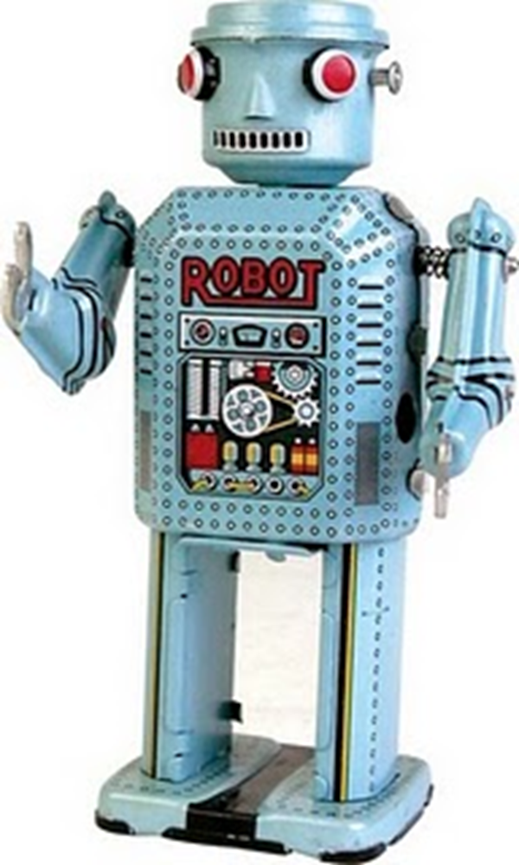
Robot talk

Slide 9
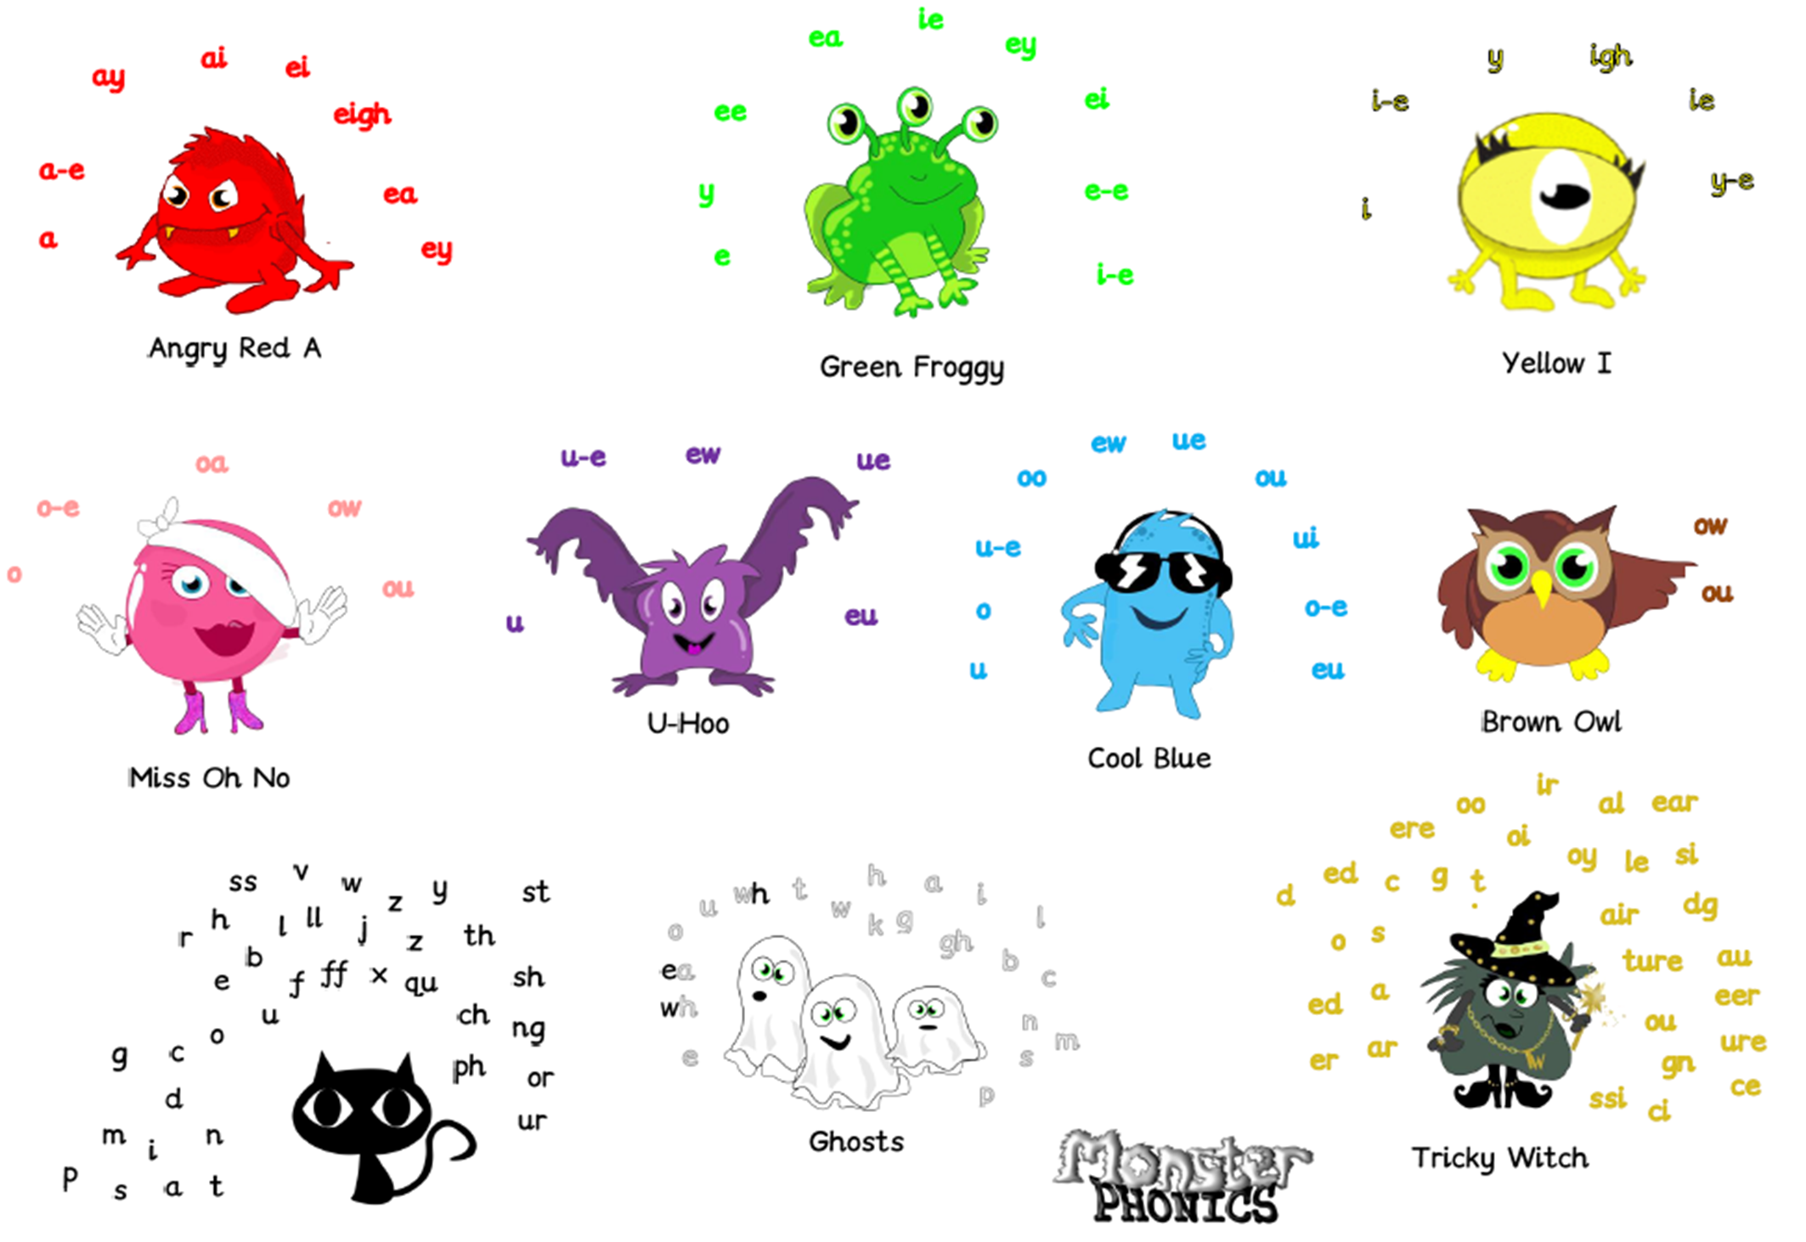

Slide 10



Phonics at home
https://www.youtube.com/watch?v=vMEvxTGvi4c&list=PLqh11DN6jmbCsIPschffPaxvCdS9d6qPN
Mr Thorne

Slide 11
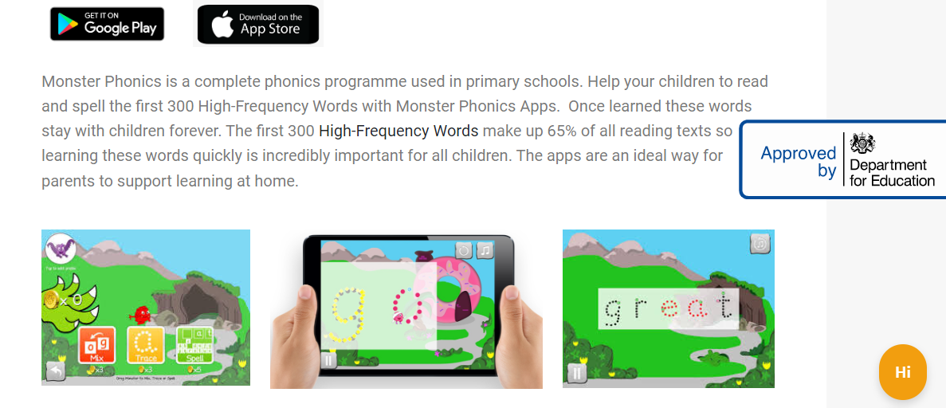
Monster Phonics App

Slide 12
Where it gets a bit tricky
There are 42 phonemes to teach in total.
Some of these phonemes are made up of more than one letter including…
ai as in rain
oa as in boat
sh as in shop
These are called diagraphs – 2 letters that make 1 sound

Slide 13
Now it gets even trickier…
Tricky words are words that can’t be sounded out – however with the colour coding in Monster Phonics the number of ‘tricky words’ is greatly reduced.
the go no I he me she we
We will be sending home words along with the sounds taught each week in your child’s reading record book. Please look at them with your child. The more that they are exposed to these words, the easier they will find it to read and write

Slide 14
Monster Phonics books
Each week your child will be issued with a Monster Phonics Book
These books are fully decodable and matched to your child’s phonics ability.
These books will begin to be issued this week.
Your child needs to know the first set of sounds and be able to blend and segment before a book is issued.
Please keep your child’s book in a plastic wallet and care for the books.

Slide 15
Writing phonetically…
The teecha can hlp the childurn to rIt.
Yoo can hellp too
Fank yoo for cumng hear

Slide 16
Thank you!!
Thank you for coming to this workshop
We want to work together to provide the best learning for your child.
Questions?

