Slide 1

Year n to year R transition Meeting for parents
Mrs Hnatiuk Miss Hyde
Notes:
Hello, this is the normal transition powerpoint we would share with you at this time of year. Hopefully as we go along any questions you have may be answered.

Slide 2

Teaching staff
Mrs Hnatiuk– Oak
Miss Hyde - Willow

Slide 3
What will we do to support transition?
We have sent home transition information.
We will be adding all new children and parents to Tapestry. Over the school holiday class teachers will upload videos of themselves reading a story.
We will contact all your child’s current setting.
We will visit any children new to our setting either in your home or at their current nursery.
All children will be invited to attend a transition morning on Thursday 13th July
All children and parents are invited to attend a Teddy Bears’ picnic on Monday 17th July.

Slide 4
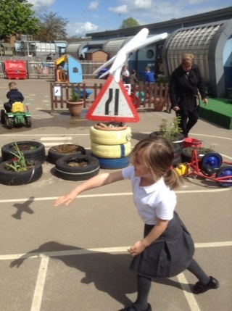
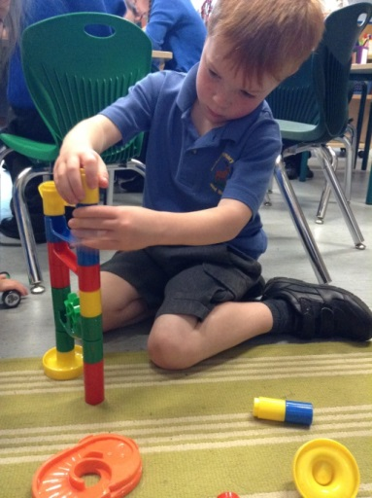
EYFS Curriculum
3 PRIME AREAS
1. Personal, Social and Emotional Development
2. Communication and Language
3. Physical Development
These are crucial for developing children's curiosity and enthusiasm for learning.
4 SPECIFIC AREAS
4. Literacy;
5. Mathematics;
6. Understanding the world;
7. Expressive arts and design
Notes:
This just gives you a general idea of the Early Years curriculum……

Slide 5
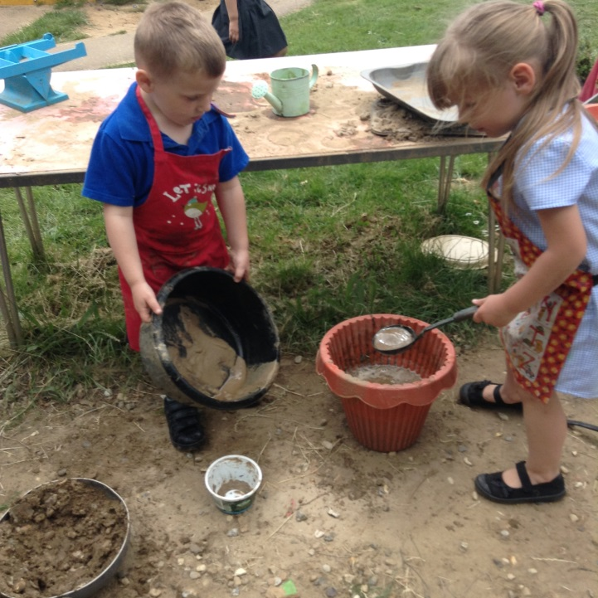
A typical day in our Foundation Class…
Busy Fingers
Dough Disco –
Phonics
Literacy – reading and writing
Maths
Jigsaw weekly
Child Initiated learning
Topic based activities
PE/Dance weekly
Outside Learning
Forest School
Notes:
This just outlines a typical day in reception.

Slide 6

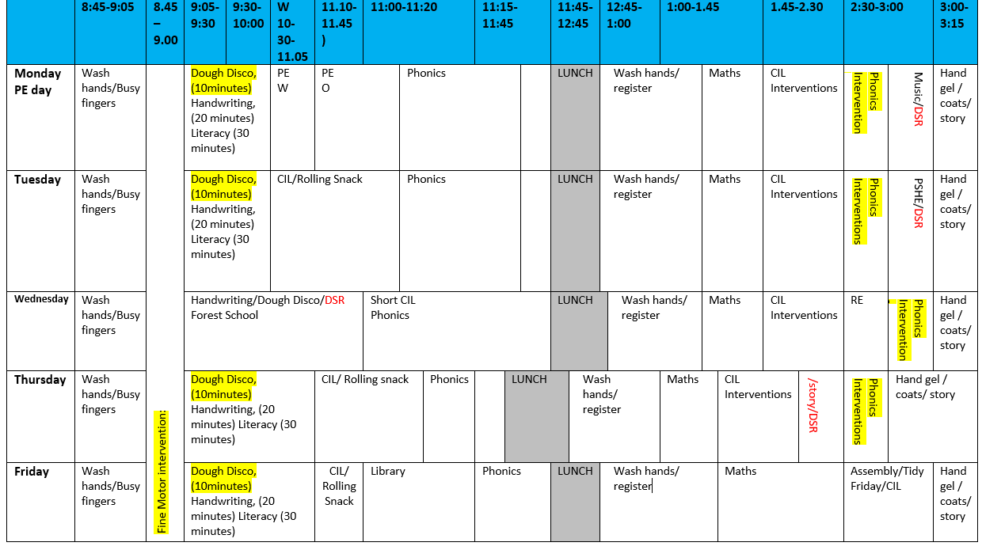
Typical timetable
Notes:
This is what our timetable usually looks like, it can be subject to change.

Slide 7


Reception Topics
Stomp
Animal Kingdom
Let’s Explore
Delicious
French
Splash
Marvellous Me!
Notes:
Each half term we focus on a new topic. These are our current topics. We sometimes like to finish each topic with a ‘Fantastic Finish’ where you will be invited into school for a celebration event.

Slide 8
Online Learning journal
In EYFS, we communicate with you about your child’s learning via an online journal called Tapestry.
What is Tapestry?
Tapestry is an on-line system which allows us to create an individual Learning journey for every child in EYFS.
Advantage for parents
Parents have access 24/7 to their child’s Learning Journey and can comment on the observations added by school staff.
Parents can add their own observations to share progress and milestones achieved at home.
Notes:
This slide explains about Tapestry which we use for our online learning journal. We regularly add observations to show what your child has been learning in school. We encourage this to be an interactive tool, where you can comment and also add any observations of activities and learning your child has done at home.
If you encounter any problems with tapestry please just speak to your class teacher.

Slide 9



Be like Superman: I ask questions.
Ask questions
Notice things
Look for patterns and connections
Ask, ‘What if..?’
Think of possible reasons
Conduct your own research and find out more
Notes:
At Roebuck Academy, growth mindset is an important part of our culture. Each week we focus on a different superhero who has unique growth mindset qualities. For example when we go on our first learning walk around the school we need to be like superman and talk about the things we notice.

Slide 10

Talk Partners at Roebuck…
Face each other
Look at each other
Listen to one another
Challenge and support each other
Talk about the question
Take turns to speak
Share ideas
together
Prepare an answer
Notes:
As part of our learning process children are encouraged to talk with each other to share ideas and solve problems. Talk partners encourages every child to be heard and contribute.
10

Slide 11
School expectations
Reading – you are expected to listen to your child read five times a week and write a comment in their reading journal each time they read the book.
Book bags, reading books and reading records need to be in school every day
Your child needs a named PE bag with named clothes inside
Please do not attach keyrings onto your child’s bookbag.
Doors open at 8.45 am . Our learning starts at 8.45 am
All children must be in school before 9 am.
Book your child’s lunch online before coming to school. This is done via school grid.
Please do not bring any toys into school
Notes:
Reading is crucial to children’s development of language and love of books. The teaching of reading is one of the school’s key priorities. You are expected to listen to your child read at home, 5 times a week. We ask that you log this in their reading record which then contributes to the schools weekly reading challenge. We both very competitive and every reading log counts.
Your child will need a book bag as we do send home work as well as any drawings they do in school. We also ask that the reading book and reading records are kept in the bag and brought into school every day.
Classroom doors are open from 8:45am and we require all children to be in school by 9am. If you are running late you will need to take your child to the school office and not the classroom door.
We will update you with the arrival and collection procedures as soon as we are given further government guidance.
Current government guidelines stipulates that visitors to the school including parents are not allowed into the building. If you feel your child will have issues separating from you at the classroom please let us know.
You should have received some information about School Grid, this is the website where you can order your child’s lunch. You have the option to do it daily or you can book them all in advance. Please make sure you register if you haven’t already done so.

Slide 12
Attendance & punctuality
We have high expectations of attendance and punctuality at Roebuck. We follow up on all absences as well as lateness to school.
As standard NO holidays are permitted to be taken in school time. All unauthorised absences will be accrued .
Any absence below 96%percent will trigger intervention with the pastoral and attendance lead, Mrs Johnson.
As a school we do follow our school policy and will issue fines when benchmarks are triggered.
Descriptor | Attendance Level | Actual Attendance | Whole Days Absence | Hours of learning lost
Excellent | 100% | 190 days | 0 | 0
 | 99% | 188 days | 2 | 10
Good | 98% | 186 days | 4 | 20
 | 97% | 184 days | 6 | 30
 | 96% | 182.5 days | 7.5 | 37.5
Satisfactory | 95% | 180.5 days | 9.5 | 47.5
Cause for Concern | 90% | 171 days | 19 | 95
Notes:
Just read slide.

Slide 13


Reading
Promoting a love of reading is the number one priority.
The best way to get better at reading is to read!
We will be running a phonics and reading workshop later in September
We actively encourage reading throughout the school.
Please can you continue to support your child’s enjoyment of reading at home by ensuring they continue to read at least 5 times a week.
Each child will have two books to take home one for reading for pleasure and one for decoding, once the children have settled in.
You will need to sign the reading record every time you read with your child.
Every class has an interacting and inviting book corner with a range of different books to read.

Slide 14
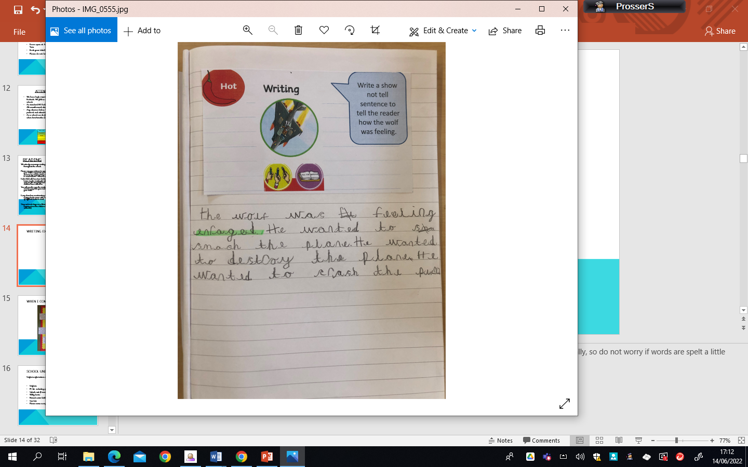
Writing expectations
Notes:
This is an example of a typical reception child’s writing by the end of the year. In reception children are taught to spell words phonetically, so do not worry if words are spelt a little different.

Slide 15
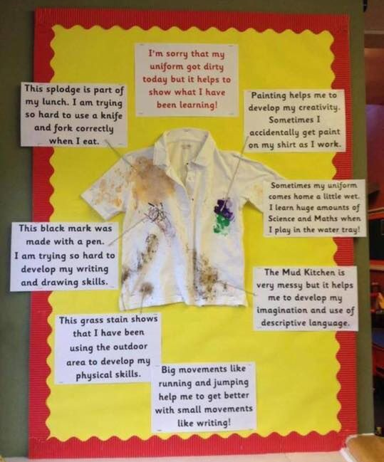
When I come home messy…
Notes:
In reception our learning is all cross curricular and means that we engage is a wide variety of activities which sometimes results in us getting messy. Of we are messy we know we have had a great day! We use child friendly paints and pens and they should all wash out easily with a bit of stain remover.

Slide 16


School Uniform
Uniform information can be found in your pack
Uniform-Samples can be viewed after the meeting
PE kit including plimsolls
Splash suit (Essesntial)
Welly boots
Named water bottle-Water only please
Sun hat
Please name everything!

Slide 17

Uniform Information children are expected to come to school appropriately dressed in our school uniform.
Please tie hair back at all times
No large bows – any hairbands or bows are to be either white, blue or black
Simple studs to be worn – no other earrings permitted
Flat shoes – no heels or astroTurf
boots
Plain Black Trainers
Notes:
Read slide.

Slide 18
How to Help your child
Independence!

Slide 19
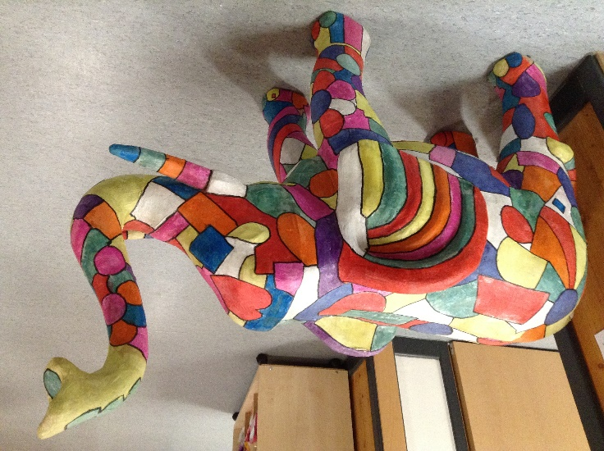
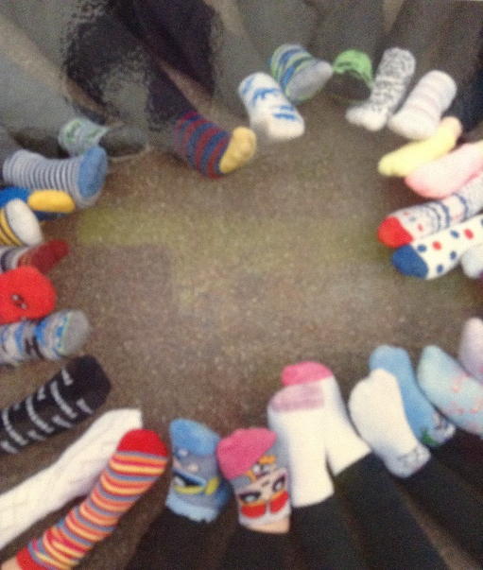
Emotional environment
PSHE lessons with strong focus on wellbeing.
Year group assembly e.g. growth mind set and celebrations.
House Teams.
Nurturing team.
Pastoral/Attendance– Mrs Johnson
Notes:
This year we realise more than ever the importance of emotional wellbeing for the children. In September our PSHE lessons will all be focussed on supporting children after this unique situation we have been through.
We also do weekly assemblies, where we celebrate birthdays, star of the week and any other good news.
On entry to Roebuck Academy your child will be placed in one of our four house teams. If they already have a sibling at the school they will be in the same team.
Mrs Johnson is our Pastoral and Attendance Officer and is here to help you with any worries or concerns you have that you feel may affect your child’s wellbeing at school.

Slide 20
Website…
Roebuck School Website is your first port of call for ALL communication
Policies
Letter Section
Admissions
Uniform
Blogs
Twitter-please follow us
Please consider joining the RSA (PTA)
Notes:
Read Slide

Slide 21

Roebuck uses Gateway for…
Online payments
Communication
Booking into workshops
Booking clubs
Booking into special events
Notes:
Read the slide. The staff in the school office are the best people to answer questions about the above.

Slide 22
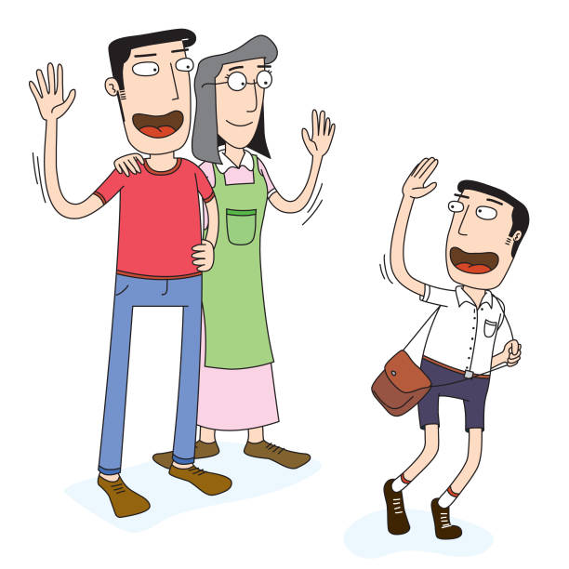
Collecting pupils from school
Drop off:
Outside the entrance to the Reception playground (blue gate)
The gate will open at 8:45am. Children are not allowed into a classroom without a teacher.
Registration begins at 8:45am. Gates will be closed at 9:00am. Anyone late will need to register at the main office.
Notes:
Read slide

Slide 23

Collecting pupils from school
Collection:
Outside the Reception gate entrance.
Gates will open at 3:15pm.
Children will remain seated on the carpet until the adult on the door calls their name.
If someone different will be collecting your child you will need to have completed a blue permission slip. Please ask a member of staff.
If you are running late please telephone the
office to inform them and we will wait until
you arrive.
Notes:
Read Slide

Slide 24
Safeguarding
Please update the office with names of parents/guardians who are permitted to collect your child.
Do not use mobile phones inside school or while on school trips.
Children below the age of 13 should not have access to any social media networking sites / platforms
Scooters and bikes to be walked into school and placed in the cycle/scooter parks
We are a NUT FREE SCHOOL. Please ensure that no items containing nuts are allowed into school. This includes peanut butter, pesto and chocolate spread.
Notes:
At Roebuck Academy, safeguarding is our number one priority. Read slide.

Slide 25
medical Information
Support your child:
Keep the school and class teacher up to date with new medical information
Ensure that your child’s asthma pump/inhaler, epi-pen or additional medicine is in date and with a good expiration life.
Ensure that all contact information; especially phone numbers are correct
Inform us if your child’s medical information or needs change
You will always be contacted if your child sustains any form of head injury – this includes minor bumps and knocks
Any sickness, diarrhoea, must be followed by at least 48 hours absence.
Head lice! Please check regularly and treat as recommended.
Any absence requires a telephone call to the school office or via the school app by 9:15am
Any prescribed medication can only be administered by prior arrangement with the school office
Notes:
Read

Slide 26

REMINDER: PACKED LUNCHES
Drink – no fizzy drinks or high-sugar content
No Chocolate bars
No Sweets
No products containing nuts
Notes:
Read

Slide 27
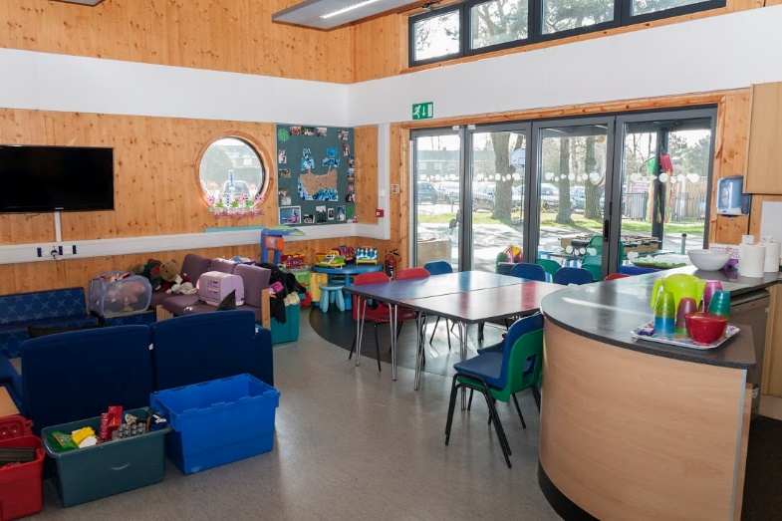
Facilities available to you…
Buccaneers Breakfast Club: 7:30 – 8:45am
Buccaneers After-School Club 3:15-6:00pm
Pastoral Support Worker – Mrs Johnson
Rising Stars Holiday Sporting Days
Range of After-School Clubs
Notes:
There are lots of extra facilities that the school offer to either develop your child’s interest in something through the after-school clubs or by offering wrap around care through our breakfast and afterschool club.

Slide 28
Transition Day
All children are invited to spend the morning with their new class teacher on Thursday 13th July.
For those children who currently attend our school Nursery, please attend Nursery as normal and your child’s class teacher (Mrs Jackson/Miss Thomas) will escort them to Reception. Transition day will finish at 11.50 am and Nursery children will be taken back to Nursery to continue their day as normal (or to go home)
For new children, please arrive at 9.30 am and make your way to the main reception area and your child’s class teacher will come and collect them. Transition day will end at 12 pm. Please make your way to the main reception again and you will be directed to your child’s class for collection.
On Transition day all children will need a named water bottle and sun hat. For those children that do not attend our Nursery, please wear comfortable clothing. School uniform is not necessary.

Slide 29

Holiday Task
We are sending home a book to read over the summer holidays. This will be given to your child on Transition Day with a short task to complete. Please bring this back at the start of September.

Slide 30
Book Bags
All new children will be provided with a new book bag. We hope to allocate these on Transition Day.
If this is not possible these will be given to new children on the first day of school.

Slide 31
Home Visits
.We would like to offer all new children a home visit. These will commence the week beginning Monday 26th June.
This is a lovely opportunity for us to meet your child in their home setting and for you to ask any questions you may have and to tell us anything you feel we need to know about your child.
These visits will be 15 minutes long and time slots have been allocated. The office will be in touch after today’s meeting. Unfortunately these time slots can not be rearranged.
We hope you can make the time we have allocated for you and your child.

Slide 32
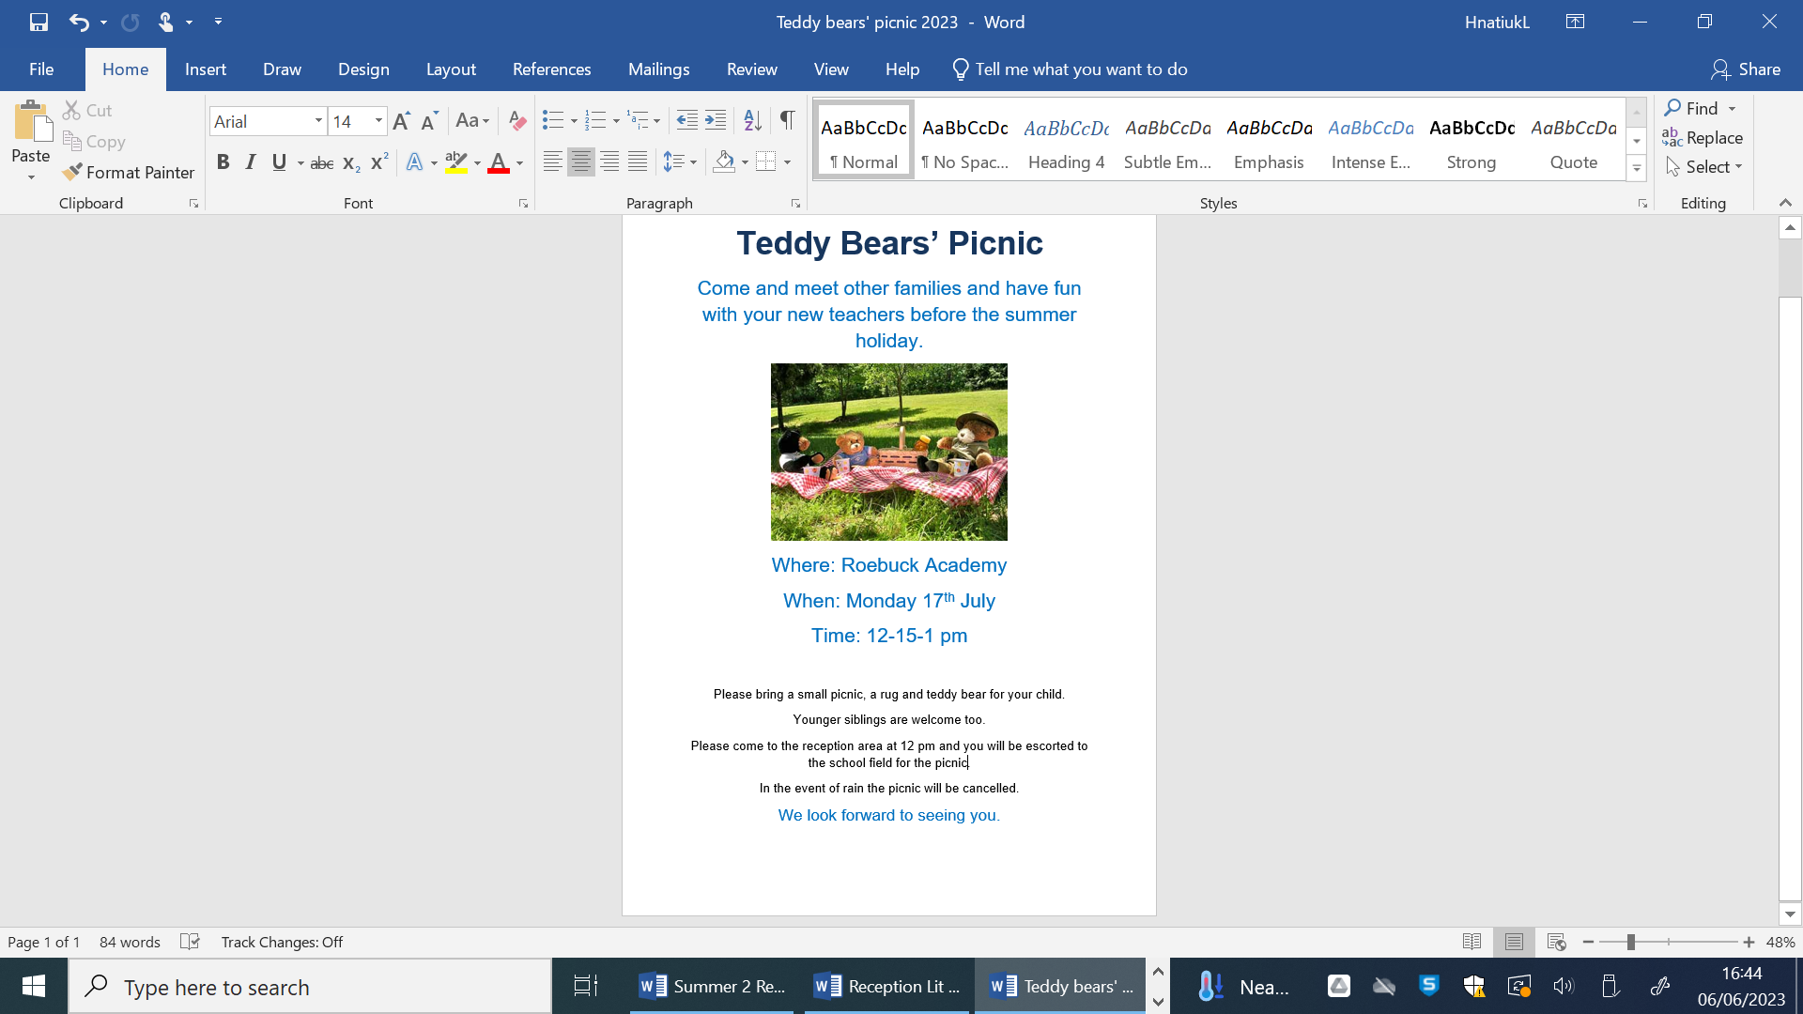
Teddy Bears’ Picnic
All children are invited to attend at Teddy Bears’ Picnic on Monday 17th July at 12:15 pm until 1 pm.

Slide 33
The First Few Days ...
There can be a lot to remember in the first few days, but please do not worry as your child will quickly be teaching you the routines!
All clothing named!
Book bag everyday
PE bag - left in school
Packed lunch or school dinner ordered via School Grid
Named water bottle-water only please
Sun hat (named)
If your child has any medication please pass this on to your child’s teacher.
Notes:
read

Slide 34


School meals and milk
Everyone to register for universal free school meals –
irrespective of income/ status.
www.hertsdirect.org/freeschoolmeals
System should be available from mid July.
Information can be found in school pack.
Notes:
Read and stress the importance of registering.

Slide 35
Questions
If you have any questions please do not hesitate to contact Mrs Hnatiuk and Miss Hyde
Please complete your forms and return these to a member of staff before you leave

