Slide 1

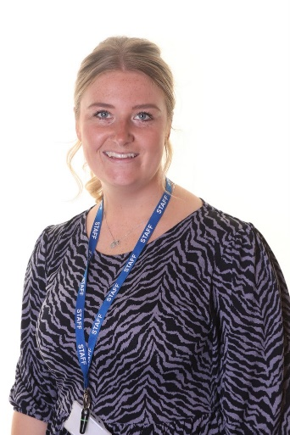
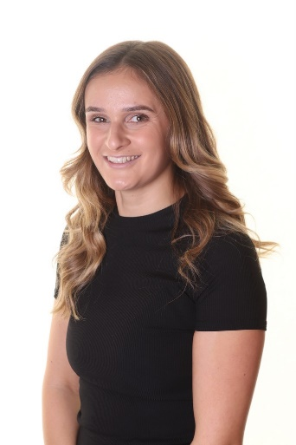
Year 2 to year 3 transition Meeting for parents
Miss O’REILLY AND MISS TAYLOR

Slide 2

Teaching staff
Miss Taylor
Miss O’Reilly
Miss Bell (HLTA)
Mrs Mower
Miss Record

Slide 3
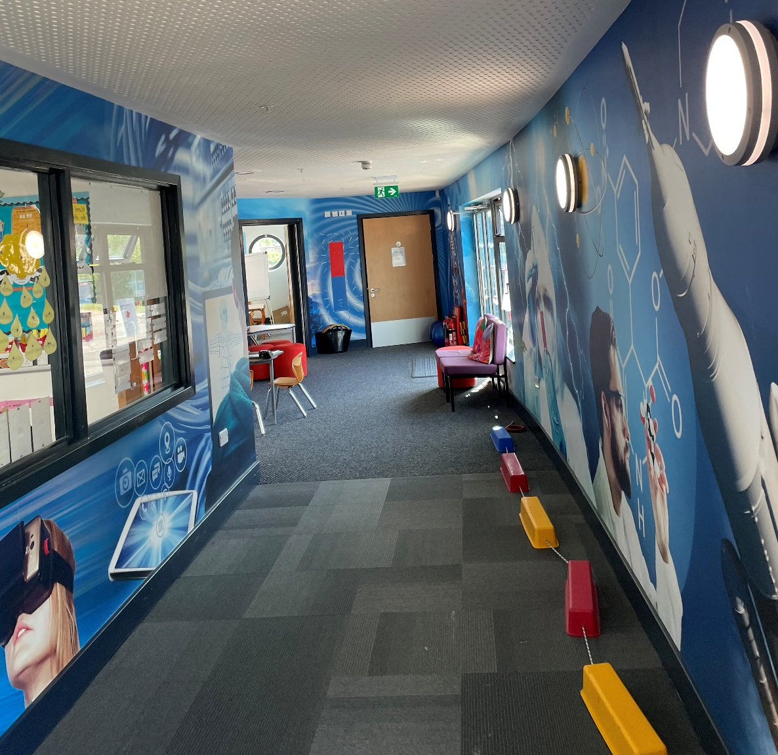
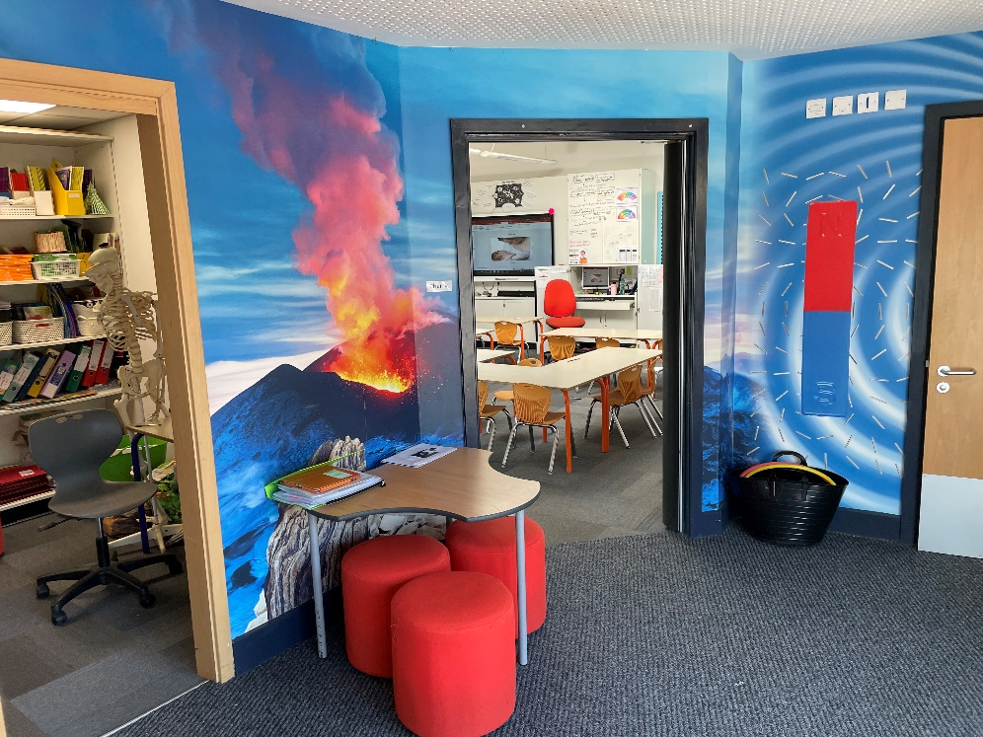
YOUR CHILD’S NEW ENVIRONMENT

Slide 4

What will we do to support transition?
Hand over meetings will take place from one class teacher to the next.
Transition morning will take place before the end of term to help your child settle in.
A transition book will be focused on towards the end of Y2 to Y3 to give the children something familiar to refer to in September.

Slide 5

Essentials for Year 3…
KS2 Playtime starts at 10:45am
KS2 Lunchtime starts at 12:30 pm.
Children have to bring their own fruit snack.
Water bottles are only to filled with water.
School dinners have to be paid for – send money in a clearly labelled envelope or use Gateway on the school website.
Children are expected to have their reading journal signed and
checked by parents / carers 5 times a week (by Thursday).

Slide 6

Year 3 national Curriculum
Computing
French

Slide 7
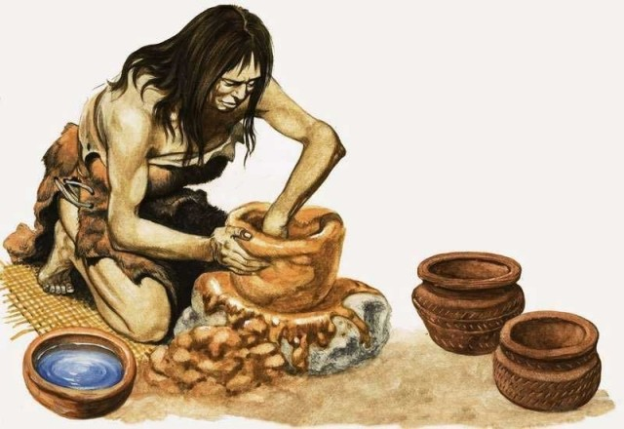
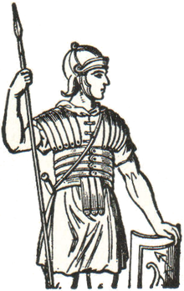
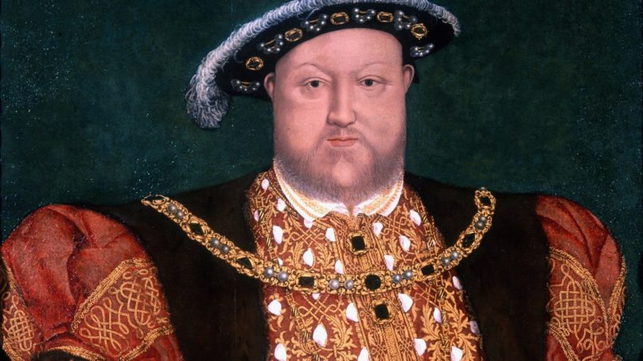
Year 3 History
Sticks, Stones and Ancient Bones
Stone age to Iron age
Ruthless Romans
Roman Empire
Computing
Off with her head!
Tudors
French

Slide 8

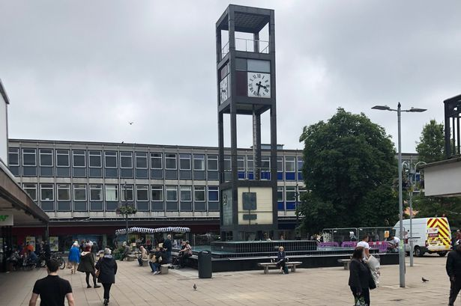
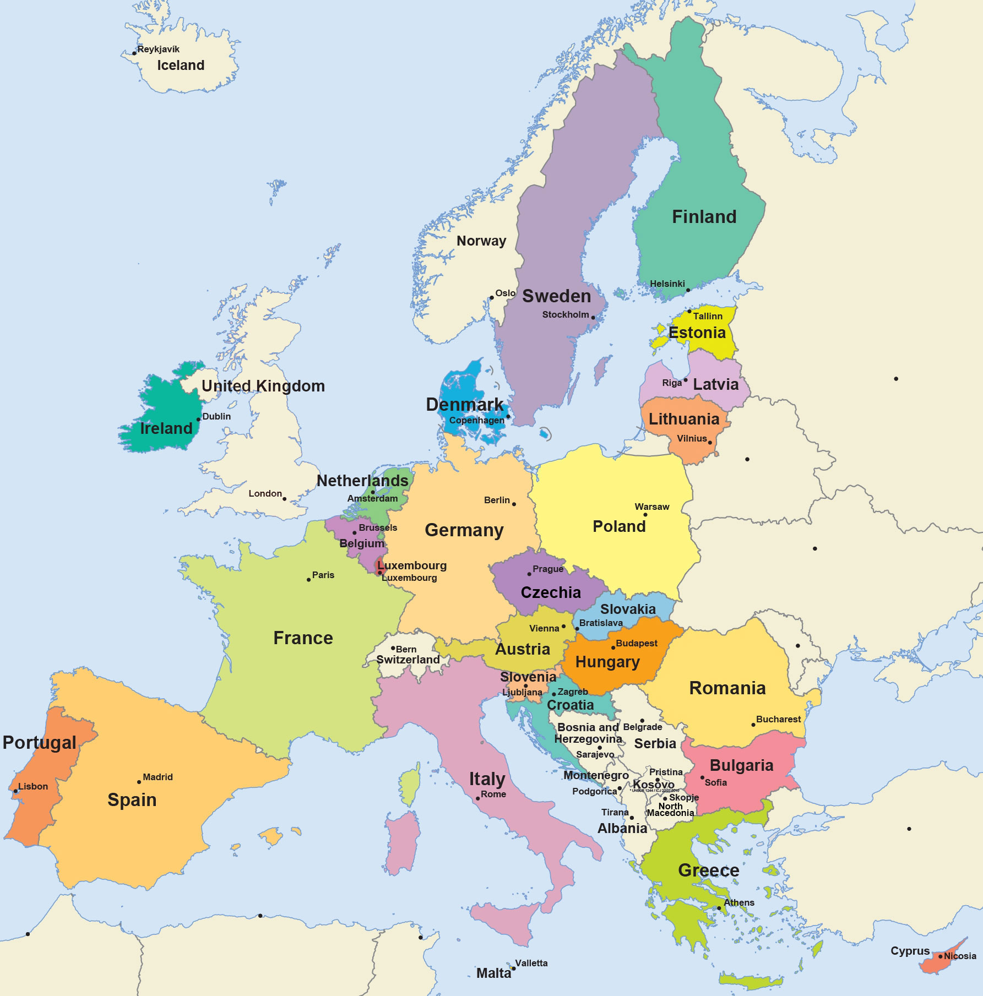
Year 3 Geography
Local study
Shakes, shocks and hotspots
Volcanoes and Earthquakes
Computing
French
You're in Europe!

Slide 9


Year 3 SCIENCE
Plants
Animals including Humans
Light
Rocks
Forces and Magnets
Computing
French

Slide 10

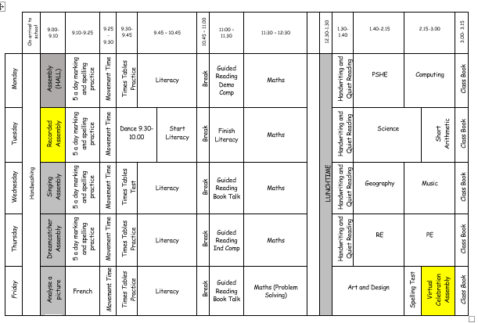
Typical timetable

Slide 11
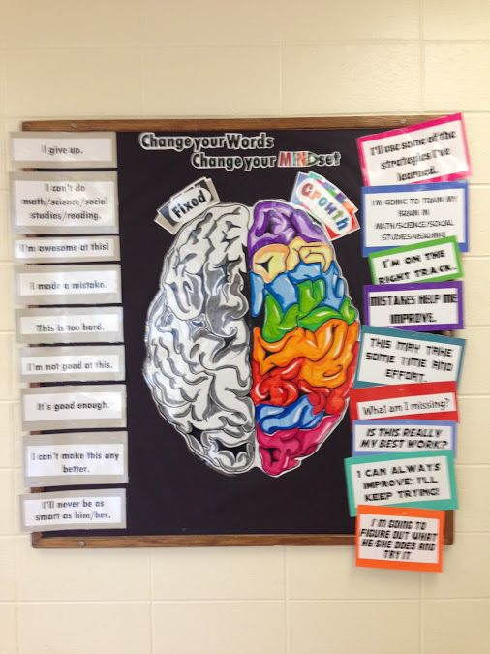

Growth Mindset
Notes:
CHECK

Slide 12
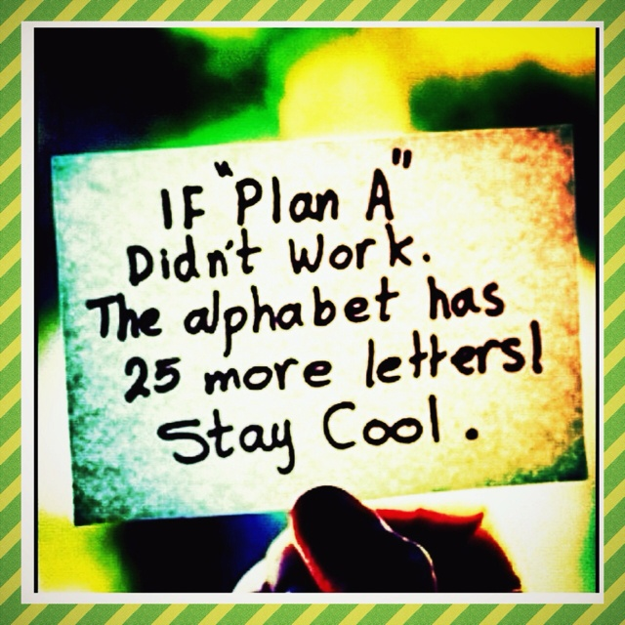

Slide 13

Talk Partners at Roebuck…
Face each other
Look at each other
Listen to one another
Challenge and support each other
Talk about the question
Take turns to speak
Share ideas
together
Prepare an answer
Notes:
13

Slide 14
Attendance & punctuality
We have high expectations of attendance and punctuality at Roebuck. We follow up on all absences as well as lateness to school.
As standard NO holidays are permitted to be taken in school time. All unauthorised absences will be accrued.
Any absence below 96%percent will trigger intervention with the pastoral and attendance lead - Mrs Johnson.
As a school, we do follow our school policy and will issue fines when benchmarks are triggered.
Descriptor | Attendance Level | Actual Attendance | Whole Days Absence | Hours of learning lost
Excellent | 100% | 190 days | 0 | 0
 | 99% | 188 days | 2 | 10
Good | 98% | 186 days | 4 | 20
 | 97% | 184 days | 6 | 30
 | 96% | 182.5 days | 7.5 | 37.5
Satisfactory | 95% | 180.5 days | 9.5 | 47.5
Cause for Concern | 90% | 171 days | 19 | 95

Slide 15
Uniform children are expected to come to school appropriately dressed in our school uniform.
Roebuck Academy logo polo shirt, white or royal blue (or plain white or royal blue without logo).
Blue and white checked or striped summer dresses
Plain grey or black school trousers/shorts/skirt./pinafore dress
Roebuck Academy sweatshirt or cardigan (logo optional)
Roebuck Academy logo fleece
Black flat school shoes or plain black trainers – no open toes
Hats with a brim for summer.

Slide 16
Uniform Information children are expected to come to school appropriately dressed in our school uniform.
Please tie hair back at all times
No large bows – any hairbands or bows are to be either white, blue or black.
Simple studs to be worn – no other earrings permitted
Book bag needed every day
Flat shoes – no heels or AstroTurf boots / shoes

Slide 17
PE Kit
White t-shirt with Roebuck Academy logo (or plain white t-shirt).
Royal blue shorts.
Plimsolls or trainers for outside games.

Slide 18

equipment
Your child will be provided with a pen, pencil and ruler
at the beginning of the year. You are welcome to add to
this and provide a sensible pencil case for your child to
store their equipment in their draw.
Your child will be participating in various Art, Design
and Technology projects throughout the year.

Slide 19
Physical environment
Working walls are there to support children with key vocabulary, steps to success and a sequence to learning.
WAPOLL and WAGOLL are used
-What a poor one looks like
-What a good one looks like
Year 3 is about developing independence in their own learning from KS1, so the use of the working walls will be a key focus.
Reading corners aim to inspire children to want to read.
Celebratory display –children’s work is displayed.

Slide 20
Physical environment
Year 3 is about developing independence in their own learning from KS1, so the use of the working walls will be a key focus.
Reading corners aim to inspire children to want to read.
Celebratory display –children’s work is displayed.

Slide 21

Emotional environment
PSHE lessons.
Whole school assemblies e.g. growth mindset
Meeting with Year 2 teachers to discuss each child individually and their needs as well as strengths.
Open door policy.

Slide 22


Reading
We actively encourage reading throughout the school.
Please can you continue to support your child’s enjoyment of reading at home by ensuring they continue to read at least 5 times a week for at least 20 minutes.

Slide 23

Reading

Slide 24

Reading
To promote children’s reading capabilities, we use the reading rainbow during daily sessions called ‘Book Talk’. The scheme ties in with The National Curriculum reading outcomes for each year group.
‘Book Talk’ in an engaging scheme of work that develops children’s understanding of the book and encourages children to discuss out loud different style sentence frames about what they have read. It is important the children have opportunities to form opinions on the text and discuss these collaboratively with a group.

Slide 25
Reading
Reading record books are collected on Thursday. This enables us to monitor their reading which feeds into a whole school weekly reading competition.
Once your child has completed a book, they will use the iPads to complete an accelerated reading quiz. You can monitor your own child’s progress by signing up to Home Connect.
http://www.roebuck.herts.sch.uk/page/?title=Accelerated+Reader&pid=99

Slide 26

Reading
This is a NEW colour scheme that does not correlate to your children’s previous book band from KS1.
For example: a blue in KS1 does NOT mean the same difficulty level as a KS2 blue.

Slide 27
Reading
Children’s outcomes during their guided reading sessions, reading assessments, reading comprehension data as well as teacher judgement decides on your child’s book band.
These are updated frequently and children are made aware of what books they can choose from the classroom book corner.

Slide 28
HOME LEARNING
5 times a week reading
Spellings (give every 2 weeks)
Times tables rockstars
Mathletics (2 tasks per week)

Slide 29
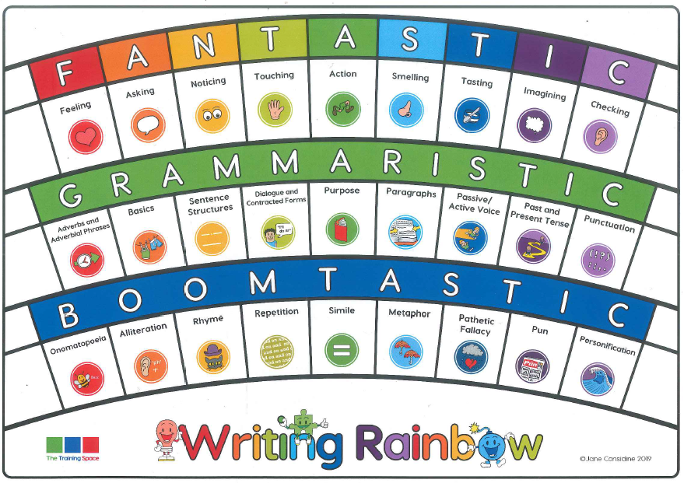
Writing

Slide 30
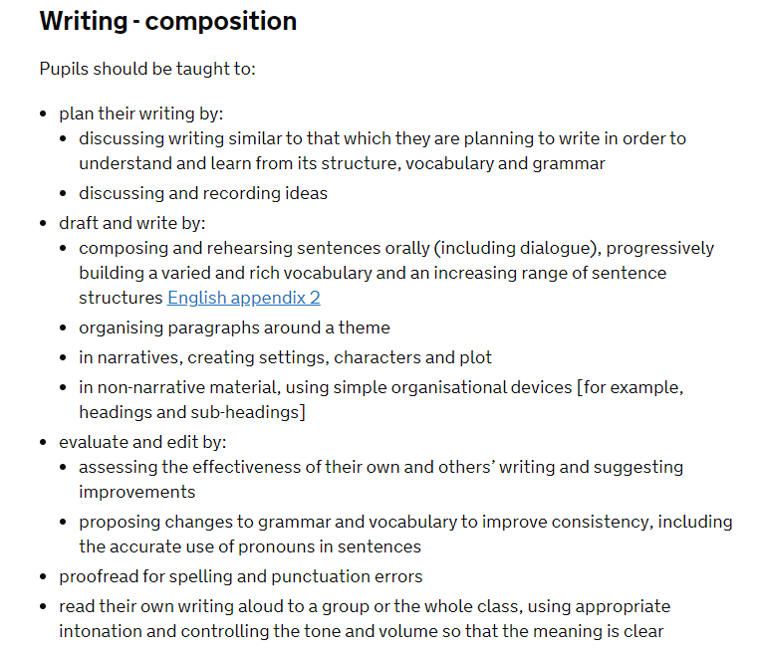
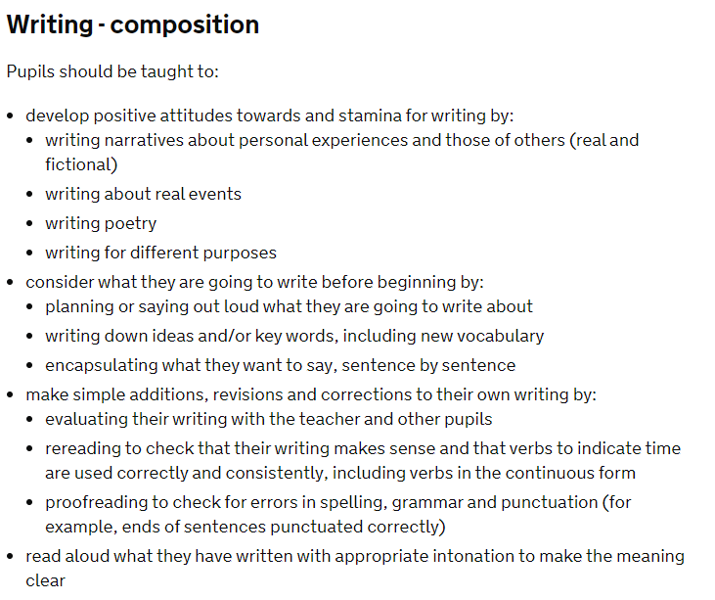
Writing progression
Year 3
Year 2

Slide 31
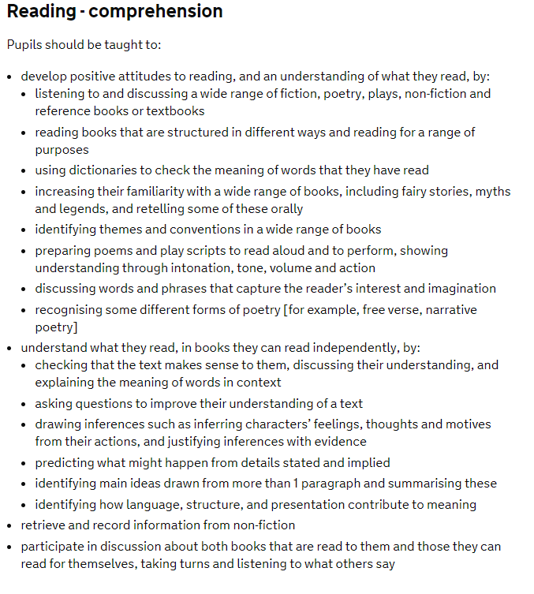
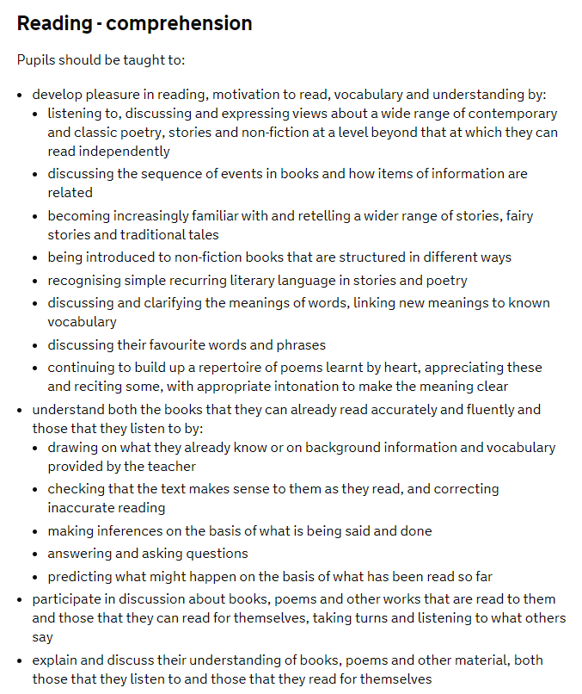
Reading progression
Year 2
Year 3

Slide 32
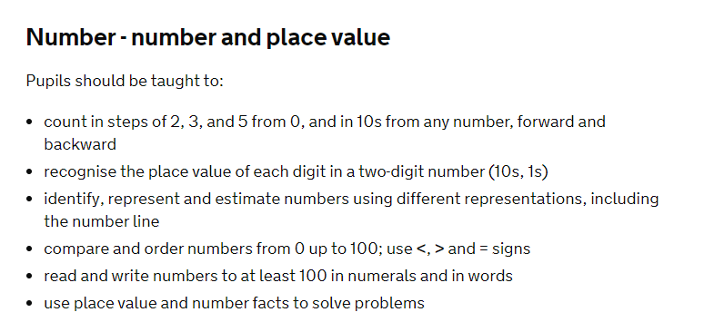
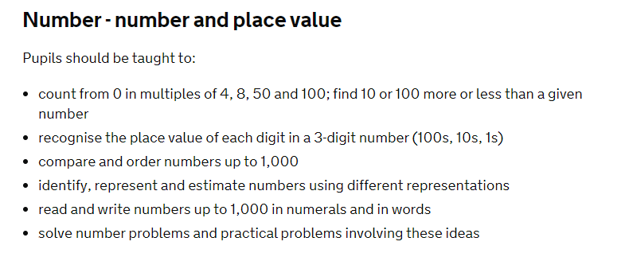
Maths progression
Year 2
Year 3

Slide 33
How to Help your child at home…
Read with your child as often as possible,
discussing the book and making predictions
about what will happen next. Encourage your
child to read aloud to you, as well as hearing
you read to them. Encourage children to
explain the meaning of unfamiliar words and
language. Use a dictionary or thesaurus to
look up their word meanings.

Slide 34
How to Help your child at home…
Ensure that your child practises their spellings
at home every evening. Every child will have
a spelling journal that they will bring home
every evening.
Encourage your child to complete their
spelling every night throughout the week.

Slide 35
How to Help your child at home…
When writing at home encourage your child to check their spelling, grammar and punctuation. Their handwriting should also be cursive and produced with a blue pen.

Slide 36


How to Help your child at home…
Mathletics
Frequent practising of times tables (TT Rockstars)
Termly Topic Homework
Spelling practice
Listening to reading and reading to them

Slide 37
How to Help your child at home…
Please monitor your child’s homework to
ensure that this is completed with care and
sufficient attention to detail.
If homework is poorly presented, children will
be expected to complete this again.
We expect the same standards at home as we
do at school.

Slide 38
How to Help your child at home…
HOMEWORK
Maths
Spellings
Reading
Topic

Slide 39
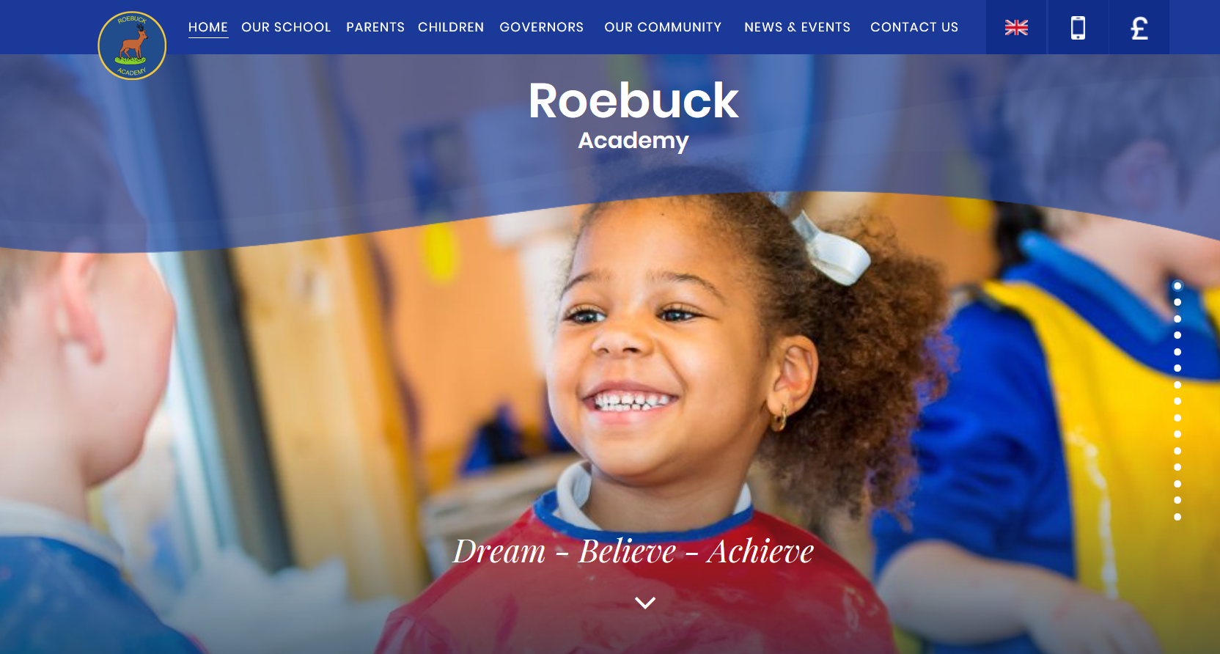
WebsitE
Roebuck School Website is your first port of call for ALL communication:
Policies
Letter Section
Admissions
Uniform
Blogs

Slide 40
Communication at roebuck…
Reminder:
Facebook
Class Representatives
School Website
Flyers and Posters
Email
Text
Open Door Policy

Slide 41
Roebuck uses Gateway foR:
Online payments
Communication
Booking into workshops
Booking clubs
Booking into special events

Slide 42
Collecting pupils from school
DRoP-OFF
Outside the classroom entrance. Doors will open at 8:45am. Children are not allowed into a classroom without a teacher. Registration begins at 8:45am. Doors will be closed at 9:00am. Anyone late will need to register at the main office. Lessons begin at 9:00am sharp.
Outside the classroom entrance at 3:15.

Slide 43

Safeguarding
Please update the office with names of parents/guardians who are permitted to collect your child.
Do not use mobile phones inside school or while on school trips.
Children below the age of 13 should not have access to any social media networking sites / platforms
Scooters and bikes to be walked into school and placed in the cycle/scooter parks
We are a NUT FREE SCHOOL. Please ensure that no items containing nuts are allowed into school.

Slide 44
medical Information
Support your child:
Keep the school and class teacher up to date with new medical information.
Ensure that your child’s asthma pump/inhaler, epipen or additional medicine is in date and with a good expiration life.
Ensure that all contact information; especially phone numbers are correct.
Inform us if your child’s medical information or needs change.
You will always be contacted if your child sustains any form of head injury – this includes minor bumps and knocks.
Children will only be permitted to miss PE if they have a letter from a parent/carer.
If it is an individual medical need to be discussed, please book an appointment with Mrs Elson, SENCO)

Slide 45
REMINDER: PACKED LUNCHES
Drinks – water in bottles only
No fizzy or high-sugar drinks
No chocolate bars
No sweets
No products containing nuts

Slide 46
Facilities available to yoU:
Buccaneers Breakfast Club: 7:30 – 8:15am
Buccaneers After-School Club 3:15-6:00pm
Pastoral Support Worker – Mrs Johnson
Range of After-School Clubs

Slide 47


Y3@roebuck.herts.sch.uk
@academy_roebuck

Slide 48

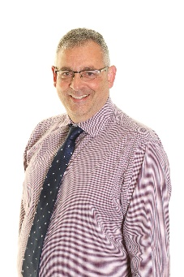
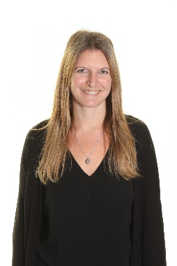
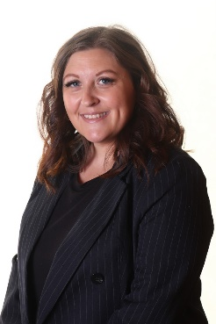

Communication
Headteacher
Mr Mari
Assistant Headteacher KS2
Mrs Longhurst
Assistant Headteacher
EYFS/KS1
Mrs Herbaut
Year 3/4 Phase Lead
Miss O’Reilly
Class Teacher
First port of call will be your child’s class teacher.
If you feel this needs to be discussed further, this then goes to 5/6 phase lead.
This will then lead to Senior Leadership Team if needed.

Slide 49
Pupil Questions?

Slide 50
Parent/Carer Questions?

