Slide 1

Year 5 to year 6 transition Meeting for parents
Mr Alden & Miss Williams

Slide 2

Teaching staff
Elder Class teacher- Mr Alden
Ash Class teacher-Miss Williams
Year 6 Teaching Assistants:
Miss Legg
Mrs Heritage
Mrs Kaur

Slide 3

What will we do to support transition?
Handover meetings will take place from one class teacher to the next.
Classes to meet new teachers Thursday 13th July for the morning.
We will complete some work to display in our classroom for the start of term.

Slide 4

Essentials for Year 6…
As with ALL year groups, Reading remains a KEY focus of the year. We shall encourage children to read a wider range of texts and those which will challenge reading and comprehension ability.
Children may read from a wider variety of texts; this will include: classical literature (e.g. Black Beauty, Treasure Island, Hamlet, Romeo and Juliet).
Children are expected to have their reading journal signed and checked by parents / carers 5 times a week.
Even though they are in Year 6, it is still important to hear your child read regularly.

Slide 5

Year 6 national Curriculum
Computing
French

Slide 6
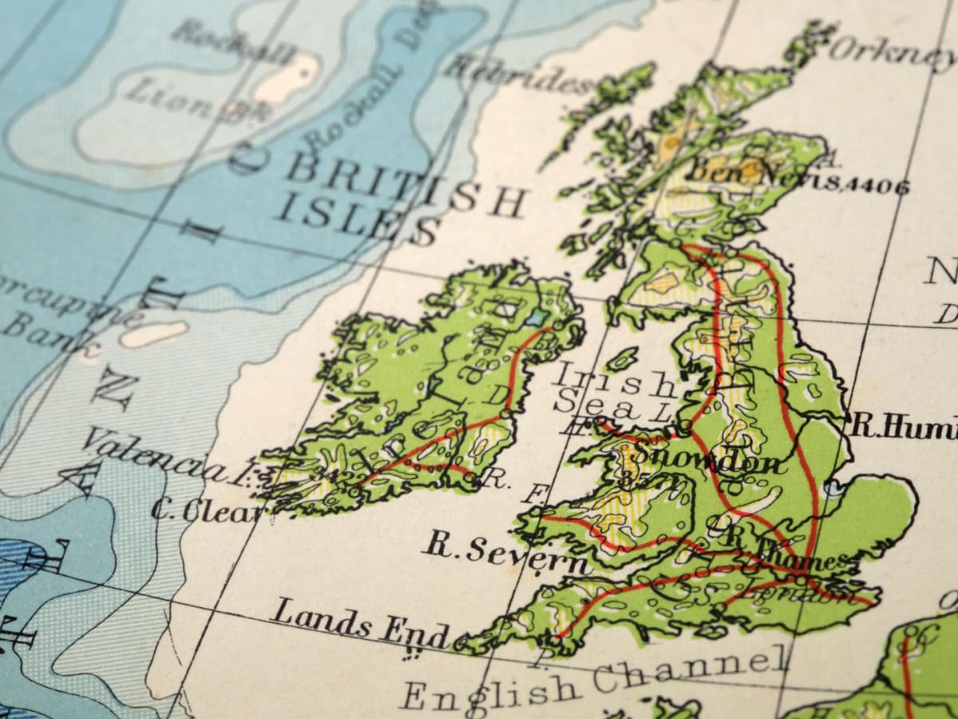
Year 6 Geogrpahy
UK
Natural Resources
South America
Computing
French

Slide 7
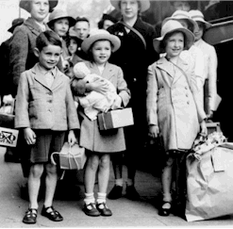

Year 6 History
World War II
Roles of women throughout history
Computing
French
The Malicious Maya

Slide 8


Year 6 SCIENCE
Electricity
Animals including Humans
Light
Evolution a& Inheritance
Sex and Relationship Education / Hygiene
Covered in PSHE
Living Things & habitats
Computing
French

Slide 9

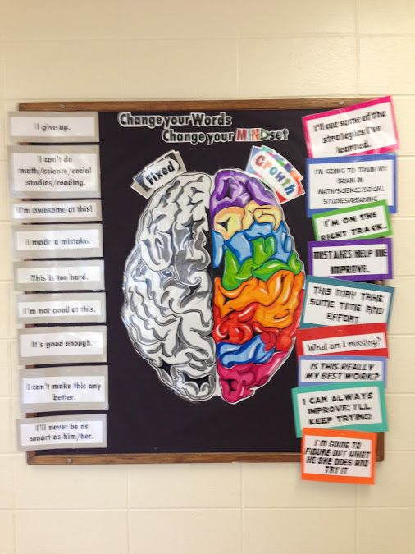

Growth Mindset

Slide 10


Slide 11
Attendance & punctuality
We have high expectations of attendance and punctuality at Roebuck. We follow up on all absences as well as lateness to school. Children should arrive prompt at 8:45am ready to start the day.
As standard, NO holidays are permitted to be taken in school time. This is an important year for Year 6’s, so it is crucial to ensure your child’s attendance is above 96%.
Any absence below 96% will trigger intervention with the pastoral and attendance lead - Mrs Johnson.
As a school, we do follow our school policy and will issue fines when benchmarks are triggered.
Descriptor | Attendance Level | Actual Attendance | Whole Days Absence | Hours of learning lost
Excellent | 100% | 190 days | 0 | 0
 | 99% | 188 days | 2 | 10
Good | 98% | 186 days | 4 | 20
 | 97% | 184 days | 6 | 30
 | 96% | 182.5 days | 7.5 | 37.5
Satisfactory | 95% | 180.5 days | 9.5 | 47.5
Cause for Concern | 90% | 171 days | 19 | 95

Slide 12

SATS
National Week for SATs 2023 is:
Monday 13 May to Thursday 16 May 2024
    SPAG test
        Grammar test
        Spelling test
    Reading test
    Maths test
        Arithmetic
        Reasoning (2 papers)
  Scaled scores of 100 or more = MEETING AGE RELATED

Slide 13
SATS
National Week for SATs 2024 is:
Monday 13 May to Thursday 16 May 2024
It is important that every child attends school this week so that they can sit their examinations. Do not book Family holidays during this period.
There will be a SATs information evening in Autumn and Spring term.
During SATs week, we will host breakfast for children to arrive earlier to ensure a good start of the day. This will include short revision sessions.
SATs – Roebuck places an immense amount of time and effort in ensuring that children do not feel any sort of pressure or anxiety during this week.

Slide 14

Additional Booster classes
Throughout the year, children may be invited to attend additional booster classes or one to one tuition with teaching staff at Roebuck.
Classes will start in Autumn term and finish in Summer 1.

Slide 15
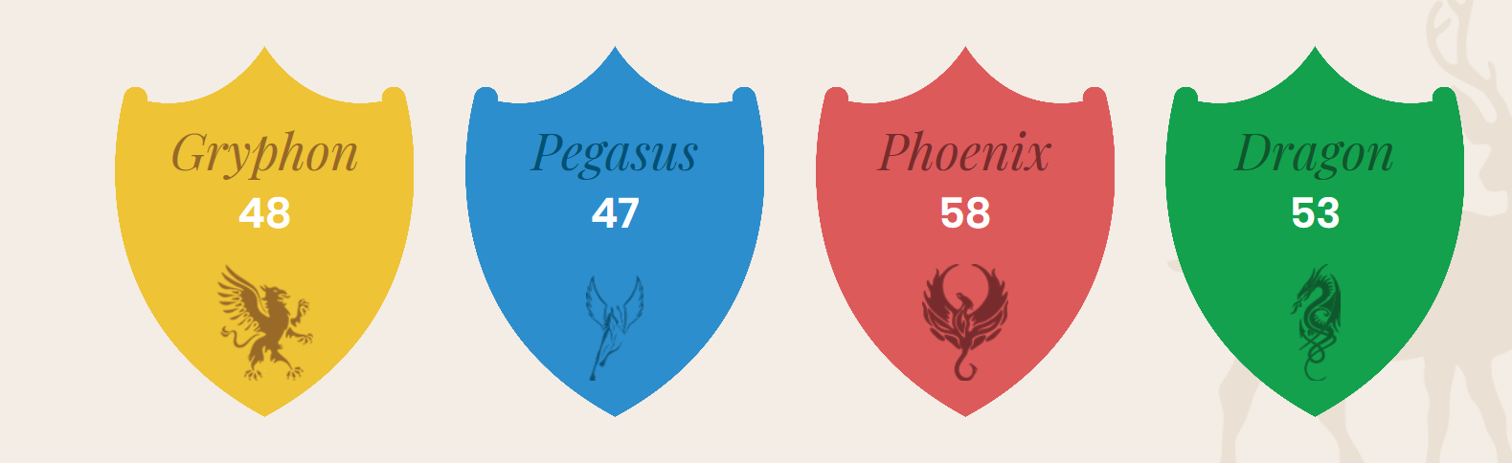
Differences between year 5 and year 6
Chance to be House Captains: Children will be asked to write a manifesto if they would like to apply and their House members will vote.
Responsibility. E.g. jobs around the school / supporting younger years with reading and in the lunch hall/ assembly set up.
Citizenship award- gold and diamond. Will continue from Year 5.
SATs – more frequent test practise
PGL (Meeting after school on Monday 17th July at 4pm)

Slide 16
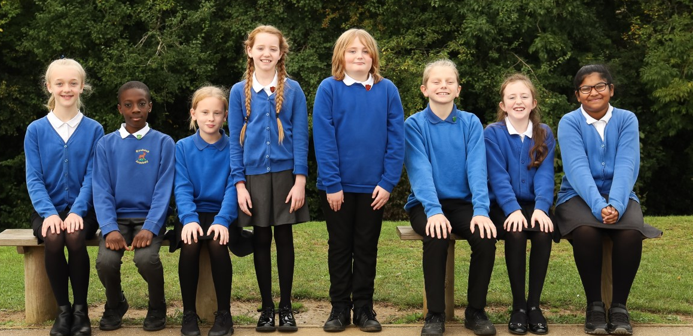
DREAM Team
Opportunity to run for election for Head / Deputy Boy/Girl – letter of application needed.
We have something that no other school has. A Dream Team! Our Dream Team has an extremely significant role of showing all children how important it is to follow our six school values, which will lead them to success. We have a head boy and girl, deputy head boys and girls and assistants. Our roles are extremely important to us and we always follow our school values and show great respect to all students and teachers. We have many great opportunities and experiences. Our Dream Team makes a big difference to all Roebuck students and staff!

Slide 17

Thinking Ahead – Transition to Year 7
From September, Stevenage Secondary schools hold open evenings for parents and pupils to go attend. Please visit as this will provide you with an insight and flavour to the school and whether this is right for you and your child.
You will need to make an application to Secondary School during October. Please ensure you submit this within the appropriate time window.
You will be notified in March of the success of your application and which Secondary school your child has been allocated.

Slide 18
Uniform children are expected to come to school appropriately dressed in our school uniform.
Roebuck Academy logo polo shirt, white or royal blue (or plain white or royal blue polo shirt).
Plain grey or black skirt/pinafore dress/tailored trousers/shorts (no leggings).
Roebuck Academy logo sweatshirt/ cardigan.
Blue and white checked or striped summer dresses
Roebuck Academy logo fleece.
Solid, black school shoes (no open toes) or plain black trainers (no white embellishment)
Hats with a brim for summer
ALL UNIFORM NEEDS TO BE LABELLED

Slide 19
Uniform Information children are expected to come to school appropriately dressed in our school uniform.
Please tie hair back at all times
No large bows – any hairbands or bows are to be either white, blue or black.
Simple studs to be worn – no other earrings permitted
Flat shoes – no heels or AstroTurf boots / shoes

Slide 20
PE Kit
White t-shirt with Roebuck Academy logo (or plain white t-shirt).
Royal blue shorts.
Plimsolls or trainers for outside games.
In order for children to take responsibility and for secondary school, letters will be sent if there is incorrect/missing kit

Slide 21

Other equipment
For Year 6, it will be expected that they bring in their own sensible pencil case every day, which will help them in being more organised and prepared for secondary school.
Your child will be provided with a blue and black pen, pencil and ruler at the beginning of the year. Once pens run out, we will replenish.
You are welcome to add to this to store other equipment in.
NO fiddle toys are permitted, unless current class teacher and inclusion lead informs us as these can become a distraction.
Labelled lunch box (not plastic bags)
Labelled water bottle (not a single use bottle)

Slide 22
Physical environment
Working walls are there to support children with key vocabulary, steps to success and a sequence to learning.
WAPOLL and WAGOLL are used
-What a poor one looks like
-What a good one looks like
Year 6 is about developing independence in their own learning, so the use of the working walls will be a key focus.
Reading corners aim to inspire children to want to read.

Slide 23

Emotional environment
PSHE lessons.
Whole school assemblies e.g. growth mindset
Transition morning – Wednesday 14th July.
Meeting with Year 5 teacher to discuss each child individually and their needs as well as strengths.
Open door policy (email contact)
Mentors (Mingle with your Mentor breakfasts)

Slide 24
Year 6 curriculum
To achieve working towards (WTS), age related (ARE) or Greater depth (GDS) children must meet objectives from the Teacher Assessment Framework.
Notes:
see hand outs
Making pancakes- using purple mash see James Mayhew book- jump into a picture

Slide 25
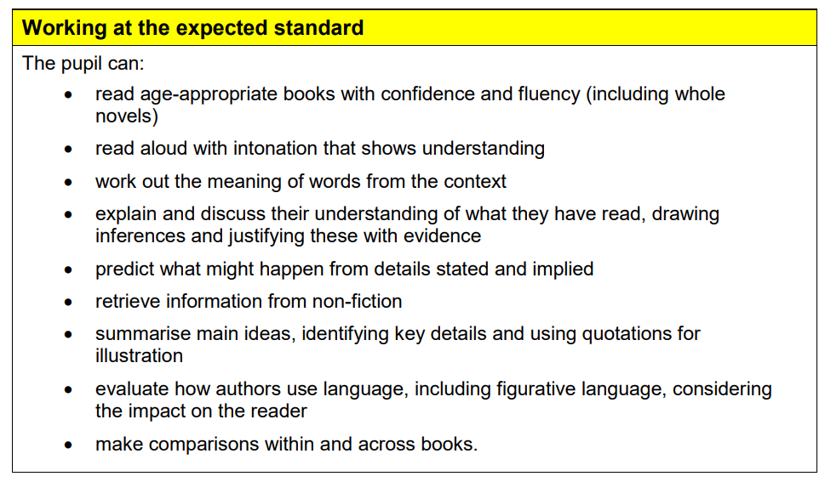
Progression - Reading

Slide 26
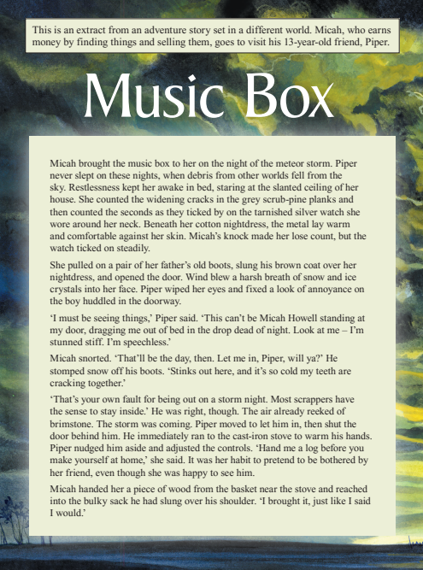
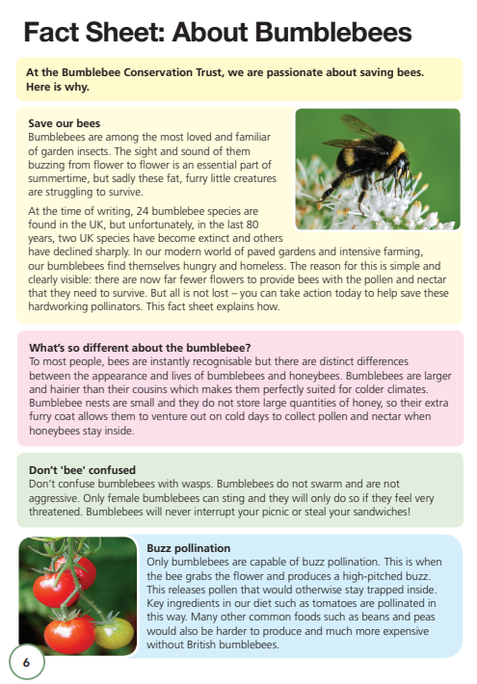
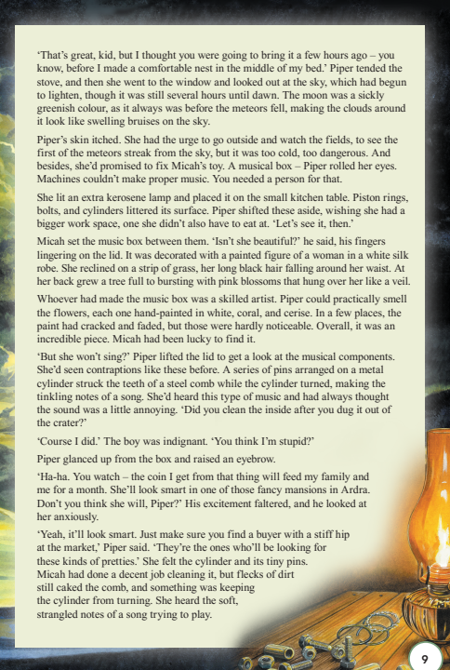
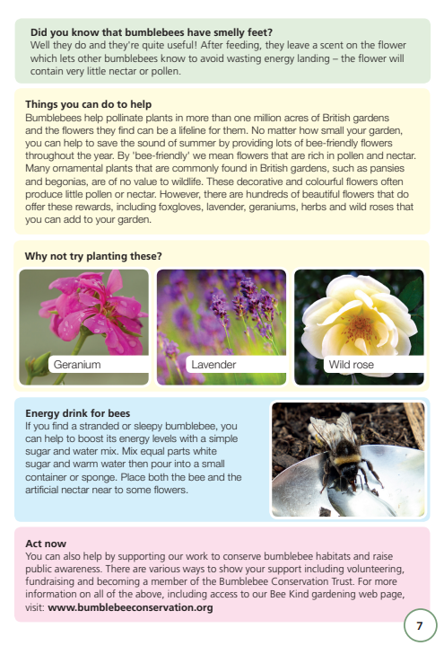

Slide 27
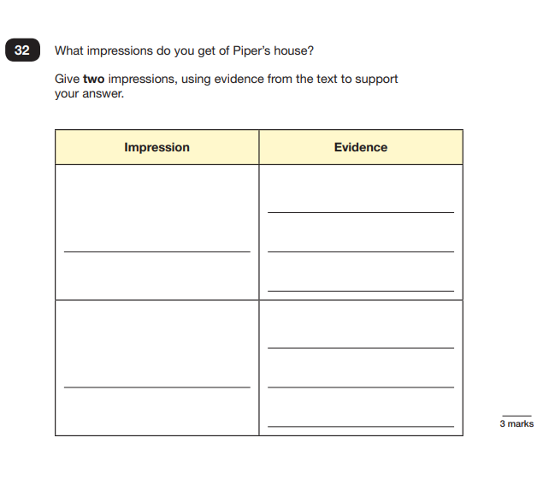
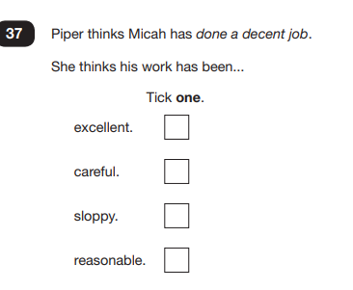
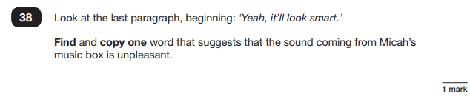
A range of questions including:
-vocabulary and language
-understanding/decoding
-inference
-prediction
-impressions
-evidence to support

Slide 28

Reading
Although there is a heavy focus on reading comprehension for SATS, promoting a love of reading is still the number one priority. The best way to get better at reading is to read!
Reading record books are collected on Thursday. This enables us to monitor their reading which feeds into a whole school weekly prize draw for obtaining a token for the vending machine.

Slide 29
reading Strategies we use
Echo reading (teacher reads a sentence/phrase and child echoes this back)
Fluency strategies
Group reading during Book Talk
Paired reading
Accessible texts tailored to child’s needs
Engaging and current book titles
Range of text types (comics, novels, classics, biographies)

Slide 30
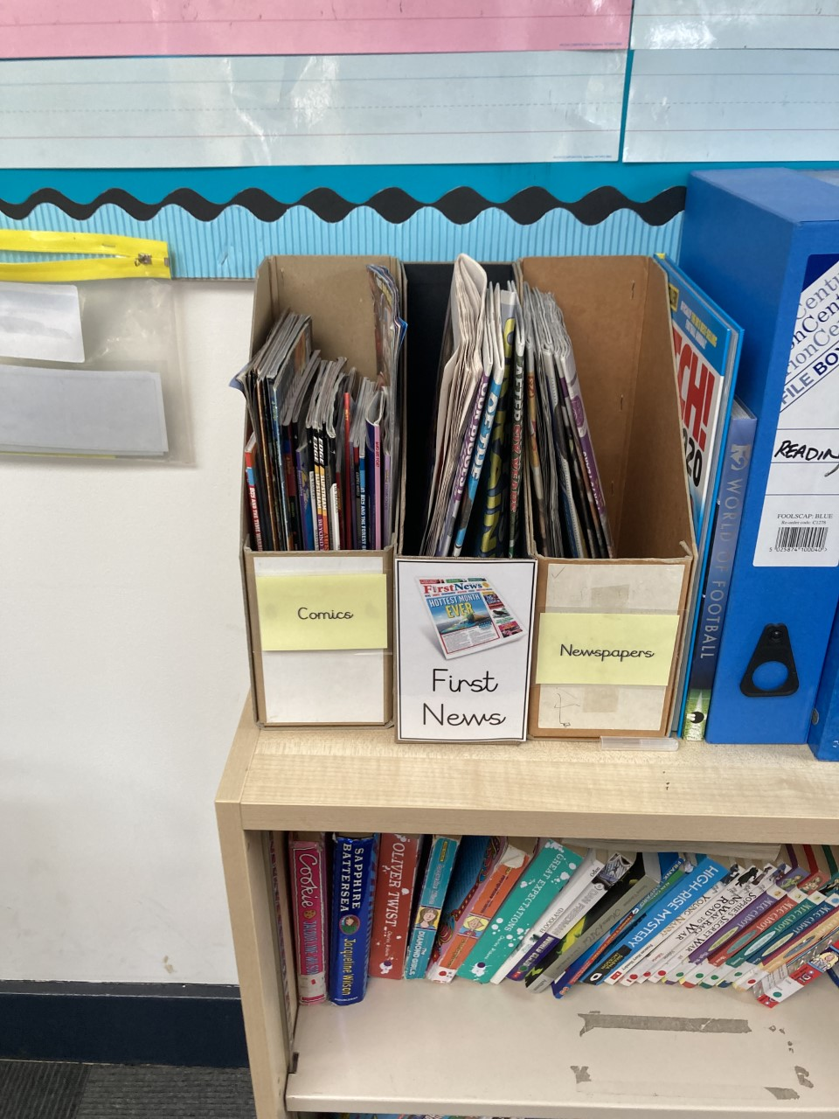
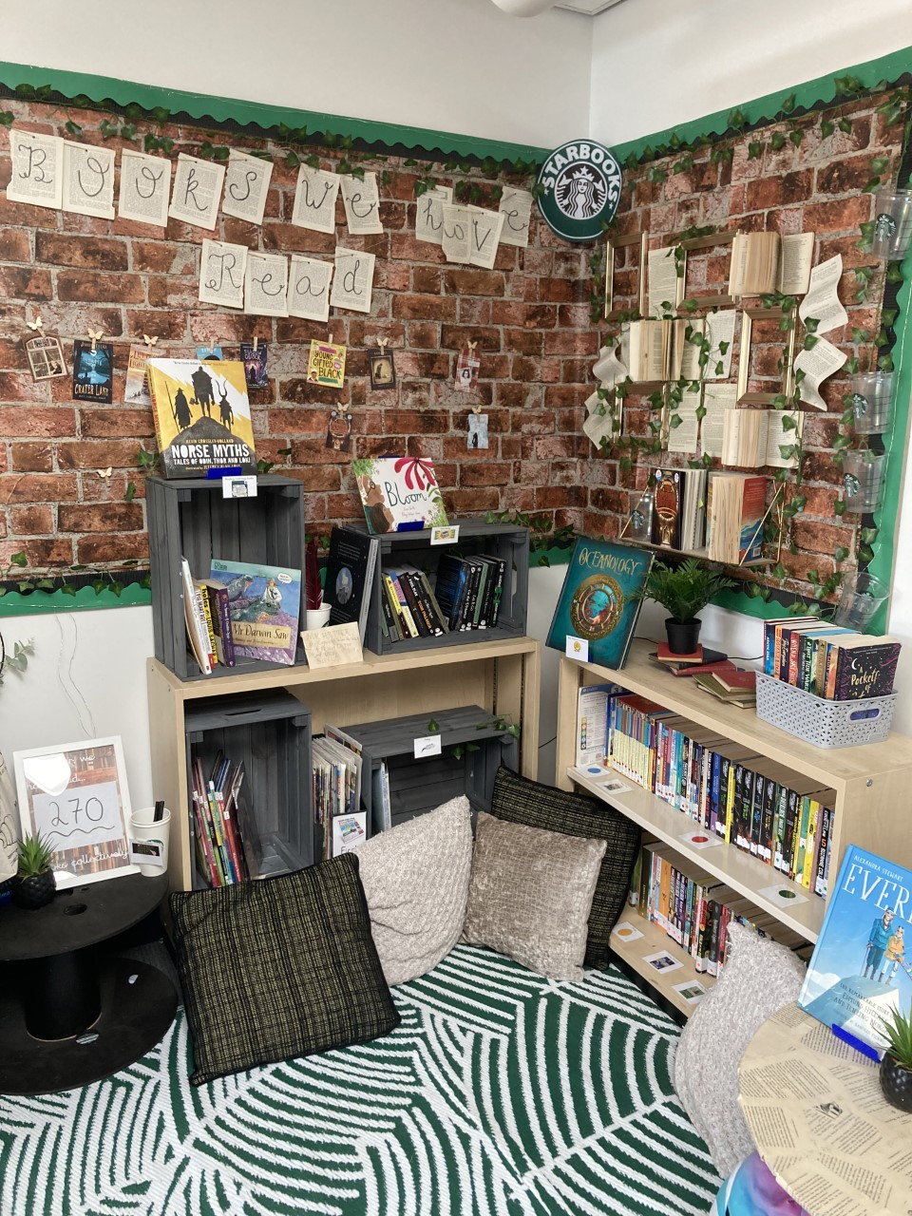
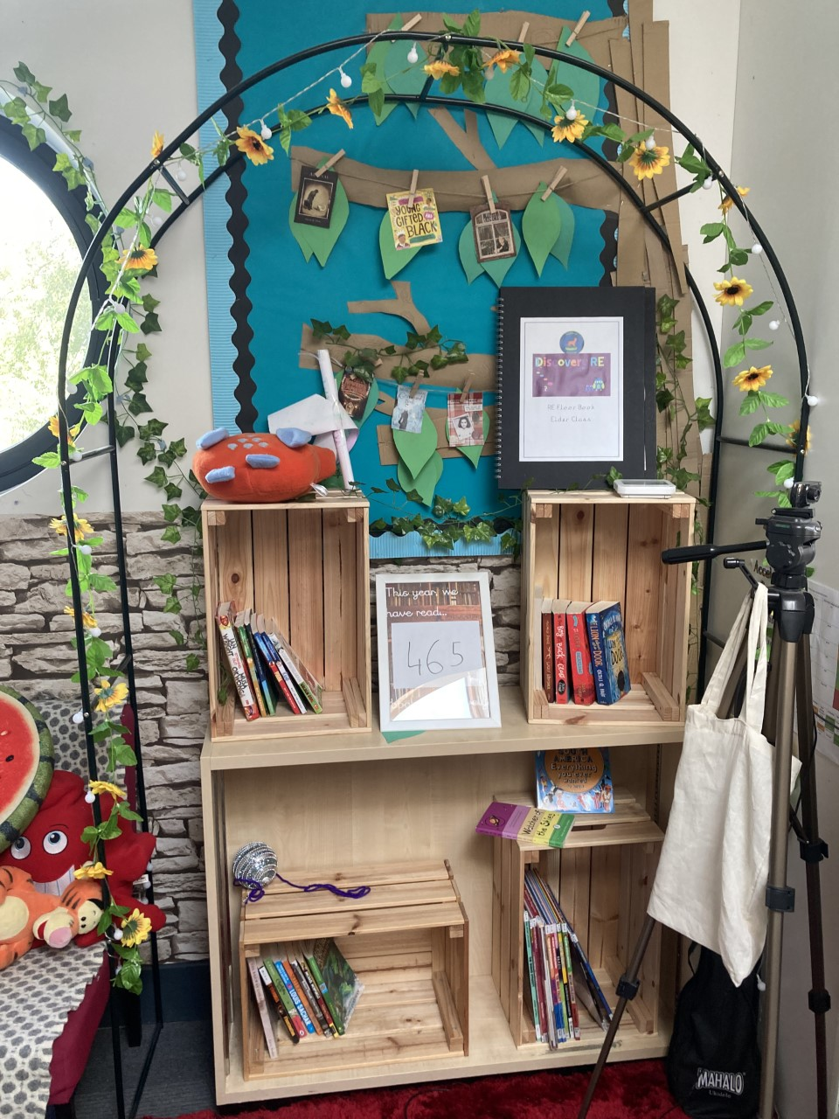
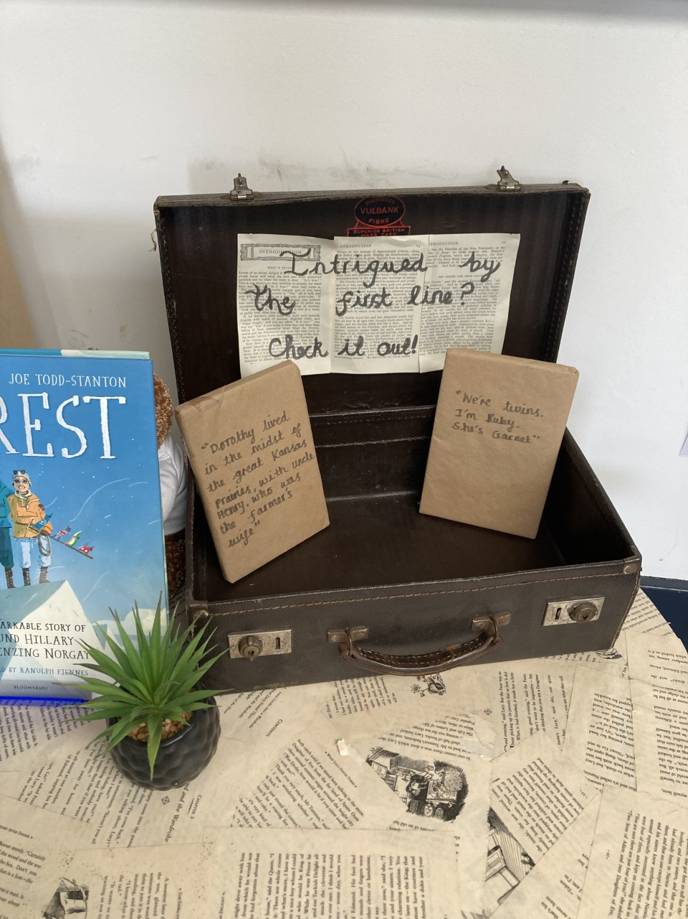
Reading corners

Slide 31
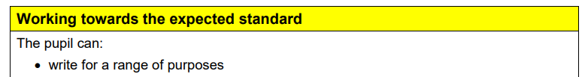
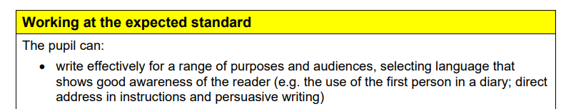
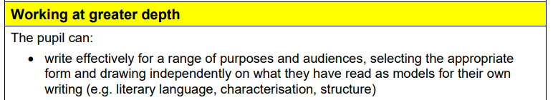
Progression - Writing

Slide 32
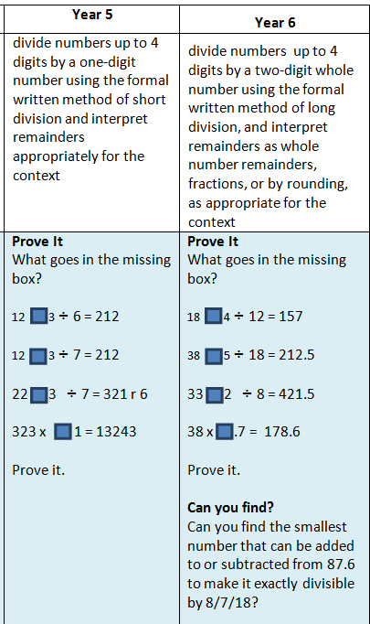
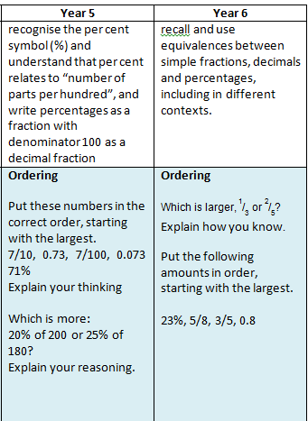
Progression - Maths

Slide 33
Maths setting
From October half term, we are going to set the children in order of ability. This will be based on their Autumn 1 assessment.
We believe that grouping the students based on their abilities will be beneficial for them in the long run, as it means that they will be working at a similar level to everyone else in the set and that the work will be accessible for all students.
We firmly believe that by grouping the students like this we are giving them the best possible chance to make as much progress as possible during their time in Year 6.

Slide 34
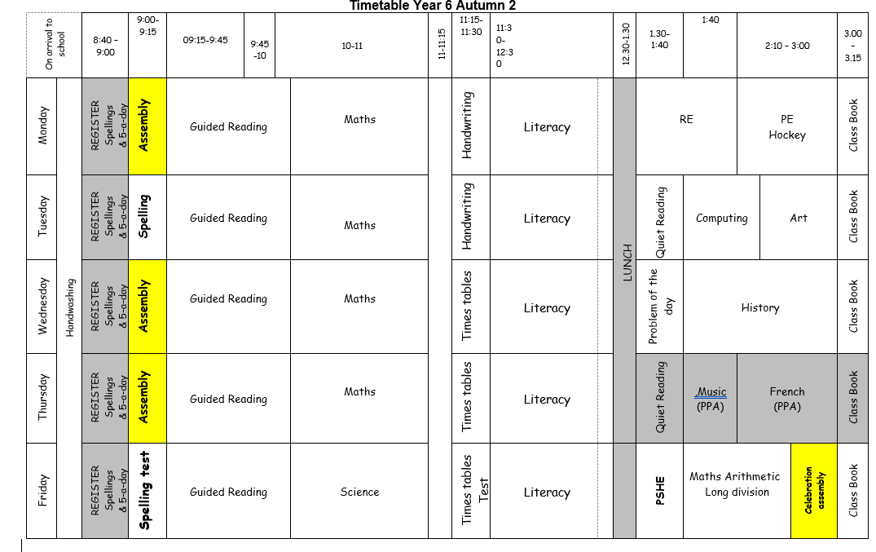
Typical timetable

Slide 35
How to Help your child at home…
Read with your child as often as possible, discuss the book and making predictions about what will happen next.
Encourage your child to read aloud to you, as well as hearing you read to them.
Encourage children to explain the meaning of unfamiliar words and language.
Use a dictionary or thesaurus to look up their word meanings.

Slide 36
How to Help your child at home…
Ensure that your child practises their spellings at home every evening. Every child will have a spelling journal that they will bring home every day. Encourage your child to complete their spelling every night throughout the week.
When writing at home encourage your child to check their spelling, grammar and punctuation. Their handwriting should also be cursive and produced with a blue pen (may alter due to spelling strategies).

Slide 37


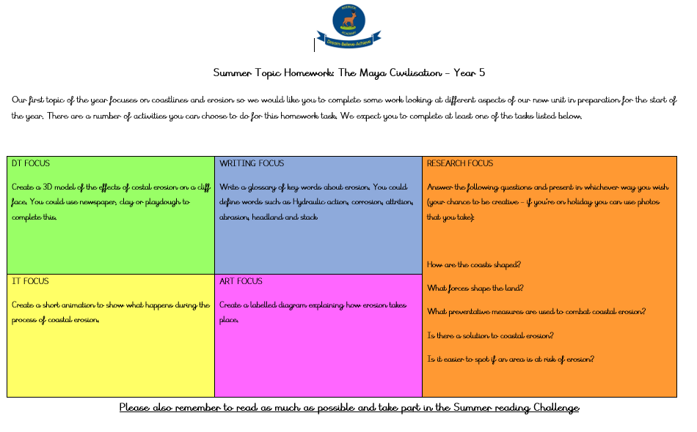
How to Help your child at home…
Use of Mathletics and TT Rockstars
Problem solving task and CGP books
Termly homework tasks

Slide 38
How to Help your child at home…
In readiness for secondary school:
Please monitor your child’s homework to ensure that this is completed with care and sufficient attention to detail.
If homework is poorly presented, or incomplete children will be expected to complete this again during lunchtime.
We expect the same standards at home as we do at school.

Slide 39
How to Help your child at home…
HOMEWORK
Problem solving task
CGP books
Spellings
Reading
SPaG.com
Termly Topic
Your child will receive Revision Guides for Reading, Grammar and Maths in the Autumn Term. These will be used for homework tasks each week and will need to be looked after. Answers are provided for you to check through with your child upon completion.

Slide 40
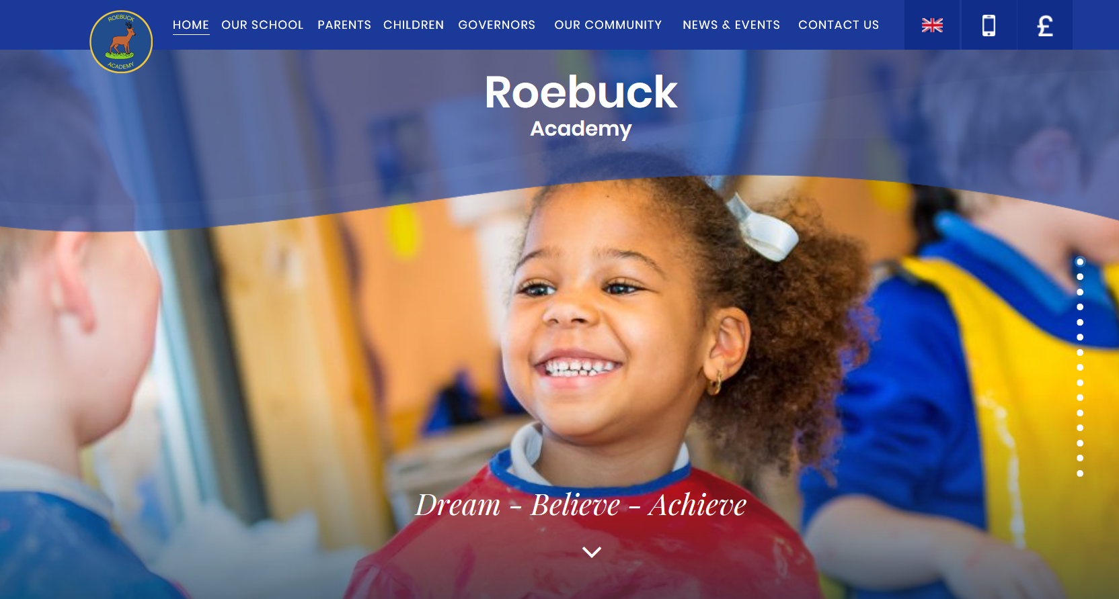

WebsitE
Roebuck School Website is your first port of call for ALL communication:
Policies
Letter Section
Admissions
Uniform
Blogs
Twitter is now fully developed and up and running. Please follow as you’ll see what we get up to in class.

Slide 41
Roebuck USES Gateway foR:
Online payments
Communication
Booking into workshops
Booking clubs
Booking for Parent Consultations
Booking for special events

Slide 42
Communication at roebuck…
Facebook
School Website
Posters
Email
Text
Open Door Policy

Slide 43
Communication continued
Communication is extremely important between us and yourselves. Please remember that we have an open door policy in which we will happily discuss any issues that may occur.
We also have our Year 6 email which will be monitored daily (Mon-Fri during school hours) Y6@roebuck.herts.sch.uk
Class group chats are great for knowing key information around school but please be mindful about discussing any issues.

Slide 44
Communication
Headteacher
Mr Mari
Assistant Headteacher
Mrs Longhurst
Assistant Headteacher
Mrs Herbaut
Year 5/6 Phase Lead
Miss Williams
First port of call will be your child’s class teacher.
If you feel this needs to be discussed further, this then goes to 5/6 phase lead.
This will then lead to Senior Leadership Team if needed.
Class Teacher

Slide 45
Collecting pupils from school
Drop off: Outside the classroom entrance. Doors will open at 8:45am. Children are not allowed into a classroom without a teacher.
Registration begins at 8:45am. Doors will be closed at 9:00am. Anyone late will need to register at the main office. Lessons begin at 9:00am sharp.
Collection: Outside the classroom entrance at 3:15. A letter has been sent home asking for permission for children to leave the classroom without an adult. If permission is not given in writing, children must be collected.

Slide 46

Safeguarding
Please update the office with names of parents/guardians who are permitted to collect your child.
Scooters and bikes to be walked into school and placed in the cycle/scooter parks.
We are a NUT FREE SCHOOL. Please ensure that no items containing nuts are allowed into school.

Slide 47
Mobile phones
In Year 6, mobile phones will be collected by class teacher in the mornings where it will be placed in a safe place.
A phone should only be brought in if it is essential-it is your child’s responsibility to hand phones in.
If a phone breaks, it is not the school’s responsibility.
Mobile phones should not be used inside school or while on school trips. Any child who is seen on their phone will need to hand it to a member of staff.

Slide 48

social media
Children below the age of 13 should not have access to any social media networking sites / platforms.
TikTok (13), Instagram (13), WhatsApp (16), Facebook (13), Twitter (13), Snapchat (13) etc
Young people risk being exposed to content which is intended for older users when they use sites that are not designed for people their age.
Significant friendship issues can arise when using these apps which can in turn cause children to become distressed and impact their time at school.

Slide 49
medical Information
Support your child:
Keep the school and class teacher up to date with new medical information.
Ensure that your child’s asthma pump/inhaler, Epi-pen or additional medicine is in date and with a good expiration life.
Ensure that all contact information; especially phone numbers are correct.
Inform us if your child’s medical information or needs change.
You will always be contacted if your child sustains any form of head injury – this includes minor bumps and knocks.
Children will only be permitted to miss PE if they have a letter from a parent/carer.
If needed, please see Mrs Elson if there are any specific needs.

Slide 50
REMINDER: PACKED LUNCHES
Drink – no fizzy drinks or high-sugar content
No Chocolate bars
No Sweets
No products containing nuts

Slide 51
Facilities available to yoU:
Buccaneers Breakfast Club: 7:30 – 8:15am
Buccaneers After-School Club 3:15-6:00pm
Pastoral Support Worker – Mrs Johnson
Summer/Holiday Club
Range of After-School Clubs
Boosters

Slide 52
Pupil Questions?

Slide 53
Parent/Carer Questions?

