Slide 1








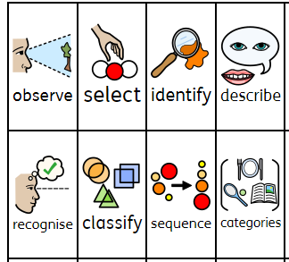
KS1
Vocabulary
Select and use basic geographical vocabulary, terms and language
Geographical features
Recognise, identify and describe geographical features
Enquiry
Ask simple geographical questions. Select information.
Fieldwork
Make simple observations. Identify, describe and categorise
Comparing
Name, identify and describe and compare familiar places
Working
Geographically is about…
Map work
Use world maps, atlases and globes, aerial photographs. Identify and categorise information
Mapwork
Make simple maps and plans
Identify 4 compass points
2 figure grid references
I can:
Weather
Identify, sequence and describe seasonal and daily weather patterns

Slide 2
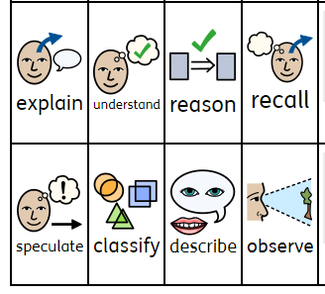
Lower KS2
Vocabulary
Recall, understand and use appropriate geographical vocabulary, terms and language
Geographical Features
Identify and describe human and physical features
Enquiry
Ask and
speculate answers to geographical questions. Analyse evidence and summarise findings
Fieldwork
Observe, measure and record
Comparing and Reasoning
Identify, recognise and understand similarities and differences
Working
Geographically is about…
Map work
Understand 8 compass points
4 figure grid references
I can:
Map work
Interpret a variety of maps. Draw maps with keys.
Weather
Explain weather conditions and weather patterns of the UK and Europe

Slide 3

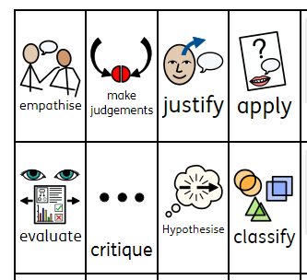
Upper KS2
Vocabulary
Understand and use specialised geographical vocabulary, terms and language
Geographical features
Understand key aspects of physical geography. Understand
human impact
Enquiry
Ask geographical questions. Make judgements Justify conclusions
Fieldwork
Observe, measure and record, present and explain
Comparing
Identify, recognise and understand similarities and differences.
Hypothesise findings
Working
Geographically is about…
Mapwork
Understand and appy 8 compass points
4 and 6 figure grid references
I can
Mapwork
Interpret a variety of maps and use to locate and describe the countries of the world.
Weather
Understand world weather patterns and apply these to climate zones.

