Slide 1
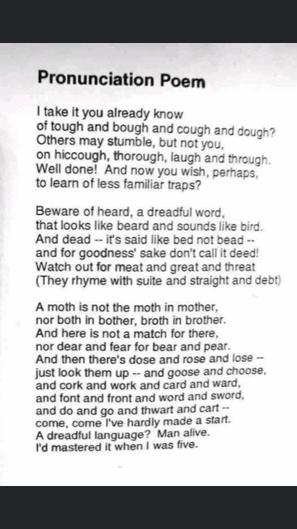
Notes:
ON SCREEN WHILE VISITORS ENTER - SOMETHING TO MAKE THEM THINK

Slide 2
Phonics Workshop
KS1

Slide 3
Read this
Wigh ar wea dueing thiss?
Ie feall sstewppide!
Notes:
Ask what strategies they used.
Phonics? Guess? Context? What skills did they need?
Look at line 1. Can they have a good go at pronouncing the words right?
Now ask questions:
Tell me in your own words what that is about? (eg like we ask pupils to recap a story)
How do you think the character felt?
These are all the sorts of questions we ask pupils. Perhaps they can sound out the words fairly confidently. But do they understand what they are reading?
Why was it easier with the second two? What skills are your relying on though? How might our pupils find this difficult?

Slide 4
What is Phonics?
Phonics is something that is taught everyday in schools.
It is what helps your child to learn to read and write.
Gives them the skills needed for reading and writing plus detailed knowledge of the alphabet.
Taught daily
Taught through Monster Phonics scheme which links closely to our writing.
Phonics is taught to every child in Early Years and Key Stage 1 and continued for children in KS2 who might need it.
Phonics is a progression. Leads to children learning their spellings through spotting the rules.

Slide 5
Phonic Phase Timeline
Phase 1- This is the Nursery phase.
Phase 2- Started towards end of Nursery year and completed in reception.
Phase 3- Reception year.
Phase 4- started towards end of reception completed in year 1.
Phase 5- Year 1
Phase 6- Year 2.
Notes:
The Government base this guide on children who attend full time nursery from 30-50 months.

Slide 6
Glossary
Phonemes: The smallest units of sound that are found within a word,
Grapheme: The spelling of the sound e.g. Th
Digraph: Two letters that make one sound when read e.g. ch, ai, oo
Trigraphs: Three letters that make one sound e.g. air, igh
CVC: Stands for consonant, vowel, consonant.
Segmenting: breaking up a word into its sounds.
Blending: Putting the sounds together to read a word
Tricky words: Words that cannot easily be decoded.

Slide 7
Common Mistakes
Learning the letter names first.
Adding a uh sound
- Sounds must be pronounced properly. https://www.youtube.com/watch?v=BqhXUW_v-1s
Moving children on too quickly.
American computer/iPad games.
Stop and spot first!

Slide 8
Phonics
Children need three essential skills -
Core skill 1 – decode for reading (ability to hear, segment and blend phonemes in words)
Core skill 2 – encode for spelling (ability to recall which letter or letter patterns stand for which phoneme)
Core skill 3 – handwriting (ability to write shapes, words, phrases and sentences fluently and accurately)
Links are vitally important as reflected in the new phonics guidance

Slide 9
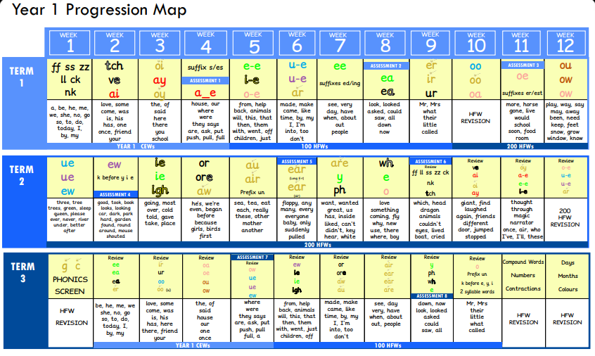
Progression

Slide 10
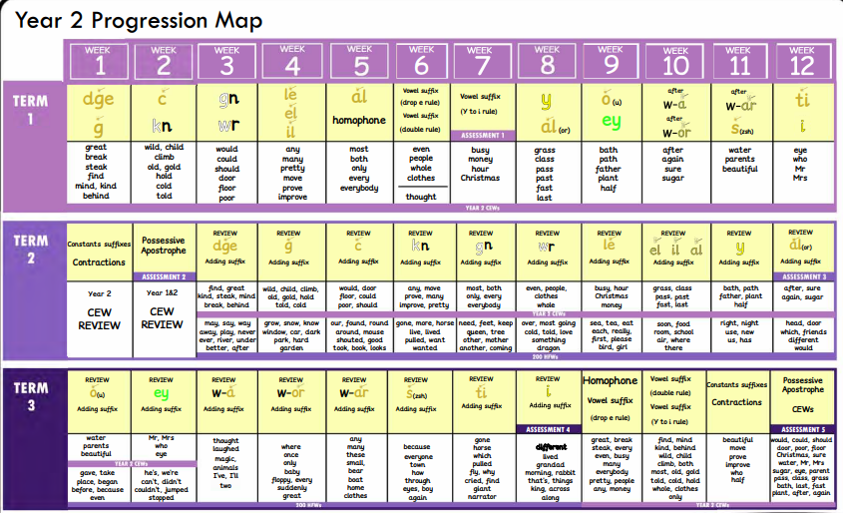
Progression

Slide 11
Tricky Words
There are many words that cannot be blended or segmented because they are irregular.
the was said you some

Slide 12
Homophones and near homophones
There/their/they’re
Here/ hear
Whose/who’s
Accept/ except
Practise/ practice
Draft/draught
See/sea
To/too/two

Slide 13
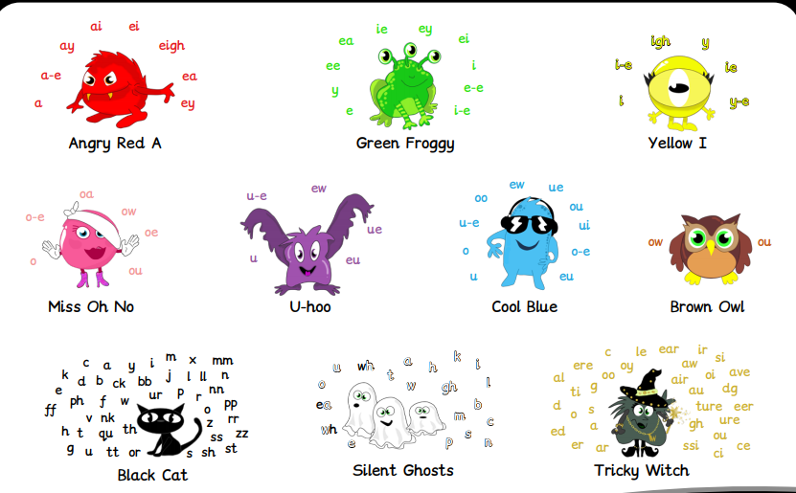
Monsters
https://player.vimeo.com/video/473469797

Slide 14
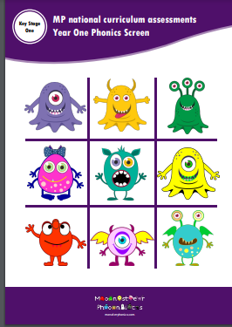
Phonics screening

Slide 15



Phonics screening test
Why are the children being tested?
Every Year 1 child in the country will be taking the phonics screening check in the same week in June.
The aim of the check is to ensure that all children are able to read by the end of year two.
This ‘midpoint check’ will ensure that we have a clear understanding of what the children need to learn in year 2.

Slide 16
What happens during the test?
The test contains 40 words. Each child will sit one-to-one and read each word aloud to a teacher.
The test will take approximately 10 minutes per child, although all children are different and will complete the check at their own pace.
The list of words the children read is a combination of 20 real words and 20 pseudo words (nonsense words).

Slide 17
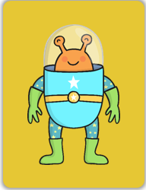
Pseudo Words (Nonsense words)
The pseudo words will be shown to your child with a picture of an alien. This provides the children with a context for the pseudo word which is independent from any existing vocabulary they may have. Pseudo words are included because they will be new to all pupils; they do not favour children with a good vocabulary knowledge or visual memory of words.

Slide 18


Example

Slide 19
Sections of the test
Section 1
The words in section 1 will have a variety of simple word structures (for example CVC, VCC, CCVC and CVCC) using:
single letters (a, b, c, d, e, f, g, h, I, j, k, l, m, n, o, p, q(u), r, s, t, u, v, w, x, y, z)
some consonant digraphs (ch, ck, ff, ll, ng, sh, ss, th, zz)
frequent and consistent vowel digraphs (ar, ee, oi, oo,or)
Section 2
The words in section 2 will have a variety of more complex word structures (for example CCVCC, CCCVC, CCCVCC and two syllable words) with some:
additional consonant digraphs (ph, wh)
less frequent and consistent vowel digraphs, including split digraphs (a-e, ai, au, aw, ay, ea, e-e, er, ew, i-e, ie, ir, oa, o-e, ou, ow, oy, ue, u-e, ur)
trigraphs (air, igh).

Slide 20
The test in action! https://www.youtube.com/watch?v=0ybdc0NHxl8

Slide 21
How is it marked?
The pass mark is set by the DFE and the children will receive either a pass or fail only.
Children who fail to meet the threshold in year 1 will retake the test in year 2
The pass mark for the previous years has been 32/40.
We must take the child’s final answer. If they blend incorrectly or not at all than the answer will be marked as incorrect even if they have segmented correctly.
Children must not add sounds or plurals to the word
Children must not pause when blending
A child’s accent, dialect or speech difficulty will be taken into account.
Children will not be told if they are correct or incorrect and we cannot ask them to try again
We cannot help the children by pointing or directing them
The teacher will not be allowed to help in ANY way. (we cannot point to sounds or help to segment or even tell the children to blend correctly)
A word is marked as incorrect if the child sounds out correctly but doesn’t blend or blends incorrectly. It is also marked wrong if the child blends too slowly. If the child adds an extra sound such as plural it is incorrect. You must take the child’s final answer so if they say it correctly and then say a different word it is incorrect. We cannot ask the child to say it again or give any prompts with our body language.

Slide 22
What do we do with the results?
Children who do not meet the pass mark will be highlighted and supported in year two to help them further with their phonics.
The results often highlight common difficulties or problem graphemes that teachers can spend further time exploring and practising with the children.
You will receive the results with the end of year reports.

Slide 23
Robot Arms & Phoneme Fingers
A way to help children segment by breaking the words up.
. . . . .
l | o | g
f | i | ll
Notes:
Each phoneme/digraph is split into a separate box with a button/line underneath that we encourage the children to press or drag as they say each sound.

Slide 24
Sound buttons
ring
chick
night

Slide 25
Answers
r | i | ng
ch | i | ck
. . _
_ . _
n | igh | t
. _ .

Slide 26
Is there anything I can do at home?
When spelling, encourage your child to think about what “looks right”. Praise your child for trying out words
Have fun trying out different options…wipe clean whiteboards are good for trying out spellings.
tray trai rain rayn
boil boyl boy boi
throat throwt snow snoa
Practise the phonemes together. STOP AND SPOT
Use them to make different words at home and play phonics games,
Useful websites
Read stories, use puppets and toys, sing an alphabet song together, play ‘I spy’, play pairs, create phonic games
Continue to play with magnetic letters, using some two-grapheme (letter) combinations, eg: r-ai-n = rain blending for reading rain = r-ai-n segmenting for spelling
Practice tricky words
REMEMBER: Phonics is not the only thing needed to become a fluent reader.
Please continue to read with your child each night and encourage them to:
Sound out, re-read to check it makes sense, use pictures for clues., ask questions about the book, and most importantly ENJOY READING!

Slide 27
Look out for...
Is your child struggling to decode words- what is it they cannot do? Segment words? Blend words? Identify graphemes? Does he/she stop and spot?
Does he/she child have enough HF words in their vocabulary?
Are they reading with intonation and expression?
Are they aware of and using punctuation?
Does he/ she read in phrases, clauses and sentences?
Does he/ she self correct?
How do they track the text? How are their eyes moving? Do they need to use their finger?

Slide 28
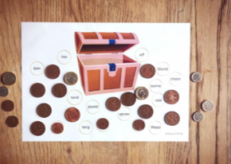
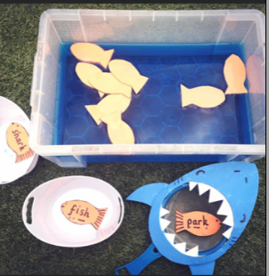
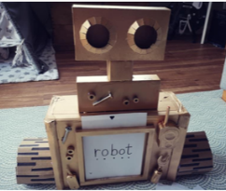
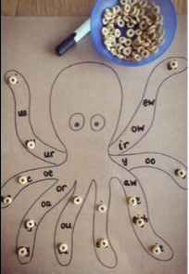
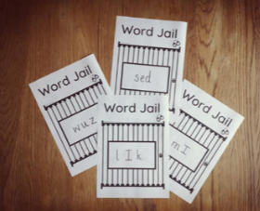
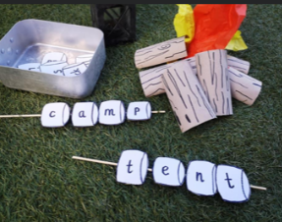
Ideas

Slide 29
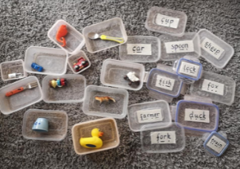
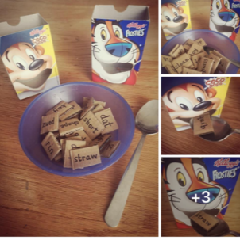
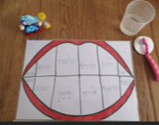
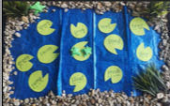

Slide 30
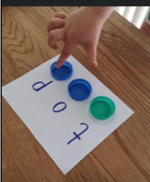
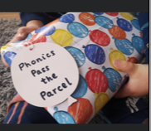
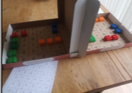
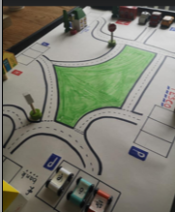
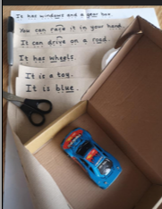
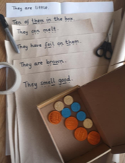

Slide 31
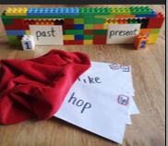
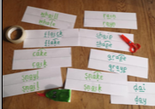
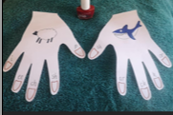
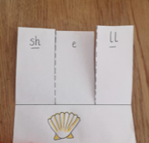
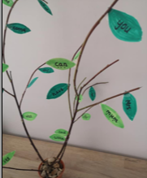
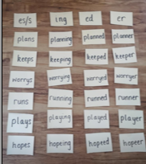
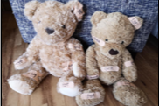

Slide 32


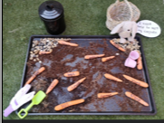


Slide 33
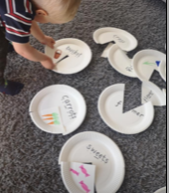
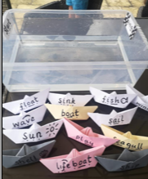
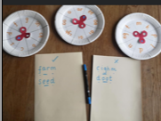
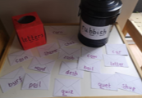
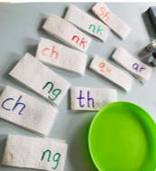


Slide 34
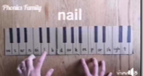
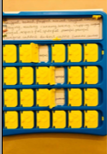

Slide 35
Let’s play some games

Slide 36
Thank you for attending and we hope you found it informative and helpful.

