Slide 1
No Nonsense Spelling
Roebuck Academy
KS1 1st October 2018
KS2 2nd October 2018

Slide 2
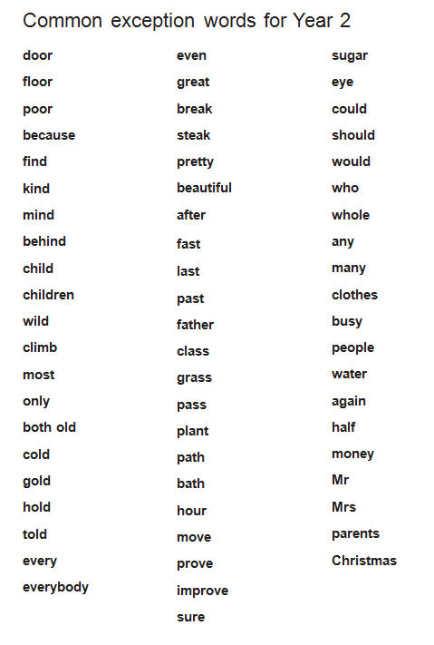
Common Exception Words Year 2

Slide 3
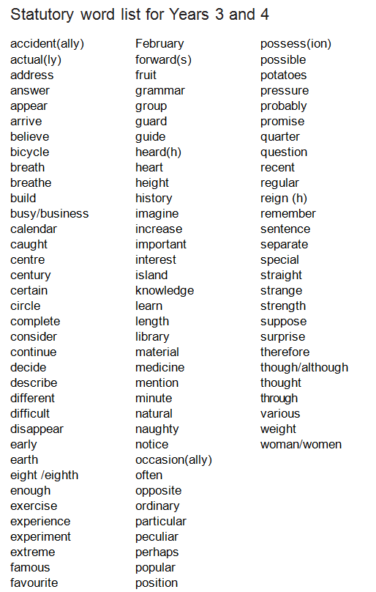
Statutory Word Lists Years 3-4

Slide 4
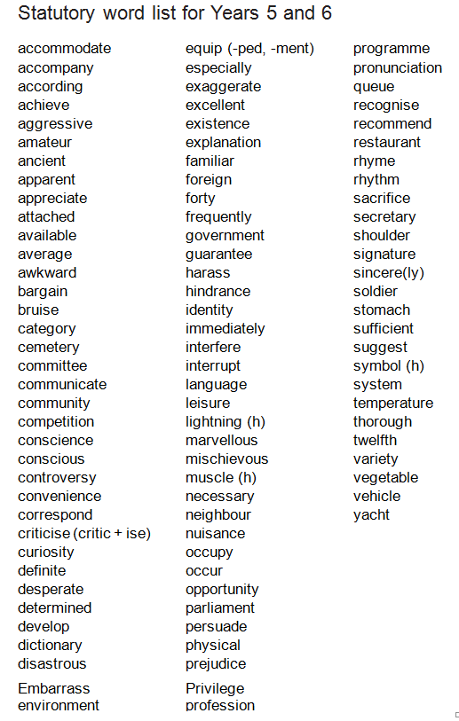
Statutory Word Lists Years 5 -6

Slide 5
Teaching Spellings
Children will be taught spelling every day. Children will spend the beginning of every day being taught spelling. On Wednesday morning children will be taught a discrete spelling lesson lasting approx. 30 minutes. Children will also be taught spelling within the teaching sequence for writing. These lessons will be embedded as part of full teaching sessions.
In these lessons, children will participate in a wide range of activities that will help with their knowledge of spellings. Children will make continual use of their spelling journals. Spelling Journals will be sent home every day along with Reading Record books.

Slide 6
Learning Spelling
Spelling needs to happen both in school and at home. Children will have the opportunity to practise what they have learned in school at home.
Tips for Spellings at home:
Learning at home will be an extension of what has happened in school that day
The number of spellings will be 6 or less a week to ensure success and deeper learning
Pupils should apply the range of spelling strategies which have been taught in school to apply and use in their home learning.

Slide 7
Assessment
Pupils’ learning is assessed throughout the programme – though the format for testing can be a combination of different ways of application:
Testing – teacher and peers
Dictation
Explaining
Independent application in writing activities
Frequent learning & testing of statutory and personal words

Slide 8
Spelling Journals
Spelling journals are more than just a word book. These are to be used both in school and at home and will therefore need to be brought to and from school every day. If you can sign these regularly that would be very helpful.
Journals will contain: words, patterns and spelling rules being taught in schools; errors from writing; statutory words etc.
Children should spend a few minutes at home most days learning any of the words included in the journal using any of the spelling strategies.

Slide 9
Spelling Journals
They are to be used for:
Practising strategies
Learning words
Recording rules/conventions/generalisations as an aide memoire
Word lists of tricky words (spelling enemies)
Having a go at the point of writing
Ongoing record of statutory words learnt
Investigations
Recording spelling targets or goals
Spelling tests

Slide 10
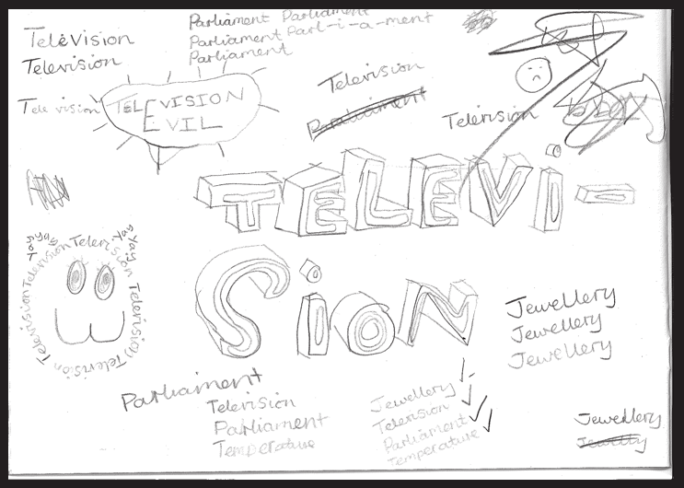
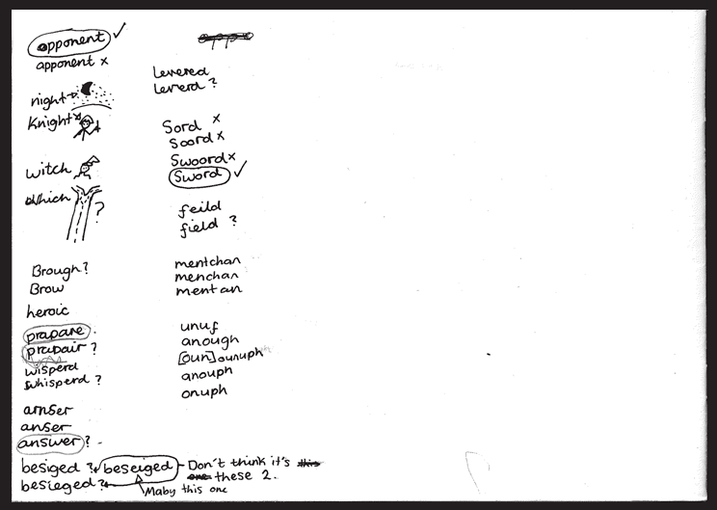
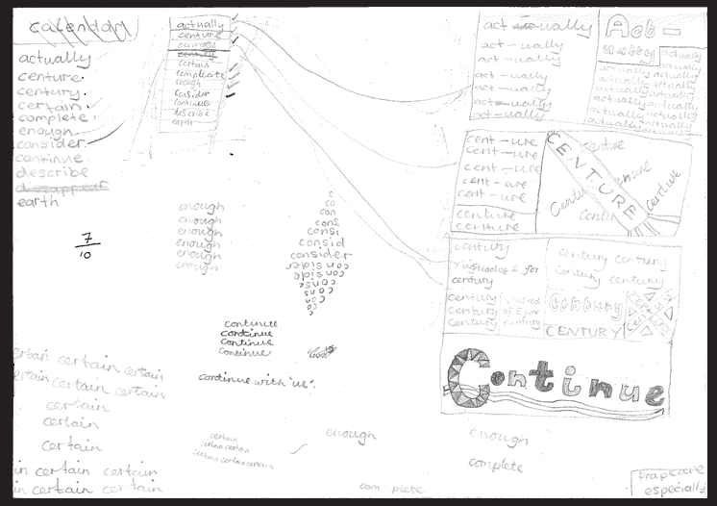
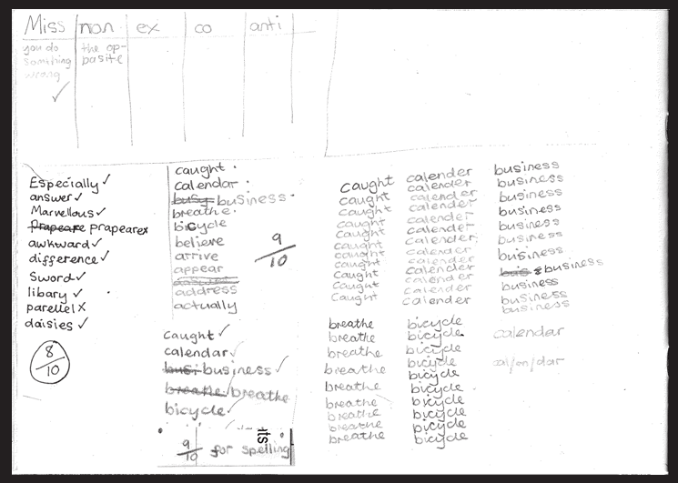

Slide 11
Look, say, cover, write, check
This is probably the most common strategy used to learn spellings.
Look: first look at the whole word carefully and if there is one part of the word that is difficult, look at that part in more detail.
Say: say the word as you look at it, using different ways of pronouncing it if that will make it more memorable.
Cover: cover the word.
Write: write the word from memory, saying the word as you do so.
Check: Have you got it right? If yes, try writing it again and again! If not, start again – look, say, cover, write, check.

Slide 12
Quickwrite
Writing the words linked to the teaching focus with speed and fluency. The aim is to write as many words as possible within a time constraint.
Pupils can write words provided by the teacher or generate their own examples. For example, in two minutes write as many words as possible with the ough letter string.
This can be turned into a variety of competitive games including working in teams and developing relay race approaches.

Slide 13

Drawing around the word to show the shape
Draw around the words making a clear distinction in size where there are ascenders and descenders. Look carefully at the shape of the word and the letters in each box. Now try to write the word making sure that you get the same shape.
totally

Slide 14

Drawing an image around the word
This strategy is all about making a word memorable. It links to meaning in order to try to make the spelling noticeable.
Monarchy
You can’t use this method as your main method of learning spellings, but it might work on those that are just a little more difficult to remember.

Slide 15
Words without vowels
This strategy is useful where the vowel choices are the challenge in the words. Write the words without the vowels and the pupils have to choose the correct grapheme to put in the space. For example, for the word field:
f ld

Slide 16
Pyramid words
This method of learning words forces you to think of each letter separately.
p
p y
p y r
p y r a
p y r a m
p y r a m i
p y r a m i d
You can then reverse the process so that you end up with a diamond!

Slide 17
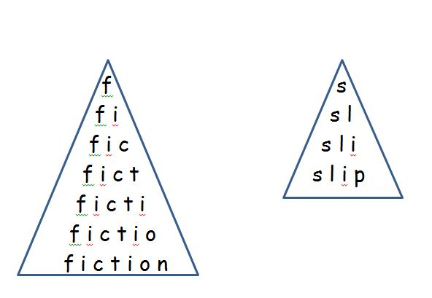

Slide 18
Other strategies
Other methods can include:
Rainbow writing: Using coloured pencils in different ways can help to make parts of the word more memorable.
  You could highlight the tricky parts of the word or write the tricky part in a different colour, or write the word in red, then overlay in orange, yellow and so on.
Making up memorable ‘silly sentences’ containing the word.
Saying the word in a funny way – for example, pronouncing the silent letter in the word. E.g. Knight.
Clapping and counting to identify the syllables in the word.

Slide 19
Reading – what is done at school to support reading
Guided Reading daily
Drop Everything and Read
Reading buddies
Class book (3:00-3:15)
Individual incentives for reluctant readers
Accelerated reader programme
Home Help
Reading x 5 a week
Signed reading records bought in every Thursday
Visits to local library
BOOK TALK

Slide 20


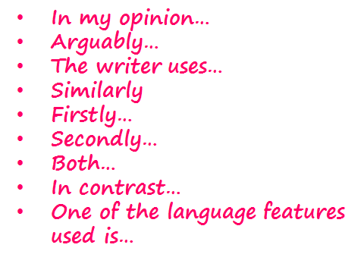

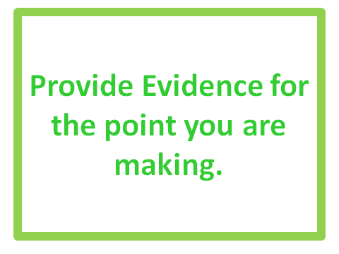
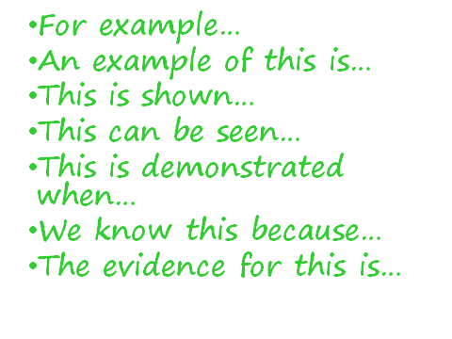
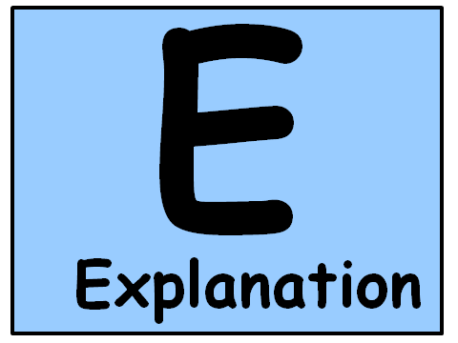
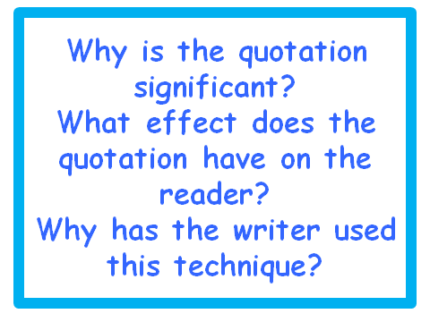
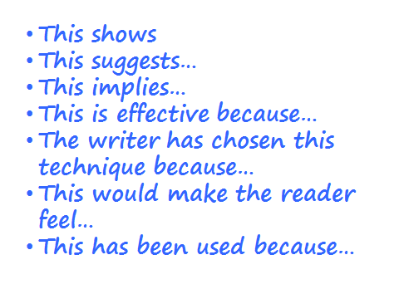

Slide 21
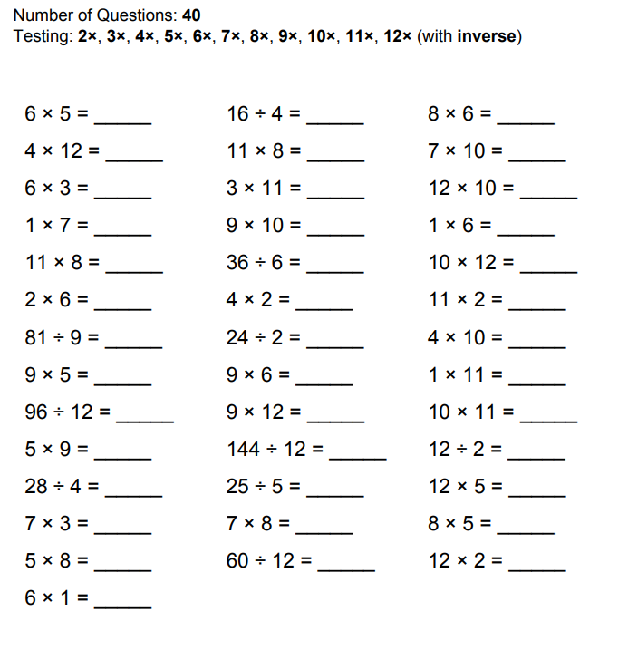
Times Tables
Mild: 2, 5, 10
Spicy: 2, 5, 10, 3, 6, 9
Hot: 2, 5, 10, 3, 6, 9, 4, 8, 7, 11, 12
Ways to learn:
Chanting
Making links
Games

Slide 22
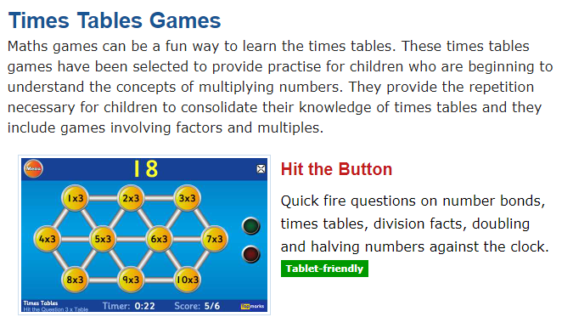
https://www.topmarks.co.uk/maths-games/7-11-years/times-tables

Slide 23
Thank you for coming
Working together, we can help enable your child to make the best possible progress.
Look out for your child’s spelling journal and reading record.
Ensure it is in school every day.

