Slide 1
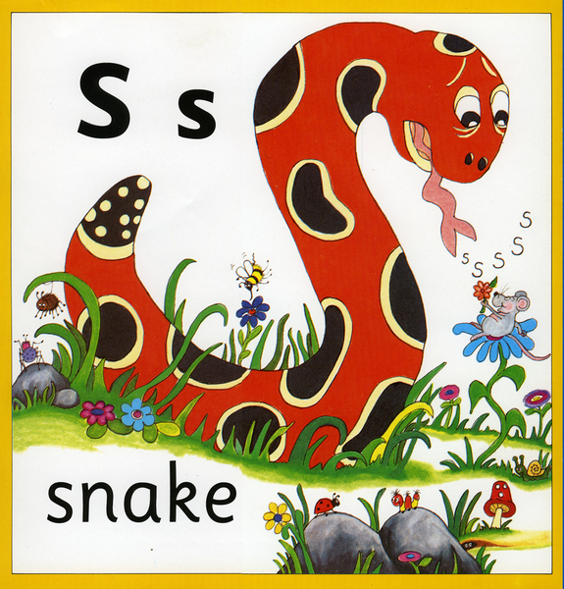
Phun with Phonics!

Slide 2
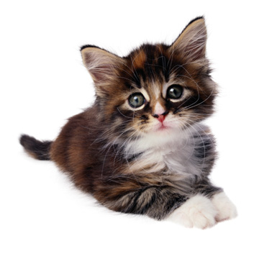
What is a phoneme?
It’s a unit of sound.
How many sounds in cat?
c a t
•
•
•

Slide 3
How often do we teach it?
We teach phonics EVERY DAY!
We enjoy phase 1 activities throughout the year – rhyming, I spy, listening game
Phase 2 – 6 weeks (19 phonemes) then assess
Phase 3 – 11 weeks (26 phonemes) then assess
Phase 4 – 5 weeks (ccvc and cvcc words) then assess
Phase 5a – 4 weeks (16 phonemes)

Slide 4


How do we teach it?
Learning through actions, pictures, stories and sounds.

Slide 5
The first sounds…
We teach the sounds not the letter names.
The first set of sounds we teach are:
s a t p i n

Slide 6
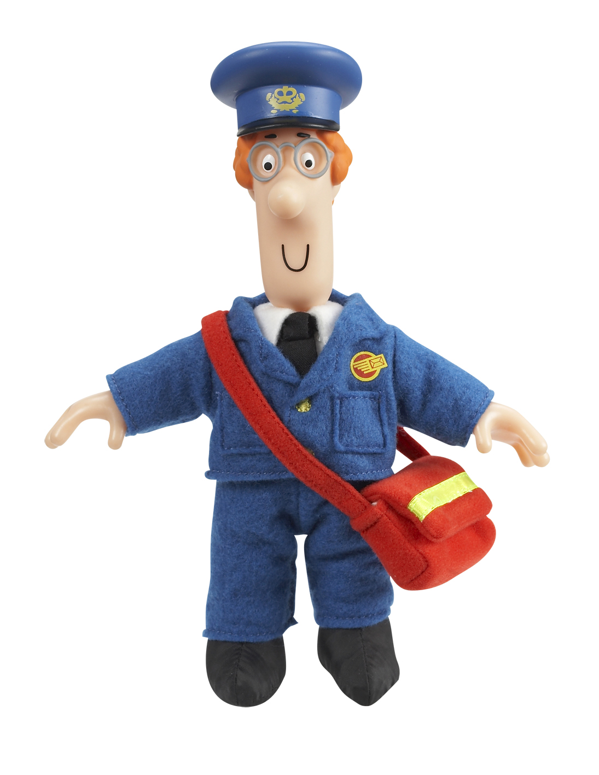

Making words
Once children know these sounds we can start making words.
sat
pin
nip
sit
pit
pat
pip
sip

Slide 7
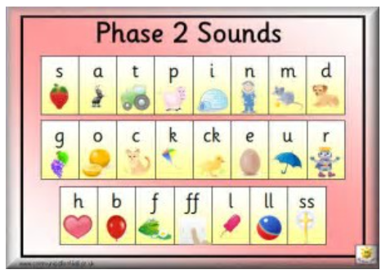

Slide 8


Phonic apps
https://www.youtube.com/watch?v=COJdn6sbbsk

Slide 9

Mr Thorne
https://www.youtube.com/watch?v=vMEvxTGvi4c&list=PLqh11DN6jmbCsIPschffPaxvCdS9d6qPN

Slide 10

Where it gets a bit tricky…
There are 42 phonemes to teach in total.
Some of these phonemes are made up of more than one letter including…
ai as in rain
oa as in boat
sh as in shop
These are called diagraphs – 2 letters that make 1 sound

Slide 11
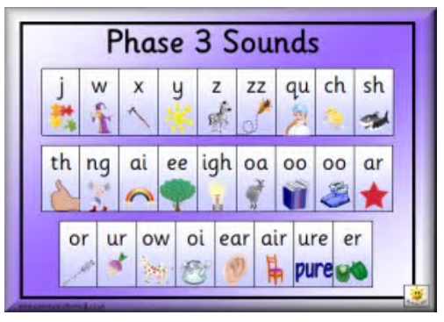

Slide 12
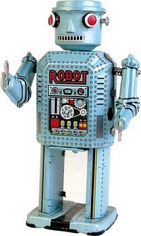
Robot talk…

Slide 13
Now it gets even trickier…
Tricky words are words that can’t be sounded out – we just have to remember them!
the go no I he me she we
We will be sending home reception word in your child’s reading record book. Please look at them with your child. The more that they are exposed to these words, the easier they will find it to read and write them.

Slide 14

Reading is not just about the words…
- before opening the book, talk about what the book might be about
- practice the sounds on the inside cover
- If you only try a page or 2, that’s OK. The key is little and often.

Slide 15

Stages of reading..
- If your child memorises the words, don’t worry this is normal as children have a very good memory for things like this. To give your child a little bit of a challenge see if they can point to any sounds they recognise. You can also ask them questions about the pictures and the story.
Our school policy is that you read with your child at least 5 times a week but this could be any book including you reading to them. Please log this in their reading record.

Slide 16
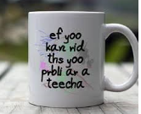
Writing phonetically…
The teecha can hlp the childurn to rIt.
Yoo can hellp too
Fank yoo for cumng hear

Slide 17
Thank you!!!
Thank you for coming to this workshop
We want to work together to provide the best learning for your child.
Questions?

