Slide 1
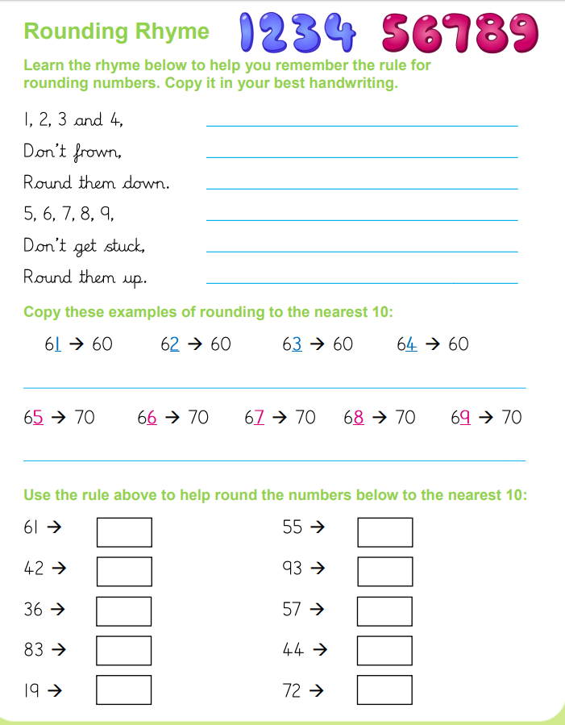
Tuesday 2nd June
Handwriting

