Slide 1
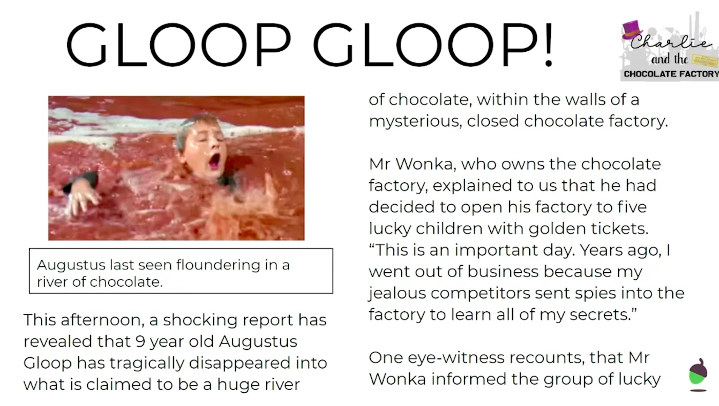
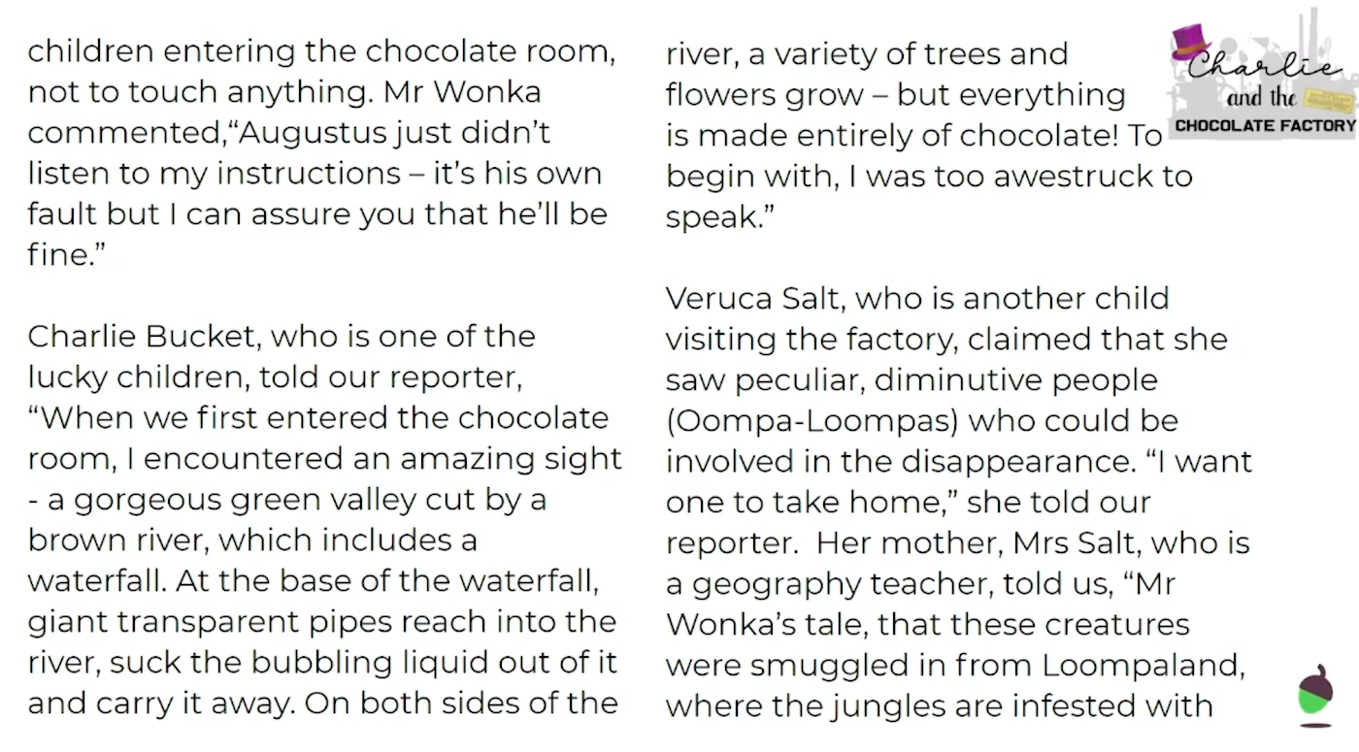
THIS TEXT WILL BE USED IN MULTPLE LESSONS THIS WEEK.

Slide 2
THIS TEXT WILL BE USED IN MULTPLE LESSONS THIS WEEK.

Slide 3
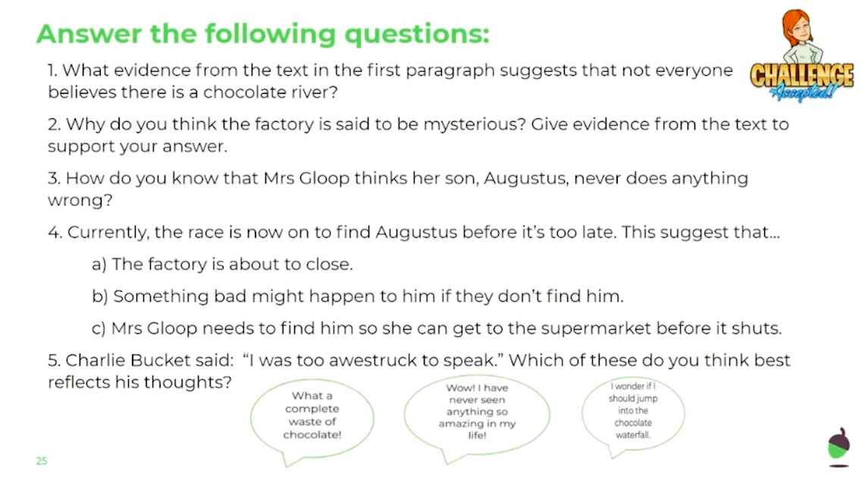
LO: To explore inference style questions.
Tuesday 2nd June
Use the ‘GLOOP GLOOP’ news report.
_________________________________
_________________________________
_________________________________
_________________________________
_________________________________
_________________________________

Slide 4
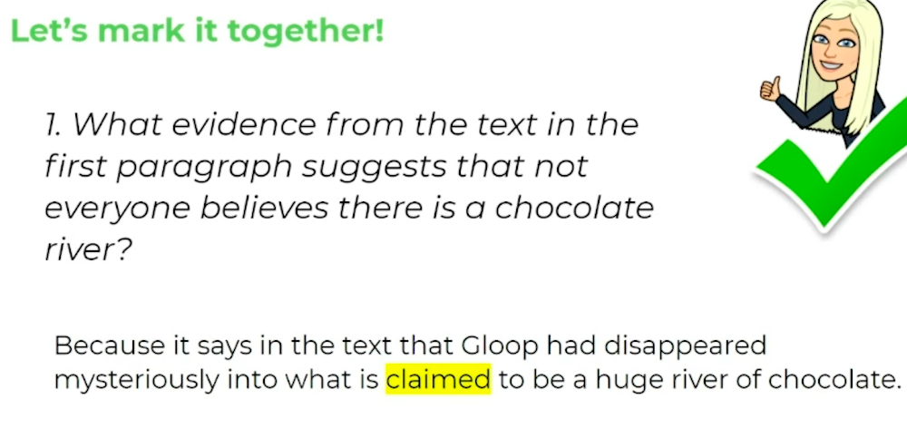
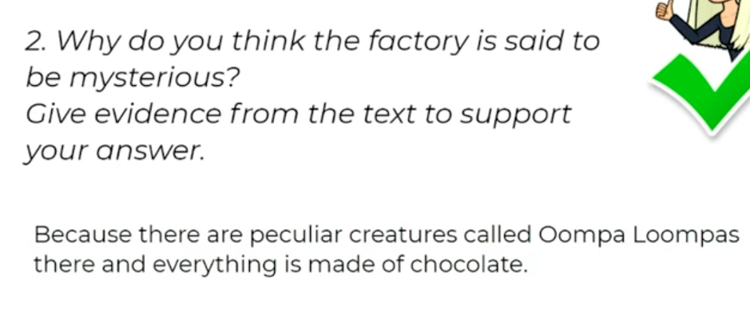
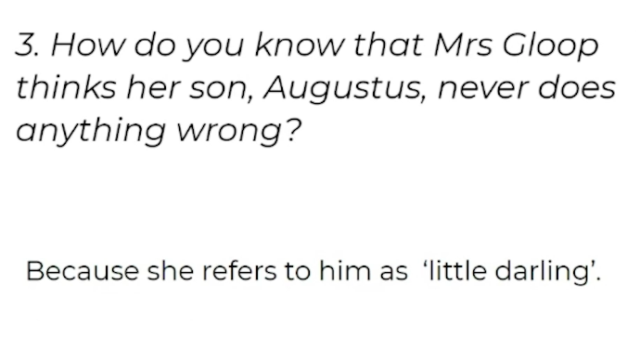
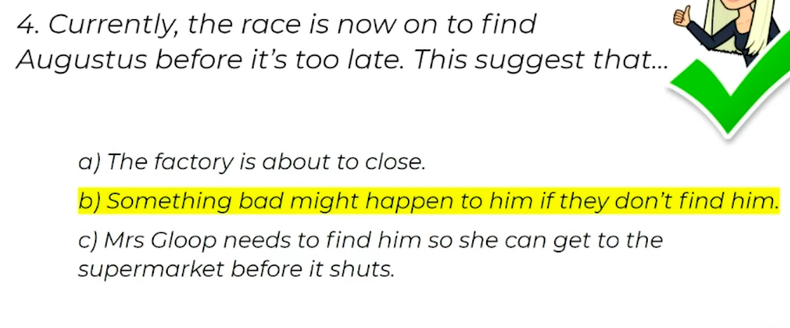
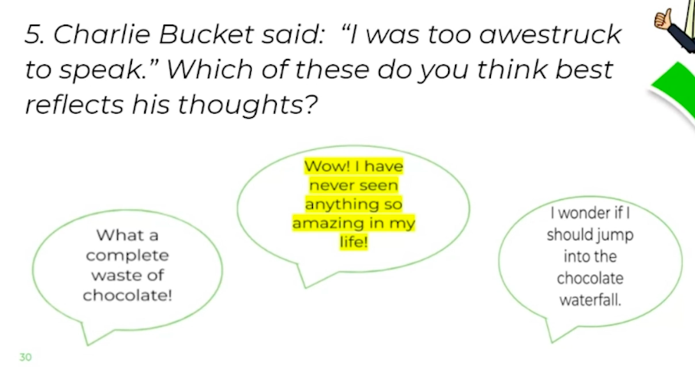
LO: To retrieve facts from a text.
Monday 1st June
ANSWER SHEET

