Slide 1
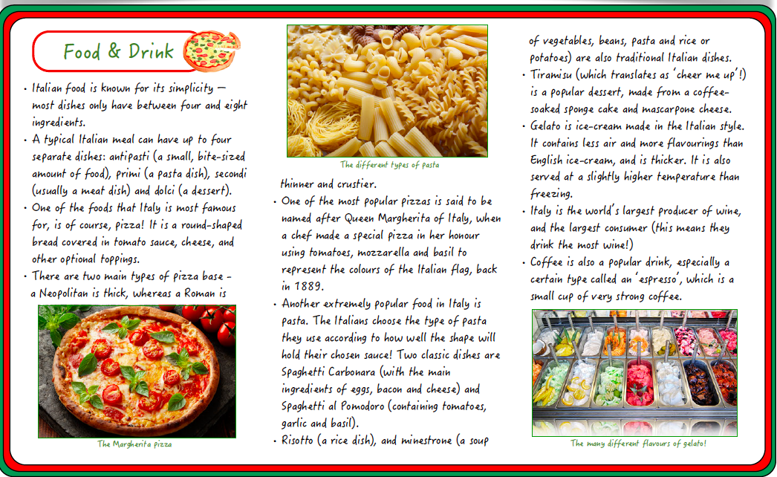
Italy Culture Information Sheets
Wednesday 3rd June

Slide 2
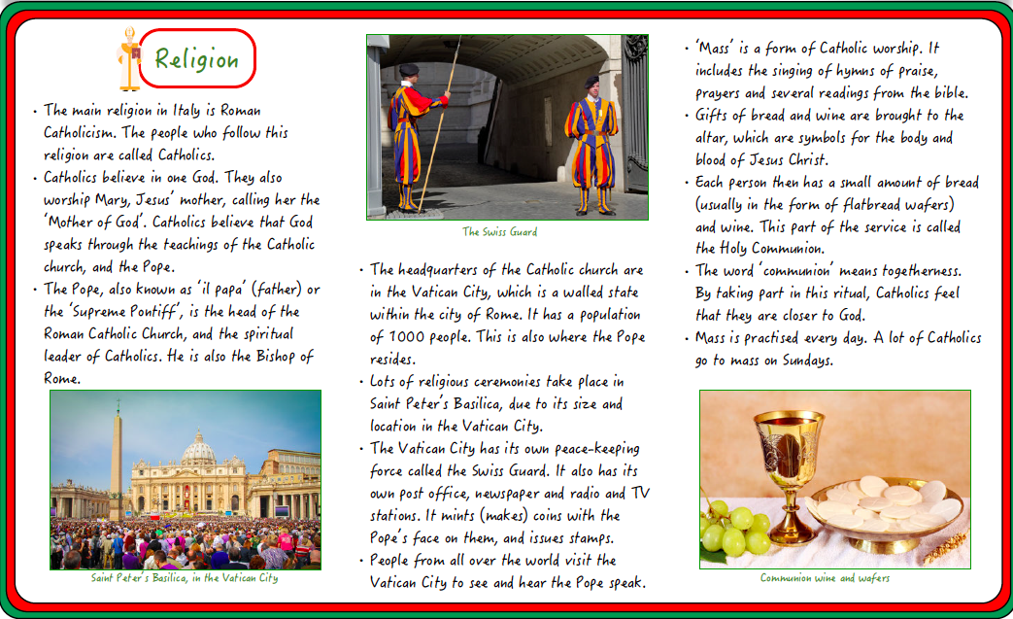
Italy Culture Information Sheets
Wednesday 3rd June

Slide 3
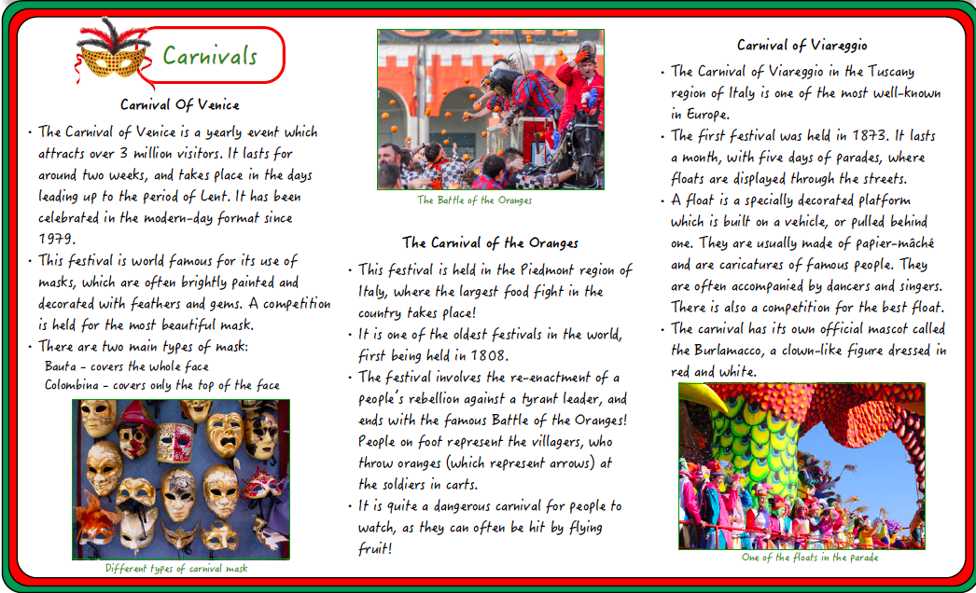
Italy Culture Information Sheets
Wednesday 3rd June

Slide 4
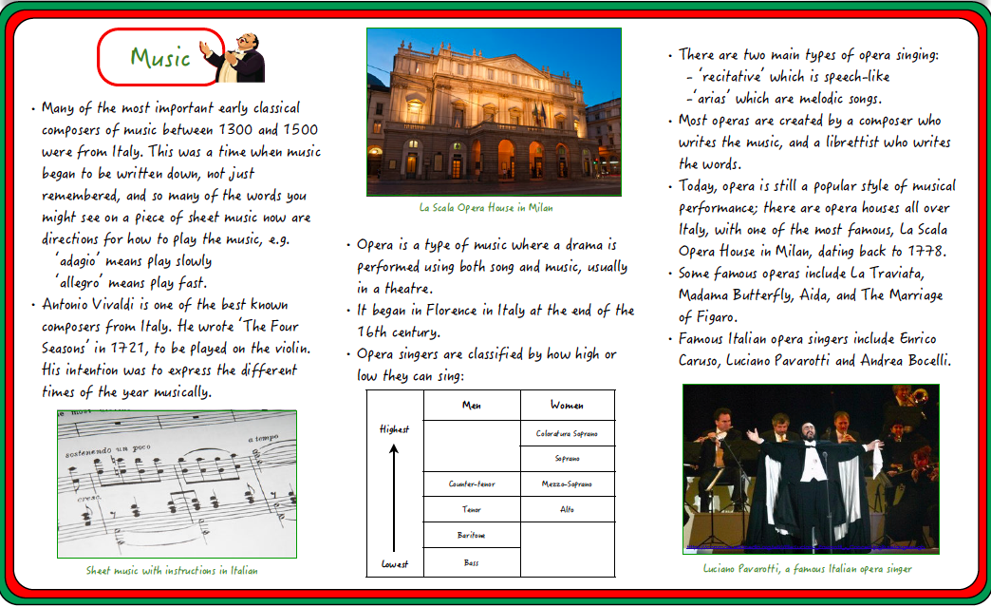
Italy Culture Information Sheets
Wednesday 3rd June

Slide 5
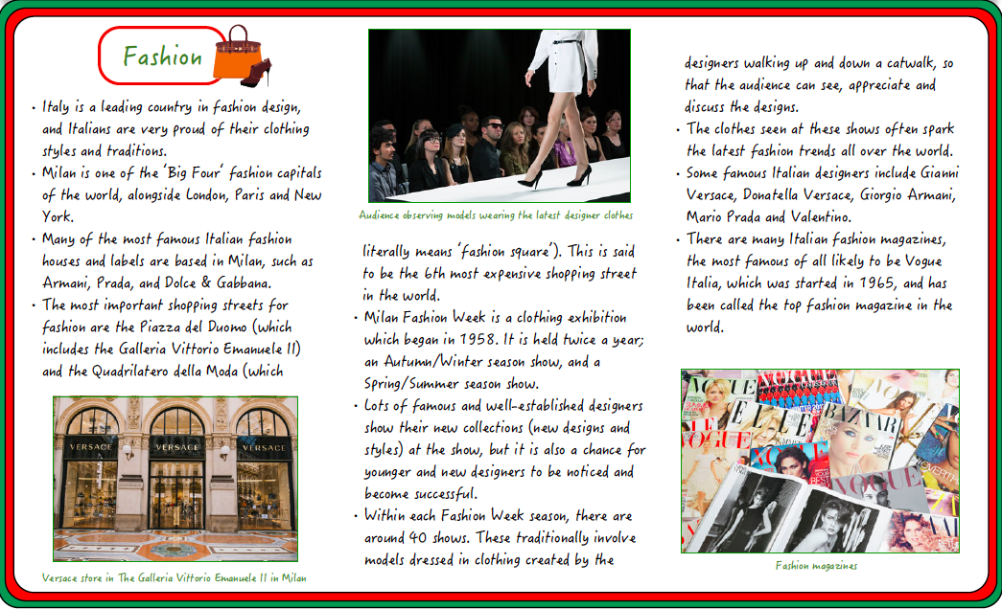
Italy Culture Information Sheets
Wednesday 3rd June

Slide 6
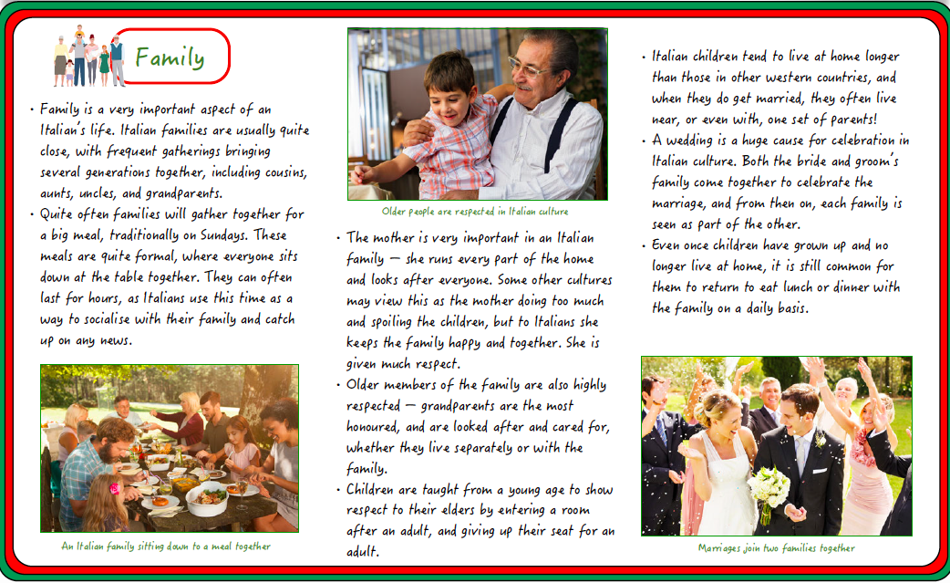
Italy Culture Information Sheets
Wednesday 3rd June

