Slide 1
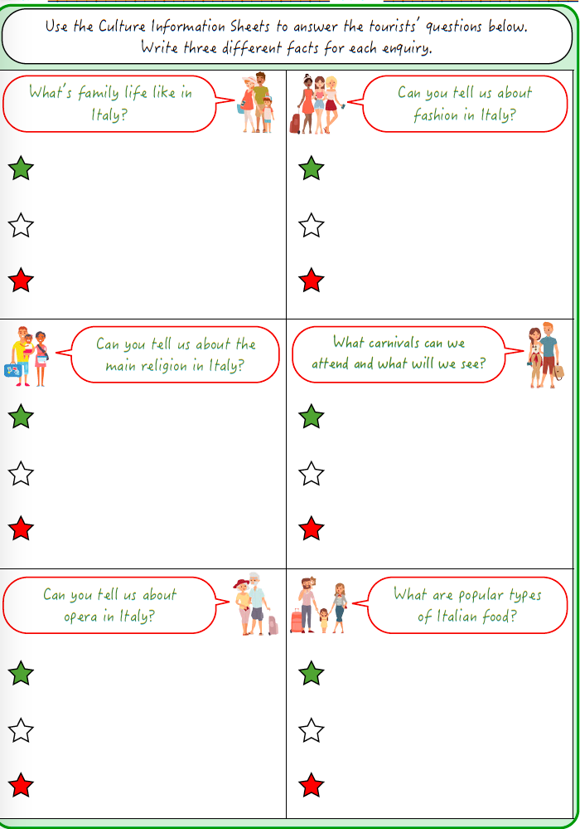
LO: To learn and know about Italian culture.
Mild Worksheet:

Slide 2
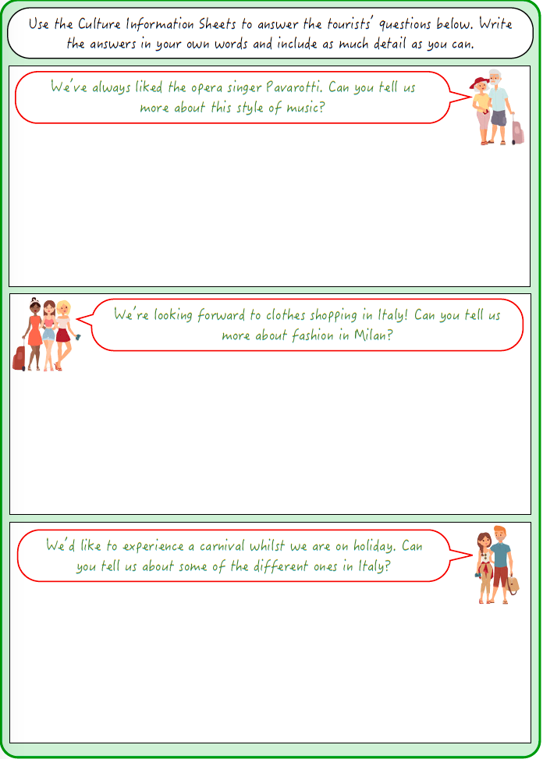
LO: To learn and know about Italian culture.
Spicy/Hot Worksheet:

Slide 3
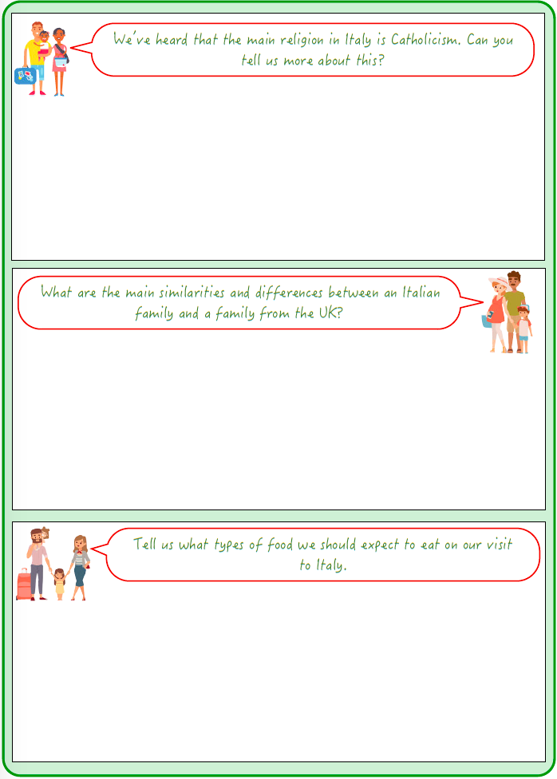
LO: To learn and know about Italian culture.
Spicy/Hot Worksheet 2:

