Slide 1
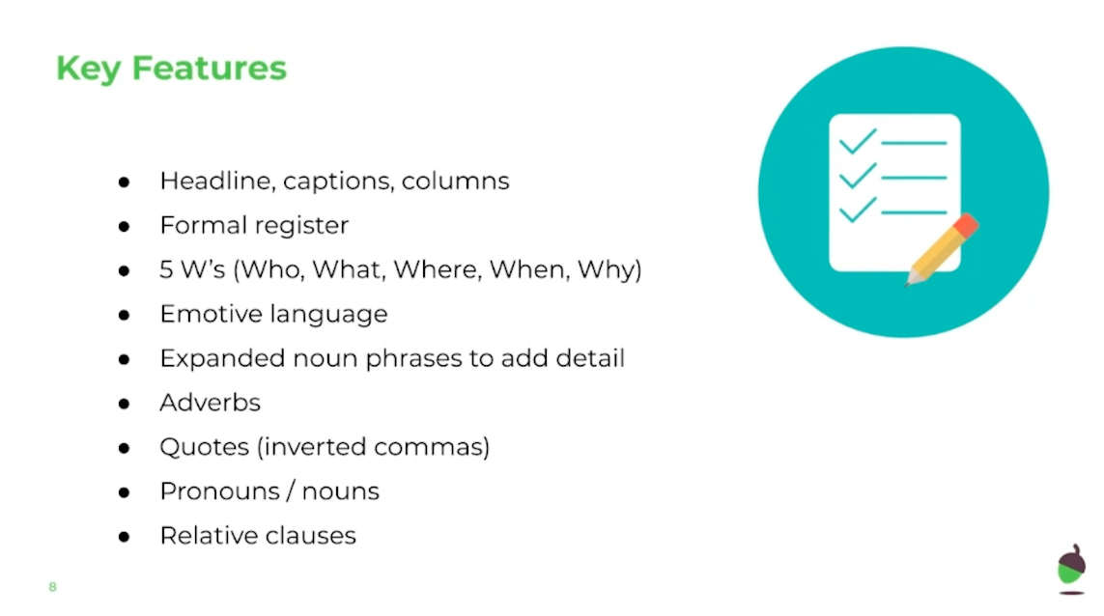
LO: To identify key features of a news report
Wednesday 3rd June
Watch the video for today’s lesson, Miss O’Reilly will identify features in the ‘Gloop Gloop’ report. Then answer questions about another report once you have read it.
Miss Smith said “I couldn’t believe what I was seeing, I was in shock!”
Using a relative pronoun like ‘that’, ‘which’, ‘who’, ‘whose’, ‘where’ and ‘when’

Slide 2
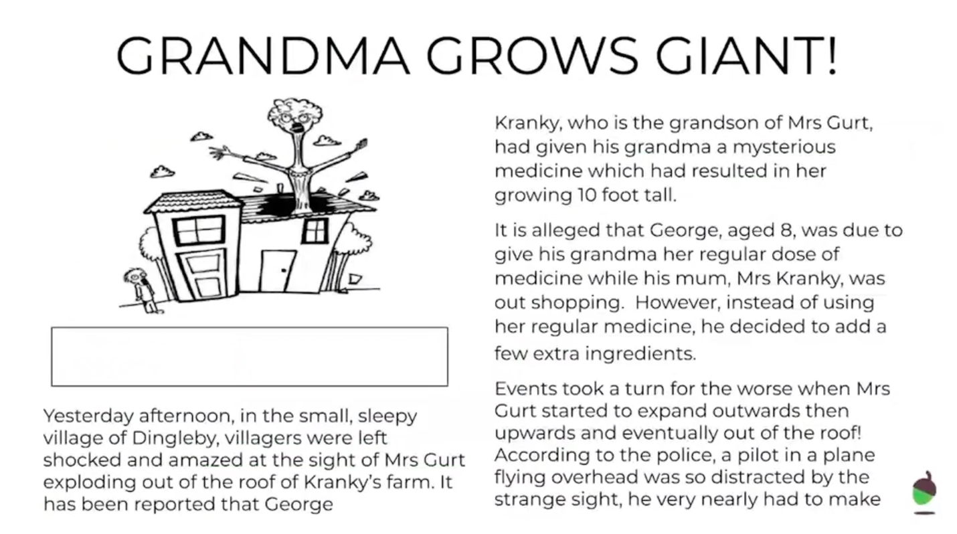
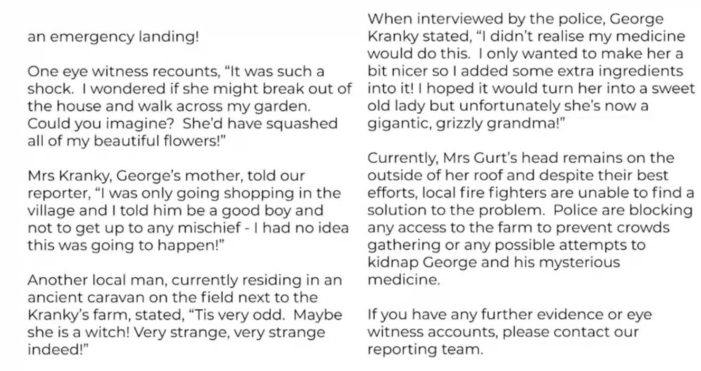
LO: To identify key features of a news report
Wednesday 3rd June
Once you have watched the video, read the report below. When you are ready, go on to the questions about the features of this report.

Slide 3
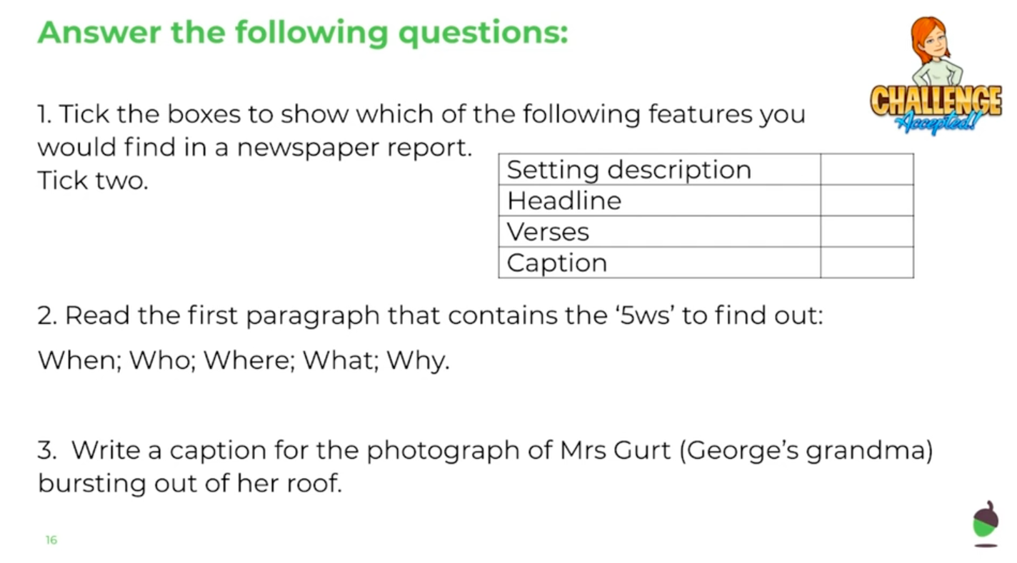
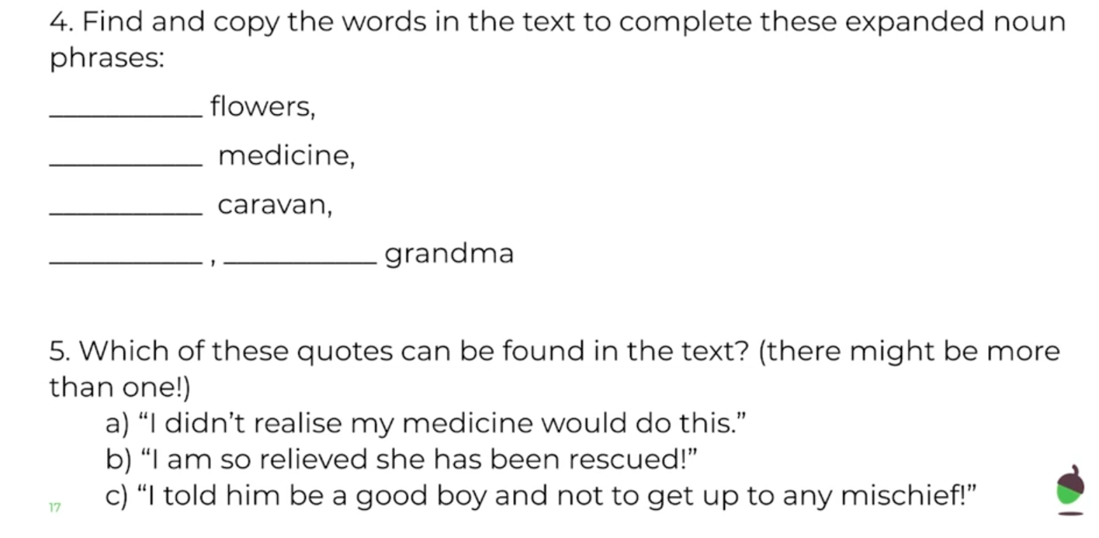
LO: To identify key features of a news report
Wednesday 3rd June
____________________________________
____________________________________
____________________________________
____________________________________

Slide 4
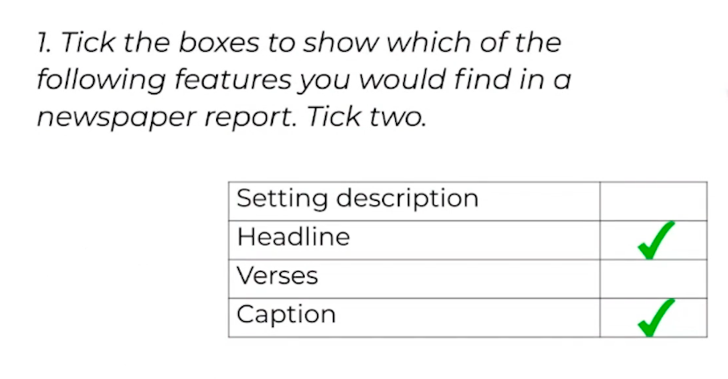
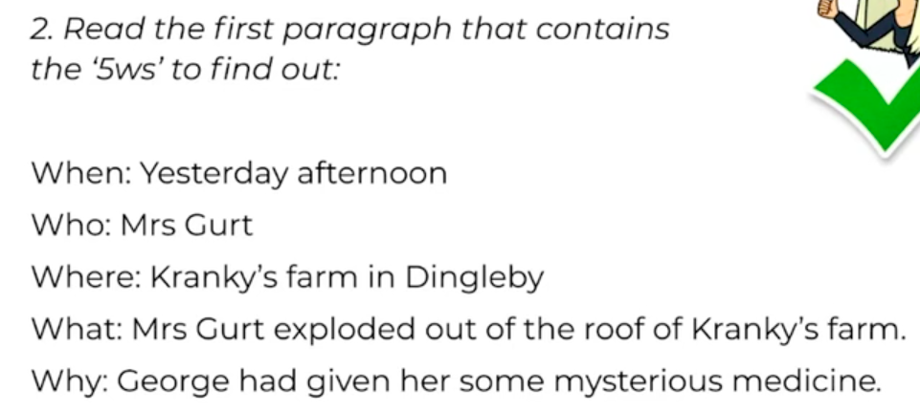
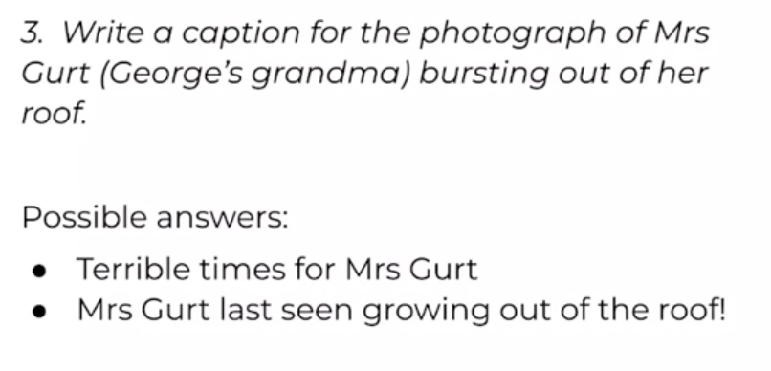
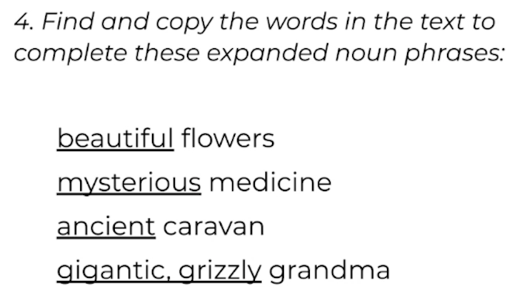
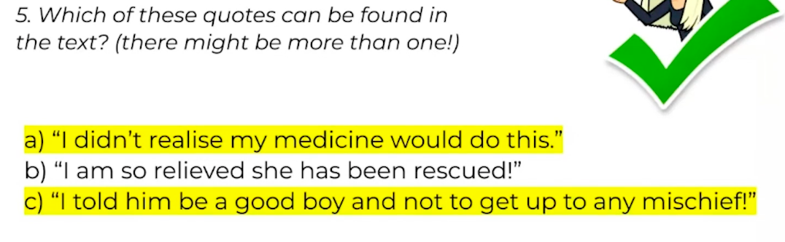
LO: To identify key features of a news report
Wednesday 3rd June
ANSWER SHEET

