Slide 1
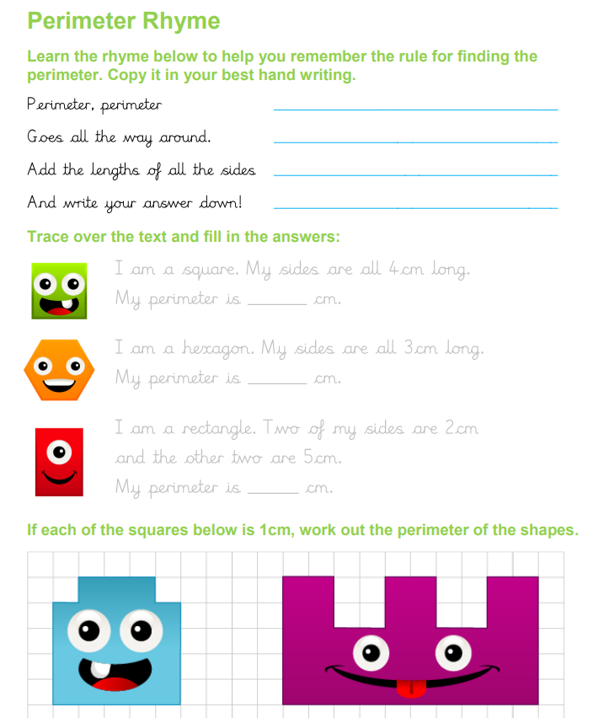
Thursday 4th June
Handwriting

