Slide 1
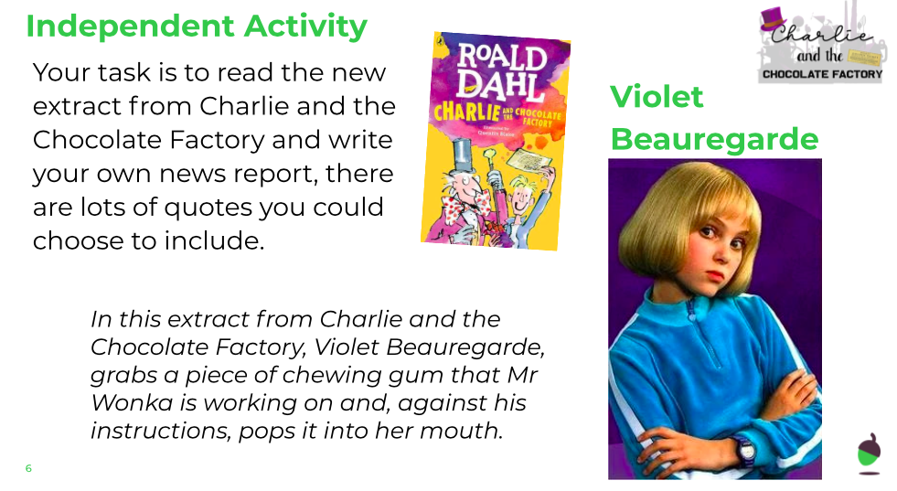
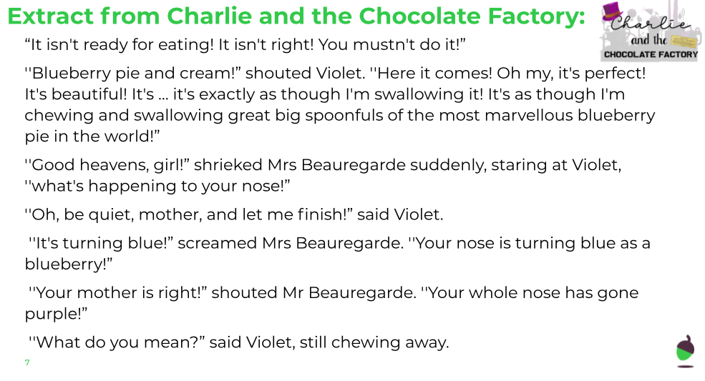
LO: To write a news report
Friday 5th June
Watch the video about Violet’s inflation from Charlie and The Chocolate Factory. https://www.youtube.com/watch?time_continue=1&v=FcqZynKuqhI&feature=emb_title
You will use the video to inspire the writing of your own newspaper report.

Slide 2
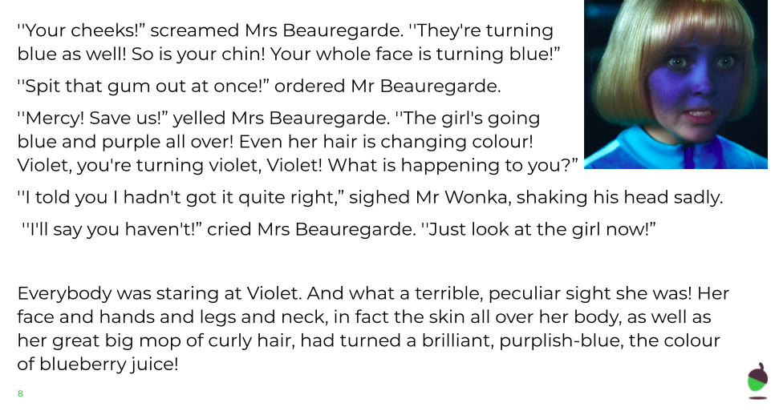
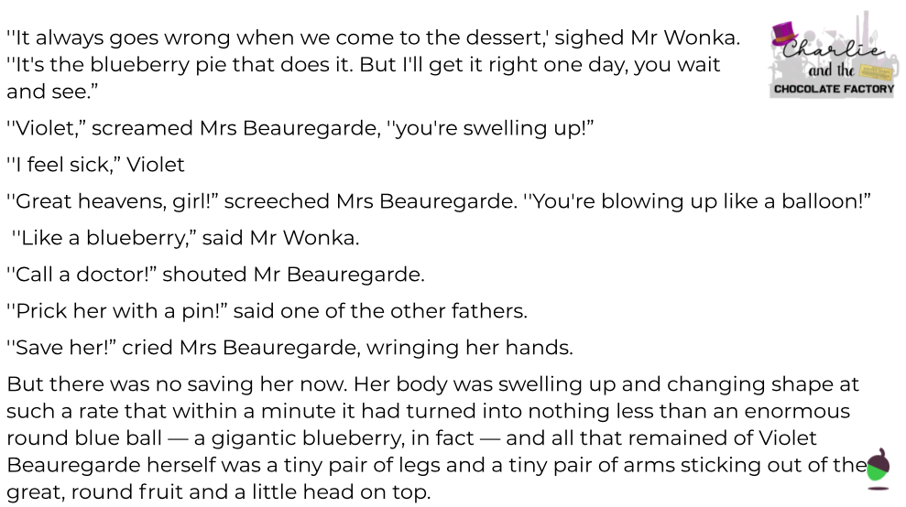
LO: To write a news report
Friday 5th June

Slide 3
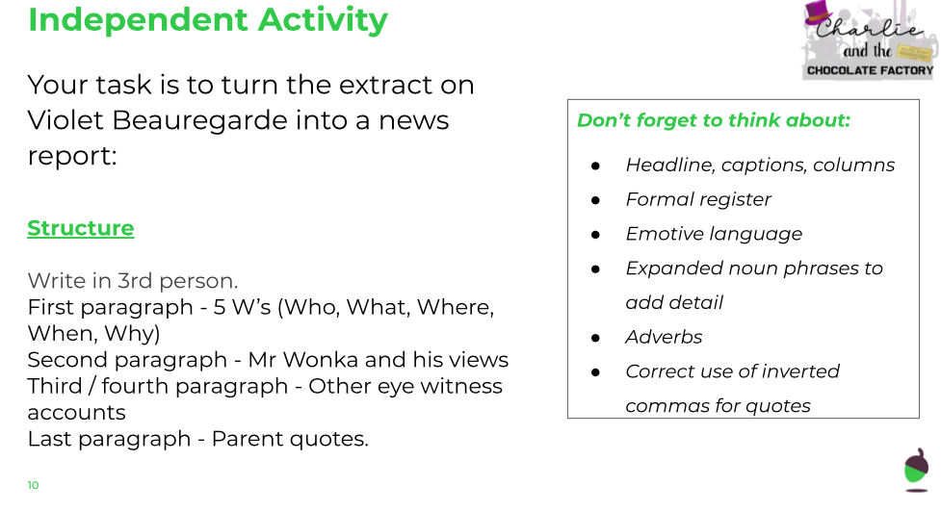
LO: To write a news report
Friday 5th June

Slide 4
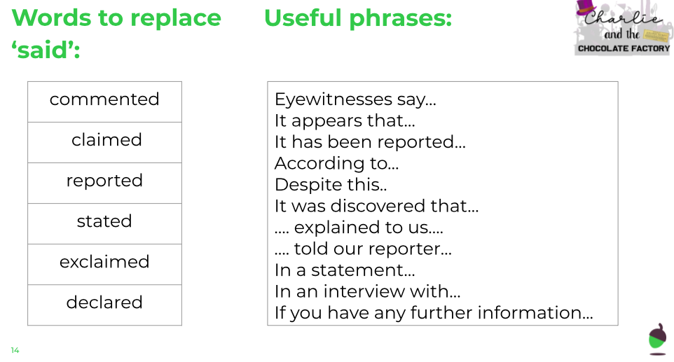
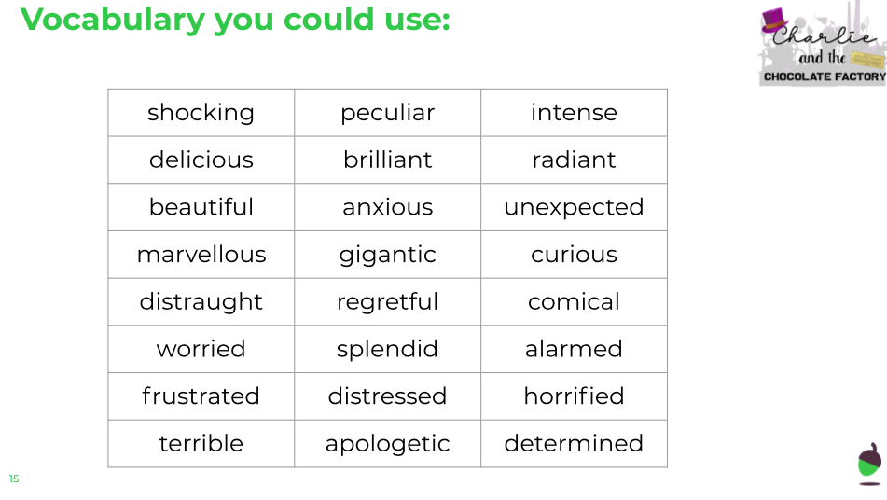
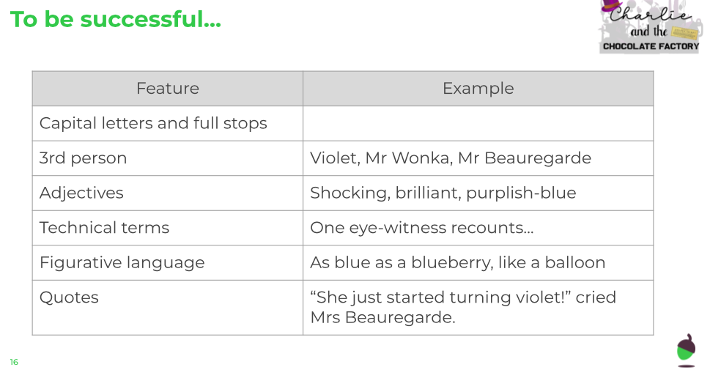
Helpful Writing Resources
LO: To write a news report
Friday 5th June

