Slide 1
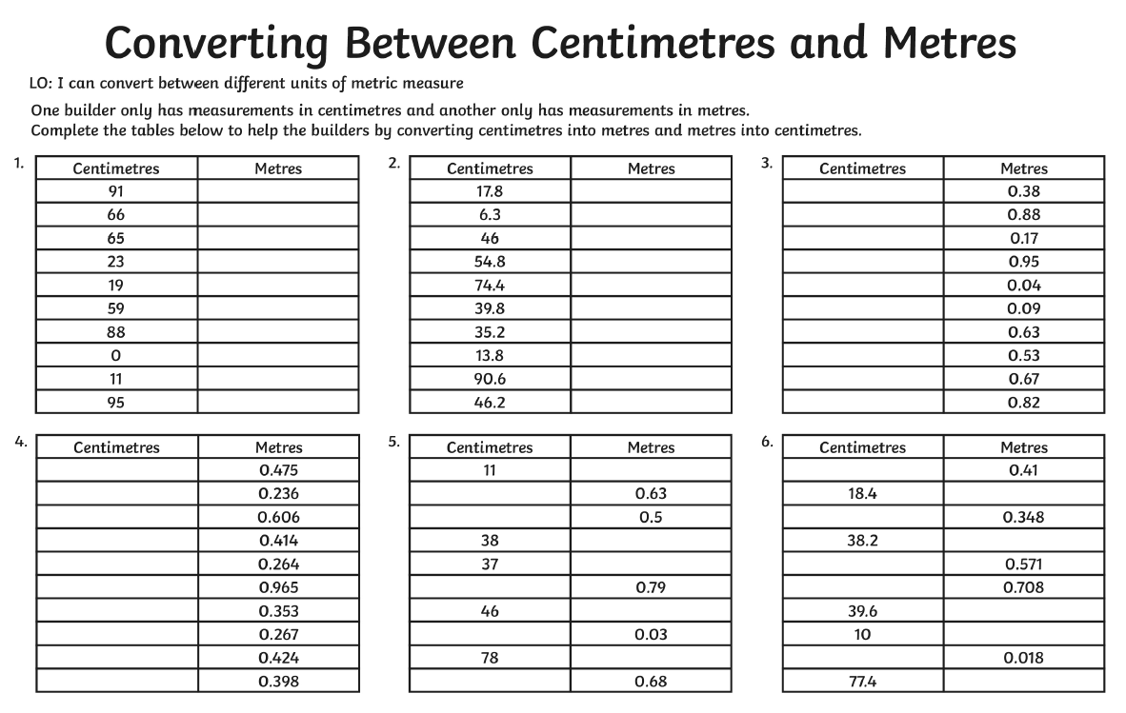
Needs Water
Friday 5th June

Slide 2
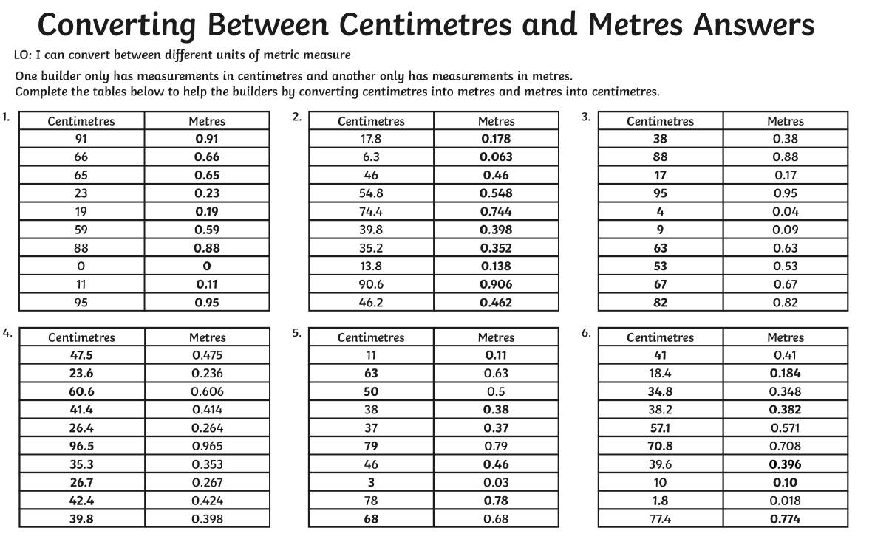
Needs Water
Friday 5th June

