Slide 1
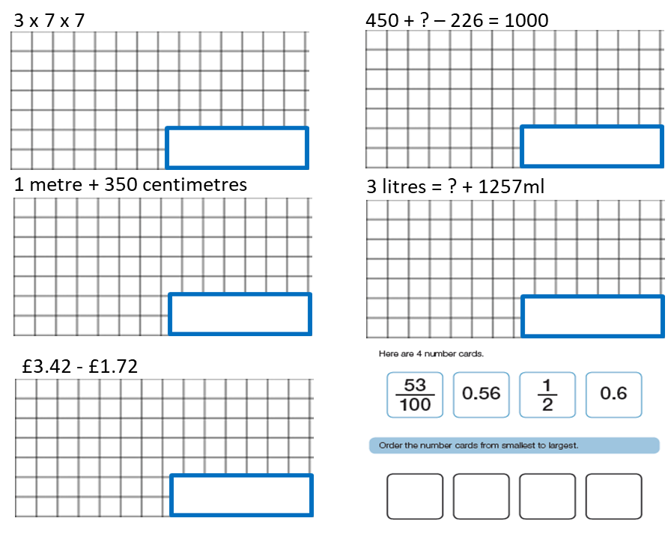

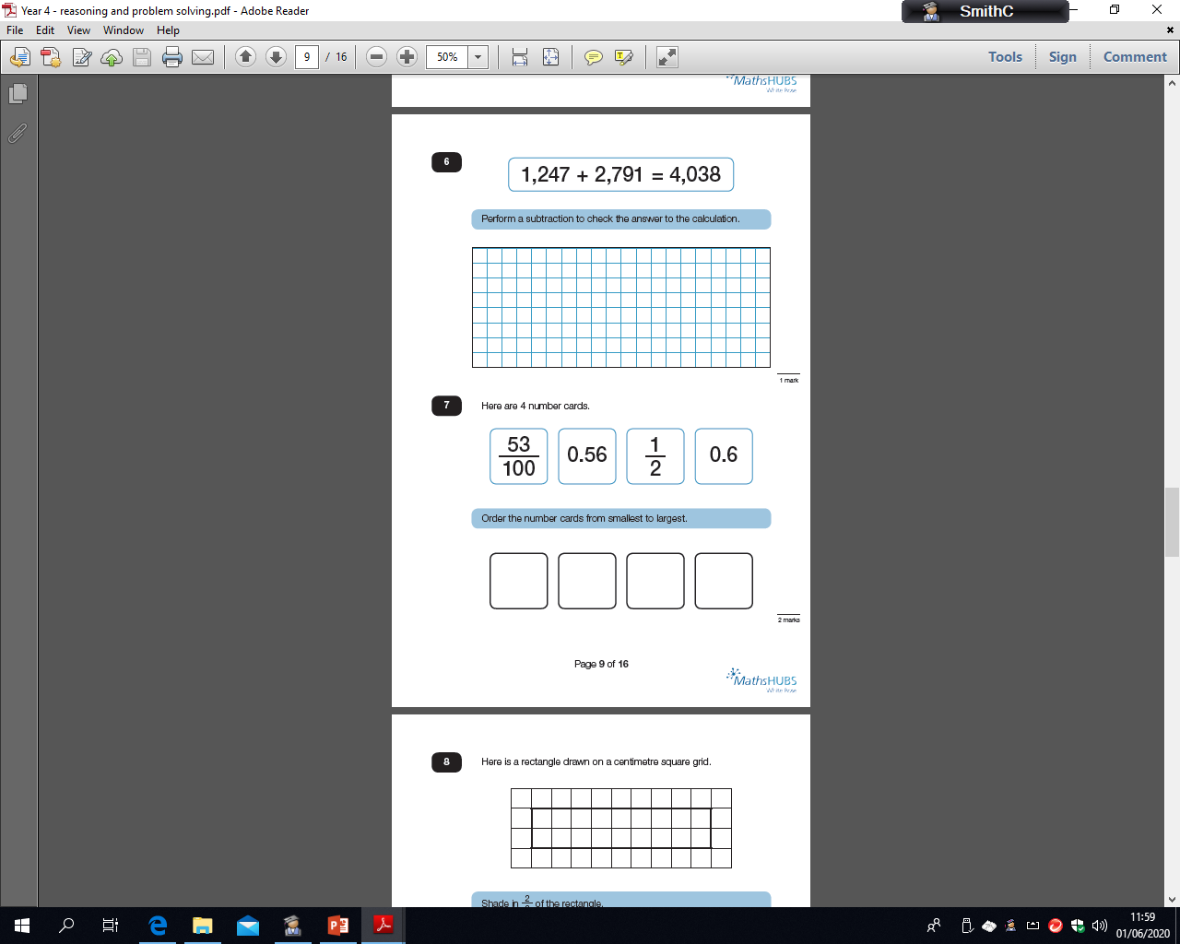
08.06.20
cm
4 x 5 x 5
09.06.20
670 + ? – 136 = 1000
6 metre + 260 centimetres
5 litres = ? + 3790ml
cm
£6.81 - £4.93
31
100
1
10
0.4
0.28

Slide 2
2 x 8 x 8
10.06.20
620 + ? – 124 = 1000
8 metre + 426 centimetres
6 litres = ? + 3471ml
cm
£7.45 - £3.51
89
100
8
10
0.9
0.87
5 x 9 x 9
11.06.20
235 + ? – 175 = 1000
4 metre + 359 centimetres
4 litres = ? + 3518ml
cm
£4.82 + £6.56
57
100
1
4
0.82
0.5

Slide 3
12.06.20
6 x 3 x 3
689 + ? – 267 = 1000
7 metre + 146 centimetres
7 litres = ? + 5992ml
cm
£8.24 + £3.37
48
100
5
10
0.4
0.37

