Slide 1
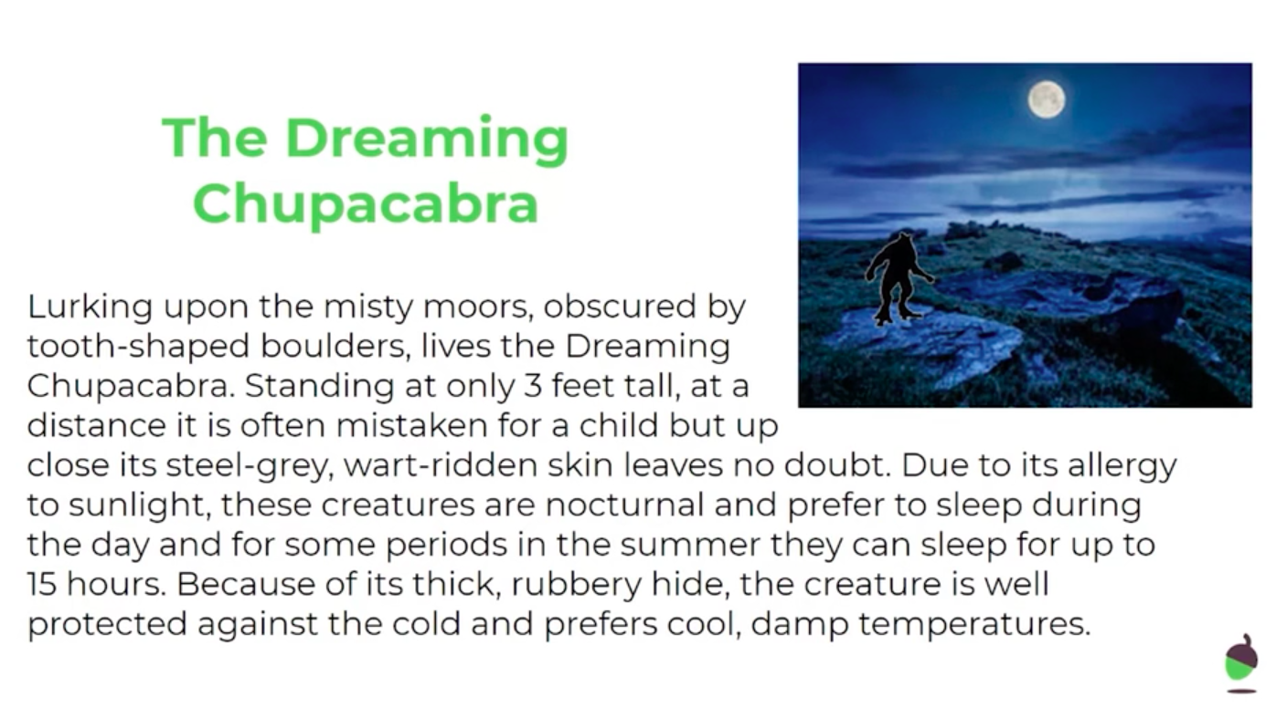
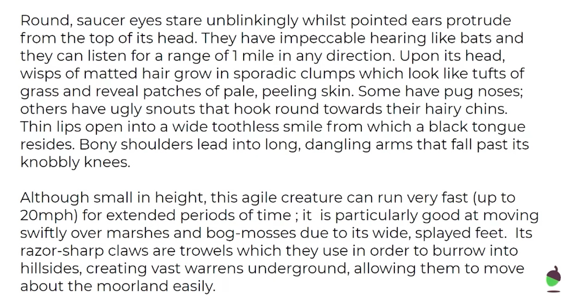
LO: To retrieve facts from a character description
Monday 8th June
In this week’s literacy we are going to be focusing on character descriptions. By the end of this week we are going to be writing our own effective character descriptions.
Miss O’Reilly will read this description in today’s literacy video
Take a look at the WAGOLL (What A Good One Looks Like) below:

Slide 2
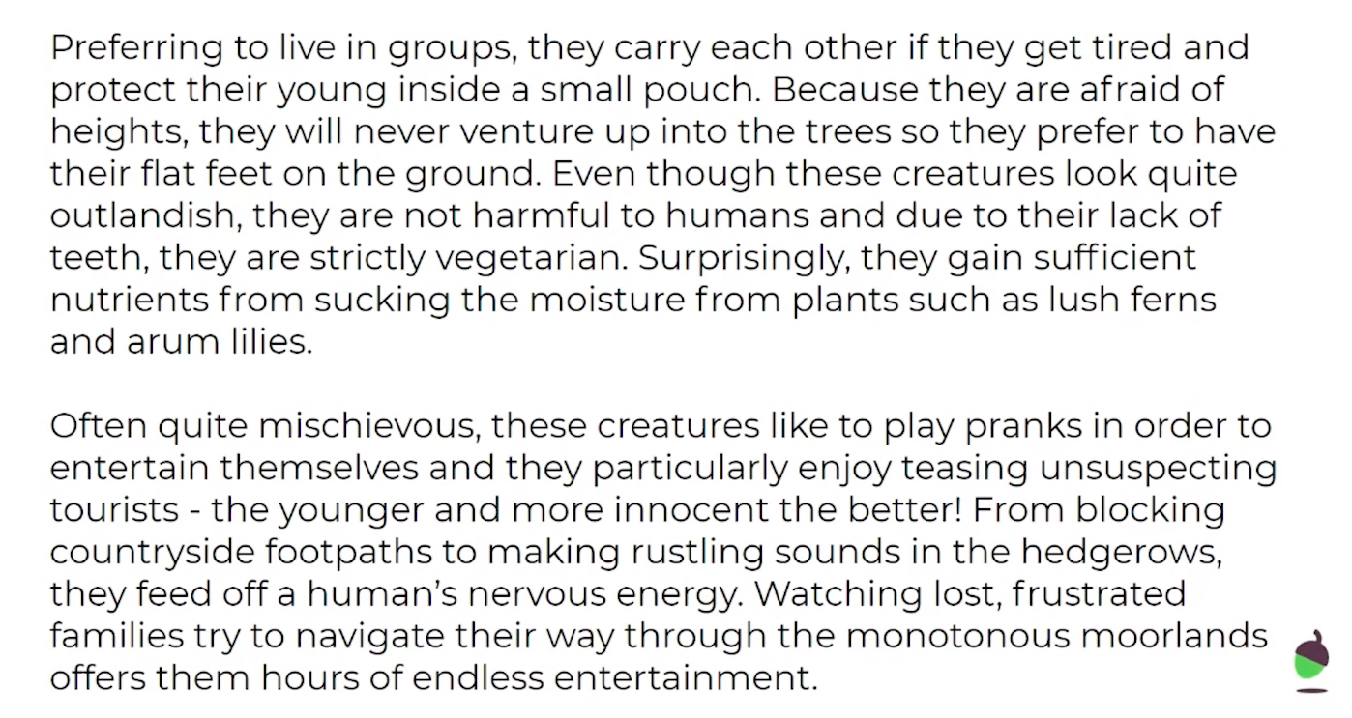
LO: To retrieve facts from a character description
Monday 8th June
In this week’s literacy we are going to be focusing on character descriptions. By the end of this week we are going to be writing our own effective character descriptions.
Miss O’Reilly will read this description in today’s literacy video
Take a look at the WAGOLL (What A Good One Looks Like) below:

Slide 3
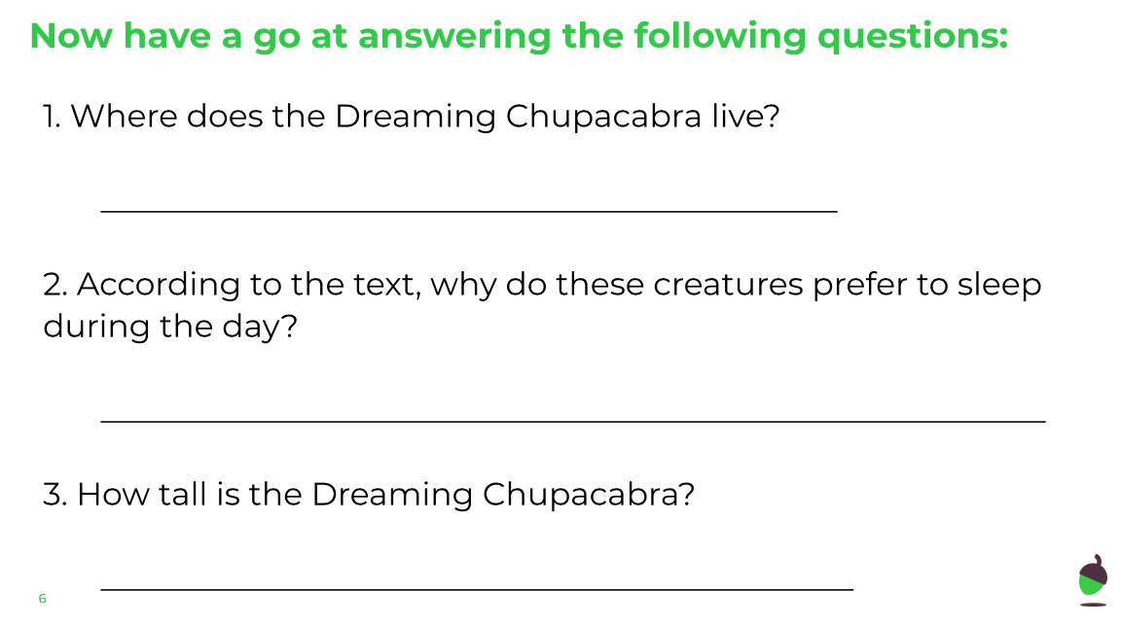
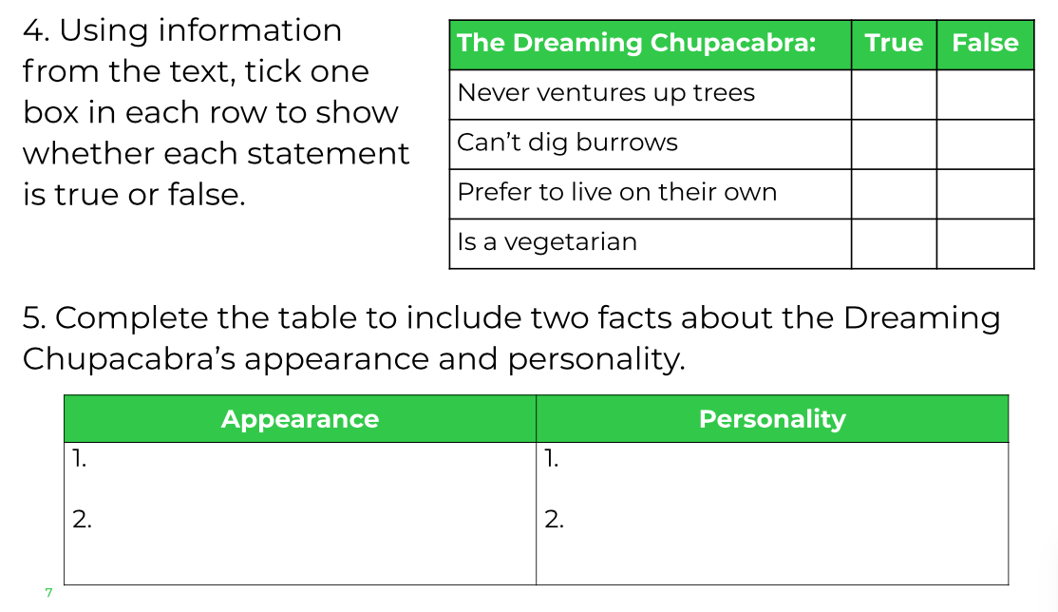
LO: To retrieve facts from a character description
Monday 8th June

Slide 4
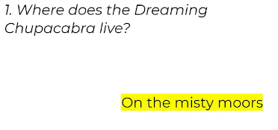
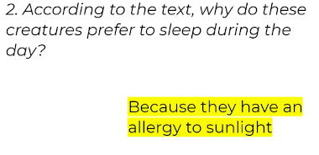
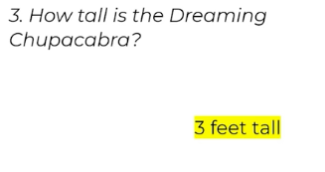
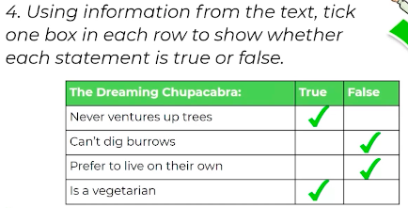
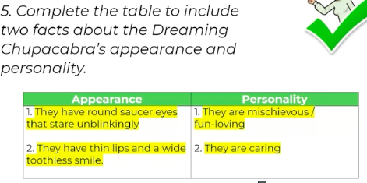
LO: To retrieve facts from a character description
Monday 8th June
ANSWER SHEET

