Slide 1
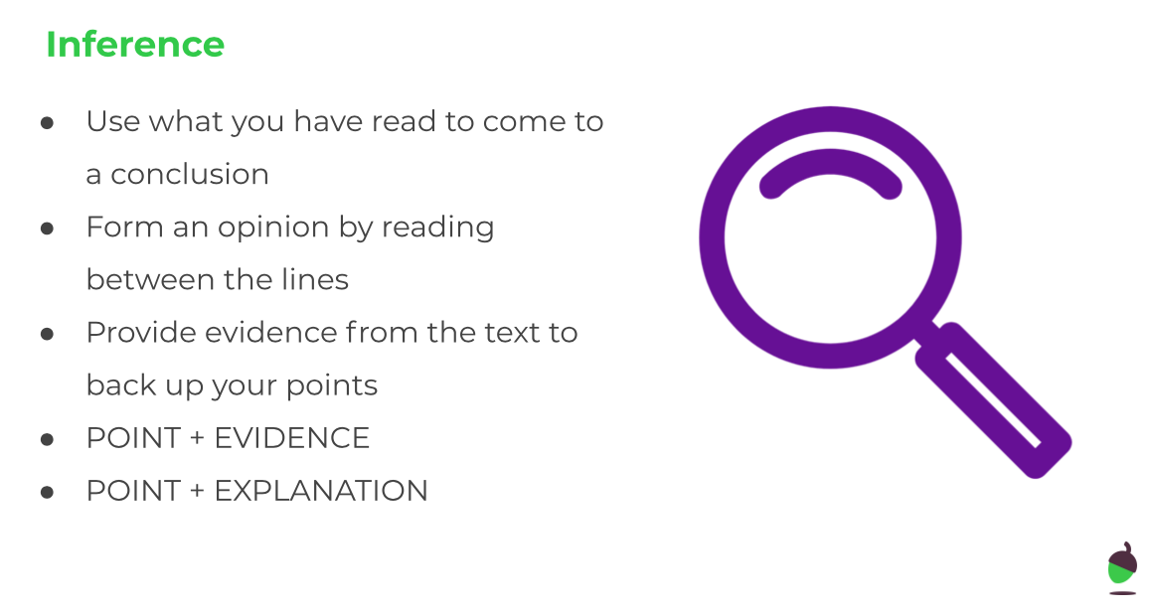
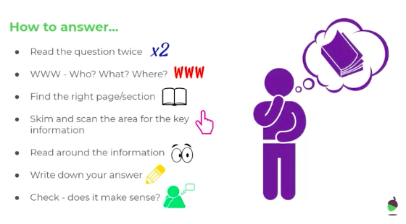
LO: To answer inference questions about a character description
Tuesday 9th June
Re-read ‘The Dreaming Chupacabra’ character description text from yesterday and then the information about how to answer an inference question. When you are ready, answer the inference style questions.

Slide 2
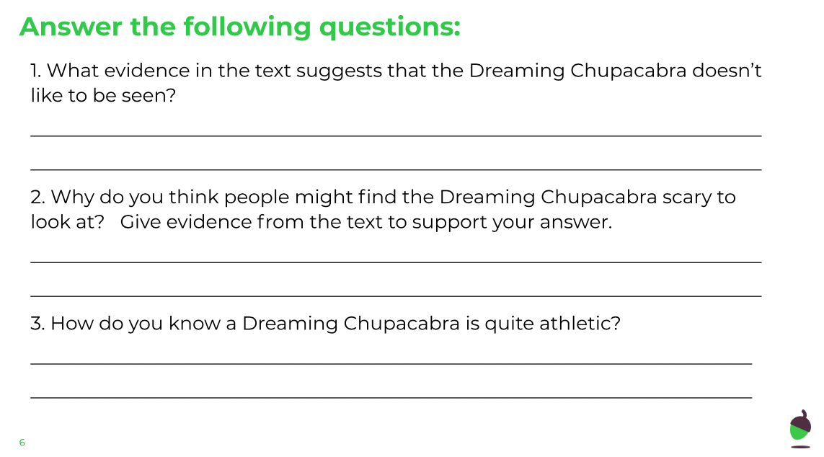
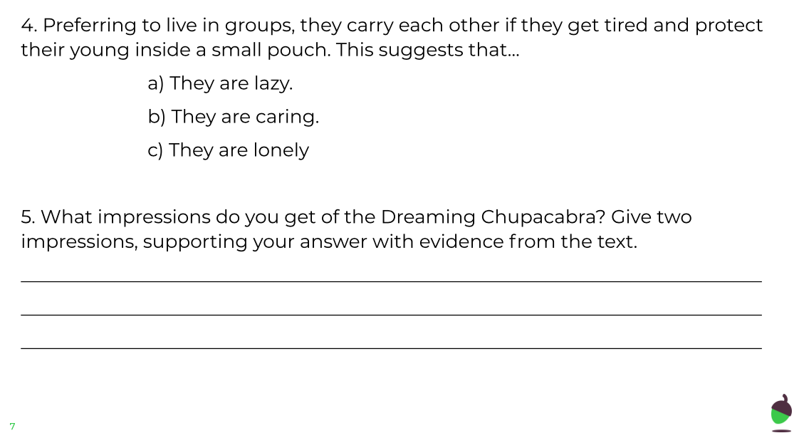
LO: To answer inference questions about a character description
Tuesday 9th June

Slide 3
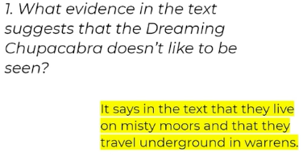
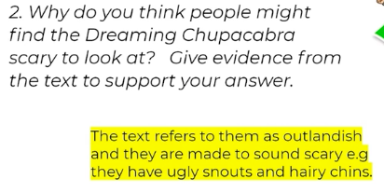
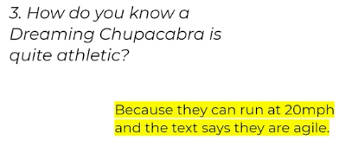
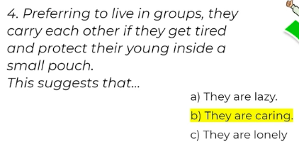
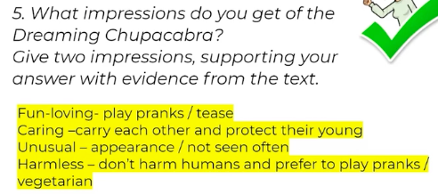
LO: To answer inference questions about a character description
Tuesday 9th June
ANSWER SHEET

