Slide 1
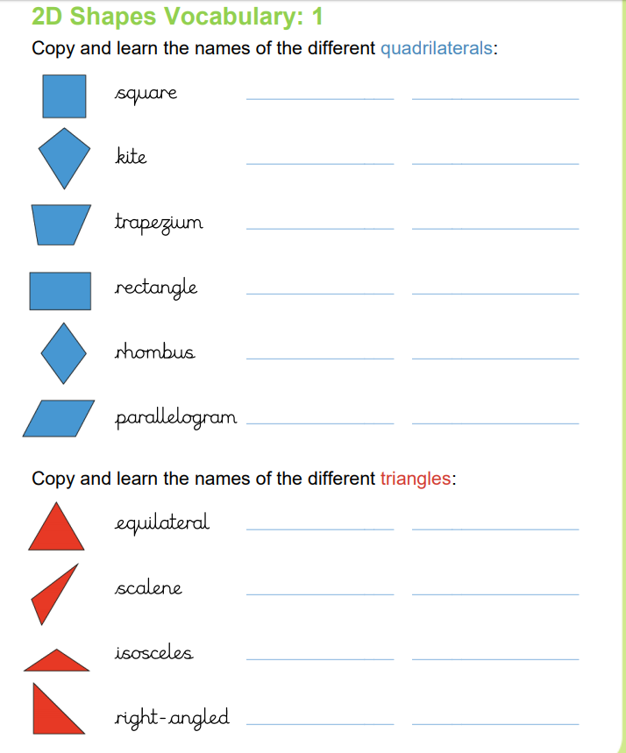
Tuesday 9th June
Handwriting

