Slide 1
Who lives in North Italy and why?
Wednesday 10th June
Italy is clearly divided between the North and South of the country. Southern Italy is a poor area and relies on agriculture (farming) and tourism (attracting visitors). The soils in Southern Italy are thin and not of a good quality, these also owned by rich people.
On the other hand, Northern Italy has developed further ahead than the south, with large amounts of factories and industrial areas. As a result of North Italy having more businesses available this means there are more jobs available, therefore people choose to live in the North of Italy.
Some other reasons why industries thrive in the North of Italy include:
Lots of roads to transport products between factories.
Flat land to build factories on.
Skilled workers live nearby.
Lots of energy sources such as natural gas and hydro-electric power to keep the factories running.
Banks will lend money for factories to start up business.

Slide 2
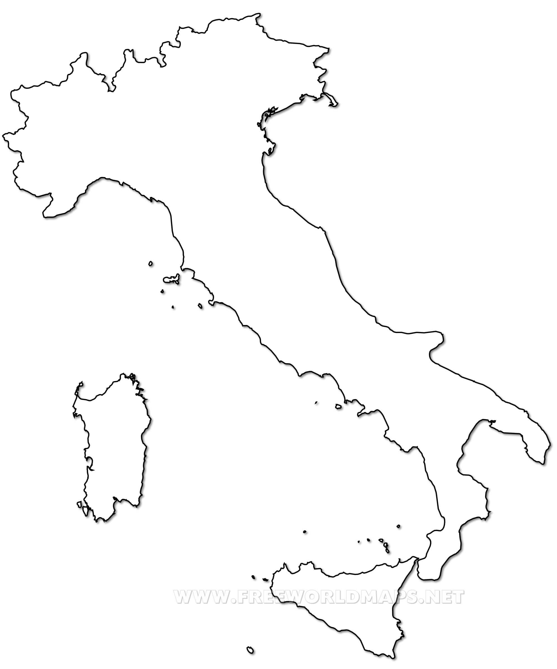



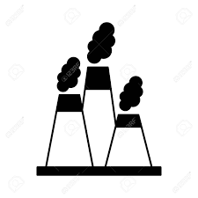
Who lives in North Italy and why?
Wednesday 10th June
Mild: Label the key industries on the map using the key provided. Use the table on the next page to find out where each industry is located.
Milan
Venice
Turin
Florence
Rome
Consumer services
Consumer goods
Heath care
Financials
Industrials
£

Slide 3
Who lives in North Italy and why?
Wednesday 10th June
Spicy: Complete the key below choosing your own symbols where one is missing. Then label the key industries on the map using the table on the next page.
Milan
Venice
Turin
Florence
Rome
Consumer services
Consumer goods
Heath care
Financials
Industrials

Slide 4
Who lives in North Italy and why?
Wednesday 10th June
Hot: Create your own key to show the industries in Italy. Then use your chosen symbols to label these in the correct locations on your map, use the table provided to help.
Milan
Venice
Turin
Florence
Rome
Naples
Key:

