Slide 1
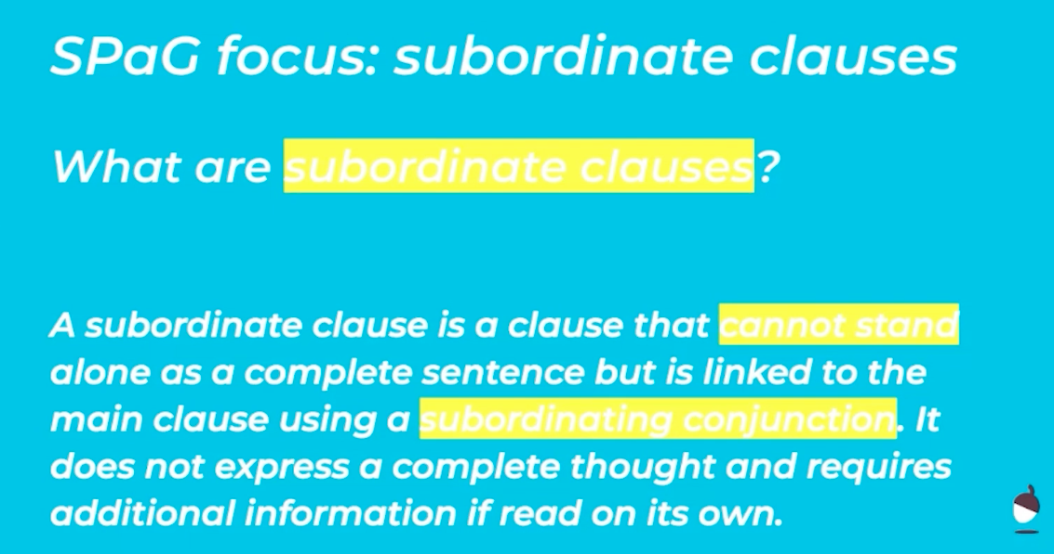
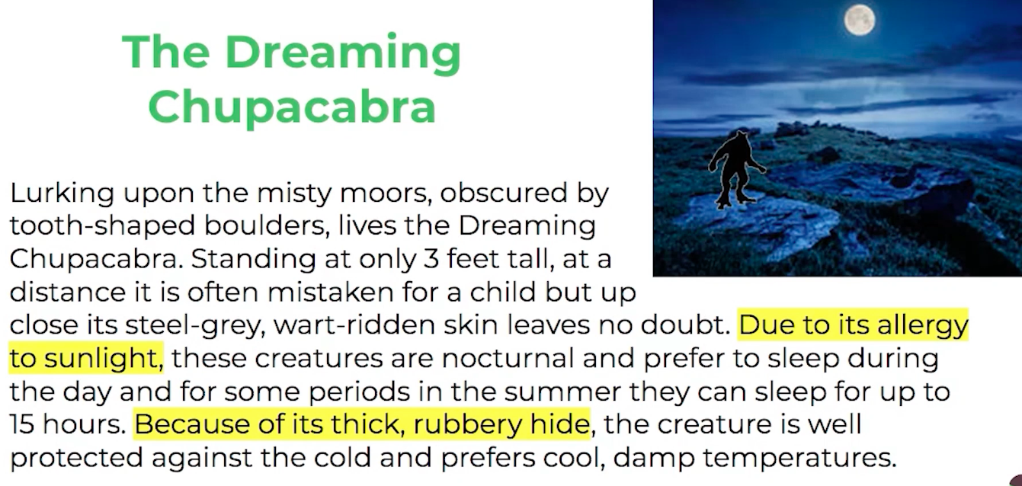
Spelling, Punctuation and Grammar Lesson – Subordinate Clauses
Thursday 11th June
Below are some examples of subordinate clauses in the text we have been using this week… the highlighted clauses do not make sense alone.

Slide 2
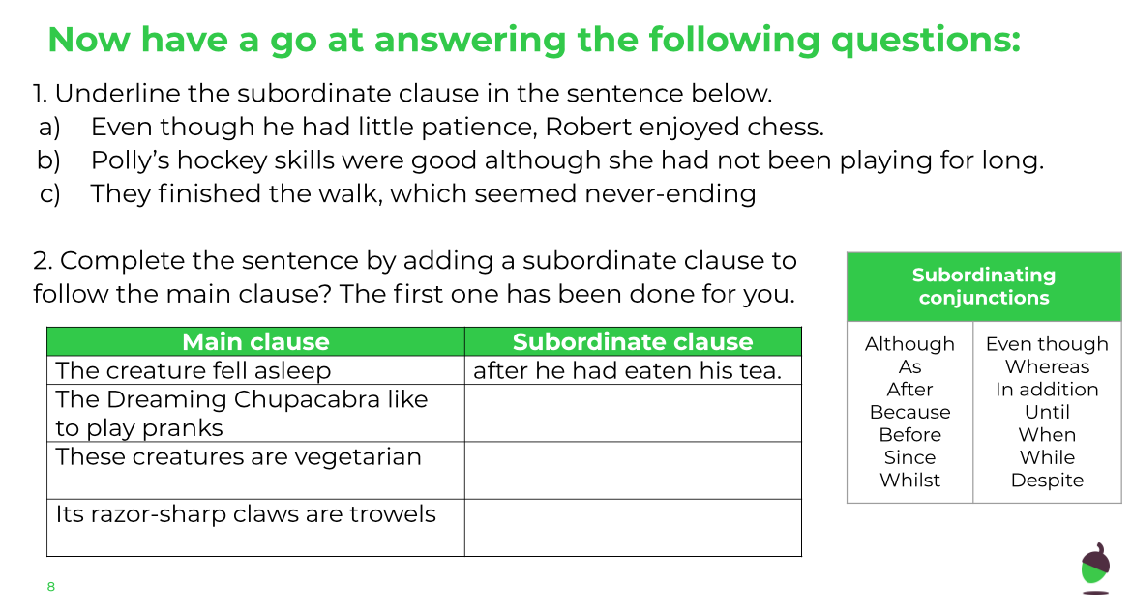
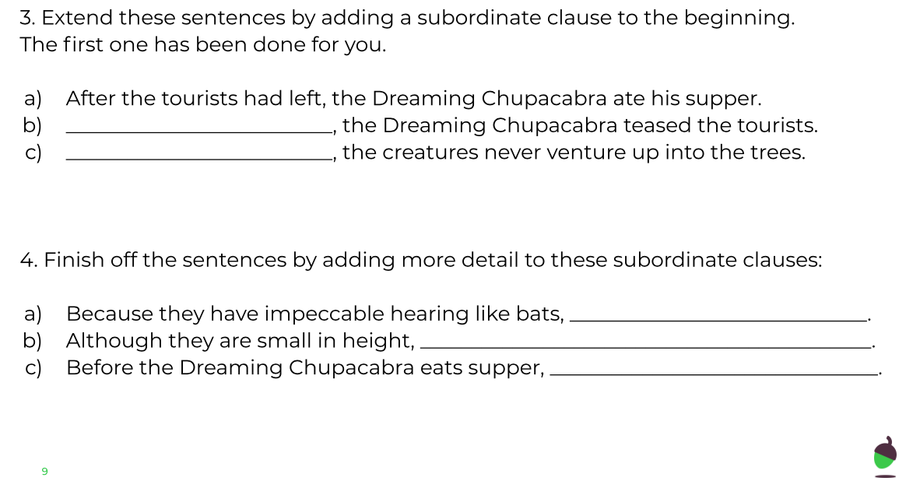
Spelling, Punctuation and Grammar Lesson – Subordinate Clauses
Thursday 11th June

Slide 3
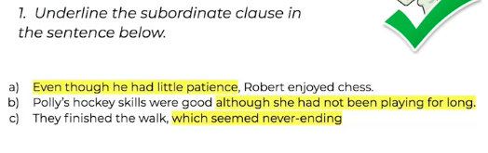
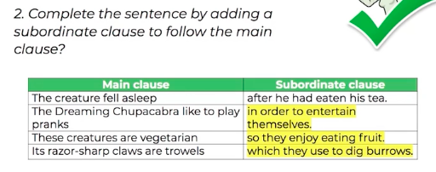
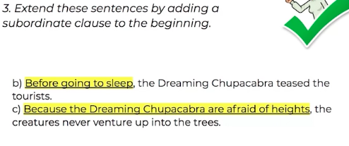
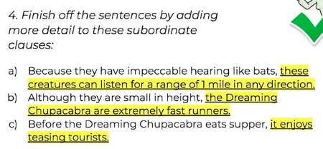
Spelling, Punctuation and Grammar Lesson
- Subordinate Clauses
Thursday 11th June
ANSWER SHEET

Slide 4
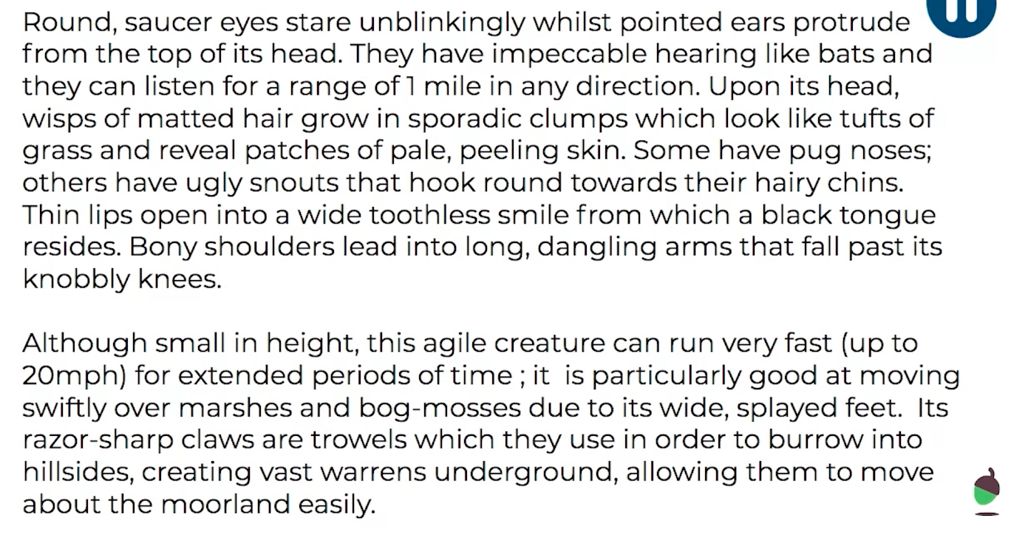
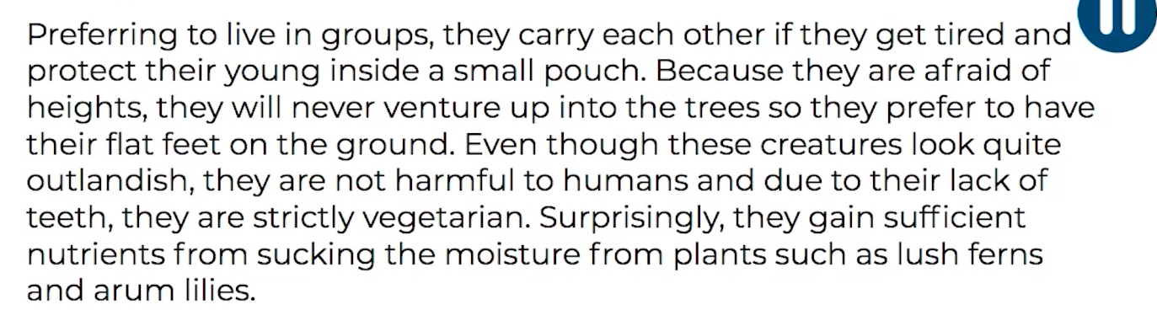
Spelling, Punctuation and Grammar Lesson
- Subordinate Clauses
Thursday 11th June
Needs Water Extension Challenge
Identify the subordinate clauses in the extract below.

Slide 5
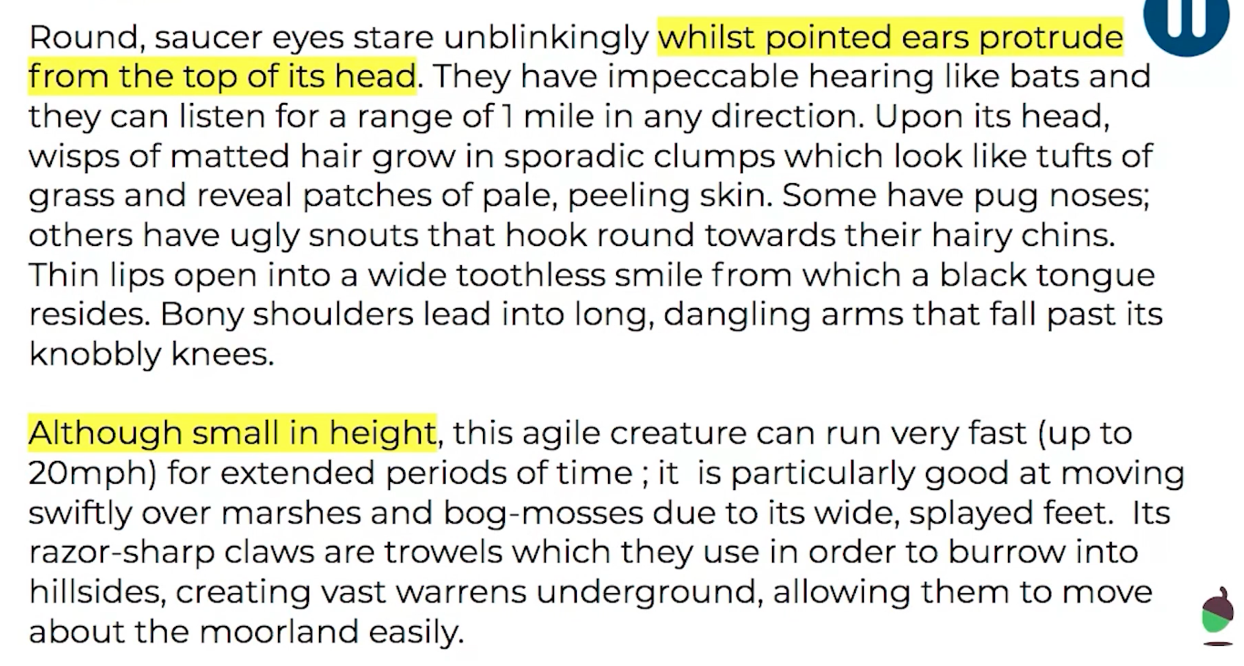
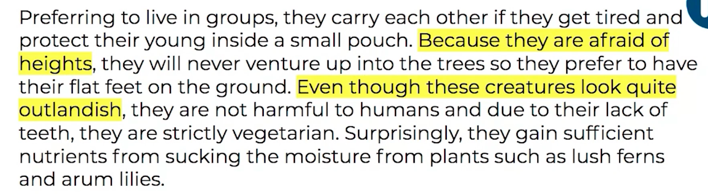
Spelling, Punctuation and Grammar Lesson
- Subordinate Clauses
Thursday 11th June
Needs Water Extension Challenge ANSWERS

