Slide 1
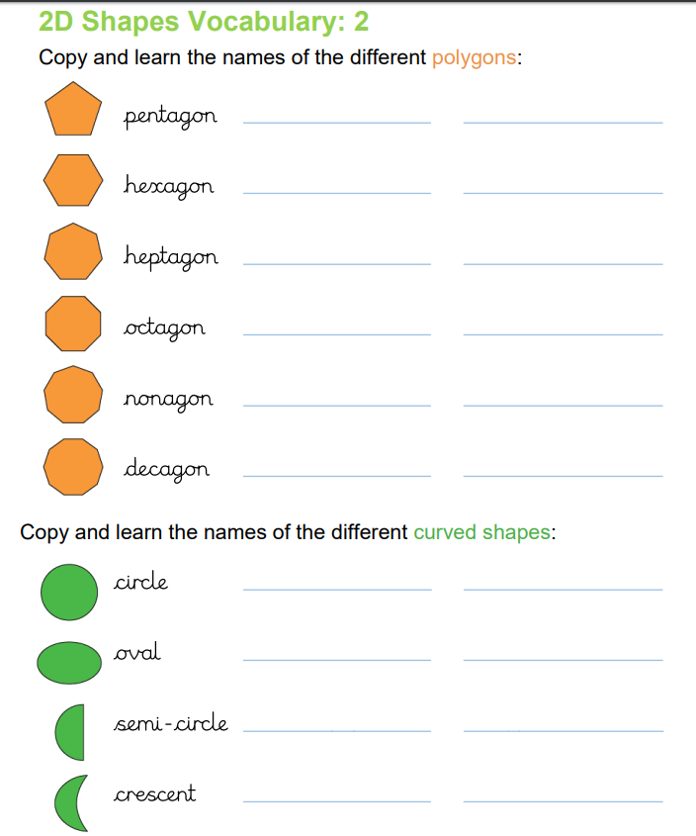
Handwriting
Thursday 11th June

