Slide 1
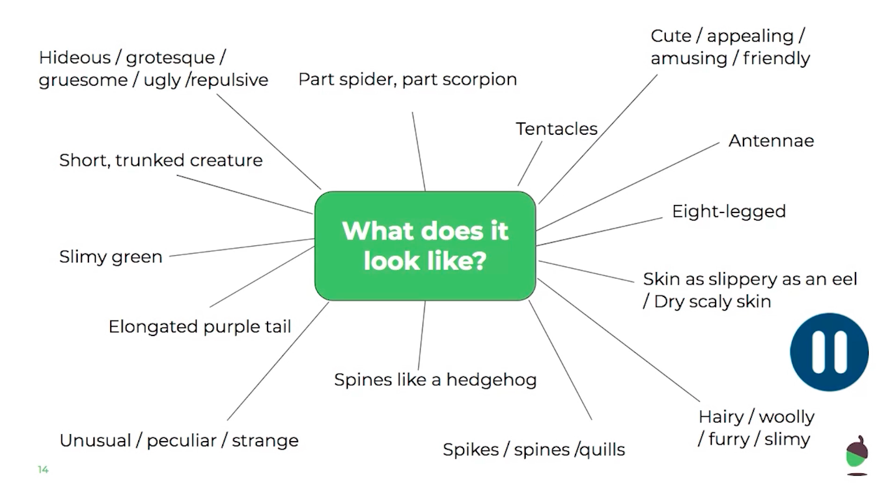
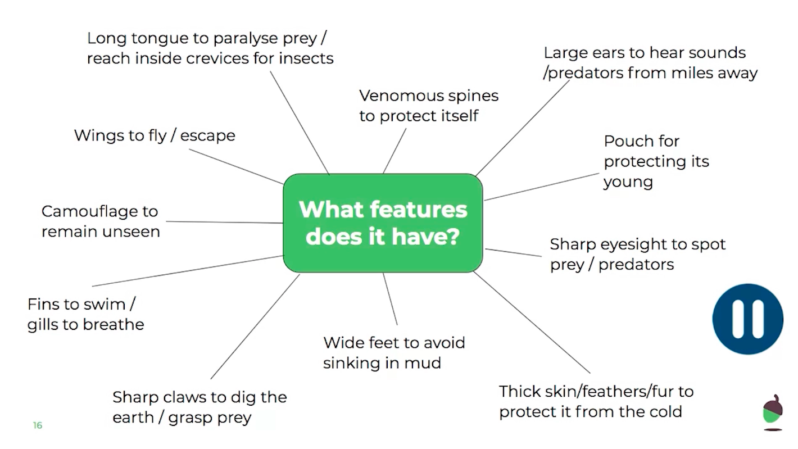
LO: To write a character description.
Friday 12th June
It’s time to write your own character description, create a mind map about your creative using the examples below to inspire you:

Slide 2
LO: To write a character description.
Friday 12th June
What does it look like?
What features does it have?

Slide 3
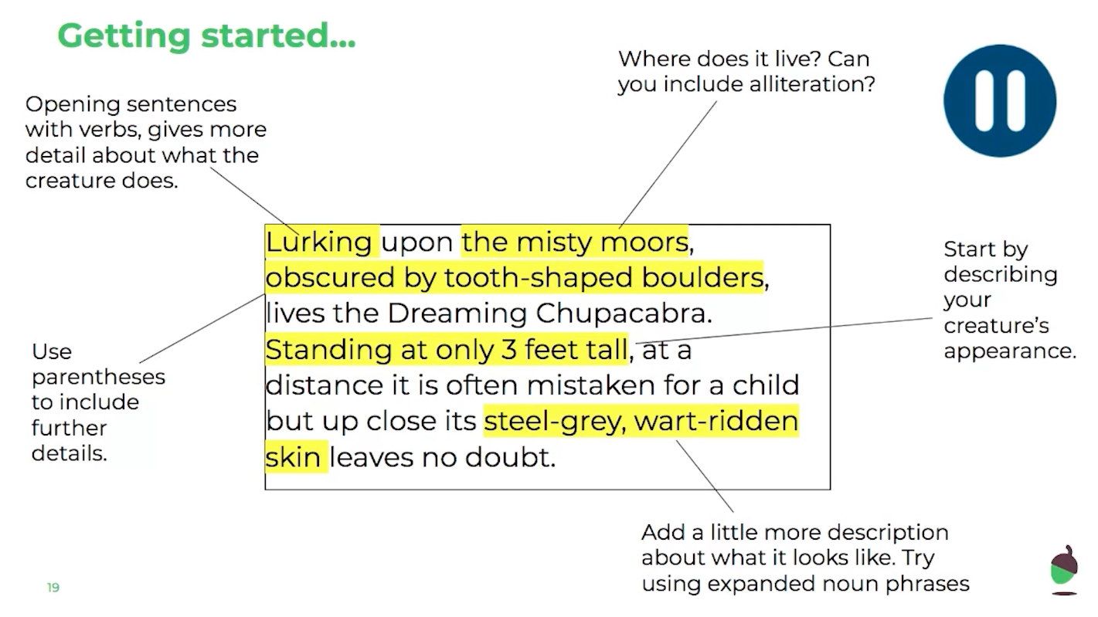
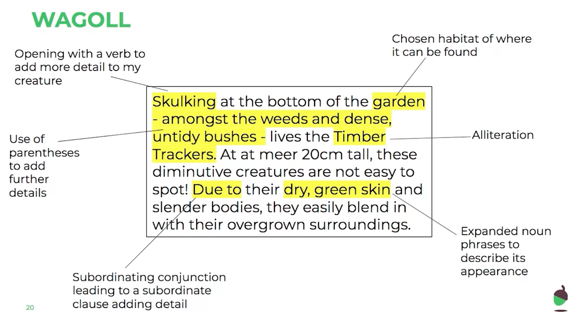
LO: To write a character description.
Friday 12th June

Slide 4
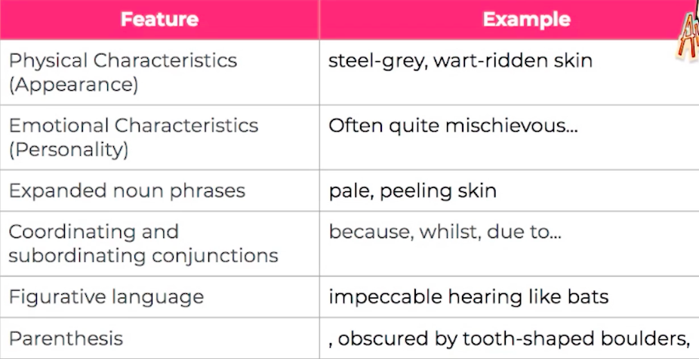
LO: To write a character description.
Friday 12th June
← To be successful checklist…
___________________________________
___________________________________
___________________________________
___________________________________
__________________________________________
______________
__________________________________________
______________
___________________________________
___________________________________
___________________________________
___________________________________
___________________________________

Slide 5
LO: To write a character description.
Friday 12th June
___________________________________
___________________________________
___________________________________
___________________________________
___________________________________
___________________________________
___________________________________
___________________________________
___________________________________
___________________________________
__________________________________________
______________
__________________________________________
______________
___________________________________
___________________________________
___________________________________
___________________________________
___________________________________

