Slide 1
Thursday 18th June 2020
LQ: What did a Roman town look like?

Slide 2
What features do you think a Roman town had?
What buildings do you think they had?
Write some of your guesses below

Slide 3
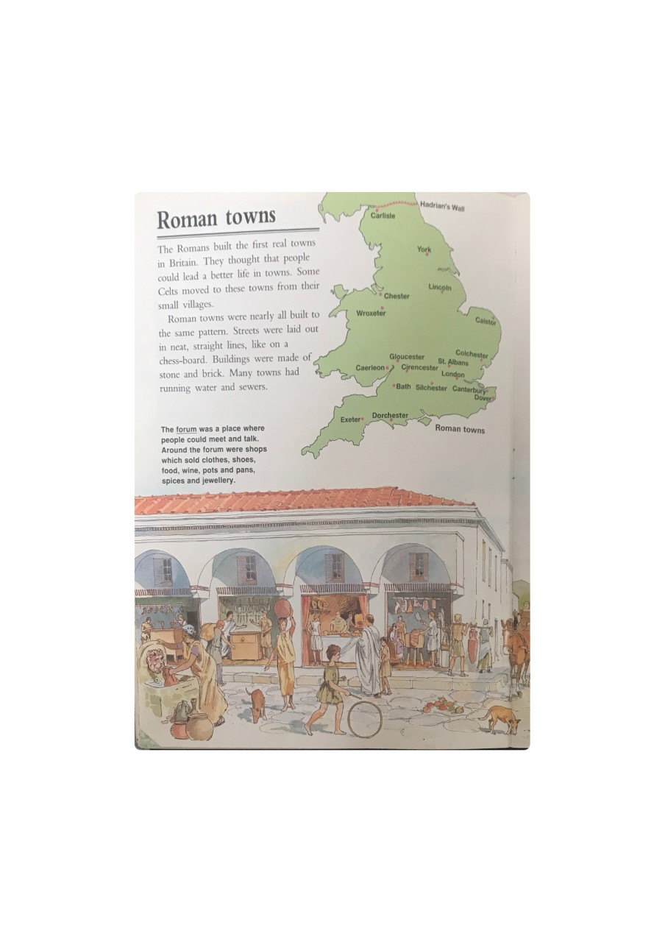
The Romans built Britain's first towns. Within 17 years of the invasion, they had several major towns in place. connected by the famous Roman roads. Towns soon became important places for meetings and trade.

Slide 5
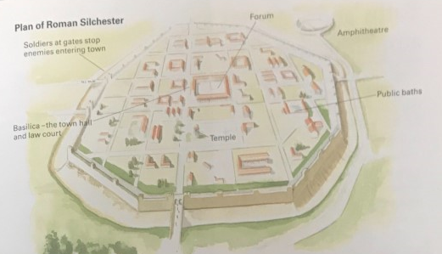
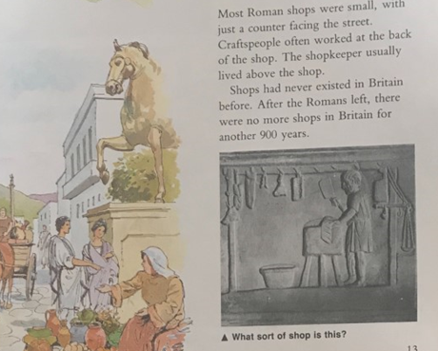

Slide 6



Your task:
Mild-To draw and label a Roman town. Remember to include:
-baths
-forum
-amphitheatre
-basilica (the town court and the law court)
-soldiers at gates to stop enemies coming in
Spicy-To draw and label a Roman town. Remember to include:
-baths
-forum
-amphitheatre
-basilica (the town court and the law court)
-soldiers at gates to stop enemies coming in
Write and research about the forum. What was it used for? What buildings were around it?
Hot-Just like spicy but research different buildings and present how you want (e.g. poster, PowerPoint, fact file etc)

Slide 7
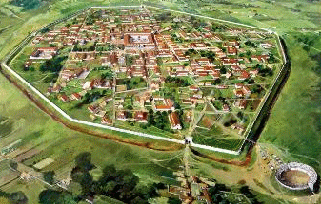
Useful websites/information
http://www.primaryhomeworkhelp.co.uk/romans/towns.htm
https://www.timetrips.co.uk/roman%20towns-towns.htm
https://www.bbc.co.uk/bitesize/clips/zq49wmn

Slide 8


