Slide 1
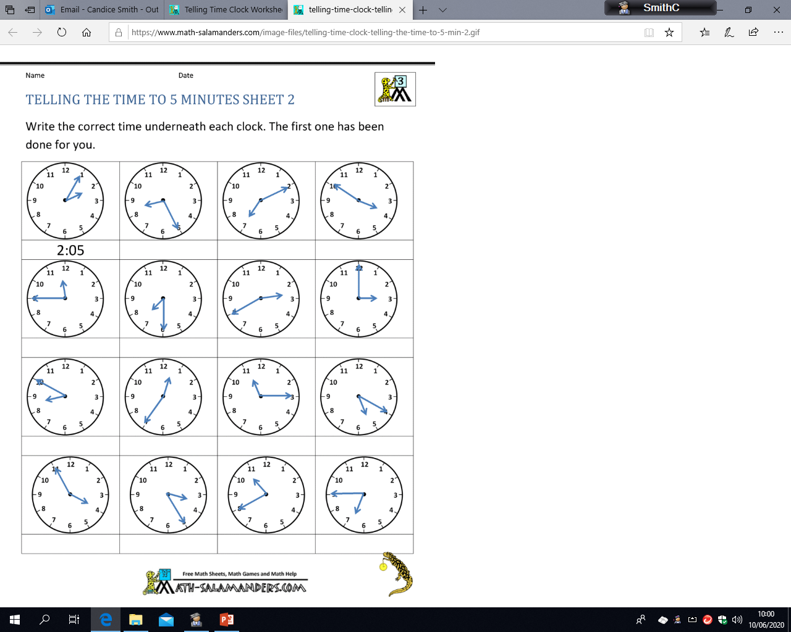
Mild
LO: to read time to the nearest 5 minute
Monday 15th June
Decide whether each clock is showing past or to and then complete the minutes or hour.
5 minutes
________
2
25 minutes
________
_____
____ minutes
________
7
10 minutes
________
_____
Quarter
________
_____
_______
________
7
20 minutes
________
_____
________
_______
10 minutes
________
_____
____ minutes
________
1
_________
________
11
____ minutes
________
5
___ minutes
________
_____
___ minutes
________
_____
____ minutes
________
_____
____ minutes
________
_____

Slide 2
Spicy
Monday 15th June
LO: to read time to the nearest 5 minute
Write the time shown in words. E.g. 20 minutes past 5

Slide 3
Hot
LO: to read time to the nearest 5 minute
Monday 15th June
Write the time shown in words(e.g. 20 minutes past 5) and digital time (e.g. 5:20)
Words:
Digital:
Words:
Digital:
Words:
Digital:
Words:
Digital:
Words:
Digital:
Words:
Digital:
Words:
Digital:
Words:
Digital:
Words:
Digital:
Words:
Digital:
Words:
Digital:
Words:
Digital:
Words:
Digital:
Words:
Digital:
Words:
Digital:
Words:
Digital:

