Slide 1
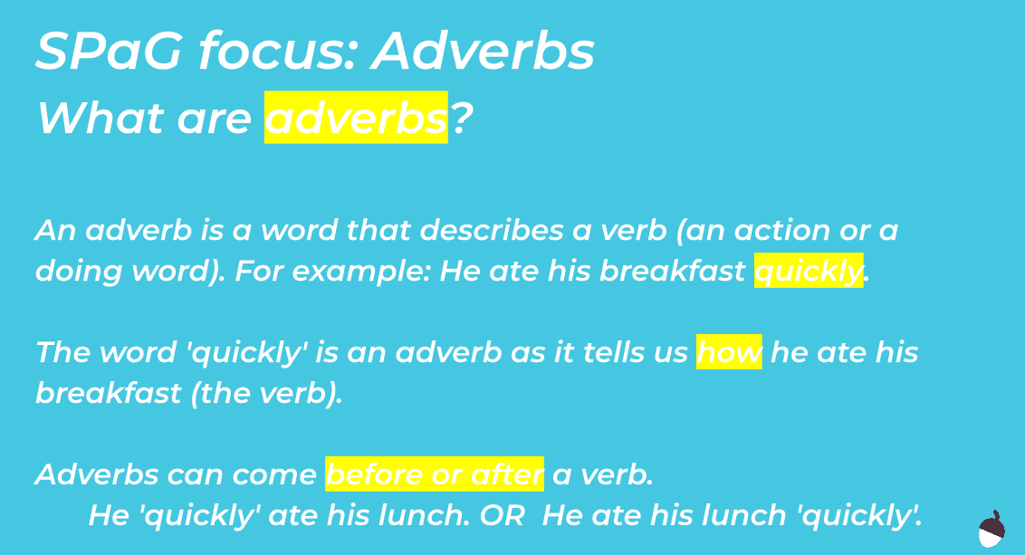
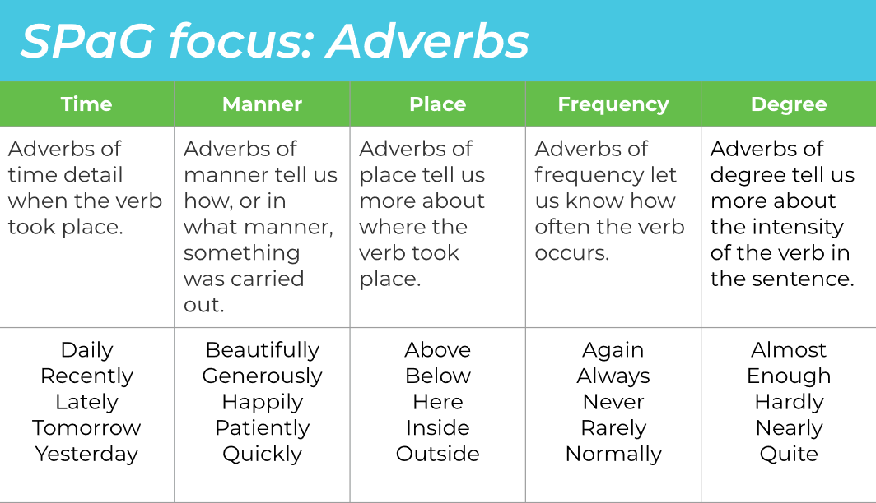
SPaG – Fronted Adverbials
Tuesday 16th June

Slide 2
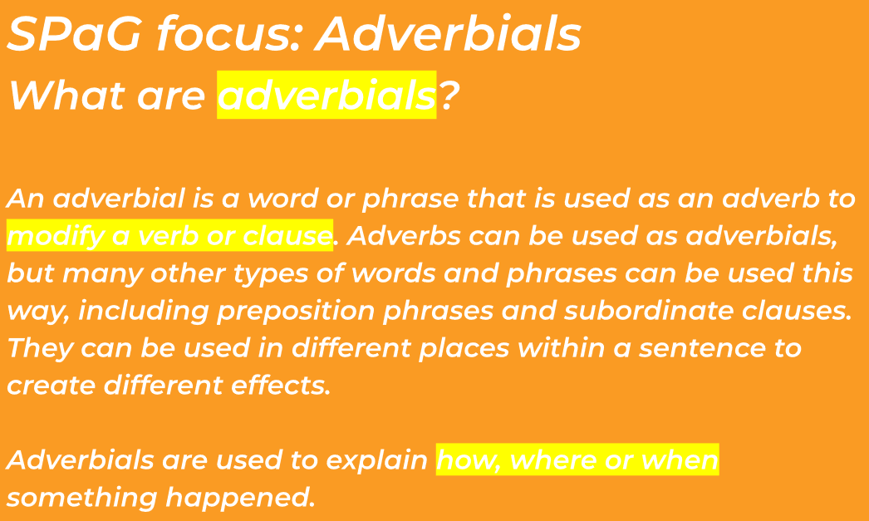
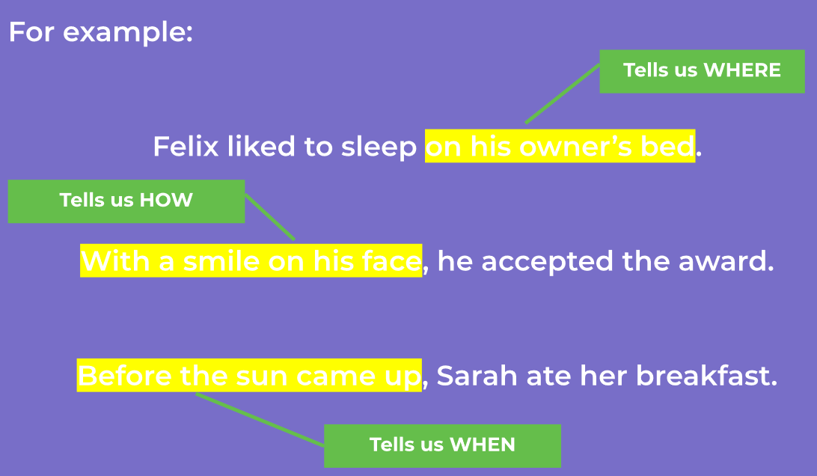
SPaG – Fronted Adverbials
Tuesday 16th June

Slide 3
SPaG – Fronted Adverbials
Tuesday 16th June
Match the different types of adverb to their definition.
Manner
These intensify/deepen the verb in the sentence
Time
How often the verb occurs
Frequency
Tell us how or the manner of how something is carried out
Place
Tell us more about where the verb took place
Degree
Tell us the time of when the verb took place
Decide what types of adverbs are below, the possible answers could be: time, manner, place, frequency or degree.
Lately,
Quickly,
_____________
_____________
Thankfully,
Tomorrow,
_____________
_____________
Below,
_____________
_____________
Almost,
Rarely,
Inside,
_____________
_____________

Slide 4
SPaG – Fronted Adverbials
Tuesday 16th June
Identify the adverbs in the sentences below with a circle, then re-write the sentences changing them to fronted adverbials.
Follow the instructions provided in your box carefully.
____________________________________________
2. Catch your creature before it escapes quickly.
____________________________________________
Answer the questions about The Dreaming Chupacabra below, using a fronted adverbial at the beginning of each sentence.
How does The Chupacabra run?
____________________________________________
2. How does The Chupacabra eat?
____________________________________________
3. How does The Chupacabra cross marshes?
____________________________________________

