Slide 1
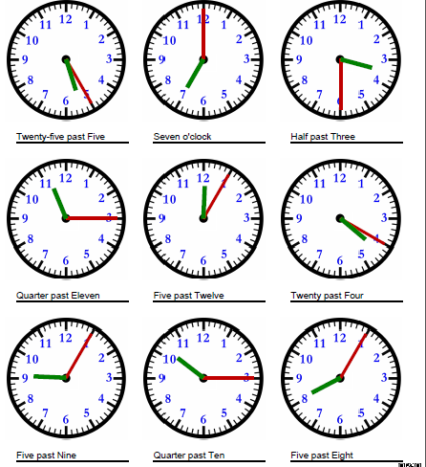
Mild
Tuesday 16th June
Draw the short hour hand and the long minute hand on each clock so they show the time written underneath. The first one has been done for you.

Slide 2

Spicy
Tuesday 16th June
Draw the hour hand and the minute hand on each clock so they show the time written underneath. The first one has been done for you.

Slide 3
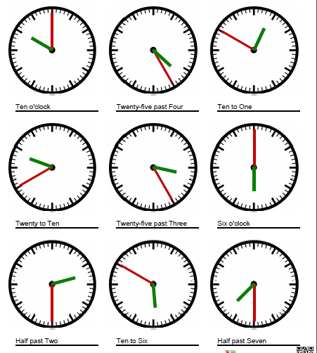
Spicy
Tuesday 16th June
Draw the hour hand and the minute hand on each clock so they show the time written underneath. The first one has been done for you.
Needs water: Now go back and write each time in digital time.

