Slide 1
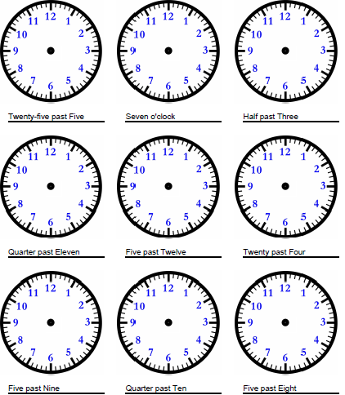
Mild
Tuesday 16th June
LO: to show time to the nearest 5 minute
Draw the short hour hand and the long minute hand on each clock so they show the time written underneath. The first one has been done for you.

Slide 2
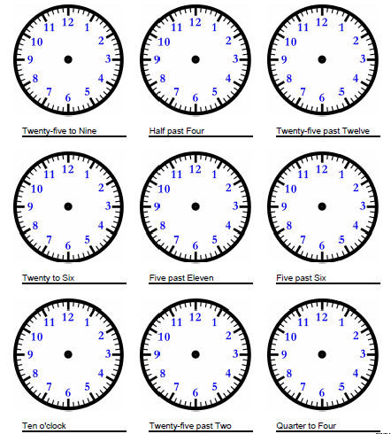
Spicy
Tuesday 16th June
LO: to show time to the nearest 5 minute
Draw the hour hand and the minute hand on each clock so they show the time written underneath. The first one has been done for you.

Slide 3
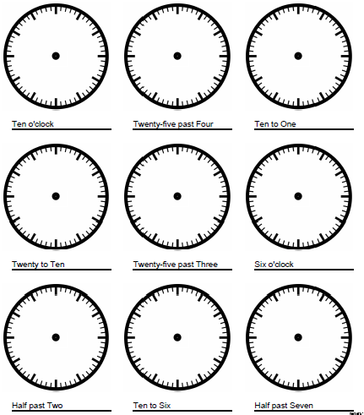
Hot
Tuesday 16th June
LO: to show time to the nearest 5 minute
Draw the hour hand and the minute hand on each clock so they show the time written underneath. The first one has been done for you.
Needs water: Now go back and write each time in digital time.

