Slide 1
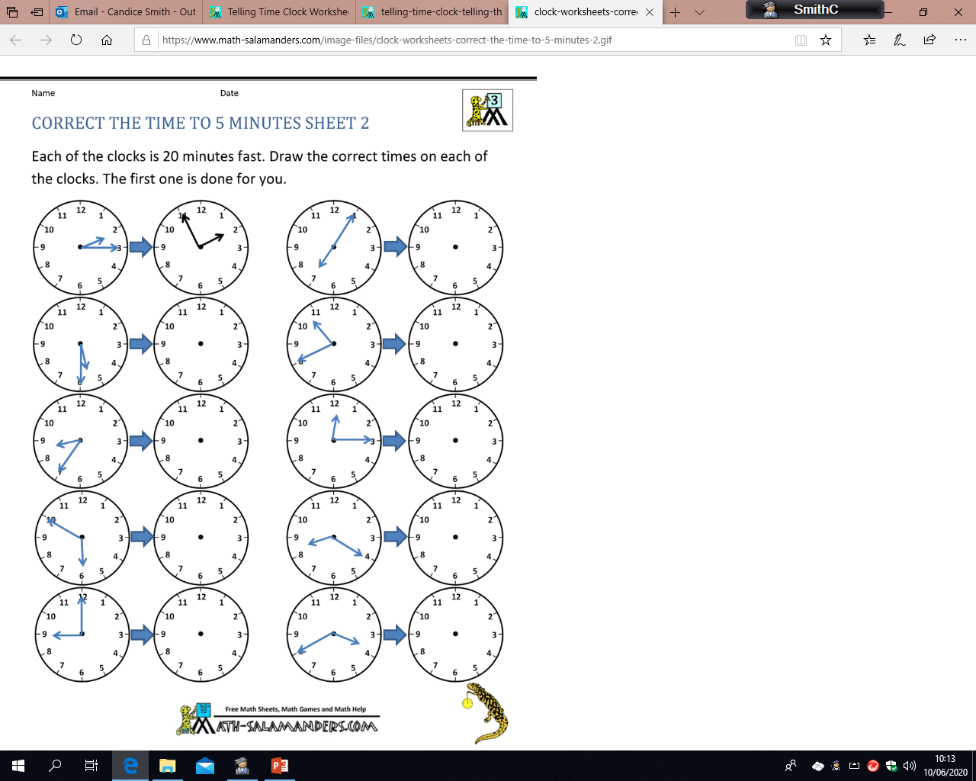
Mild
Wednesday 17th June
LO: to calculate time intervals
Each of the clocks is 10 minutes slow. Draw the correct times on each of the clocks. The first one is done for you.

Slide 2
Spicy
Wednesday 17th June
LO: to calculate time intervals
Each of the clocks is 20 minutes fast. Draw the correct times on each of the clocks. The first one is done for you.

Slide 3
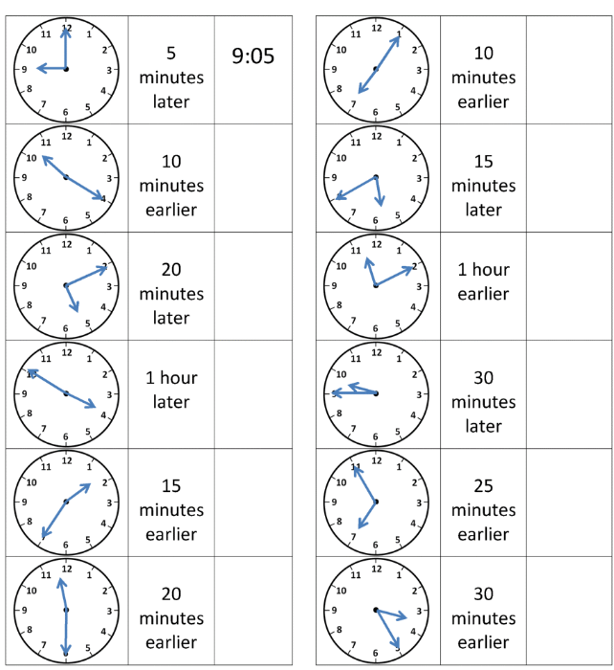
Hot
Wednesday 17th June
LO: to calculate time intervals
Look at the analogue time displayed on the clock, then write the digital time after the specified period has past. The first one has been done for you.

