Slide 1
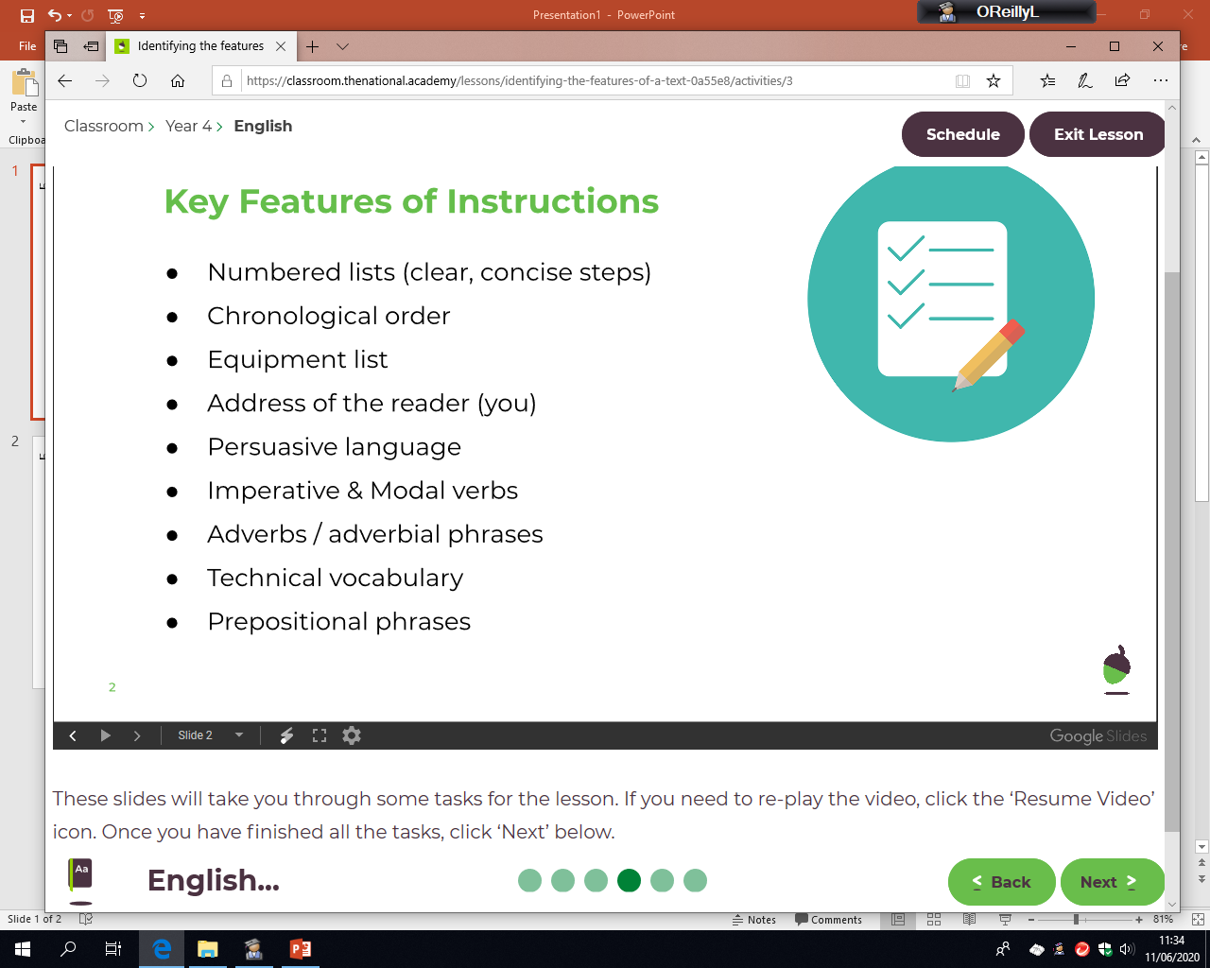
Wednesday 17th June
LO: To identify features of instructions.
Watch today’s video where Miss O’Reilly will identify the features of instructions, then have a go at identifying the features on a different set of instructions.
Title (so the reader knows what it is about)
(time order)
(e.g could, must, should)
(quickly, carefully, next)
(words/phrases you would not use regularly)
(on top of, next to, above, below, underneath)
Parenthesis (brackets to give extra detail)

Slide 2
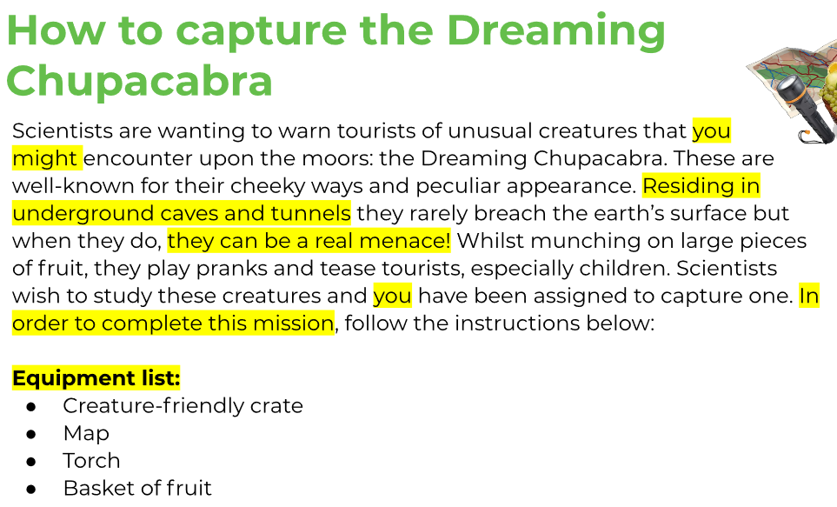
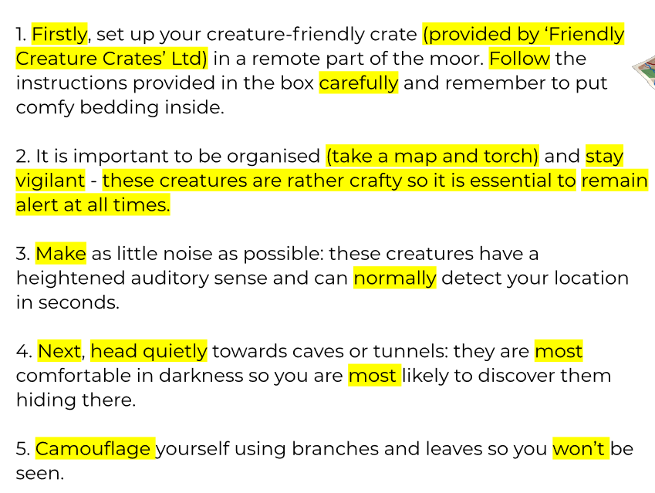
Wednesday 17th June
LO: To identify features of instructions.

Slide 3
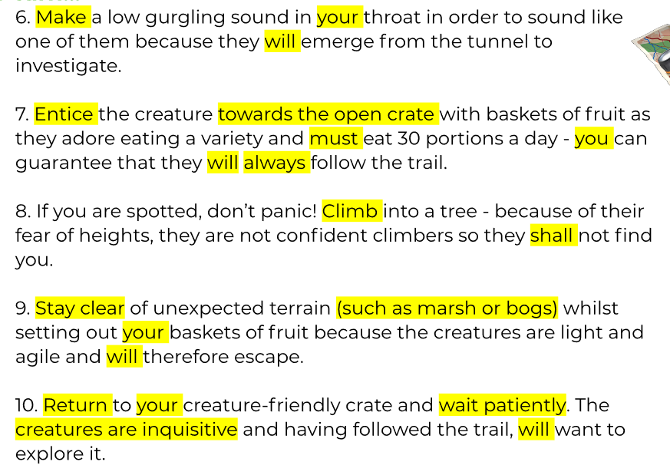
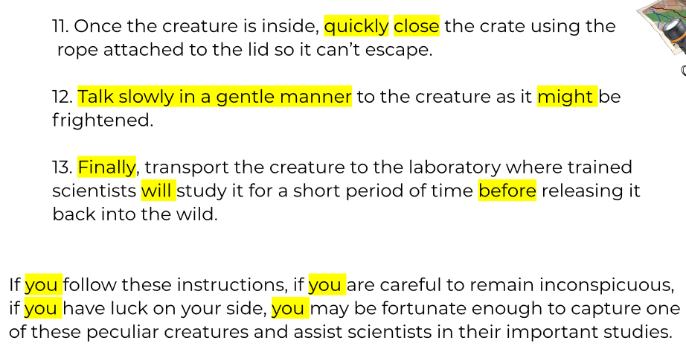
Wednesday 17th June
LO: To identify features of instructions.

Slide 4
LO: To identify features of instructions.
Wednesday 17th June
TASK: Below are a set of instructions that have been highlighted. Read the instructions carefully and then label what features have been found. Use a ruler to draw your labels.
How to look after your pet Mongobull
Mongobulls are extremely rare creatures to have, and if you have one as a pet then congratulations to you for finding one. This set of instructions will tell you all you need to know for how to care for your pet Mongobull during the early stages of its life cycle. Residing inside toilet pipes and under kitchen sinks, they are quite the tricky characters to house train.
Equipment List:
plunger
hobnob biscuits
a blanket (preferably fluffy)
7 socks
an old kitchen sink
1. Firstly, it’s time to assemble your rusty, old kitchen sink and you should pad it out the fluffy blankets as stated in the equipment list, make it inviting.
2. Carefully, tie together the 7 socks tightly in a knotted rope. This will be for the Monogbull to latch on to.

Slide 5
LO: To identify features of instructions.
Wednesday 17th June
TASK 2: Here are the rest of instructions, now have a go at highlighting some more of the same features yourself.
3. Next, lure the Mongobull out of it’s travelling crate with the tight sock rope. You should take extra care when doing this.
4. Once your Mongobull is safely attached around the rope, place it into the cosy kitchen sink bed that you have created.
5. The next 12 hours will be crucial, keep your Mongobull warm (in the specifically fluffy blanket) and well fed with hobnob biscuits as stated in the equipment list.
6. Once 12 hours have passed, your Mongobull is now ready to become a full member of your household. Quietly, tell your Mongobull that it must now come out of the sink and explore the surroundings.
If you follow these instructions carefully, you will have a guaranteed companion for life. However, if you do not, your Mongobull may choose to rebel against you.

