Slide 1

Hamlet
Monday 15th/Thursday 18th June English PowerPoint
To be or not to be? That is the question.

Slide 2


LO: Write a Description: Detail sentence about each key character
First past of sentence gives description
Second part of sentence gives the detail
The two parts are separated by a colon
Choose you vocabulary carefully.
Improve each sentence by adding in powerful adjectives, adverbs and carefully selecting verb choice.

Slide 3
Let’s recap…
Monday 15th/Thursday 18th June English PowerPoint

Slide 4
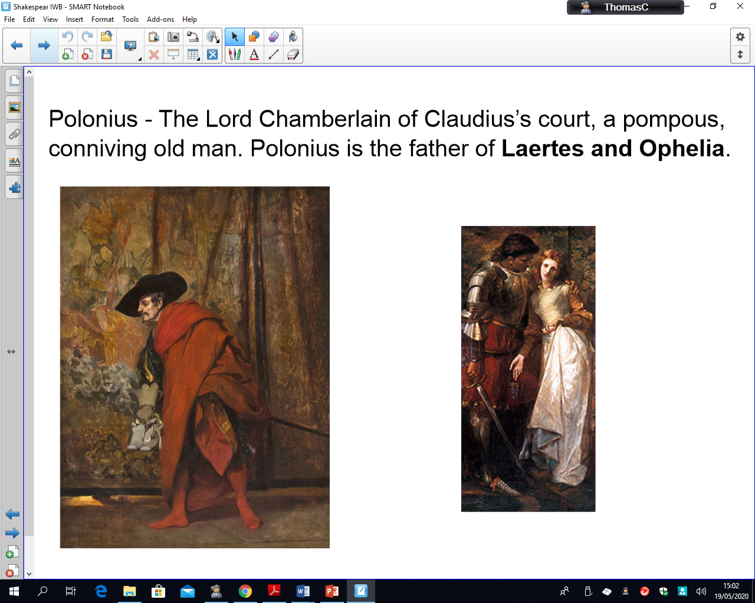
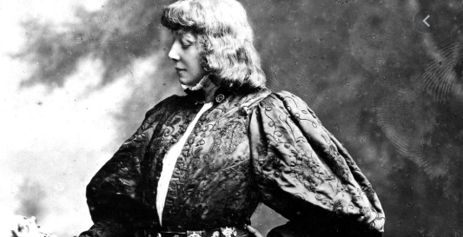
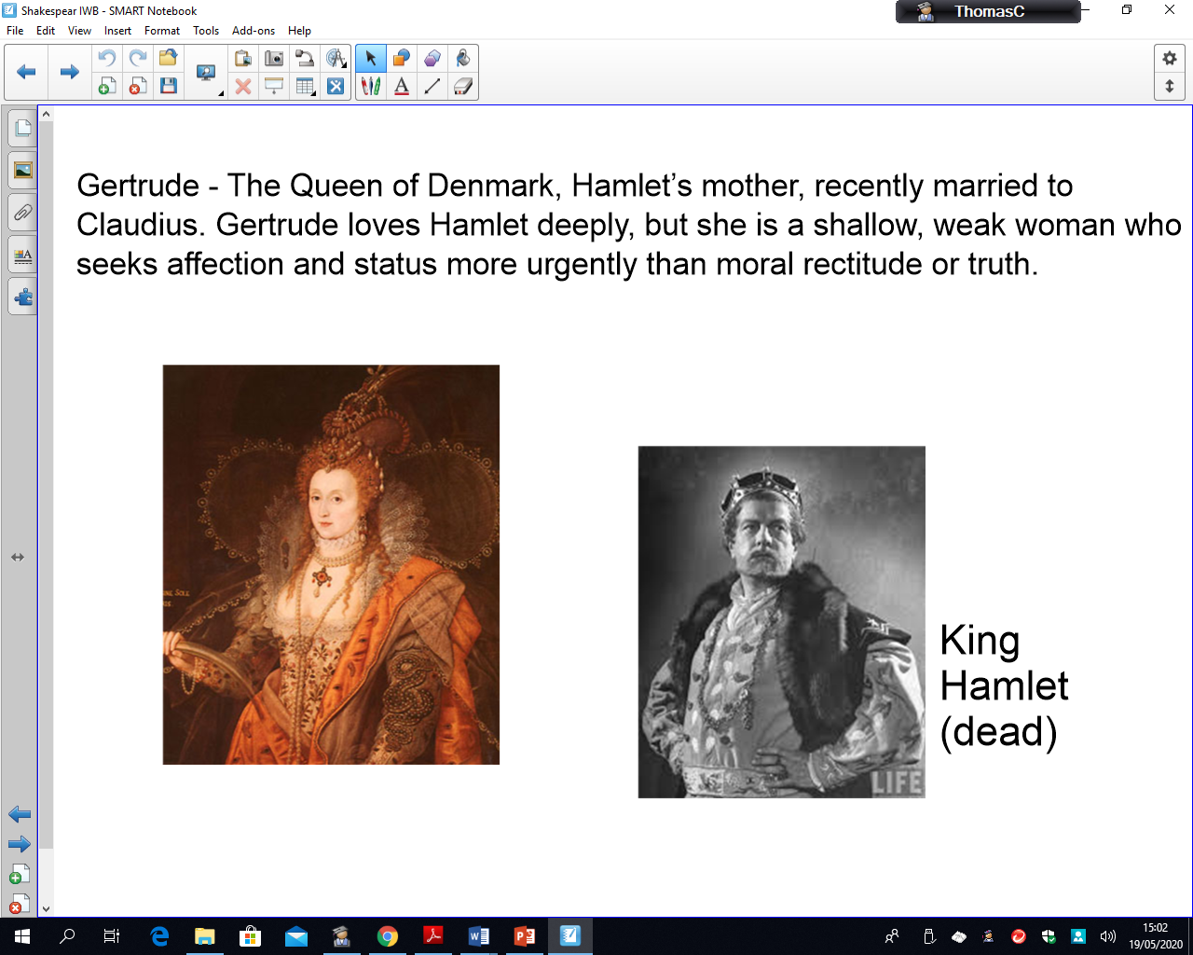
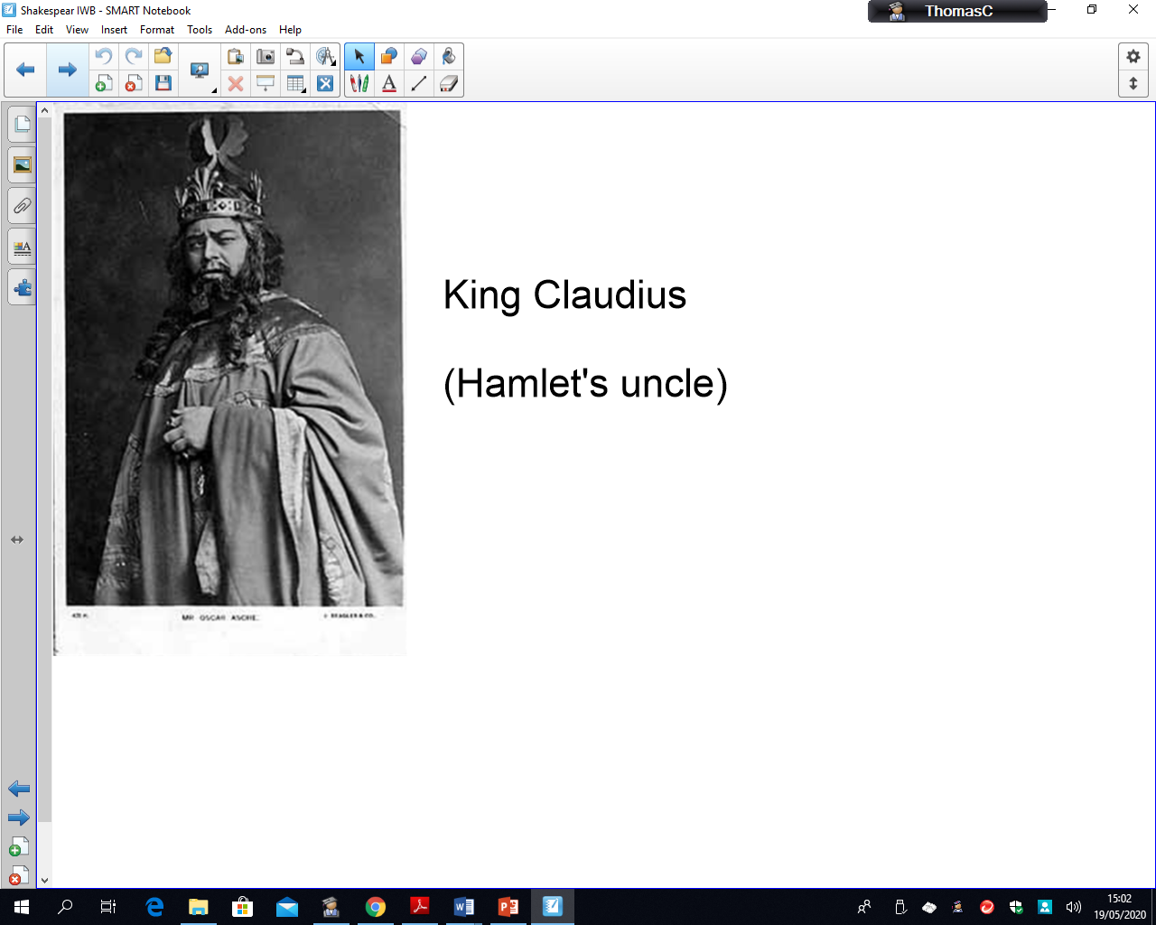
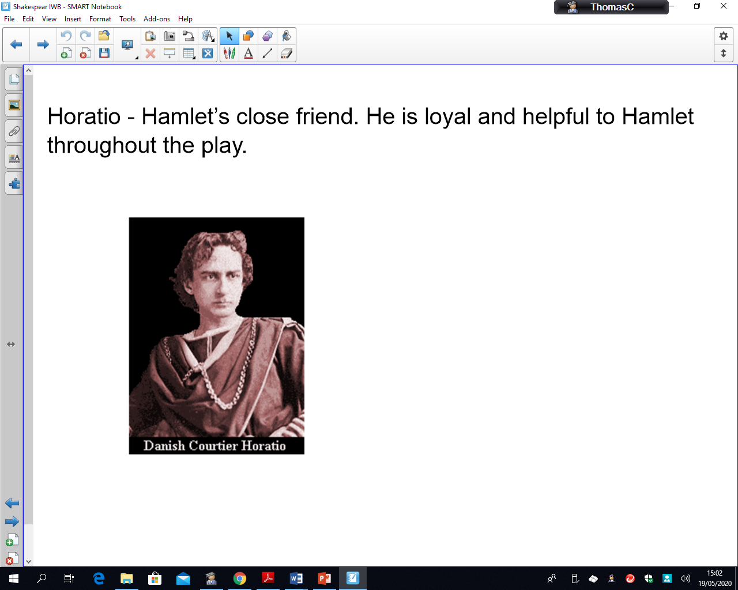
Who’s Who?
Monday 15th/Thursday 18th June English PowerPoint

Slide 5
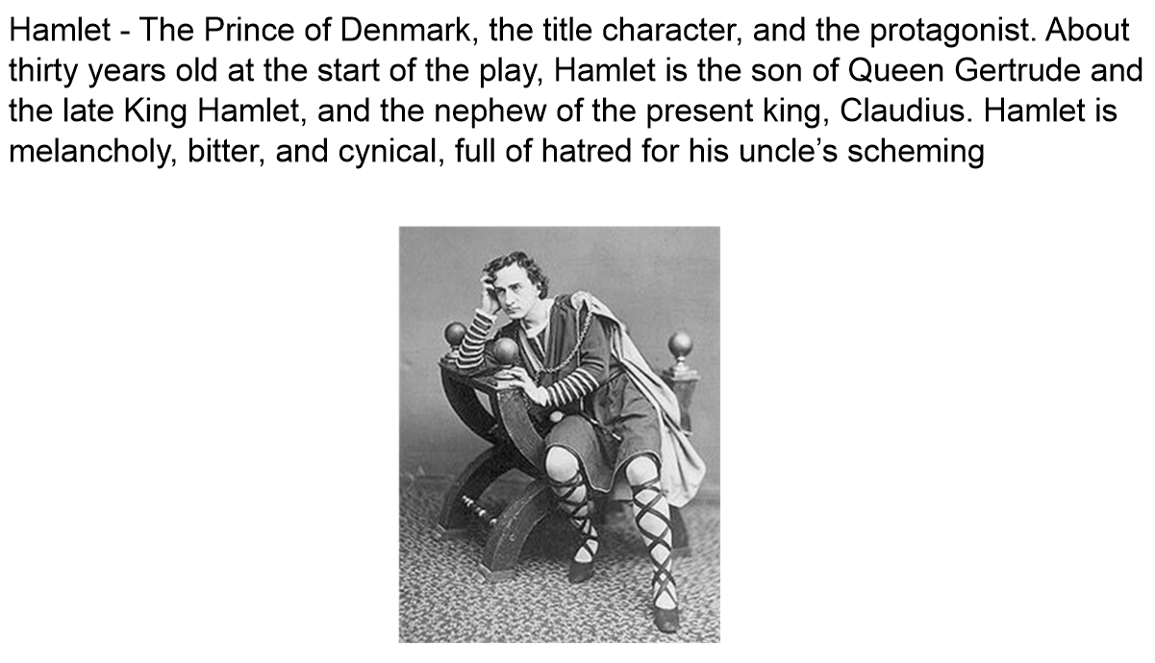
Monday 15th/Thursday 18th June English PowerPoint

Slide 6
Monday 15th/Thursday 18th June English PowerPoint

Slide 7
Monday 15th/Thursday 18th June English PowerPoint

Slide 8
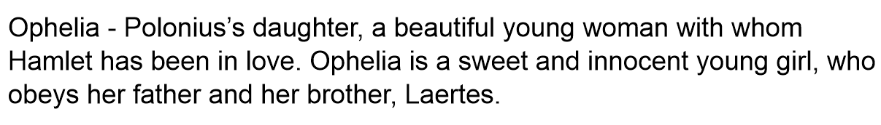
Monday 15th/Thursday 18th June English PowerPoint

Slide 9
Monday 15th/Thursday 18th June English PowerPoint

Slide 10
LO: Write a Description: Detail sentence about each key character
Monday 15th/Thursday 18th June English PowerPoint
First past of sentence gives description
Second part of sentence gives the detail
The two parts are separated by a colon
Choose you vocabulary carefully.
Improve each sentence by adding in powerful adjectives, adverbs and carefully selecting verb choice.

Slide 11
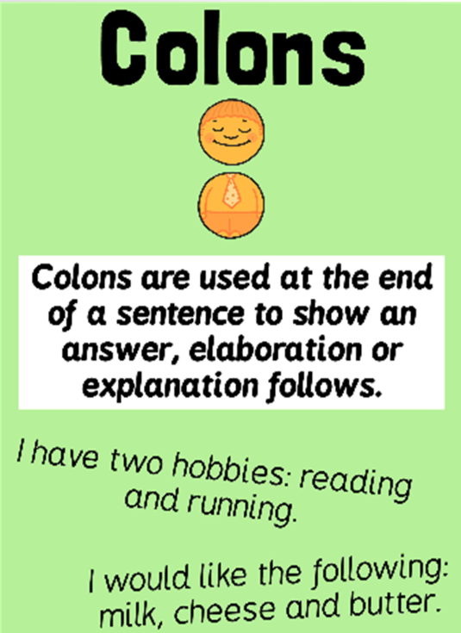
Monday 15th/Thursday 18th June English PowerPoint

Slide 12
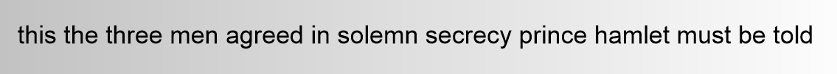
Monday 15th/Thursday 18th June English PowerPoint
Warm Up:
Improve this sentence with the correct punctuation.

Slide 13
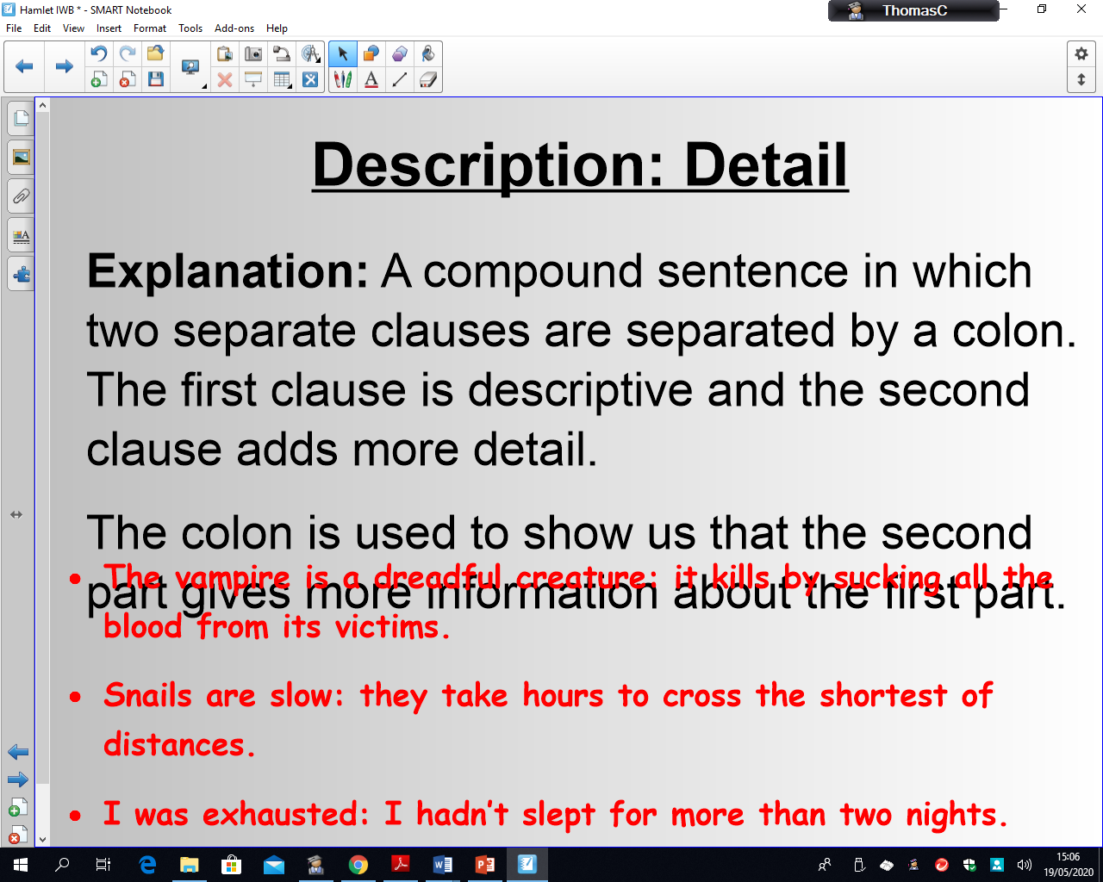
Monday 15th/Thursday 18th June English PowerPoint
How would you describe King Claudius?
What punctuation should be used to separate the description from the detail?
The colon is used to show us that the second part gives more information about the first part.
Share write a Description: Detail sentences together (example in notes below)
Notes:
King Claudius is cold-hearted: he brutally poisoned his innocent brother so he could steal the throne.

Slide 14
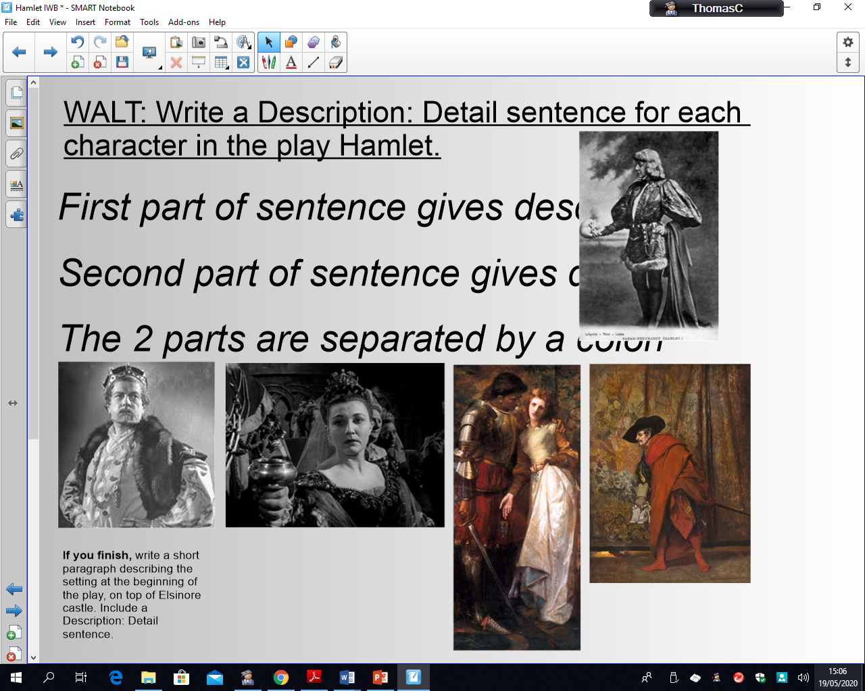
LO: Write a Description: Detail sentence about each key character
Monday 15th/Thursday 18th June English PowerPoint
First past of sentence gives description
Second part of sentence gives the detail
The two parts are separated by a colon
Choose you vocabulary carefully.
Improve each sentence by adding in powerful adjectives, adverbs and carefully selecting verb choice.

