Slide 1

Hamlet
Tuesday 16th /Friday 19th June English PowerPoint
To be or not to be? That is the question.

Slide 2
Let’s recap…
Tuesday 16th /Friday 19th June English PowerPoint

Slide 3
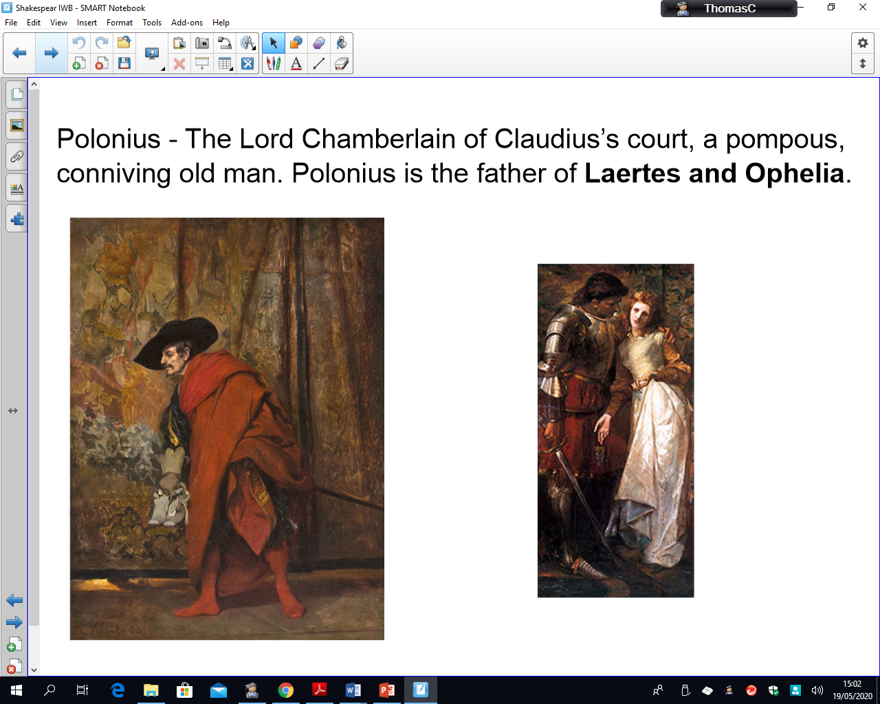
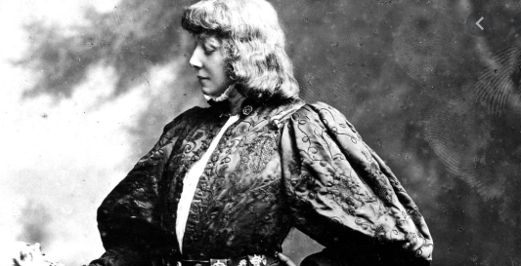
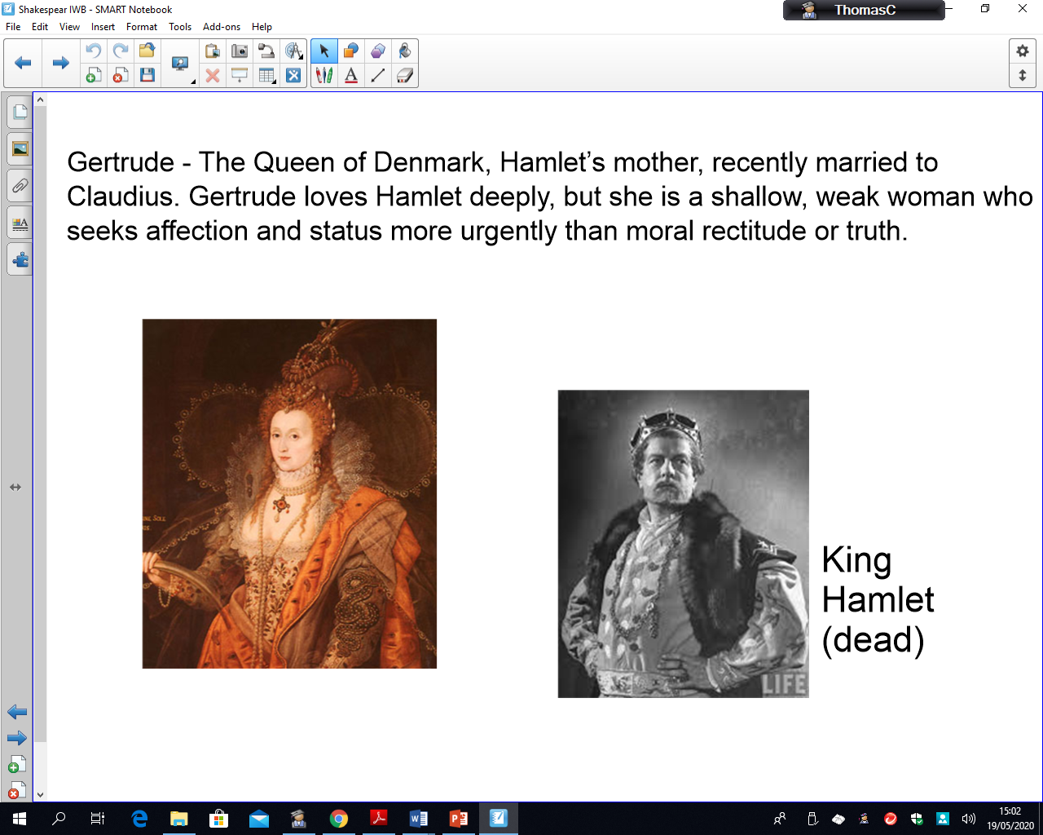
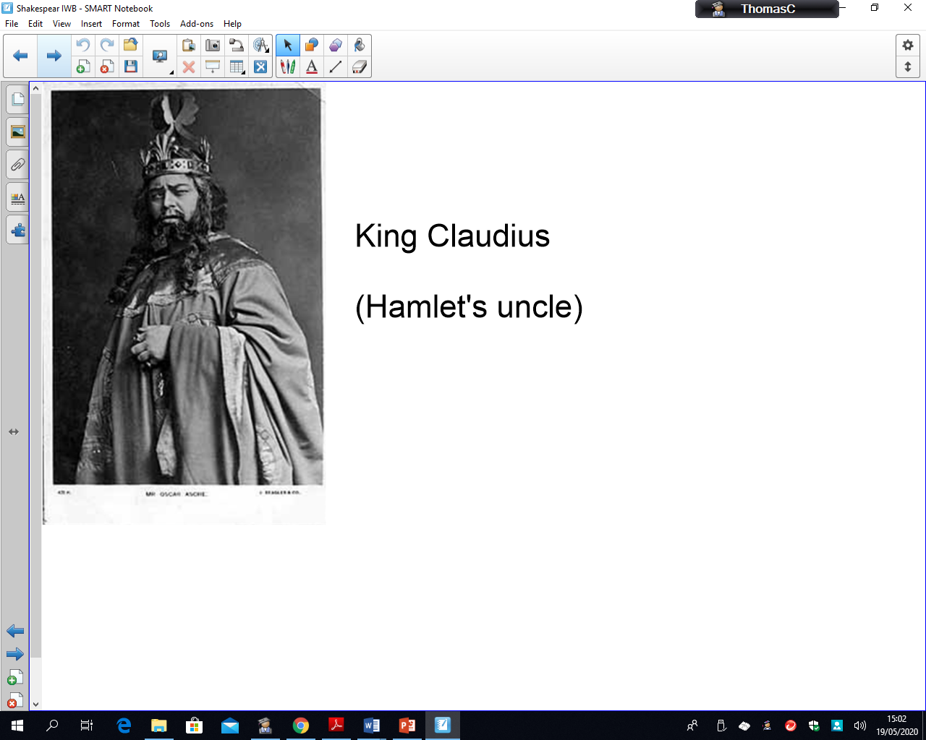
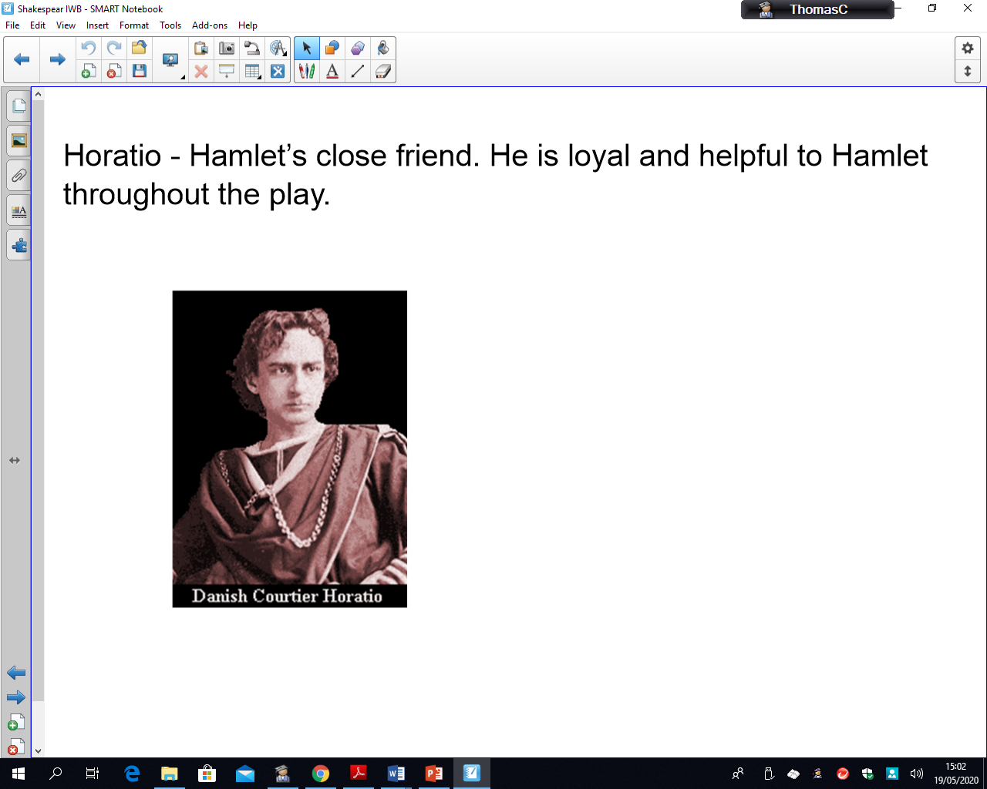
Who’s Who?
Tuesday 16th /Friday 19th June English PowerPoint

Slide 4
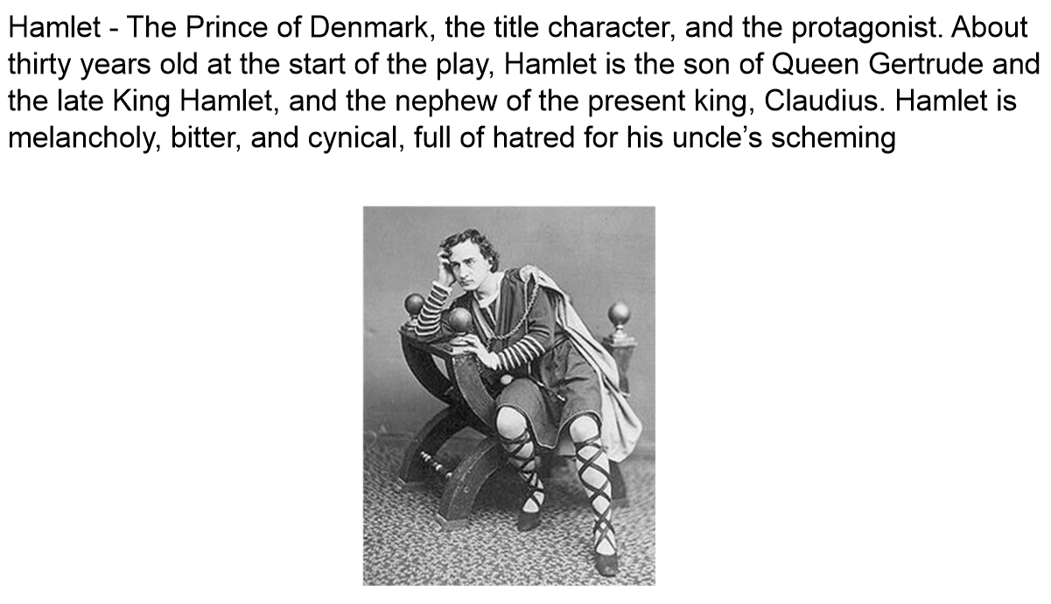
Tuesday 16th /Friday 19th June English PowerPoint

Slide 5
Tuesday 16th /Friday 19th June English PowerPoint

Slide 6
Tuesday 16th /Friday 19th June English PowerPoint

Slide 7
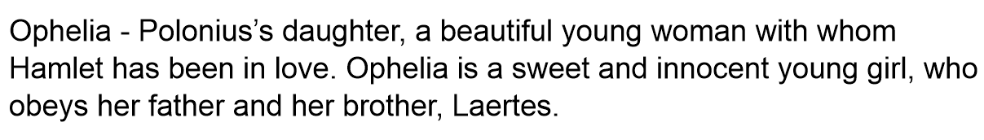
Tuesday 16th /Friday 19th June English PowerPoint

Slide 8
Tuesday 16th /Friday 19th June English PowerPoint

Slide 9
Tuesday 16th /Friday 19th June English PowerPoint
Let’s read the next 2 chapters…

Slide 10
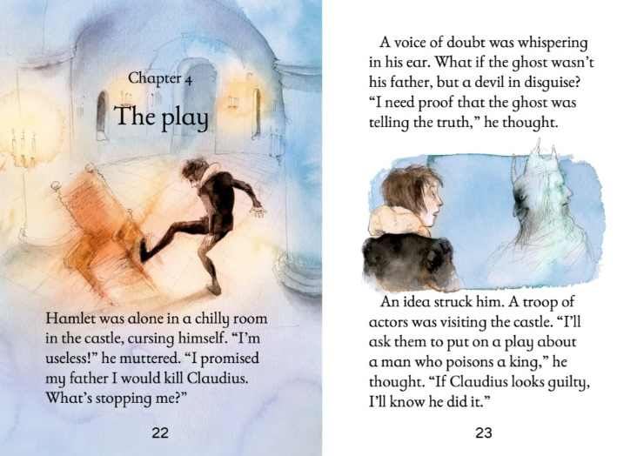
Tuesday 16th /Friday 19th June English PowerPoint

Slide 11
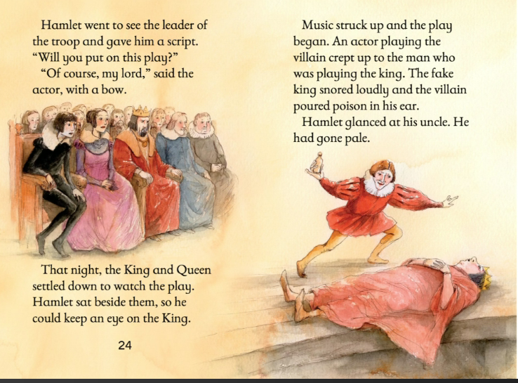
Tuesday 16th /Friday 19th June English PowerPoint

Slide 12
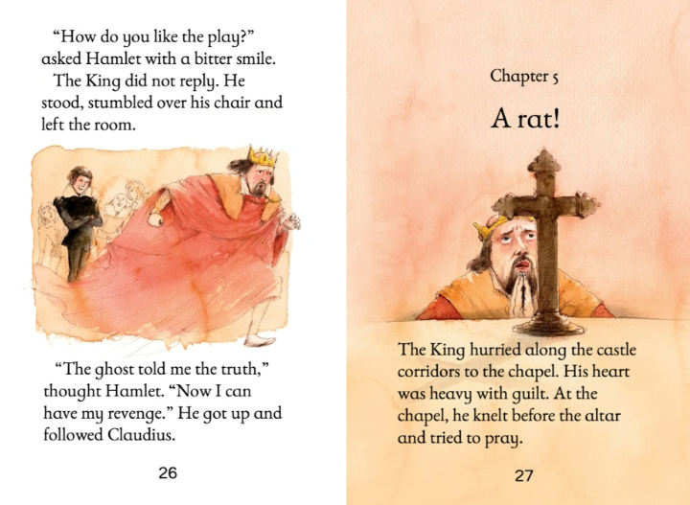
Tuesday 16th /Friday 19th June English PowerPoint

Slide 13
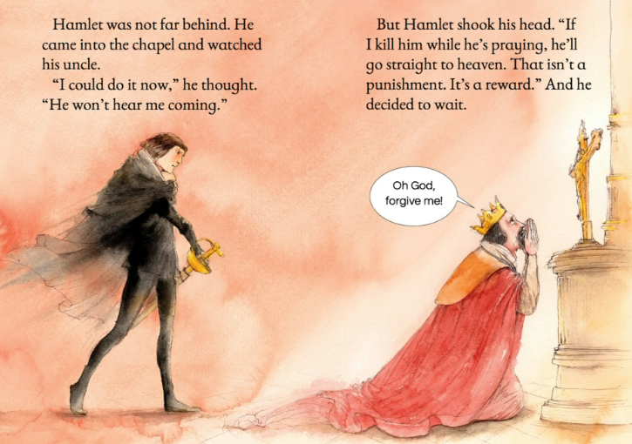
Tuesday 16th /Friday 19th June English PowerPoint

Slide 14
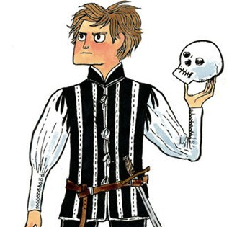

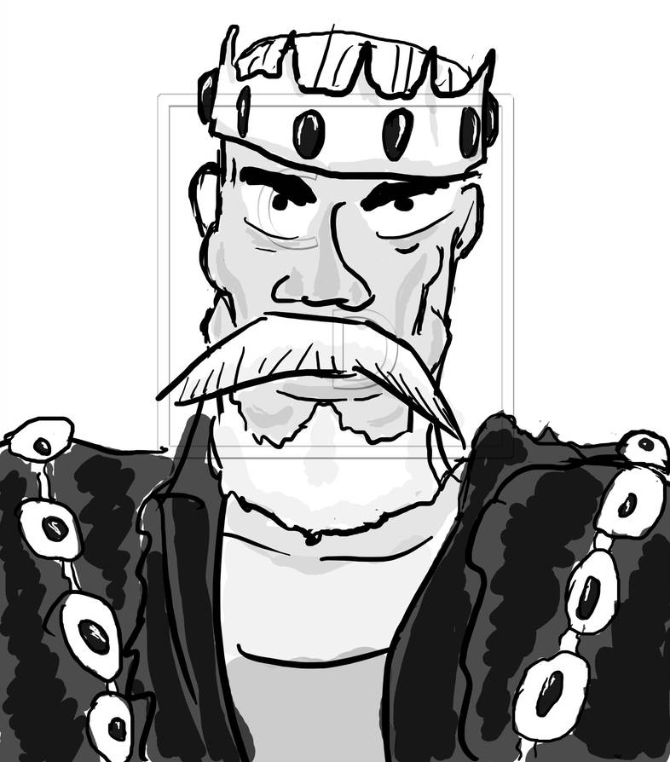
Tuesday 16th /Friday 19th June English PowerPoint
LO: Use hot-seating to gain a greater depth of understanding of character
Generate 3 questions that you would like to ask Hamlet and 3 questions you would like to ask King Claudius.
Remember to make your questions open-ended so that you can glean the most information about their characters and motives from their answers.
A volunteer child (or Mr Alden) to play each of the characters in turn and answer the questions in as much detail as possible.
Next lesson you will be writing a diary entry from the view point of either Hamlet or Claudius.

Slide 15
Tuesday 16th /Friday 19th June English PowerPoint
If time, have a read of the diary entry examples written by children at Mrs Sparrow’s old school.
What do you like about them?
What key features have been included?
What techniques has the child used to make them sound like they were written during Shakespearean times?
Is there anything you would like to magpie?
How has punctuation be used for effect?

