Slide 1
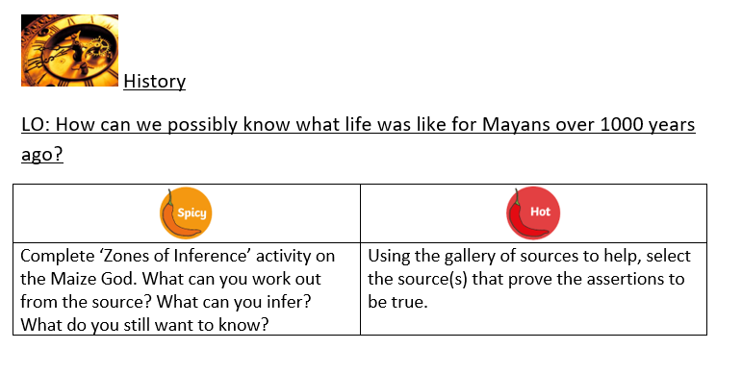
Monday 15th/ Thursday 18th June History PowerPoint

Slide 2
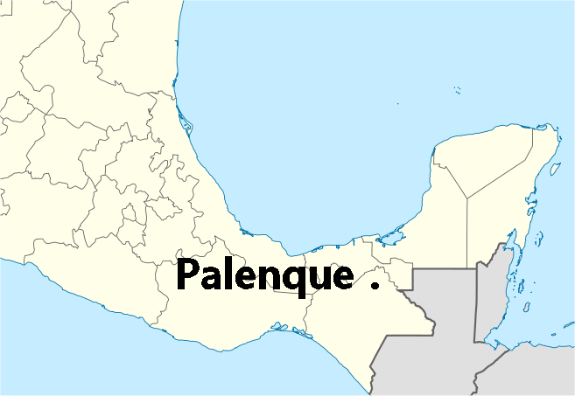
What the archaeologists found
Monday 15th/ Thursday 18th June History PowerPoint
Alberto Ruz was the Director of research at Palenque.
For a long time he had worried about a particular part of one pyramid. Why had no-one been able to explain why a flagstone in the centre of the temple’s floor had a number of holes in it that looked as if they had been drilled. As he investigated further he spotted that the walls of the temple actually continue below floor level. There was more to this temple than met the eye. Perhaps there was a secret chamber below. Clearly the clever Mayans had used the holes in the flagstones to string rope through to lower the slab and seal the chamber by filling the holes. But what might be in it?
Let’s take a look.

Slide 3
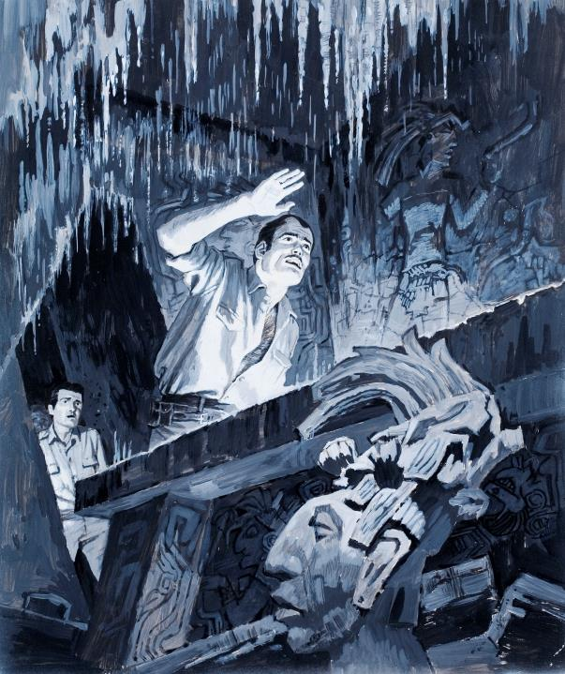
Monday 15th/ Thursday 18th June History PowerPoint
The discovery of Pacal
Out of the dim shadows emerged a vision from a fairy tale, a fantastic, ethereal sight from another world. It seemed a huge magic grotto carved out of ice, the walls sparkling and glistening like snow crystals. Delicate festoons of stalactites hung like tassels of a curtain, and the stalagmites on the floor looked like drippings from a great candle. The impression, in fact, was that of an abandoned chapel. Across the walls marched stucco figures in low relief. Then my eyes sought the floor. This was almost entirely filled with a great carved stone slab, in perfect condition.

Slide 4
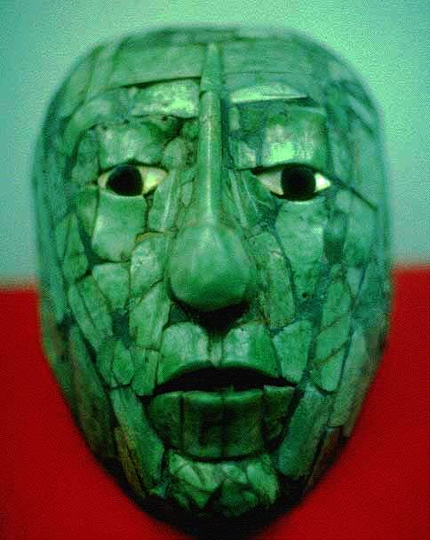
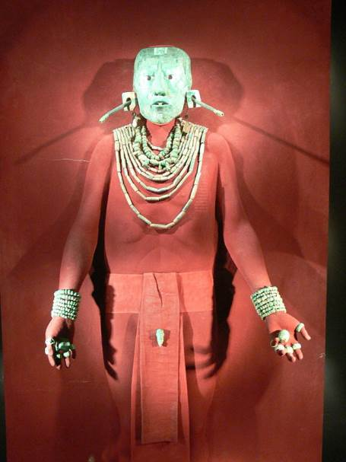
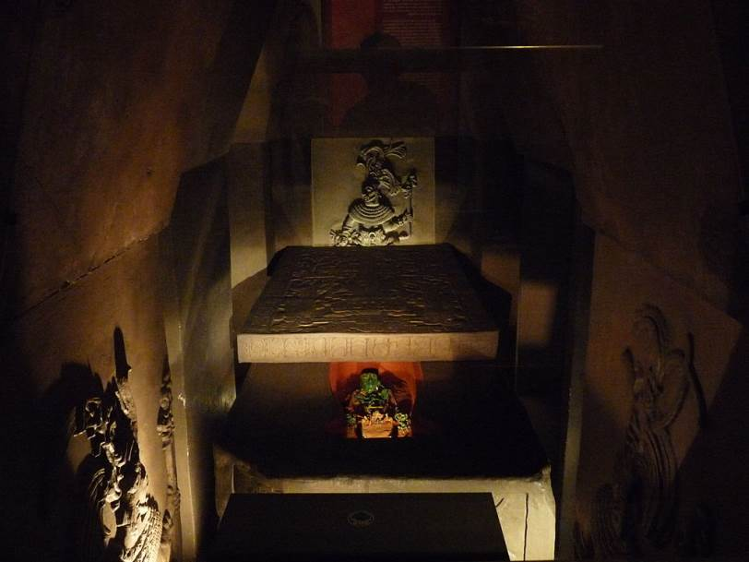
Monday 15th/ Thursday 18th June History PowerPoint
K'inich Janaab' Pakal (23 March 603 CE - 31 March 683 CE) was the Maya king of Palenque in the modern-day State of Chiapas, Mexico. Also known as Pacal (which means 'shield') and Pacal the Great, he is most famous for raising the city of Palenque (known as B'aakal) from relative obscurity to a great power,

Slide 5
When Ruz opened the sarcophagus, he..
Monday 15th/ Thursday 18th June History PowerPoint
knew he was looking at a life-sized mosaic mask, made out of jade (a green stone), which had been carefully placed over the face.
identified from the mask that this was Pacal with his prominent nose, close set eyes and narrow chin (Pacal became king in AD 615 when he was just 12. )
recalled that jade symbolised moisture and breath, the indicator of life.
noticed that the eyes were of shell and obsidian, a reflective stone they made mirrors from.
realised that by placing a mask over Pacal’s face, the Mayans were showing their belief that they were guaranteeing the king a life in the underworld.

Slide 6
Tasks
Monday 15th/ Thursday 18th June History PowerPoint
What now follows are 2 activities focusing on deductions made from evidence found.

Slide 7
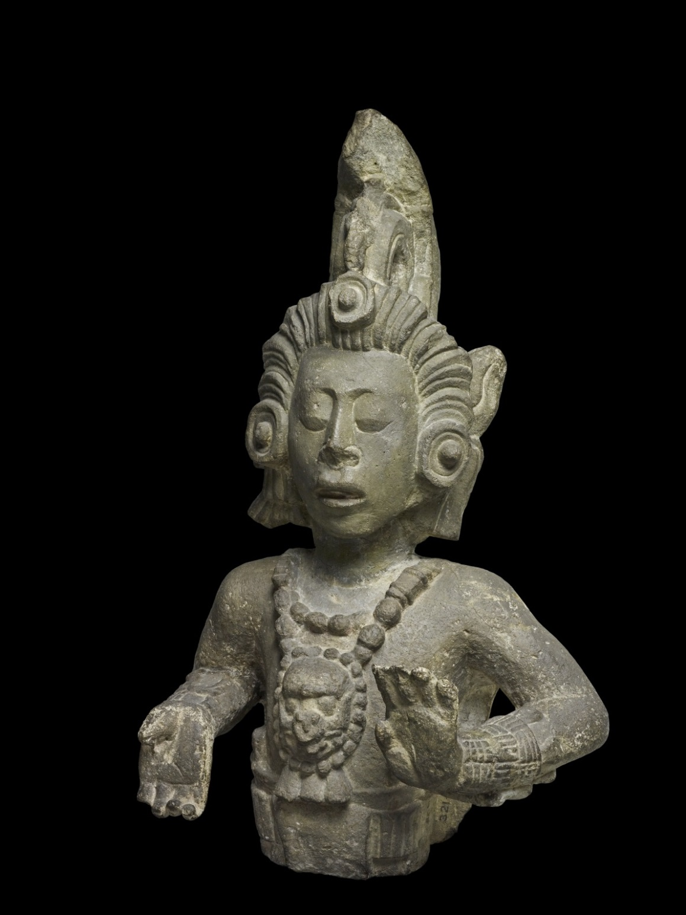
Monday 15th/ Thursday 18th June History PowerPoint
Activity 1
This is a photo of a Maize God.
You have to use a ‘zones of inference’ template to write down:
In the inner zone what you can see
In the middle zone what you can work out
In the outer zone what you don’t understand/still need to know/questions for which I need answers
Once finished, look at the completed template to see if there is anything you can add.

Slide 8
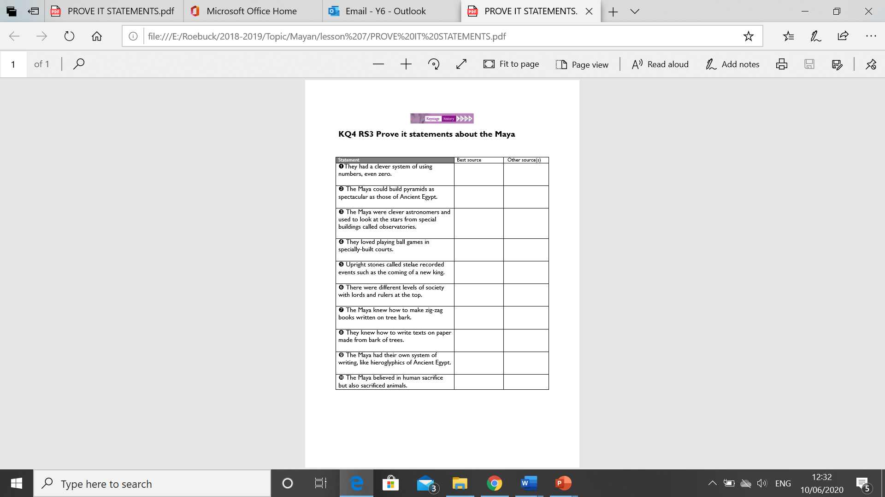
Monday 15th/ Thursday 18th June History PowerPoint
Activity 2
Below are some statements about Mayan culture. But how do we know they are true? Using the gallery of sources to help them (images a-i) select the source(s) that prove the assertion to be true. Sometimes there are more than one. In this case the stronger source goes in the left-hand column.

Slide 9
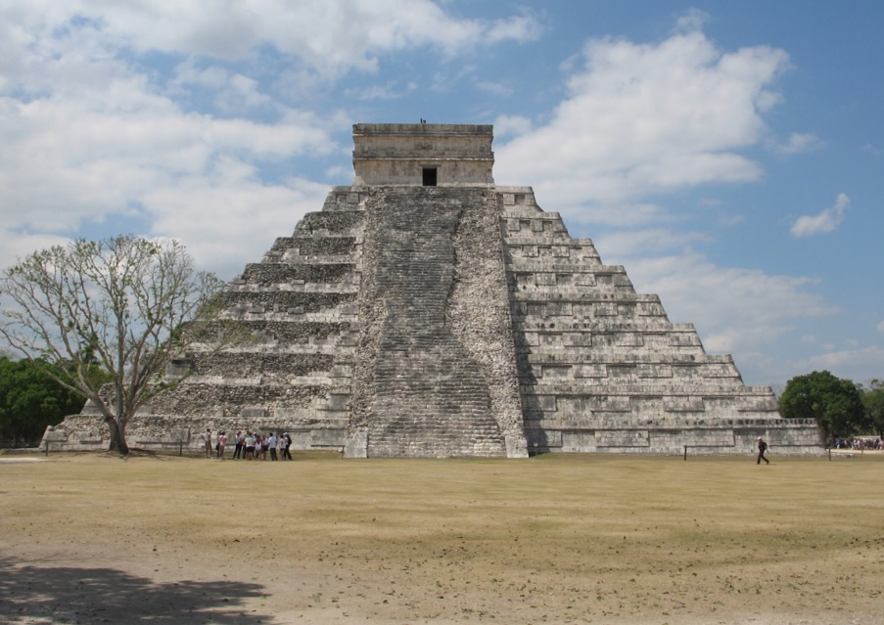
Monday 15th/ Thursday 18th June History PowerPoint
Image a

Slide 10
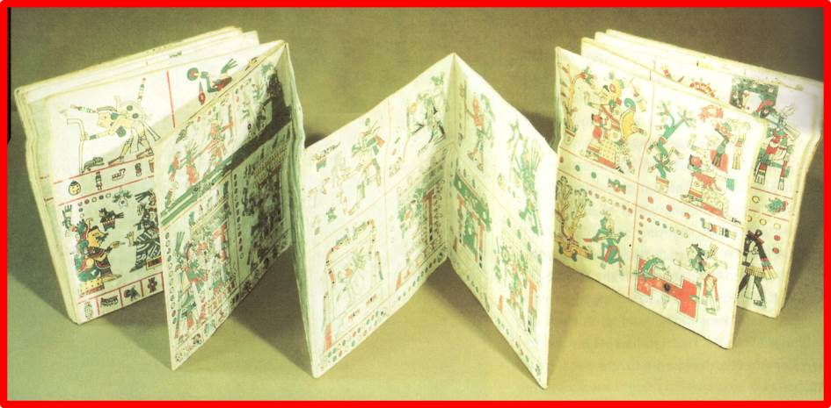
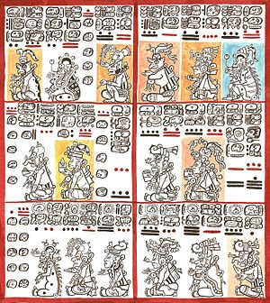
Monday 15th/ Thursday 18th June History PowerPoint
Image b
http://upload.wikimedia.org/wikipedia/commons/thumb/9/96/L%C3%A1minas_8_y_9_del_C%C3%B3dice_de_Dresden.jpg/300px-L%C3%A1minas_8_y_9_del_C%C3%B3dice_de_Dresden.jpg

Slide 11
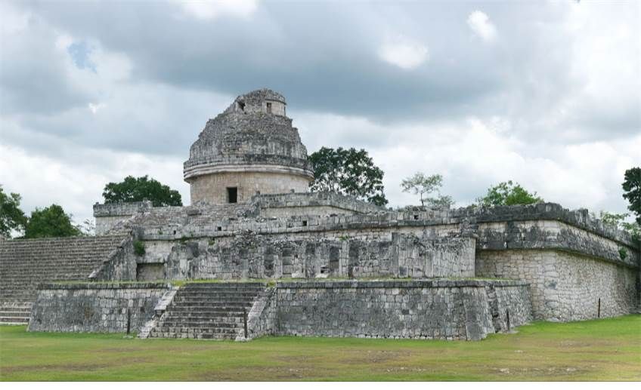
Monday 15th/ Thursday 18th June History PowerPoint
Image c
http://upload.wikimedia.org/wikipedia/commons/thumb/5/58/Chichen_Itza_4.jpg/1920px-Chichen_Itza_4.jpg

Slide 12
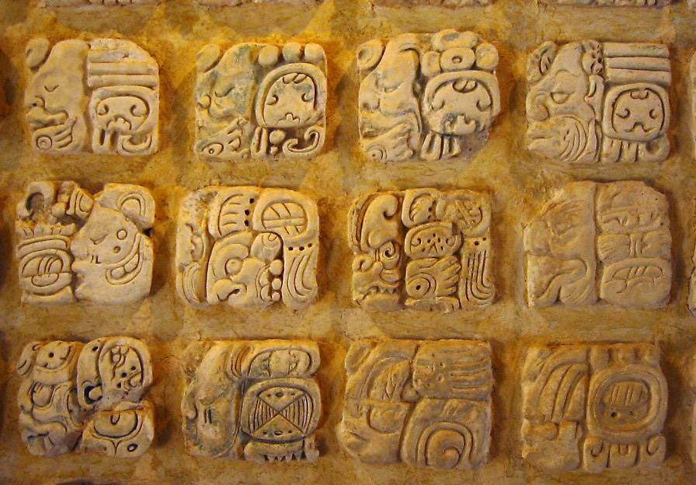
Monday 15th/ Thursday 18th June History PowerPoint
Image d
http://upload.wikimedia.org/wikipedia/commons/0/05/Palenque_glyphs-edit1.jpg

Slide 13
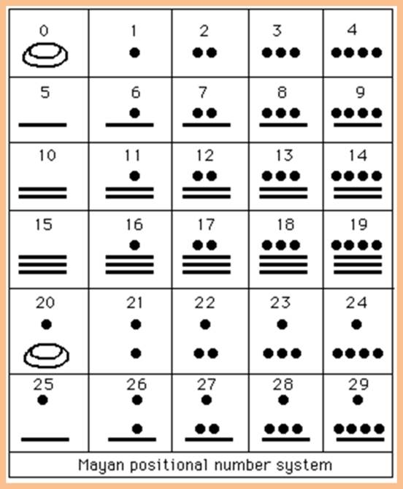
Monday 15th/ Thursday 18th June History PowerPoint
Image e

Slide 14
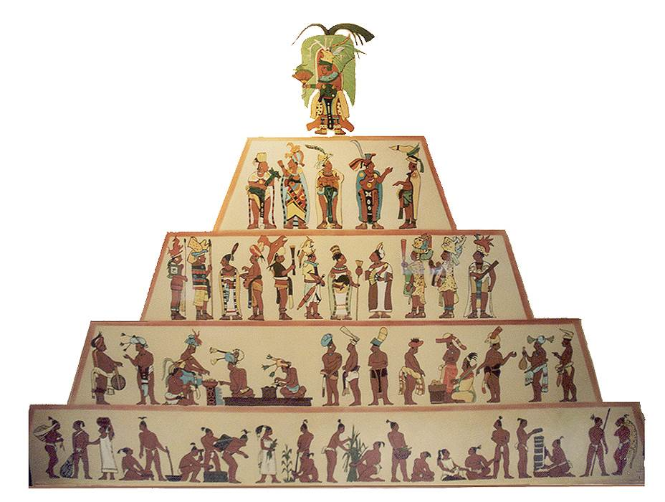
Monday 15th/ Thursday 18th June History PowerPoint
Image f
http://www.latinamericanstudies.org/maya/maya-society.jpg

Slide 15
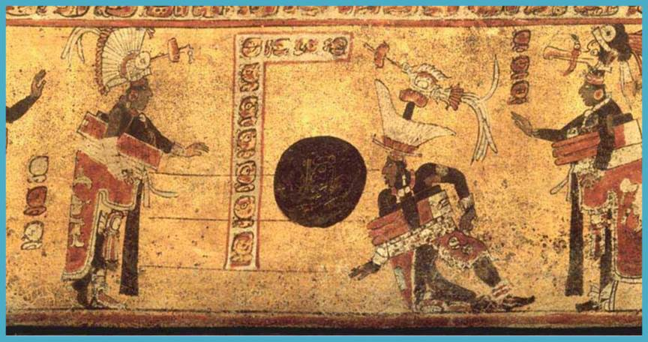
Monday 15th/ Thursday 18th June History PowerPoint
Image g

Slide 16
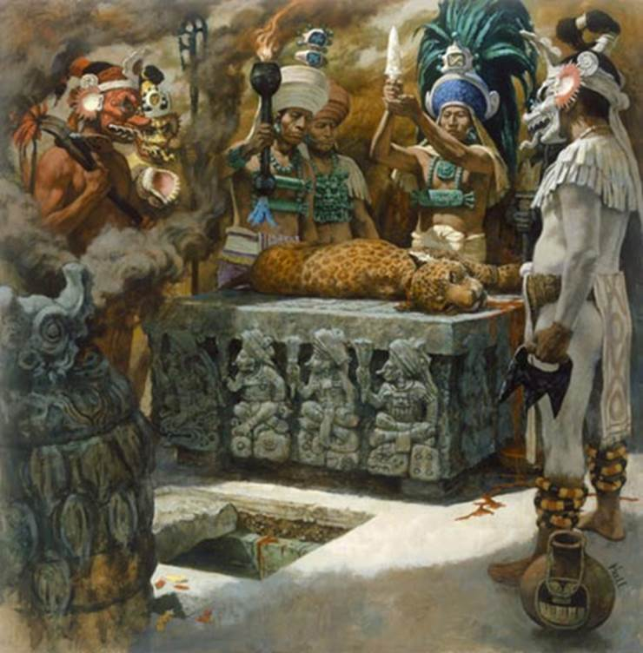
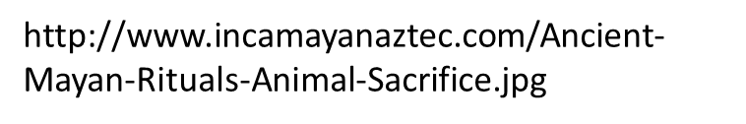
Monday 15th/ Thursday 18th June History PowerPoint
Image h

Slide 17
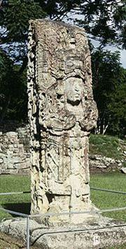
Monday 15th/ Thursday 18th June History PowerPoint
Image i
http://upload.wikimedia.org/wikipedia/commons/thumb/2/24/Copan_St_H.jpg/180px-Copan_St_H.jpg

