Slide 1
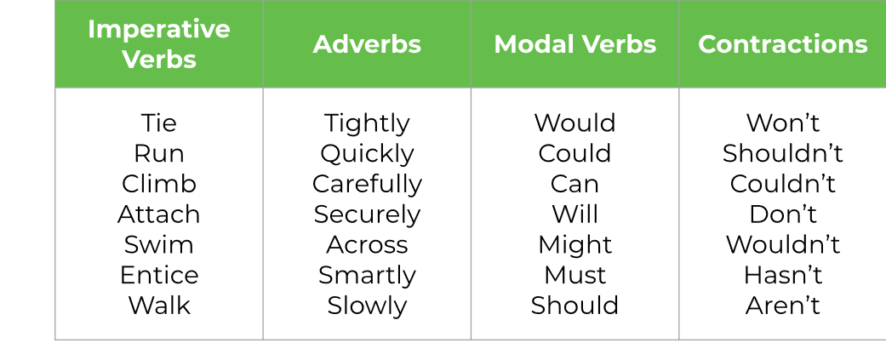
LO: To plan a set of instructions
Thursday 18th June
You are now going to plan a set of instructions on how to capture a creature, it’s important to plan before we write our set of instructions tomorrow.
1. Where does your creature usually live? (habitat)
2. How will you capture your creature?
3. What is your creature’s personality like?
4. What does your creature like?
5. What does your creature dislike?
6. How will you capture your creature?
To include in your writing →

