Slide 1
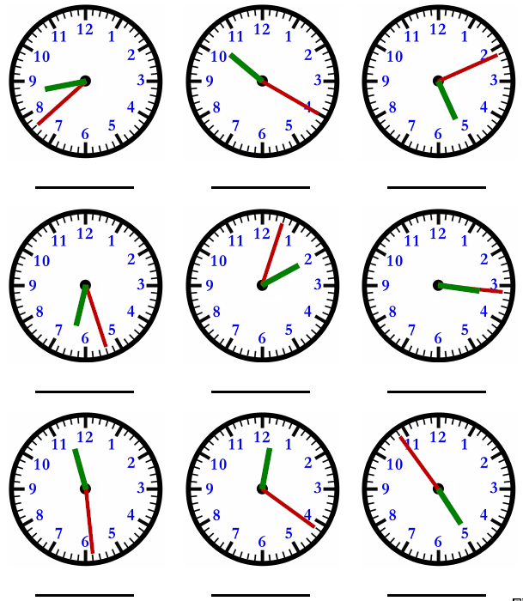
Mild
Thursday 18th June
LO: To read time to the nearest minute
Write the time shown in words beneath each clock. The first one has been done for you.

Slide 2
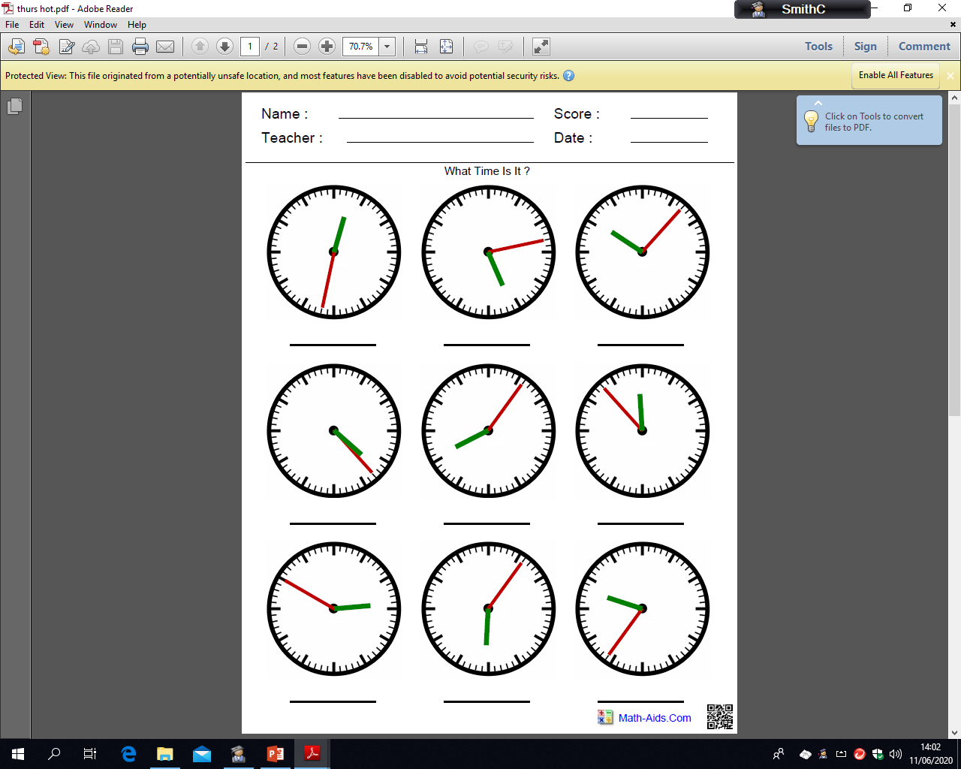
Spicy
Thursday 18th June
LO: To read time to the nearest minute
Write the time shown in words beneath each clock. The first one has been done for you.

Slide 3
Hot
Thursday 18th June
LO: To read time to the nearest minute
Write the time shown in words beneath each clock and then in digital time. The first one has been done for you.

Slide 4
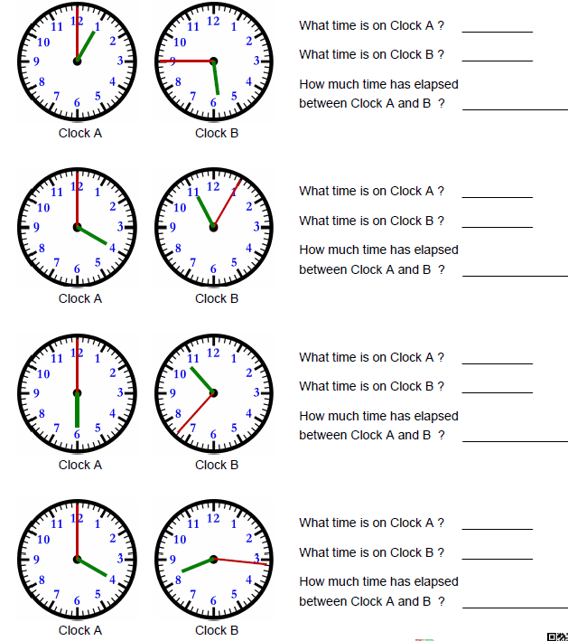
Needs Water
Thursday 18th June
LO: To read time to the nearest minute
Write the time shown by each clock in digital time. Then calculate the time interval between these two times.

