Slide 1
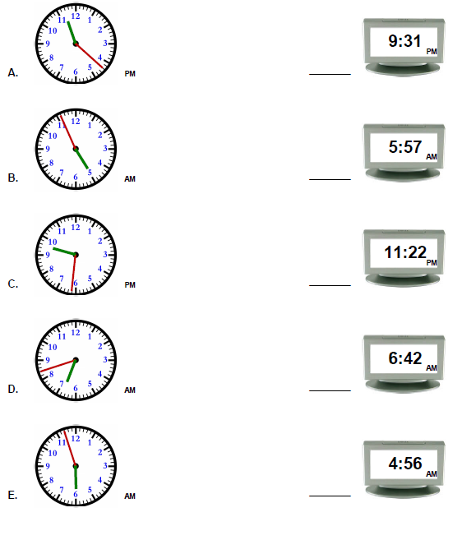
Mild
Friday 19th June
LO: to know analogue and digital time
Draw a line to match the time shown on the analogue clock with the corresponding time on the digital clock.

Slide 2
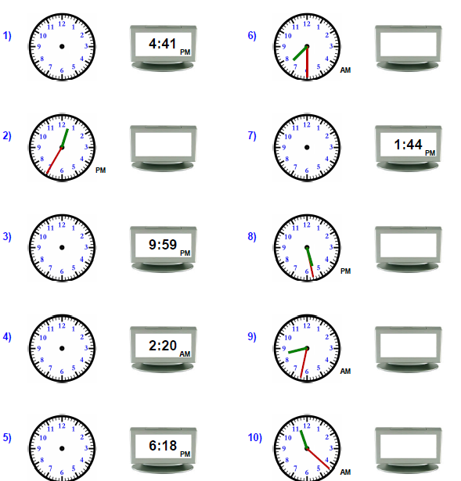
Spicy
Friday 19th June
LO: to know analogue and digital time
Complete each missing clock (analogue or digital) based off the time of its matching pair

Slide 3
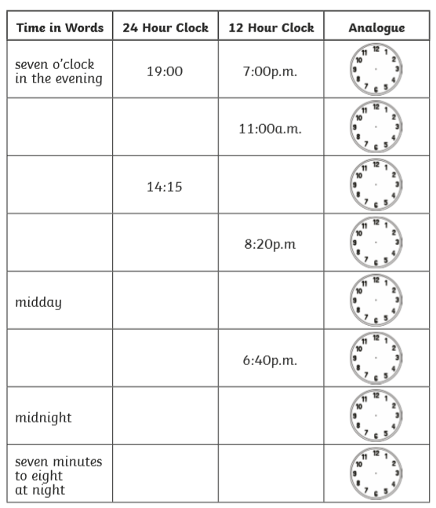
Spicy
Friday 19th June
LO: to know analogue and digital time
Complete the missing times in each row so the same time is shown in words, on both the 24 hour and 12 hour clock and analogue clock.

