Slide 1
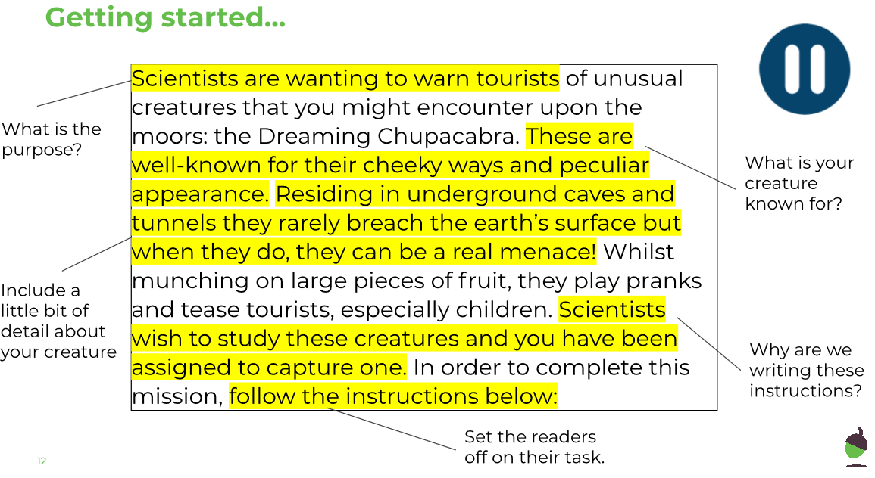
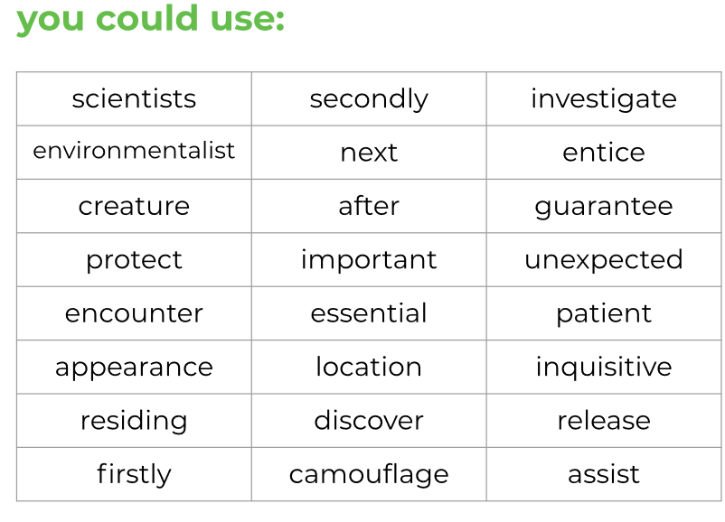
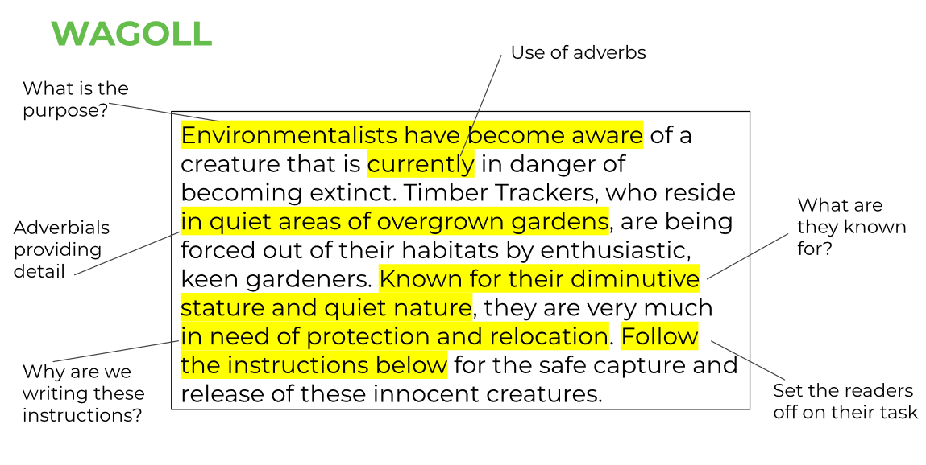
LO: To write a set of instructions
Friday 19th June

Slide 2
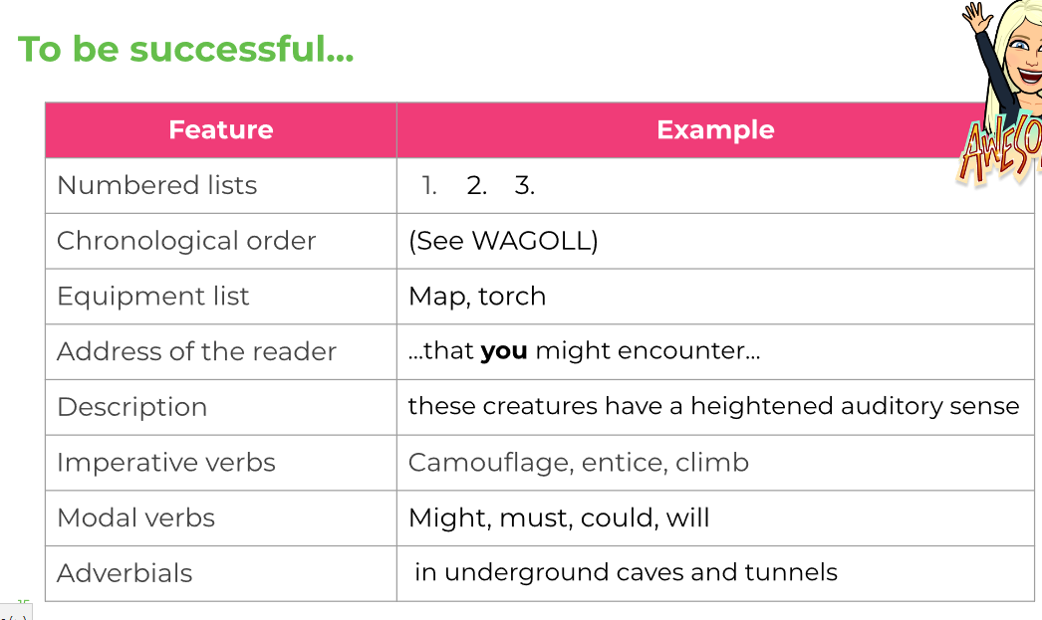
LO: To write a set of instructions
Friday 19th June

Slide 3
LO: To write a set of instructions
Friday 19th June
_________________________
__________________________________
__________________________________
__________________________________
__________________________________
__________________________________
__________________________________
__________________________________
__________________________________
__________________________________
__________________________________
__________________________________
__________________________________
__________________________________
__________________________________
__________________________________
__________________________________
__________________________________
__________________________________
__________________________________

