Slide 1
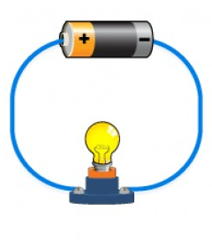
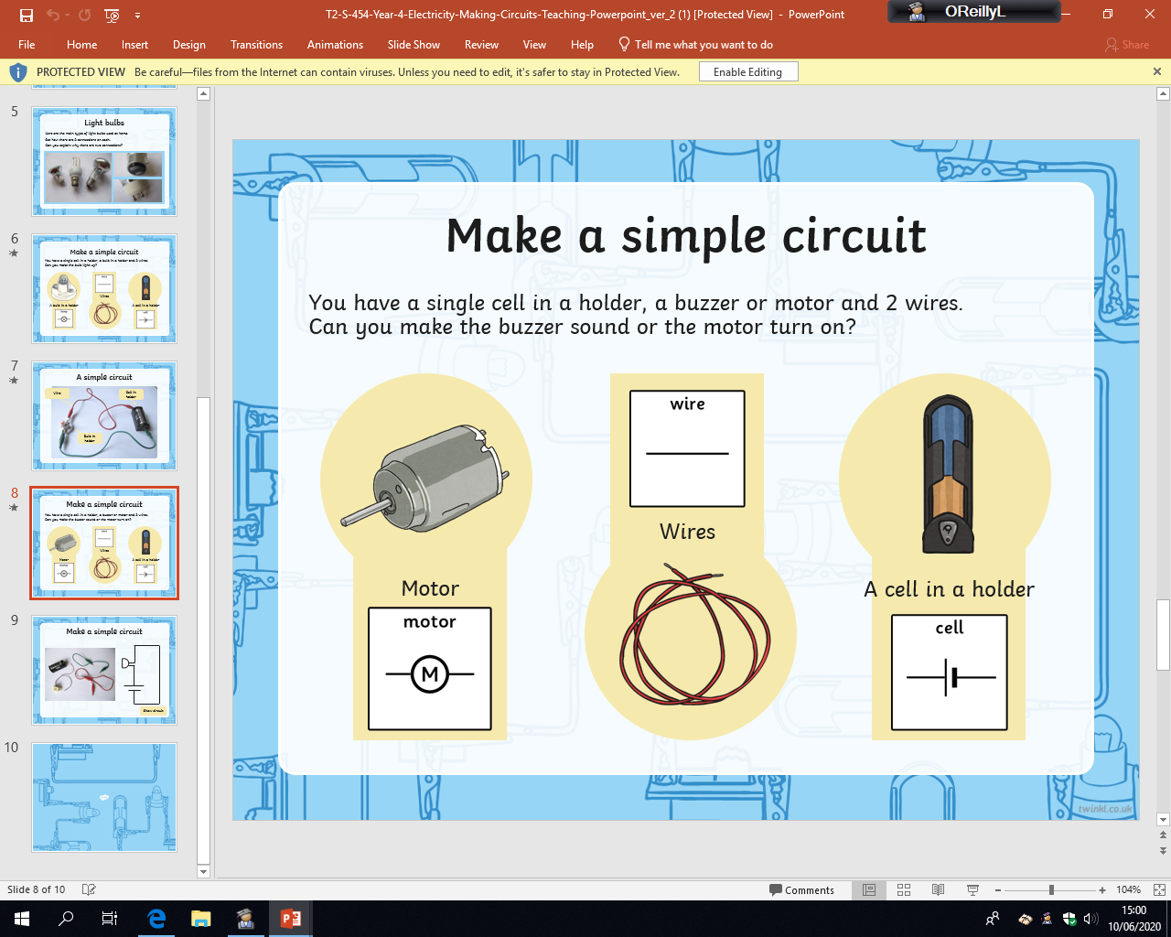

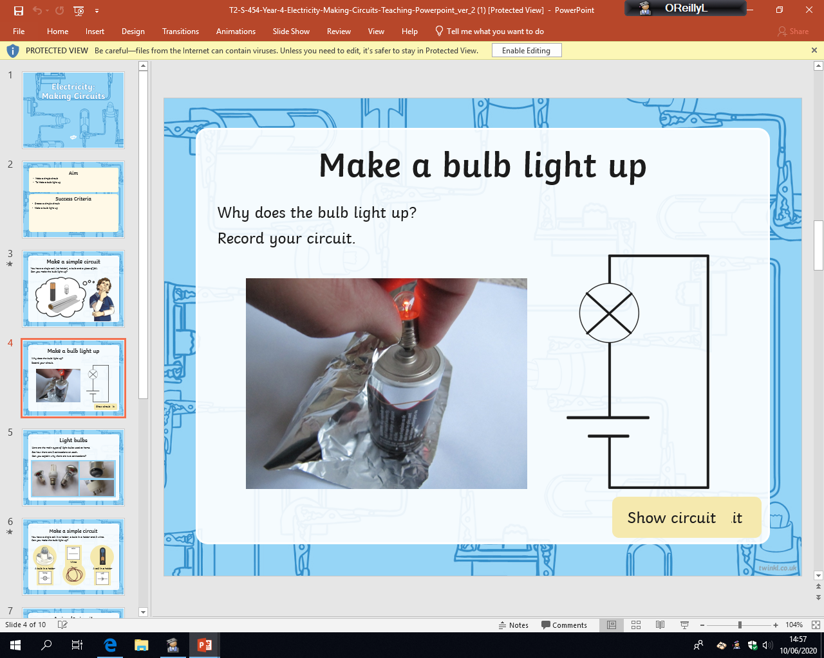
Friday 19th June
Mild
Can you light a bulb?
1. Below is a simple circuit, can you draw it out using the symbols from the key instead of the pictures.
Decide if the circuits below are complete and circle your answer.
Is it a complete circuit? Yes/No
Is it a complete circuit? Yes/No
Is it a complete circuit? Yes/No
Is it a complete circuit? Yes/No
Key:
battery/cell
wire
bulb
Is it a complete circuit? Yes/No
Is it a complete circuit? Yes/No
Is it a complete circuit? Yes/No
Is it a complete circuit? Yes/No

Slide 2
Friday 19th June
Spicy
Can you light a bulb?
1. Below is a simple circuit, can you draw it out using the symbols from the key instead of the pictures.
Decide if the circuits below are complete and explain why they are or are not complete.
Key:
battery/cell
wire
bulb

Slide 3
Friday 19th June
Hot
Can you light a bulb?
1. Below is a simple circuit, can you draw it out using the symbols from the key instead of the pictures.
Decide if the circuits below are complete and explain why they are or are not complete. THEN, on the back of the sheet redraw the broken circuits so that they are now complete.
Key:
battery/cell
wire
bulb

