Slide 1
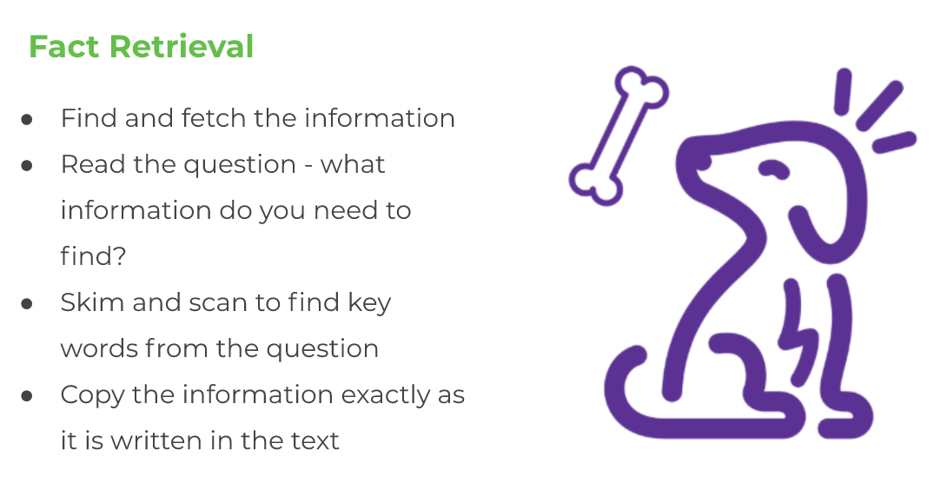
LO: To retrieve information from a persuasive rap
Monday 22nd June
If you can, watch the video on the slides using this link: https://classroom.thenational.academy/lessons/persuasion-reading-comprehension-fact-retrieval/activities/3
This week for literacy we will be focusing on persuasive text.
To ‘persuade’ some means to convince or change someone’s mind.
For example, sometimes you might have to persuade your parents to let you do something.
On the next page, read the persuasive rap ‘One Small Change’, you will then answer some questions about the text.

Slide 2
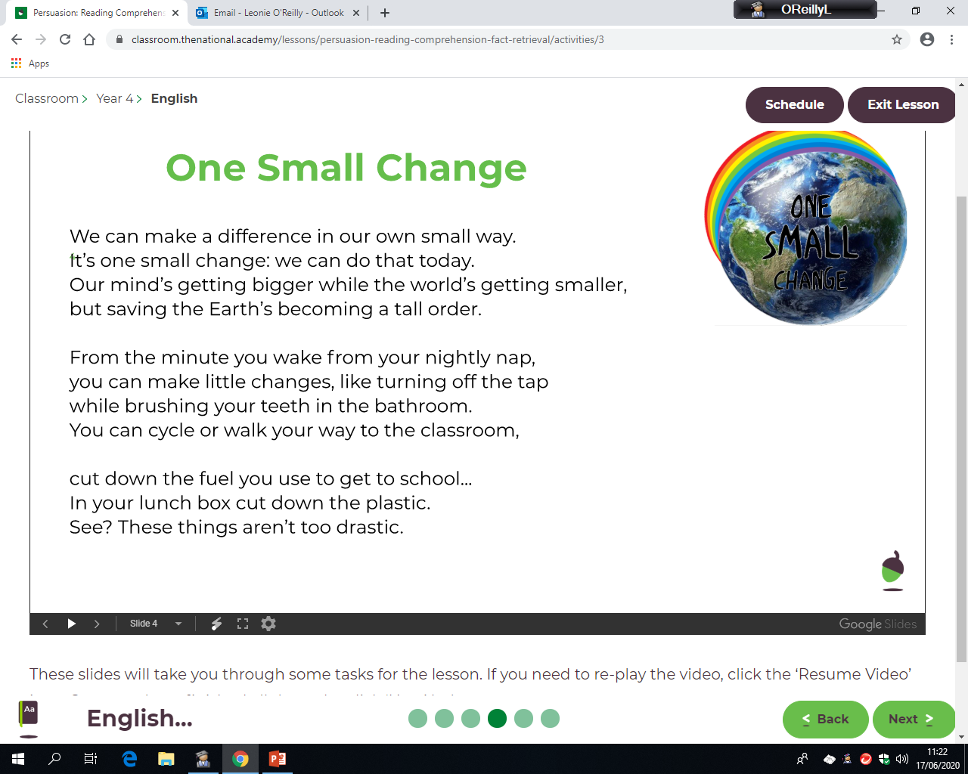
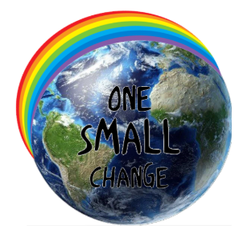
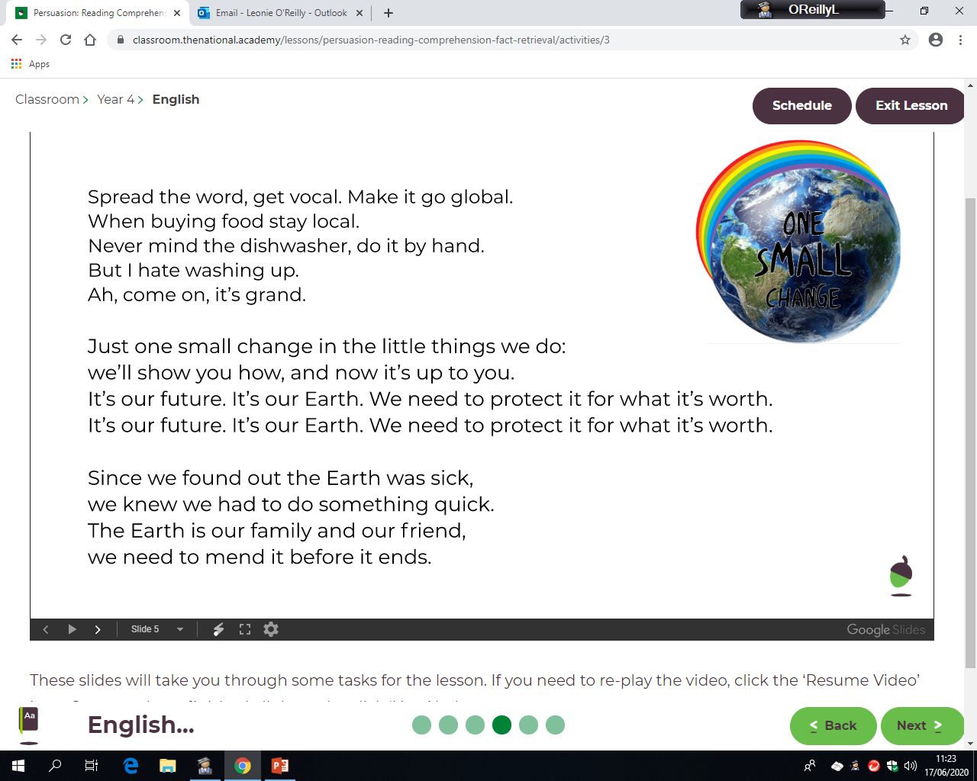


Slide 3
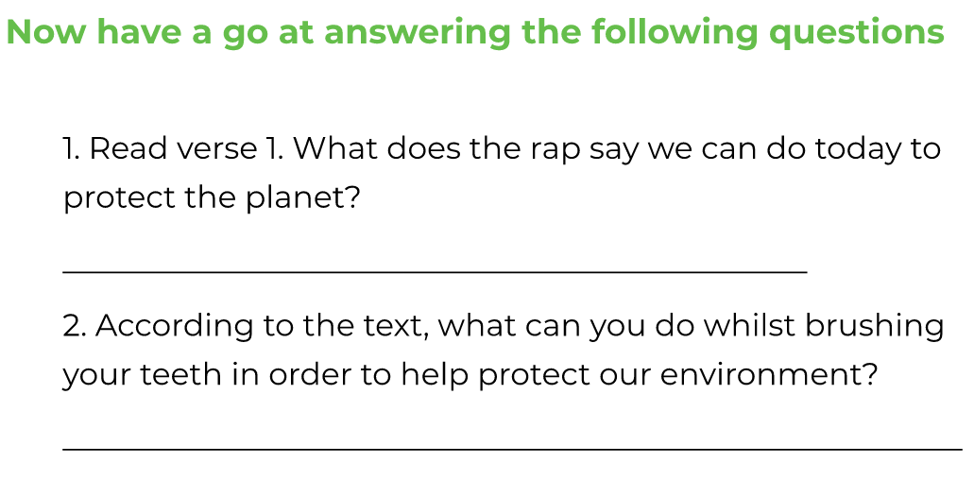
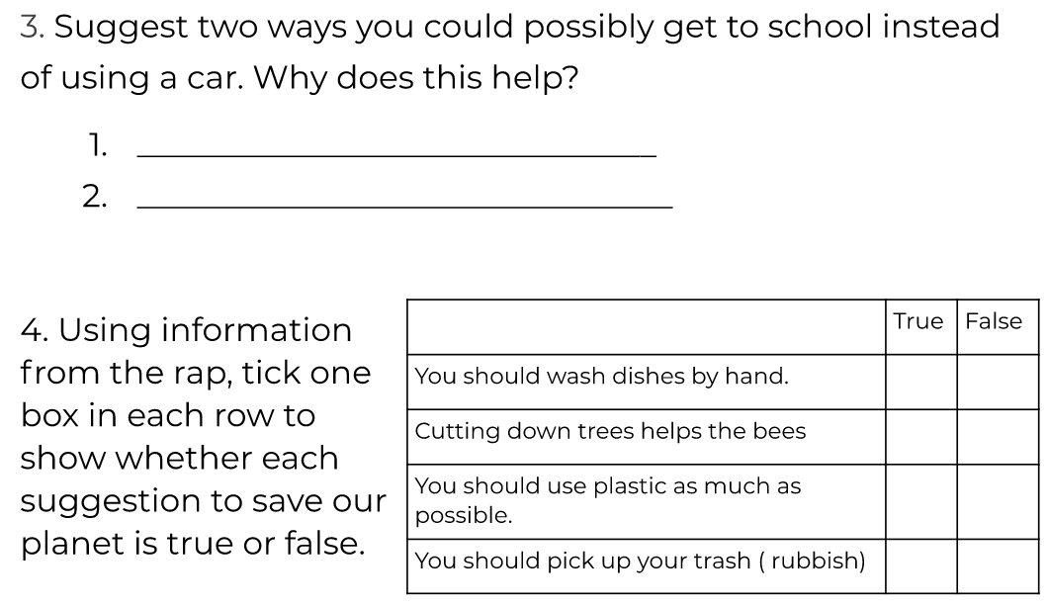
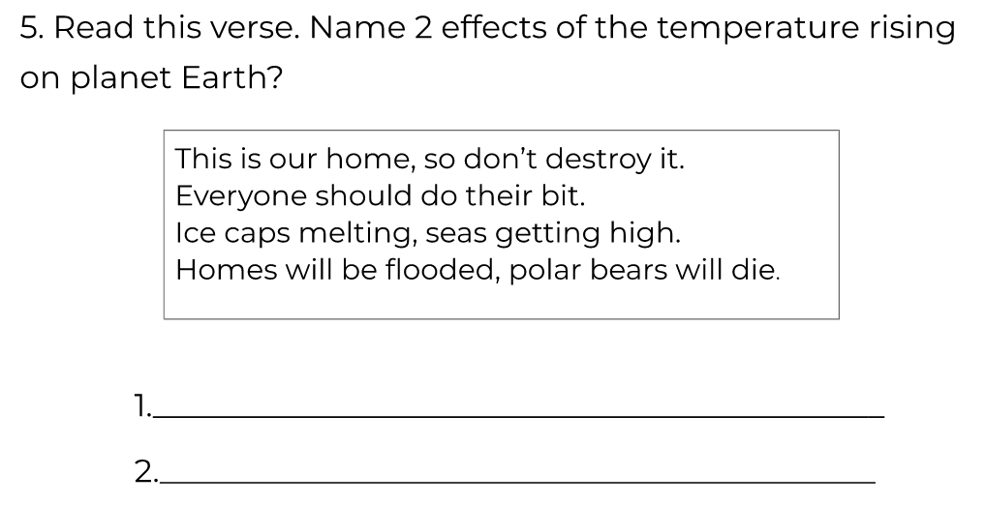
LO: To retrieve information from a persuasive rap
Monday 22nd June

Slide 4
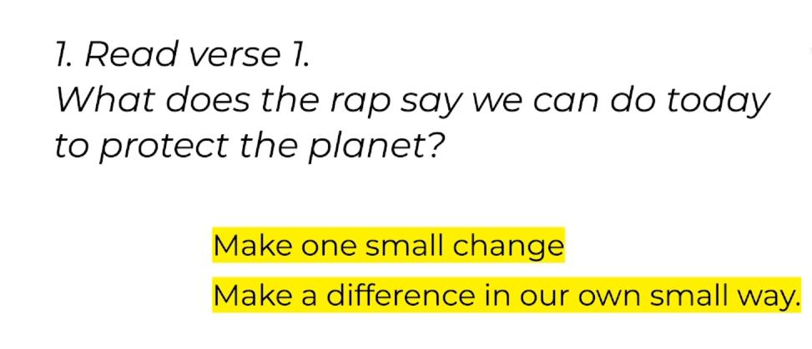
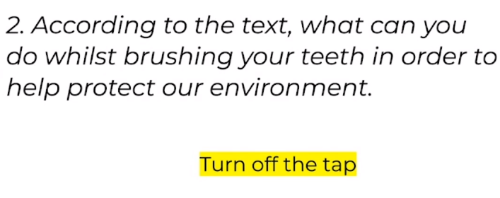
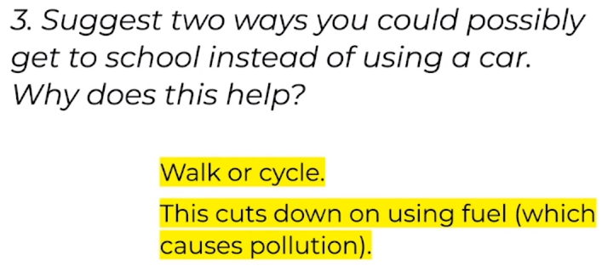
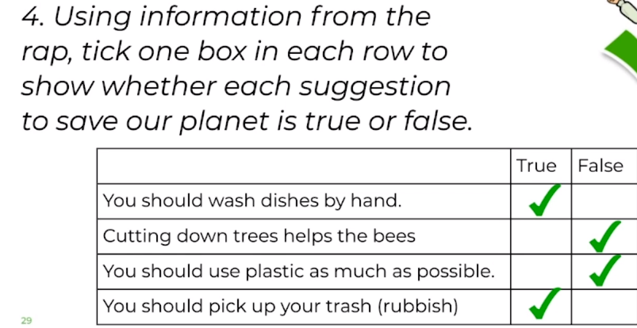
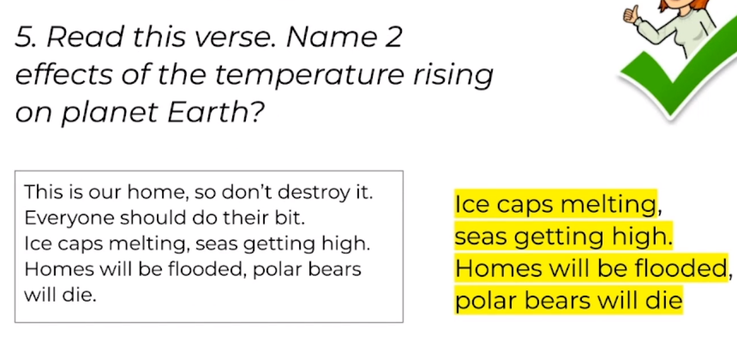
ANSWER SHEET
Monday 22nd June

